Slide 2
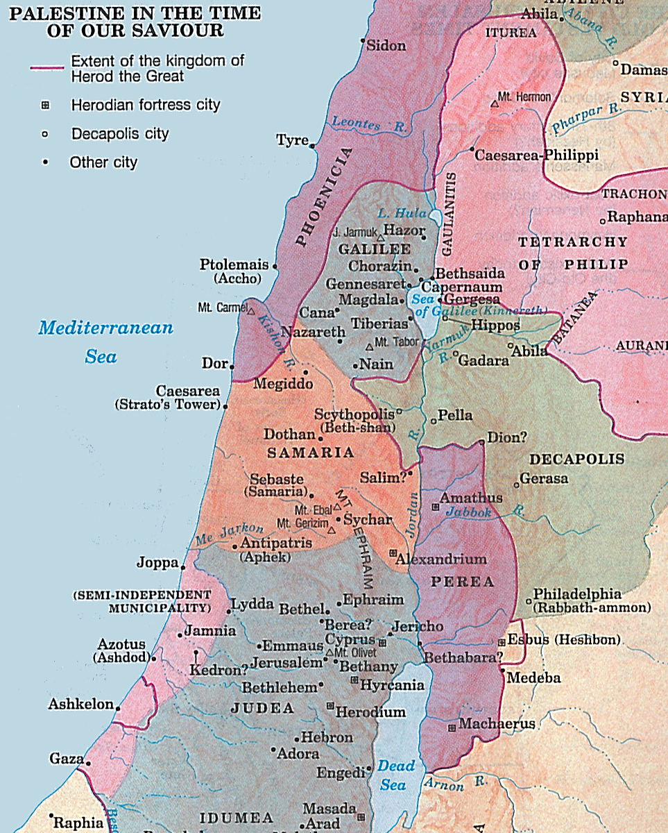
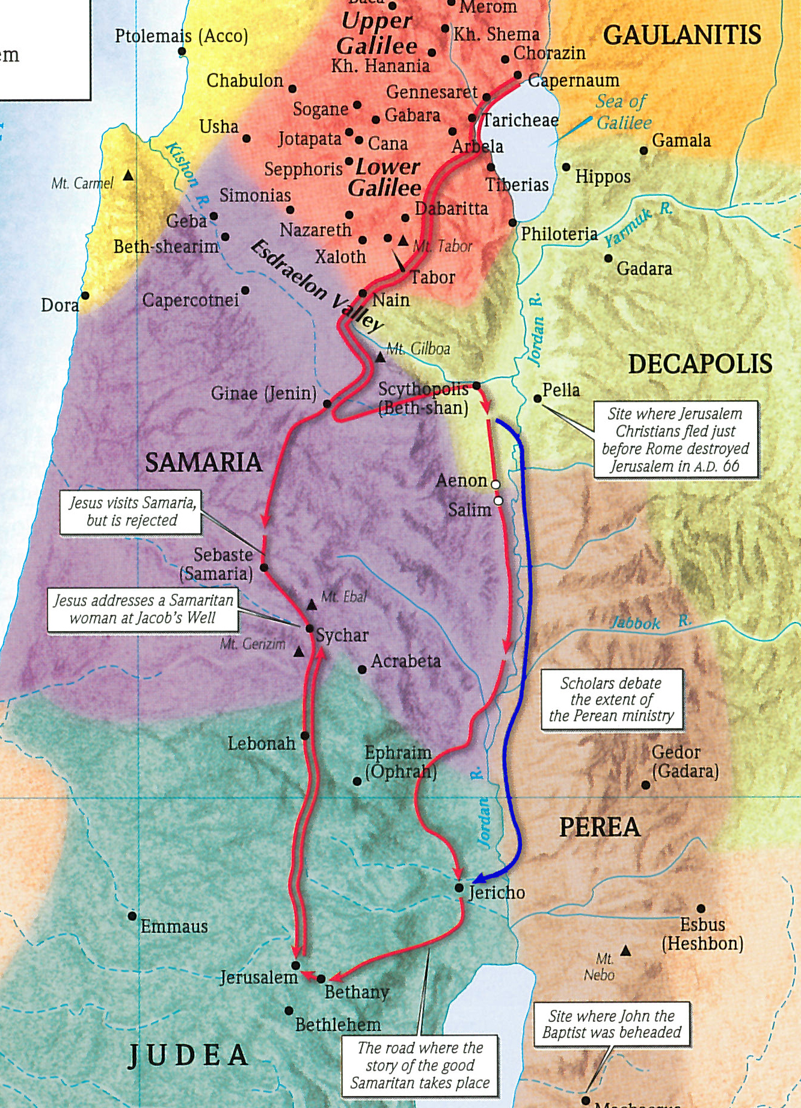
“But He needed to go through Samaria” (John 4:4)

Slide 3
Jesus knew…
Every Person You See Has a Soul (Matt. 10:28)…
Given By God upon Conception of Life (Gen. 1:26-27)…
That Is More Valuable Than the Whole World (Matt. 16:26)…
And That Will Abide Forever (2 Cor. 4:16-18)…
In Heaven or in Hell (Matt. 25:46)…
And You Can Affect That Soul’s Eternal Destiny (Jas. 5:20)!

Slide 4
“Personal” evangelism is different from “world” evangelism.
“World” evangelism:
I may not personally be able to reach and teach the lost around the world. But I can help support missionaries who can.
“Personal” evangelism:
There are people that I know, that I meet, that I live near, that I have contact with, that I talk to, etc.
My circle of influence is filled with non-Christians, and I may be their only link to Jesus Christ!
No other Christian may ever have the opportunity to reach those within my circle of influence in the way that I can!

Slide 5
“Personal” evangelism is different from “world” evangelism.
Jesus said:
“Behold, I say to you, lift up your eyes and look at the fields, for they are already white for harvest” (John 4:35).
We must learn to see souls!
Lost souls have identities!
Every soul you see needs Jesus Christ!

Slide 6
Close Relative
Distant Relative
Neighbor
Friend
Workmate
Schoolmate
Teammate
Casual Acquaintance
Online Acquaintance
Religious Friends
Club Members
Restaurant Worker
Retail Store Worker
Grocery/Rx Worker
Repair/Service Man
Ins. Agent/Accountant
Worker Seen Often
Church Visitor
Wayward Member
Spouse of Member
Child of Member
Relative of Member
Friend of Member
Life Changes
New Home
New Resident
Recently Engaged
Newlyweds
New Parents
Recent Empty Nest
Recently Retired
Rest Home Resident
New Job
Change in Job
Recently Lost Job
Financial Hardships
Death of Loved One
Death in Family
Hospital Patient
Personal Injury/Illness
Tragedy in Life
Family in Hospital
Marital Problems
Divorced
Separated
Children of Divorce
Struggling Parent
Marital Reconciliation
Recent Graduate
College Student
Military Personnel
Prisoner
“Undesirable”
Stressed about Life
Depressed
“Own Church”
Moral Trends
Asking Questions
Honest, Sincere
Others

Slide 7
The Best Part of the Great Commission
“…and lo, I am with you always, even to the end of the age” (Matt. 28:20).
A Heavenly Reminder & Reassurance:
This is HIS Work!
We are NOT alone!
We are NOT to worry!

