Slide 1
Judges
Palm Beach Lakes
April-May 2024
Dan Jenkins

Slide 2
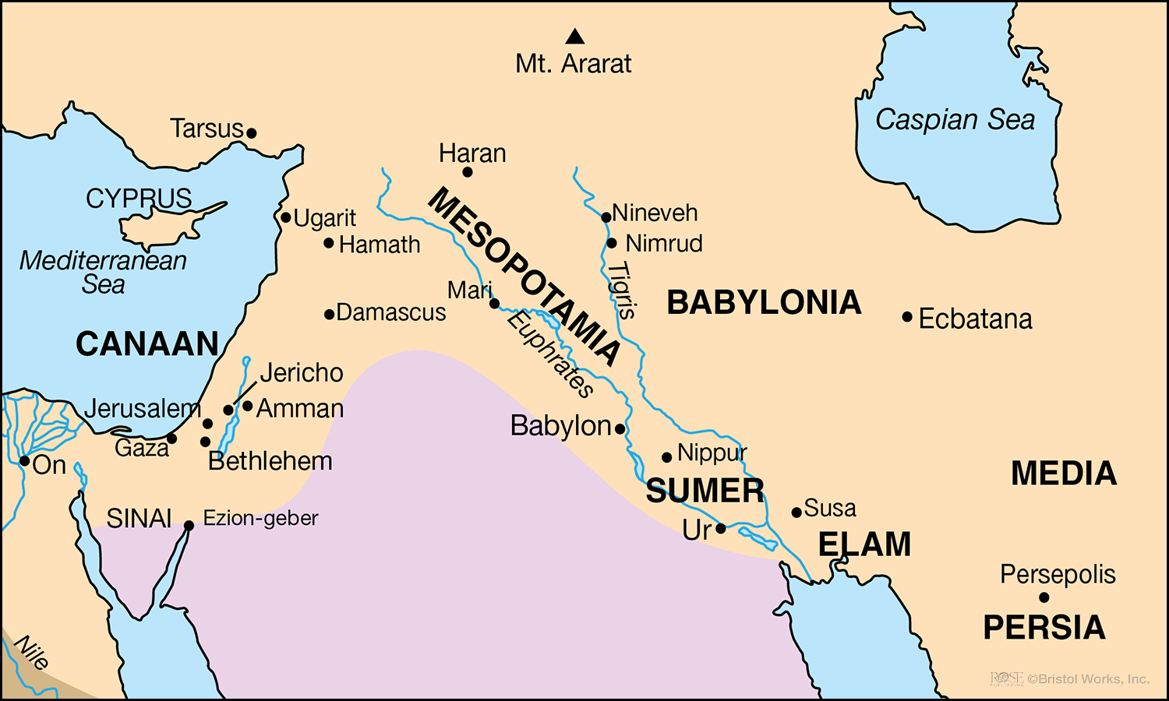

Slide 3
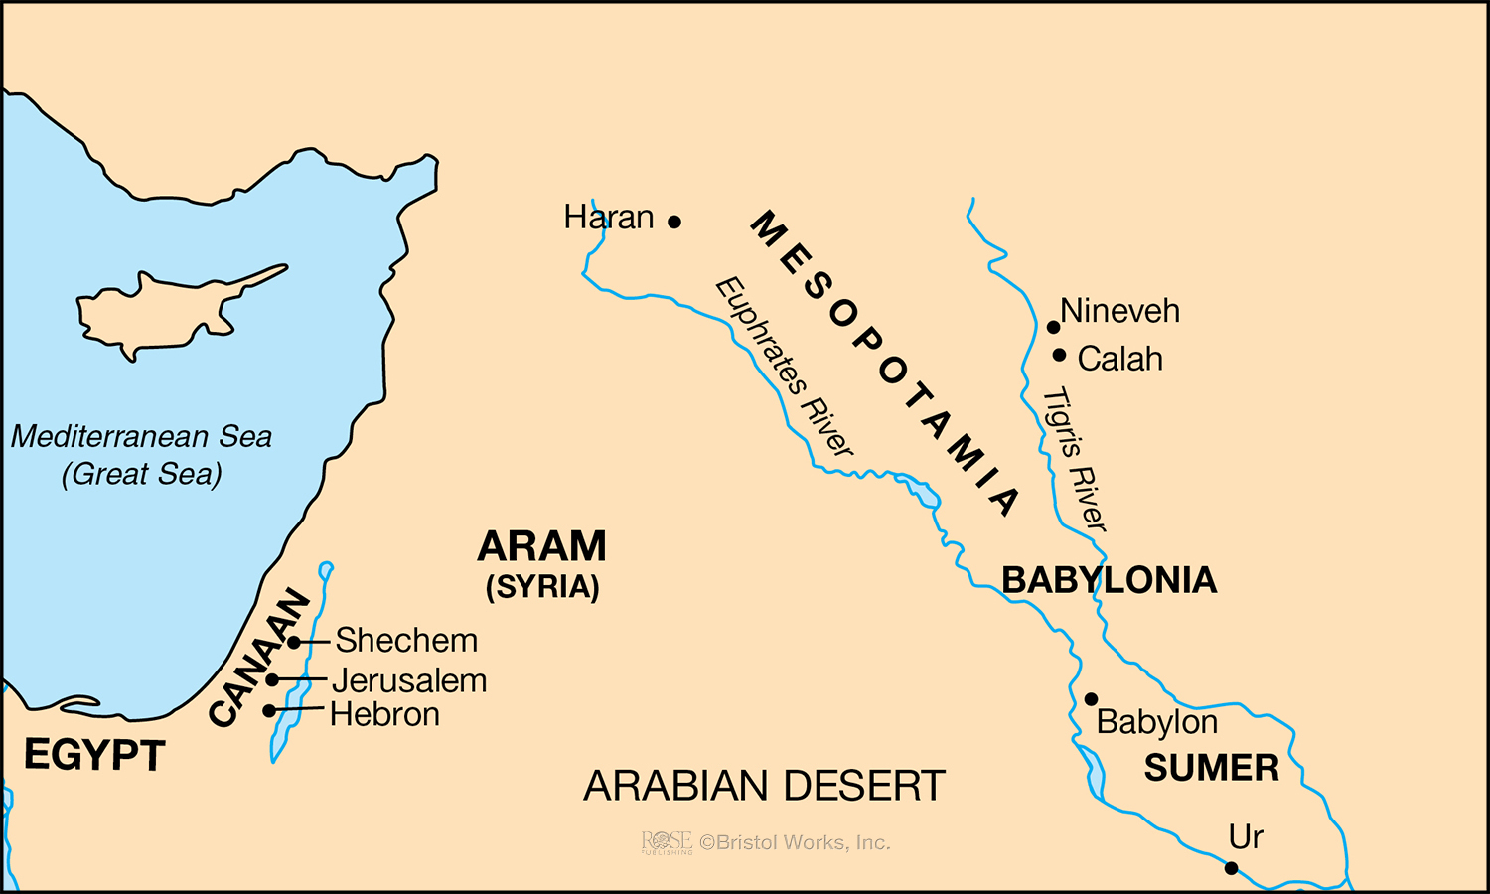

Slide 4
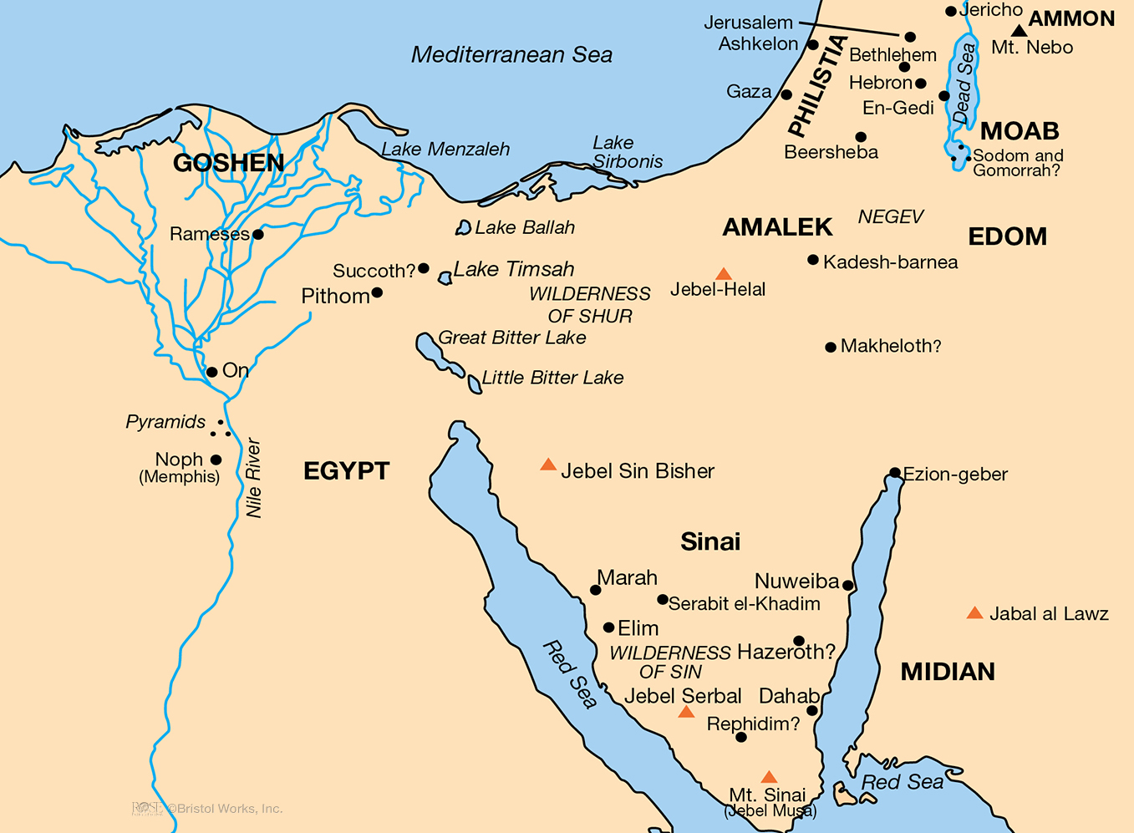

Slide 5
Introduction
Moses lived 120 years; Joshua lived 110 years
Joshua obeyed God and divided the land among the tribes

Slide 6
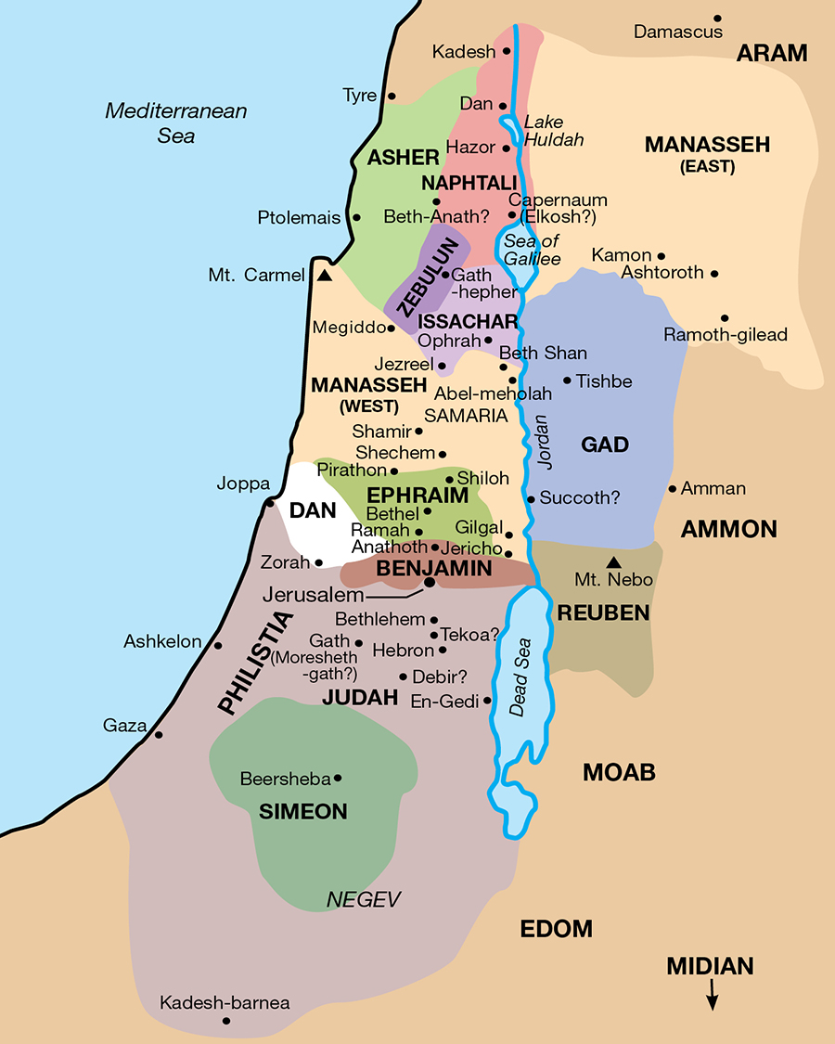

Slide 7
Introduction
Moses lived 120 years; Joshua lived 110 years
Joshua obeyed God and divided the land among the tribes
They failed to drive out the Canaanite nations—Judg. 1

Slide 8
Destroy the Nations—Deut.20:16ff
16 "But of the cities of these peoples which the LORD your God gives you as an inheritance, you shall let nothing that breathes remain alive,
17 but you shall utterly destroy them: the Hittite and the Amorite and the Canaanite and the Perizzite and the Hivite and the Jebusite, just as the LORD your God has commanded you,
18 lest they teach you to do according to all their abominations which they have done for their gods, and you sin against the LORD your God.

Slide 9
Destroy the Nations—Deut.20:16ff
16 "But of the cities of these peoples which the LORD your God gives you as an inheritance, you shall let nothing that breathes remain alive,
17 but you shall utterly destroy them: the Hittite and the Amorite and the Canaanite and the Perizzite and the Hivite and the Jebusite, just as the LORD your God has commanded you,
18 lest they teach you to do according to all their abominations which they have done for their gods, and you sin against the LORD your God.
Jews Did Not Destroy—Judges 1:27ff
27 However, Manasseh did not drive out the inhabitants of Beth Shean..they put the Canaanites under tribute…
29 Nor did Ephraim drive out the Canaan- ites who dwelt in Gezer…
30 Nor did Zebulun drive out the inhabi- tants of Kitron…so the Canaanites dwelt among them, and were put under tribute.
31 Nor did Asher drive out the inhabitants of Acco or the inhabitants of Sidon…
33 Nor did Naphtali drive out the inhabitants of Beth Shemesh…
34 And the Amorites forced the children of Dan into the mountains, for they would not allow them to come down to the valley;

Slide 10
“Clock”
of the Judges

Slide 11
Faithful
“Clock”
of the Judges

Slide 12
Faithful
“Clock”
of the Judges
Idolatry

Slide 13
Faithful
“Clock”
of the Judges
Idolatry
Repentance

Slide 14
Faithful
“Clock”
of the Judges
Deliverer/Judge
Idolatry
Repentance

Slide 15
Othniel
Ehud
Shamgar
Deborah
Gideon, Abimelech
Tola, Jair, Jephthah
Ibzan, Elon, Abdon
Samson, Eli, Samuel

Slide 17
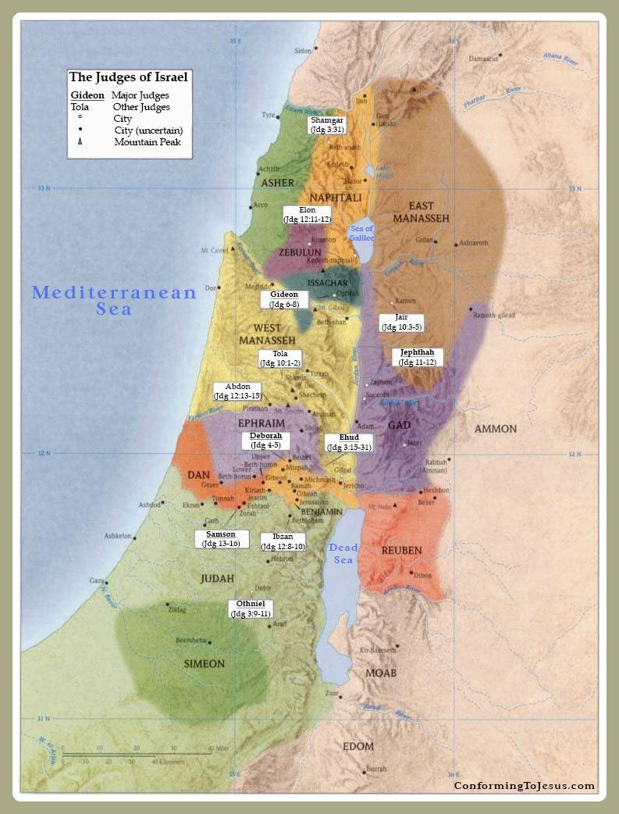
Shamgar
Othniel
Ehud
Shamgar
Deborah
Gideon, Abimelech
Tola, Jair, Jephthah
Ibzan, Elon, Abdon
Samson, Eli, Samuel

