Slide 1
Judges
Palm Beach Lakes
April-May 2024
Dan Jenkins

Slide 2
Introduction

Slide 3
Introduction
Moses lived 120 years; Joshua lived 110 years

Slide 4
Introduction
Moses lived 120 years; Joshua lived 110 years
Joshua obeyed God and divided the land among the tribes

Slide 5
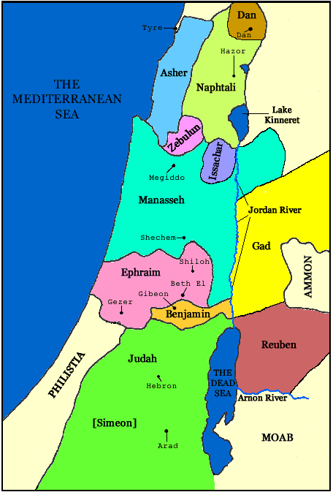

Slide 6
Introduction
Moses lived 120 years; Joshua lived 110 years
Joshua obeyed God and divided the land among the tribes
Faithfulness of Joshua’s generation—Judg. 1

Slide 7
Introduction
Moses lived 120 years; Joshua lived 110 years
Joshua obeyed God and divided the land among the tribes
Faithfulness of Joshua’s generation—Judg. 1
Another generation—arose who left God—Judg. 1

Slide 8
Introduction
Moses lived 120 years; Joshua lived 110 years
Joshua obeyed God and divided the land among the tribes
Faithfulness of Joshua’s generation—Judg. 1
Another generation—arose who left God—Judg. 1
They failed to drive out the Canaanite nations—Judg. 1

Slide 9
Introduction
Moses lived 120 years; Joshua lived 110 years
Joshua obeyed God and divided the land among the tribes
Faithfulness of Joshua’s generation—Judg. 1
Another generation—arose who left God—Judg. 1
They failed to drive out the Canaanite nations—Judg. 1
They were oppressed and finally turned to God—Judg. 1

Slide 10
Introduction
Moses lived 120 years; Joshua lived 110 years
Joshua obeyed God and divided the land among the tribes
Faithfulness of Joshua’s generation—Judg. 1
Another generation—arose who left God—Judg. 1
They failed to drive out the Canaanite nations—Judg. 1
They were oppressed and finally turned to God—Judg. 1
Judges were raised up by God to drive out nations—Judges 2-24

Slide 11
Introduction
Moses lived 120 years; Joshua lived 110 years
Joshua obeyed God and divided the land among the tribes
Faithfulness of Joshua’s generation—Judg. 1
Another generation—arose who left God—Judg. 1
They failed to drive out the Canaanite nations—Judg. 1
They were oppressed and finally turned to God—Judg. 1
Judges were raised up by God to drive out nations—Judges 2-24
Fifteen Judges (13 in book of Judges)

Slide 12
Introduction
Moses lived 120 years; Joshua lived 110 years
Joshua obeyed God and divided the land among the tribes
Faithfulness of Joshua’s generation—Judg. 1
Another generation—arose who left God—Judg. 1
They failed to drive out the Canaanite nations—Judg. 1
They were oppressed and finally turned to God—Judg. 1
Judges were raised up by God to drive out nations—Judges 2-24
Fifteen Judges (13 in book of Judges)
Period of judges 350-450 years (cf. 1 Kings 6:1)

Slide 13
Introduction
Moses lived 120 years; Joshua lived 110 years
Joshua obeyed God and divided the land among the tribes
Faithfulness of Joshua’s generation—Judg. 1
Another generation—arose who left God—Judg. 1
They failed to drive out the Canaanite nations—Judg. 1
They were oppressed and finally turned to God—Judg. 1
Judges were raised up by God to drive out nations—Judges 2-24
Fifteen Judges (13 in book of Judges)
Period of judges 350-450 years (cf. 1 Kings 6:1)
Lifestyle during the time of the judges changed from being nomads to eventually becoming a unified nation with a king

Slide 14
Destroy the Nations—Deut.20:16ff
16 "But of the cities of these peoples which the LORD your God gives you as an inheritance, you shall let nothing that breathes remain alive,
17 but you shall utterly destroy them: the Hittite and the Amorite and the Canaanite and the Perizzite and the Hivite and the Jebusite, just as the LORD your God has commanded you,
18 lest they teach you to do according to all their abominations which they have done for their gods, and you sin against the LORD your God.

Slide 15
Destroy the Nations—Deut.20:16ff
16 "But of the cities of these peoples which the LORD your God gives you as an inheritance, you shall let nothing that breathes remain alive,
17 but you shall utterly destroy them: the Hittite and the Amorite and the Canaanite and the Perizzite and the Hivite and the Jebusite, just as the LORD your God has commanded you,
18 lest they teach you to do according to all their abominations which they have done for their gods, and you sin against the LORD your God.
Jews Did Not Destroy—Judges 1:27ff
27 However, Manasseh did not drive out the inhabitants of Beth Shean..they put the Canaanites under tribute…
29 Nor did Ephraim drive out the Canaan- ites who dwelt in Gezer…
30 Nor did Zebulun drive out the inhabi- tants of Kitron…so the Canaanites dwelt among them, and were put under tribute.
31 Nor did Asher drive out the inhabitants of Acco or the inhabitants of Sidon…
33 Nor did Naphtali drive out the inhabitants of Beth Shemesh…
34 And the Amorites forced the children of Dan into the mountains, for they would not allow them to come down to the valley;

Slide 16
Judges—Chapter 1
1-19: Judah, Simeon, Caleb
21-26: Benjamin
27-28: Manasseh
29: Ephraim
30: Zebulon
31-32: Asher
33: Naphtali
34-36: Dan

Slide 17
List of the Judges

Slide 18
List of the Judges
Othniel

Slide 19
List of the Judges
Othniel
Ehud

Slide 20
List of the Judges
Othniel
Ehud
Shamgar

Slide 21
List of the Judges
Othniel
Ehud
Shamgar
Deborah

Slide 22
List of the Judges
Othniel
Ehud
Shamgar
Deborah
Gideon, Abimelech

Slide 23
List of the Judges
Othniel
Ehud
Shamgar
Deborah
Gideon, Abimelech
Tola, Jair, Jephthah
Ibzan, Elon, Abdon
Samson, Eli, Samuel

Slide 24
List of the Judges
Othniel
Ehud
Shamgar
Deborah
Gideon, Abimelech
Tola, Jair, Jephthah
Ibzan, Elon, Abdon
Samson, Eli, Samuel

Slide 25
“Clock”
of the Judges

Slide 26
Faithful
“Clock”
of the Judges

Slide 27
Faithful
“Clock”
of the Judges
Idolatry

Slide 28
Faithful
“Clock”
of the Judges
Idolatry
Repentance

Slide 29
Faithful
“Clock”
of the Judges
Deliverer/Judge
Idolatry
Repentance

