Slide 2
Times in the Bible When People Sang
Moses and Israel (Ex. 15:1-18)
David (2 Sam. 22:1-31)
Priests and Levites (Ezra 3:11)
Mary (Luke 1:46-55)
Paul and Silas (Acts 16:25)
Heavenly beings (Rev. 4:8-11; 5:9-14)
The redeemed in heaven (Rev. 14:9-10; 15:3-4)

Slide 3
Reasons God Wants Us to Sing
To glorify and praise Him (Heb. 13:15; Eph. 5:19; Col. 3:16; Rom. 15:9)
To edify, teach, admonish and unite one another (Eph. 5:19; Col. 3:16; 1 Cor. 14:26)
To draw me closer to Him and my brethren (Psa. 42:1-2; 84:1-2)

Slide 4
How We Sound
How we sound to each other:
Words
Parts: Soprano, Alto, Tenor, Bass (Men/Women)
How we sound to God (Eph. 5:19; Col. 3:16; Psa. 19:14)
Words
Heart

Slide 5
Adding New Songs
There are many beautiful and uplifting “new” songs
However, some are NOT Scriptural – look at the words
Some are NOT written for acapella, congregational worship
We are selecting easy songs that we are capable of singing as a congregation
We are teaching and introducing only a few at a time

Slide 6
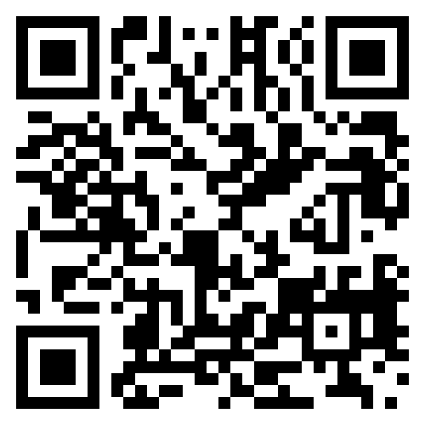
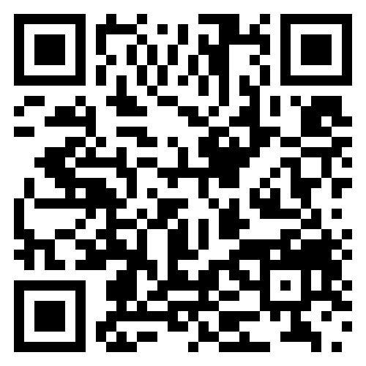
Adding New Songs
“Only a Holy God”
“Highly Exalted”

