Slide 1
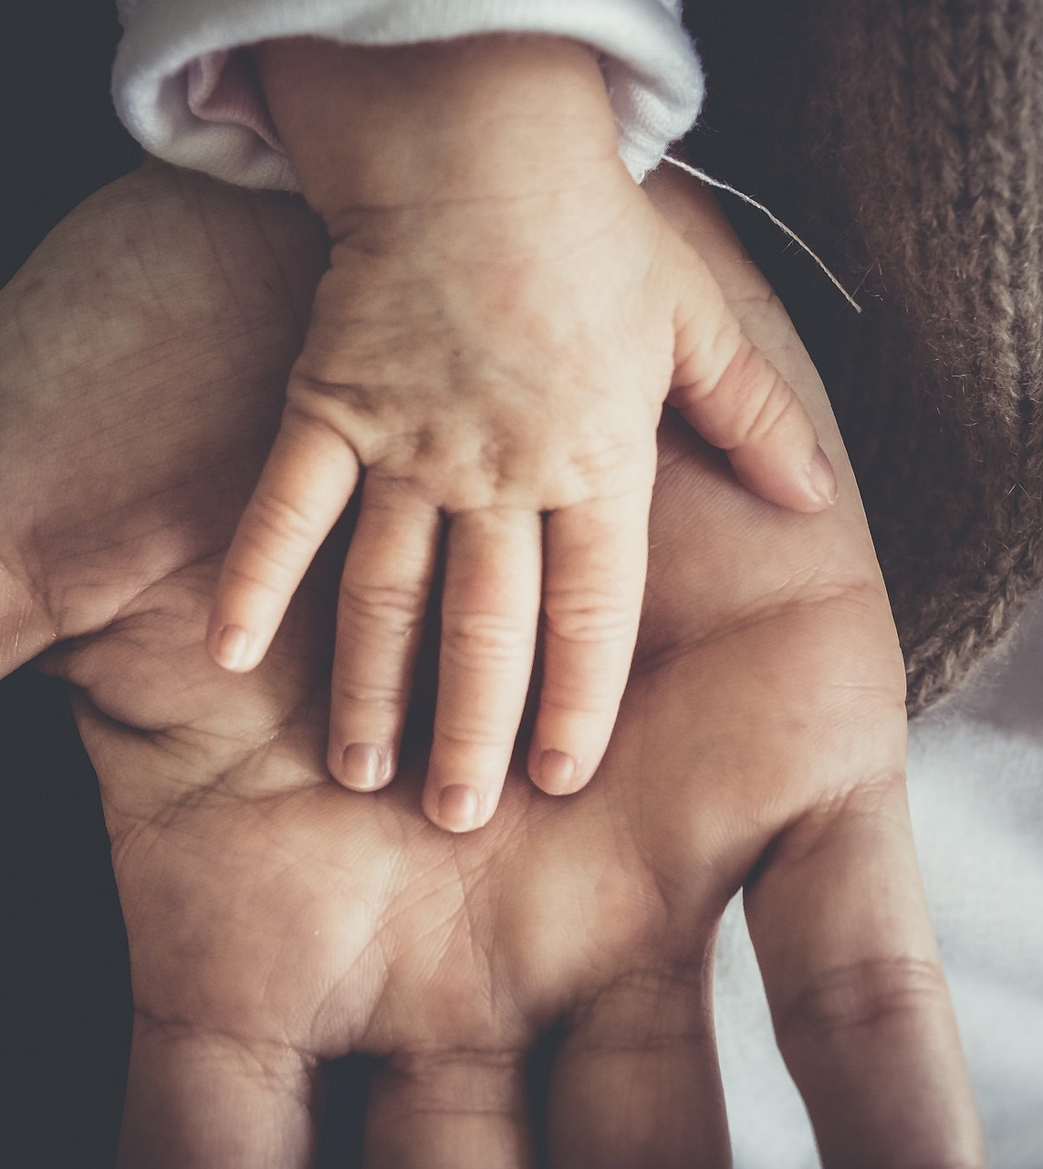
Our children rely on us.
“Anyone who does not provide for his family…has denied the faith and is worse than an unbeliever.” – 1 Tim. 5:8.
What if we do not provide SPIRITUALLY for our children?

Slide 2
STAND
in the
GAP
STRENGTHENING
Our Youth

Slide 3
Strengthen…
Their KNOWLEDGE of the Lord
– 2 Tim. 1:13
They must hold fast to the knowledge – v. 13.
They need someone to teach them how.
There is no better teacher than a parent – Deut. 6:6-7.

Slide 5
Strengthen…
Their KNOWLEDGE of the Lord
– 2 Tim. 1:13
Our children must hold fast to the knowledge – v. 13.
They need someone to teach them how.
Take an ACTIVE role in strengthening their KNOWLEDGE of the Lord!
Make sure they are at EVERY Bible class.
Make sure they are at EVERY worship service.
Make sure they are at EVERY devotional.
Make Bible study a REGULAR activity in your home.

Slide 6
Strengthen…
Their FRIENDSHIPS in the Lord
– 2 Tim. 3:1-5
They must avoid bad influences.
Evil companions will corrupt – v. 6-7; 1 Cor. 15:33.
Children need Christian friends – 2 Tim. 3:22-25; Heb. 10:24-25; Ecc. 4:9.

Slide 8
Strengthen…
Their FRIENDSHIPS in the Lord
– 2 Tim. 3:1-5
They must avoid bad influences.
Evil companions will corrupt – v. 6-7; 1 Cor. 15:33.
Children need Christian friends – 2 Tim. 3:22; Heb. 10:24-25.
Take an ACTIVE role in strengthening their FRIENDSHIPS in the Lord!
The more time they have together, the better!
Make youth group activities a priority.
Go out of your way to arrange hangouts with their church friends.
Plan sleepovers, parties, and trips for your children and their friends.

Slide 9
Strengthen…
Their COMMITMENT to the Lord
– 2 Tim. 1:8
They must be committed in good times and bad – 2 Cor. 11:25-28.
They need a charge to remain committed – 2 Tim. 11-14.
- If they die with Christ, they will live with Christ – v. 11; Col. 3:9-10.; 1 Cor. 15:55-58.

Slide 11
Strengthen…
Their COMMITMENT to the Lord
– 2 Tim. 1:8
They must be committed in good times and bad – 2 Cor. 11:25-28.
They need a charge to remain committed – 2 Tim. 11-14.
- If they die with Christ, they will live with Christ – v. 11; Col. 3:9-10.; 1 Cor. 15:55-58.
- If they endure, they will reign with Christ – v. 12a; Col. 1:9-10, 13-14.

Slide 14
Strengthen…
Their COMMITMENT to the Lord
– 2 Tim. 1:8
They must be committed in good times and bad – 2 Cor. 11:25-28.
They need a charge to remain committed – 2 Tim. 11-14.
- If they die with Christ, they will live with Christ – v. 11; Col. 3:9-10.; 1 Cor. 15:55-58.
- If they endure, they will reign with Christ – v. 12a; Col. 1:9-10, 13-14.
- If they deny Christ, He will deny them – v. 12b; Mt. 10:33; 7:21-33; 1 Jn. 2:22.

Slide 16
Strengthen…
Their COMMITMENT to the Lord
– 2 Tim. 1:8
They must be committed in good times and bad – 2 Cor. 11:25-28.
They need a charge to remain committed – 2 Tim. 11-14.
- Die with Christ and they will live with Christ – v. 11; Col. 3:9-10.; 1 Cor. 15:55-58.
- Endure, and they will reign with Christ – v. 12a; Col. 1:9-10, 13-14.
- Deny Christ, and He will deny them – v. 12b; Mt. 10:33; 7:21-33; 1 Jn. 2:22.
- When their faith weakens, Christ remains faithful – v. 13; 1 Cor. 10:13; 1 Jn. 1:9.

Slide 18
Strengthen…
Their FRIENDSHIPS in the Lord
– 2 Tim. 3:1-5
They must be committed in good times and bad – 2 Cor. 11:25-28.
They need a charge to remain committed – 2 Tim. 11-14.
- Die with Christ and they will live with Christ – v. 11; Col. 3:9-10.; 1 Cor. 15:55-58.
- Endure, and they will reign with Christ – v. 12a; Col. 1:9-10, 13-14.
- Deny Christ, and He will deny them – v. 12b; Mt. 10:33; 7:21-33; 1 Jn. 2:22.
- When their faith weakens, Christ remains faithful – v. 13; 1 Cor. 10:13; 1 Jn. 1:9.
Take an ACTIVE role in strengthening their COMMITEMENT to the Lord!
Challenge them to grow in faith (study more, pray more).
Challenge them to grow in service (service projects, be creative).
Challenge them to be more involved in the youth group.
Challenge them to deny all sinful activities.

Slide 19
Will you commit to
STRENGTHENING
our Youth?
Our children are relying on you!

