Slide 2
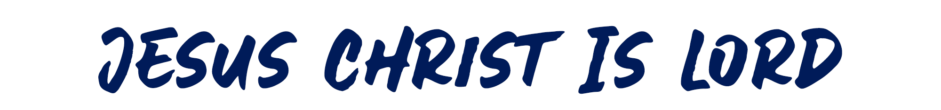

Slide 3
Answering Questions Regarding Marriage (7:1-40)
Answering Questions Regarding Meats Offered to Idols and Christian Liberty (8:1-10:33)
Answering Questions Regarding the Assemblies and Worship (11:2-34)
  Instructions Concerning Women’s Head Covering (11:2-16)
  Instructions Concerning the Lord’s Supper (11:17-34)
    The Frequency of the Lord’s Supper (11:17-20)
    The Designation of the Lord’s Supper (11:20-22)
    The Institution of the Lord’s Supper (11:23-25)
    The Purpose of the Lord’s Supper (11:24-26)
    The Manner of Observing the Lord’s Supper (11:27-34)

