Slide 1
Just Say ! NO ! ... to SIN
Adult Classroom 1
Winter 2024

Slide 2
Outline of the Series
Origin of SIN & What is Sin
Kinds of Sin
What Sin will do to you
Attitudes Towards Sin
Helps in Overcoming Sin
The beauty of Forgiveness of Sin
Sins against our selves and our Brethren
Sin against the home
Sins the Lord will not forgive
Hell, the Eternal Consequence of Sin

Slide 3
Class Structure
Premise of the lesson for the night
Discussion (That’s YOU)
Practical Application for YOU

Slide 4
The Origin of Sin.
What is Sin?

Slide 7
When was the First SIN?

Slide 8
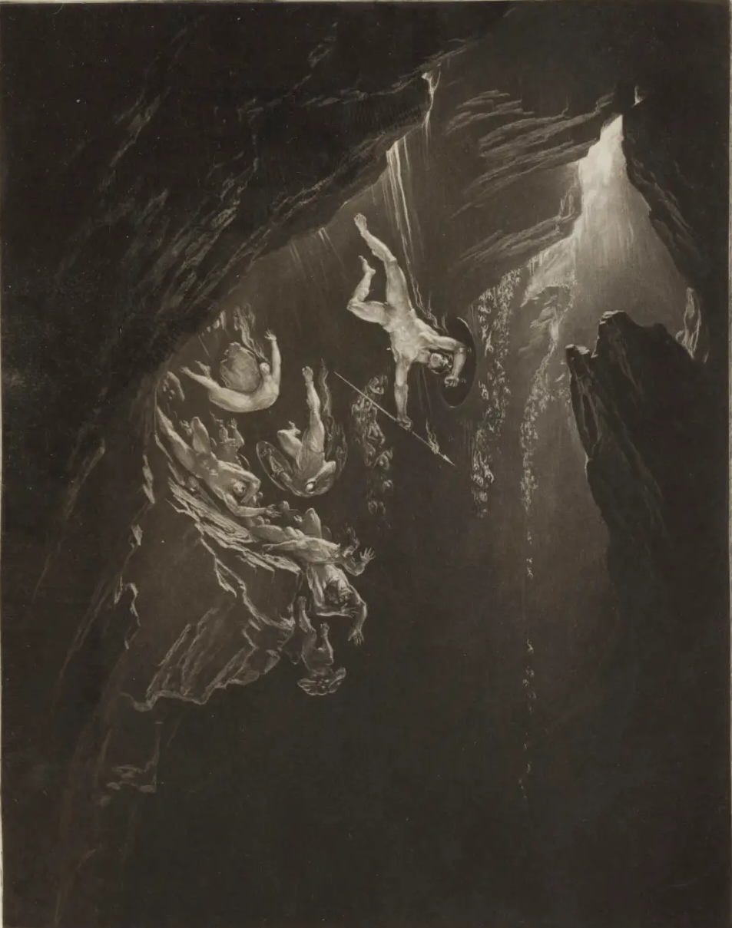
Origin of Sin on Before Eden
Satan apparently was originally a holy angel in heaven but sinned.
1 John 3:8. He who sins is of the devil, for the devil has sinned from the beginning. For this purpose, the Son of God was manifested, that He might destroy the works of the devil.
Upon sinning, Satan was cast out of heaven, God dwells in absolute holiness.
Luke 10:18 And He said to them, “I saw Satan fall like lightning from heaven.
Inevitable and immediate – Like lightening
Pride seems to have been Satan’s sin
1 Ti 3:6. 6 not a novice, lest being puffed up with pride he fall into the same condemnation as the devil
Proverbs 16:18 Pride goes before destruction,
And a haughty spirit before a fall.

Slide 9
Satan and his followers are destined to everlasting fire with no scheme for redemption
Matthew 25:41 (NKJV)
⁴¹ “Then He will also say to those on the left hand, ‘Depart from Me, you cursed, into the everlasting fire prepared for the devil and his angels:

Slide 10
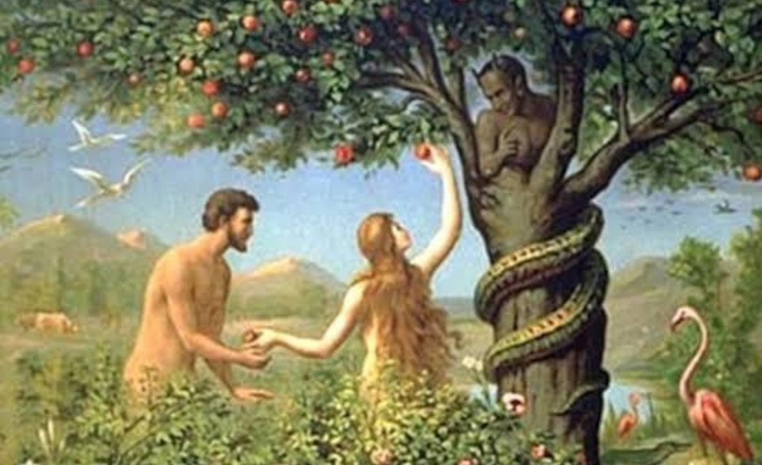
First Sin on Earth

Slide 11
Origin of Sin on Earth
Satan’s diabolical and deceptive tactics:
Gen 3: 1, 13
2 Cor 11:2-3
1 Peter 5:8
1. Satan’s timing
2. Insinuating question
3. Implication of unfair treatment
4. Satan blatantly and presumptuously lies
Man HEARD a lie
Man must HEAR the truth
Man BELIEVED a lie
Man must BELIEVE the truth
Man OBEYED a lie
Man must OBEY the truth
There IS a Pattern Here

Slide 12
Genesis 3:1–6 (NKJV)
3 Now the serpent was more cunning than any beast of the field which the Lord God had made. And he said to the woman, “Has God indeed said, ‘You shall not eat of every tree of the garden’?”
² And the woman said to the serpent, “We may eat the fruit of the trees of the garden; ³ but of the fruit of the tree which is in the midst of the garden, God has said, ‘You shall not eat it, nor shall you touch it, lest you die.’ ”
⁴ Then the serpent said to the woman, “You will not surely die. ⁵ For God knows that in the day you eat of it your eyes will be opened, and you will be like God, knowing good and evil.”
⁶ So when the woman saw that the tree was good for food, that it was pleasant to the eyes, and a tree desirable to make one wise, she took of its fruit and ate. She also gave to her husband with her, and he ate.

Slide 13
Satan’s Three-Way Approach
Lust of the Flesh
Lust of the Eyes
Pride of Life
Driven by Desire
James 1:13–15 (NKJV)
¹³ Let no one say when he is tempted, “I am tempted by God”; for God cannot be tempted by evil, nor does He Himself tempt anyone. ¹⁴ But each one is tempted when he is drawn away by his own desires and enticed. ¹⁵ Then, when desire has conceived, it gives birth to sin; and sin, when it is full-grown, brings forth death.

Slide 14
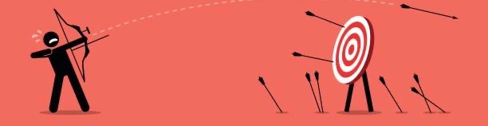
What is SIN?
Missing the Mark
Romans 3:23 for all have sinned and fall short of the glory of God,
Transgression
Hebrews 2:2 ²For if the word spoken through angels proved steadfast, and every transgression and disobedience received a just reward,
Violation of conscience Rom 14:23
Knowing to do good and not doing it. Jas 4:17
Violation or breaking of God’s Law. 1 John 3:4
Failure to keep God’s commands 1John 5:17

Slide 15
APPLICATION

Slide 16
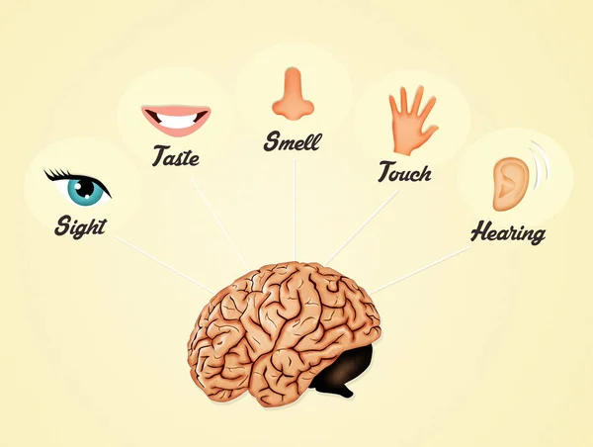
Where is THE battleground between GOOD and EVIL?
Inside of YOU, Your brain, YOUR Soul!
Who CONTROLS YOU?
Who CONTROLS YOUR Thoughts/Desires?
Who/What INFLUENCES YOUR Thoughts/Desires?
Your Senses are conduits to your very soul,
they influence you!
Only YOU can control what goes into your brain.
Only YOU can decide what action to take.
Satan cannot MAKE you do anything!

Slide 17
How do YOU Just Say !NO! … To Sin?
Equip
Prepare
Train/Condition – Physical and Mental
Practice…always
Know your Desires / weaknesses
Build Fortresses to defend
IT TAKES EFFORT, CONSTANTLY, CONSISTENTLY, WITH RESOVE FOCUSING ON THE TARGET

Slide 18
Next Week
Richard Watson will be filling in for me.
Topic
Kinds of Sin
READ
1 Peter

Slide 19
Support Material

Slide 20
References
Nature of God
https://christiancourier.com/articles/the-wages-of-sin-and-the-free-gift-of-god
Righteousness of God: https://christiancourier.com/articles/the-righteousness-of-god-revealed
Drawing Power of God: https://christiancourier.com/articles/the-drawing-power-of-god. Taught, Hear, Learn, Come

