Slide 2



Slide 3

Young men, follow in the footsteps of Jesus: become a preacher/missionary
Give your life to the work! Stand in the gap!

Slide 4

Make it about the work (and the gap) and not about you (Phil. 2:25, 30)
Give your time to the work! Stand in the gap!

Slide 5
We need to use our God-given money for God’s work (Phil. 4:14-18)
Give your money to the work! Stand in the gap!

Slide 6
Do not expect (or ask) for anything in return (Luke 6:35; 10:35)
Give your words to the work! Stand in the gap!

Slide 7
Pray for the lost (Rom. 10:1)
Pray for the missionaries (1 Thess. 5:25)
Pray for the work and for doors to be opened (Col. 4:3)
Pray for the gospel to spread and be received (2 Thess. 3:1)
Give your heart to the work! Stand in the gap!

Slide 8

January 28
Every dollar given on Mission Sunday
goes toward mission work.

Slide 9

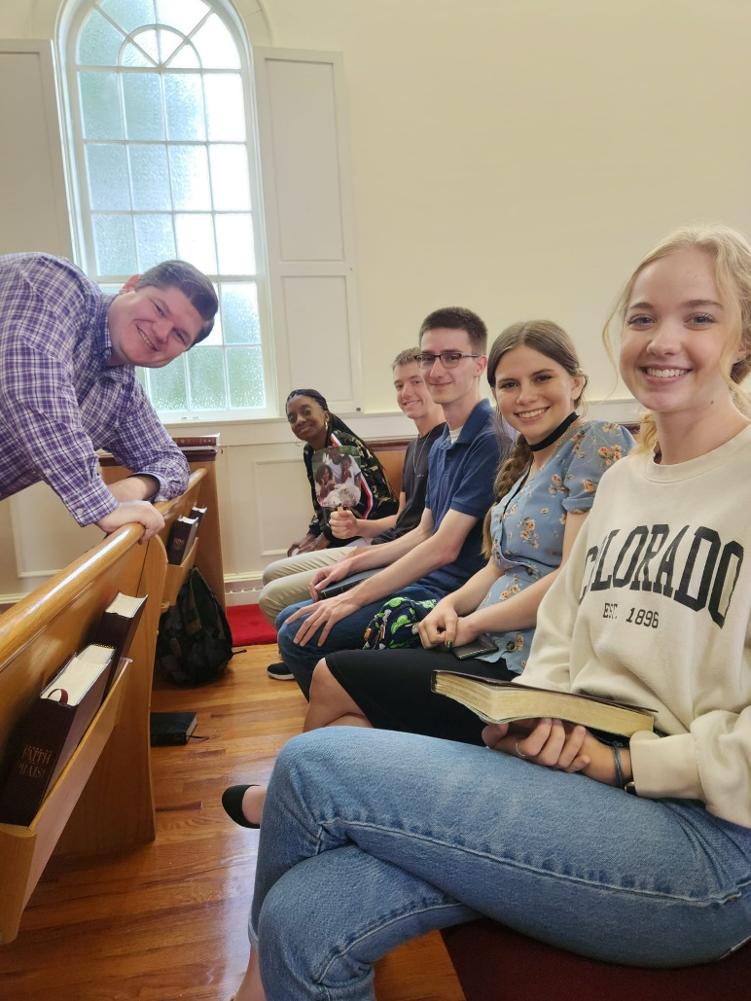
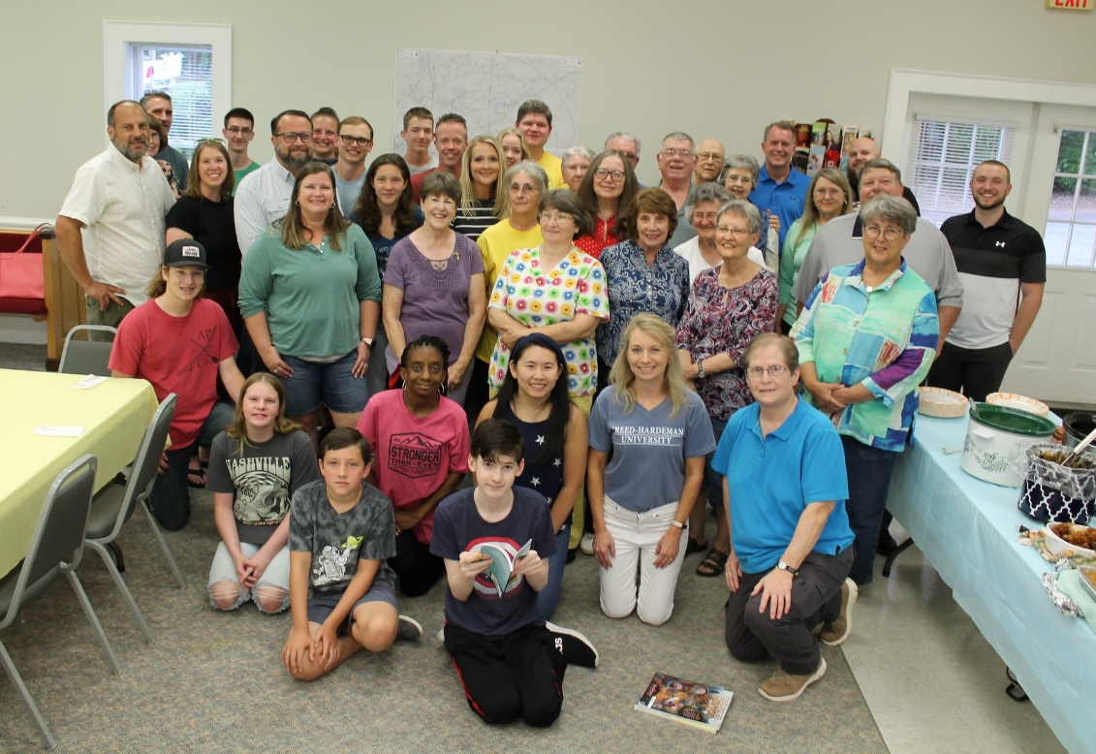
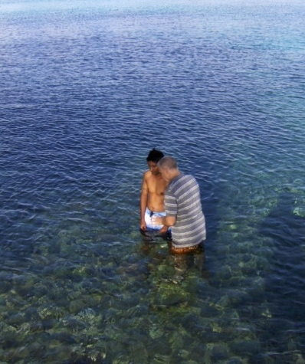

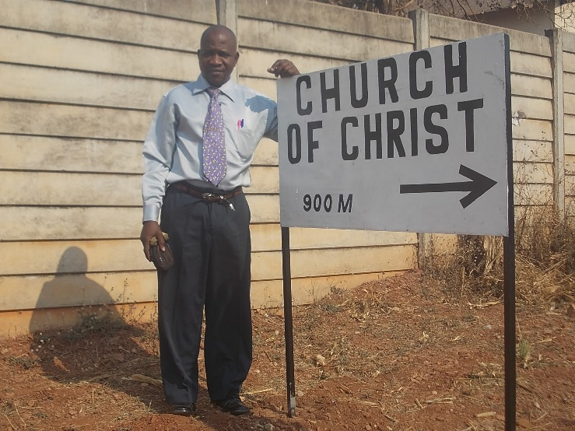
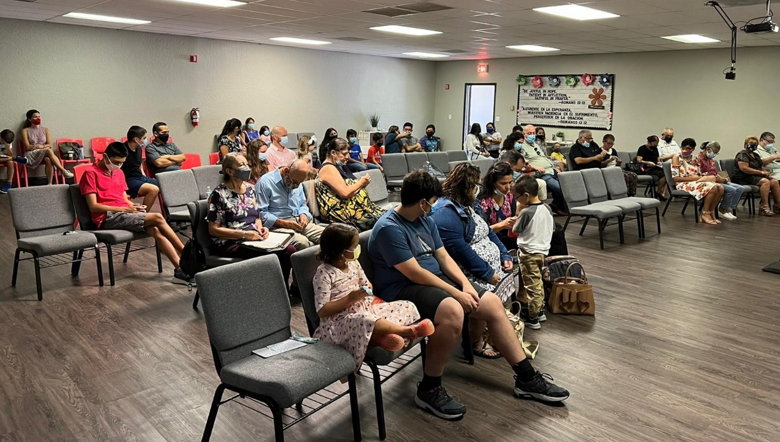
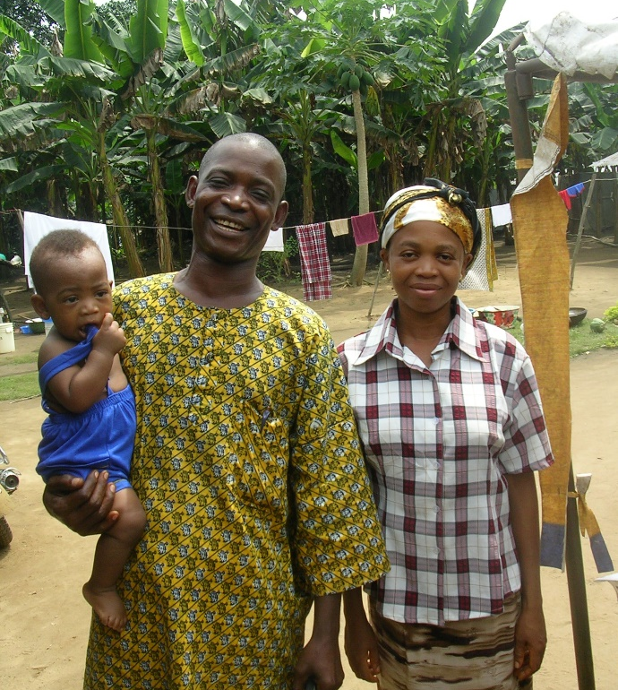
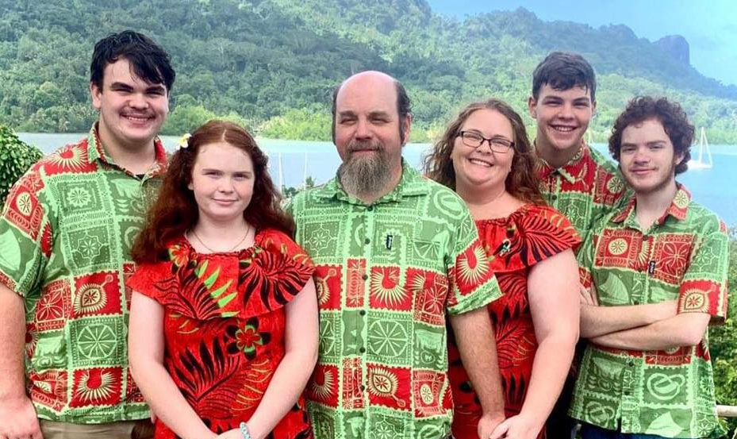
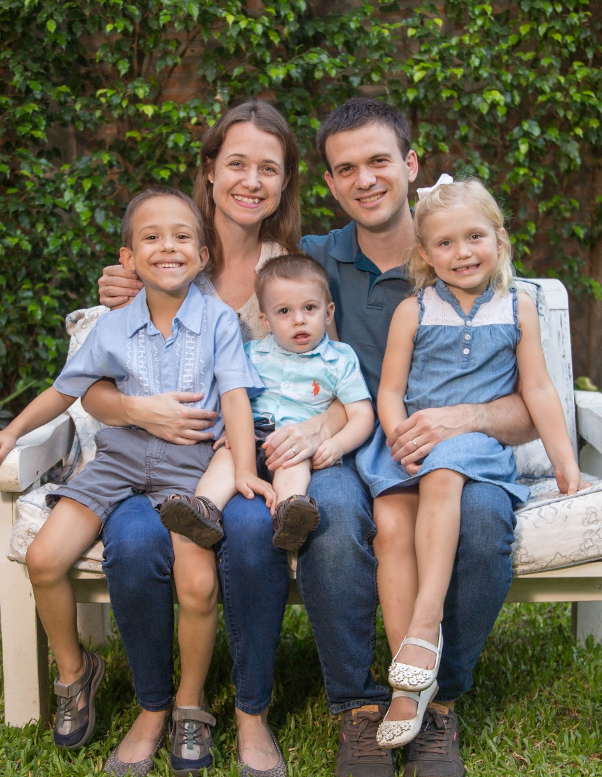
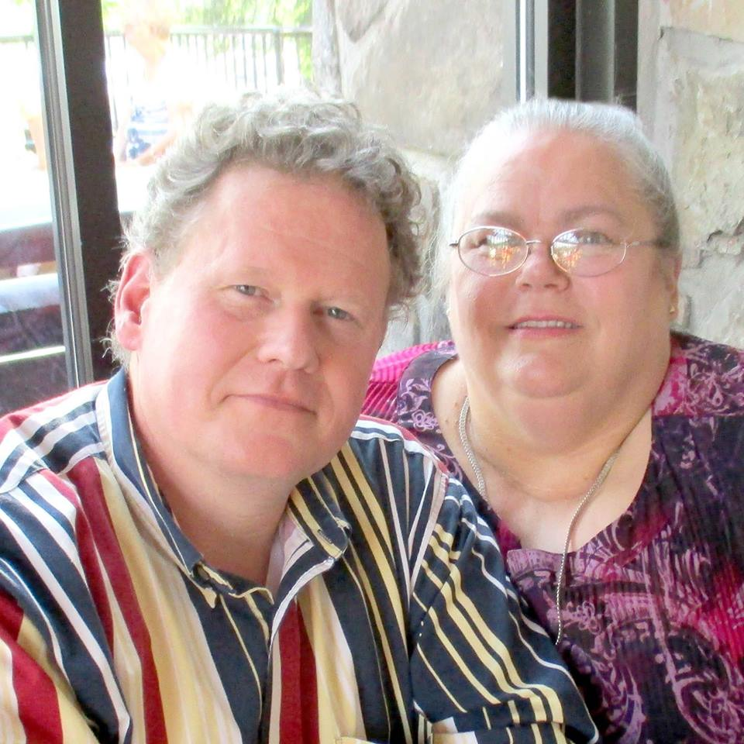
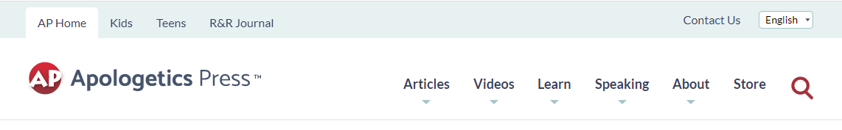
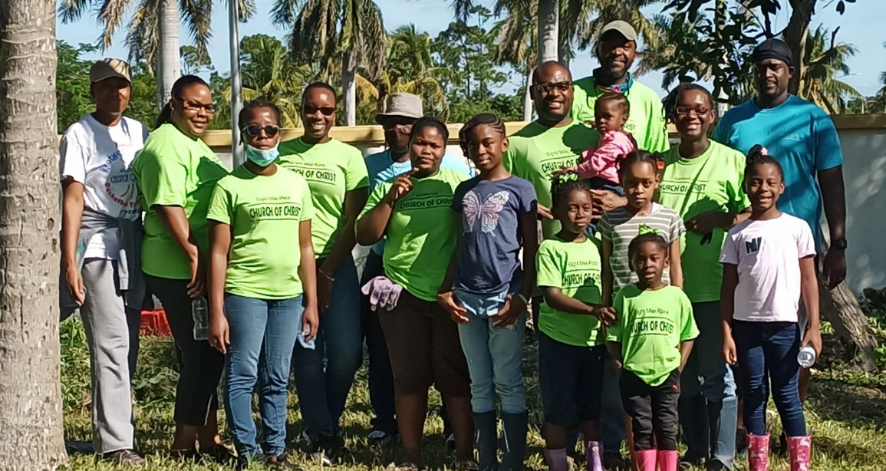

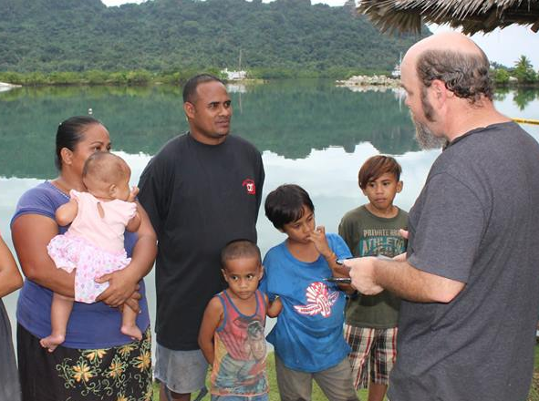
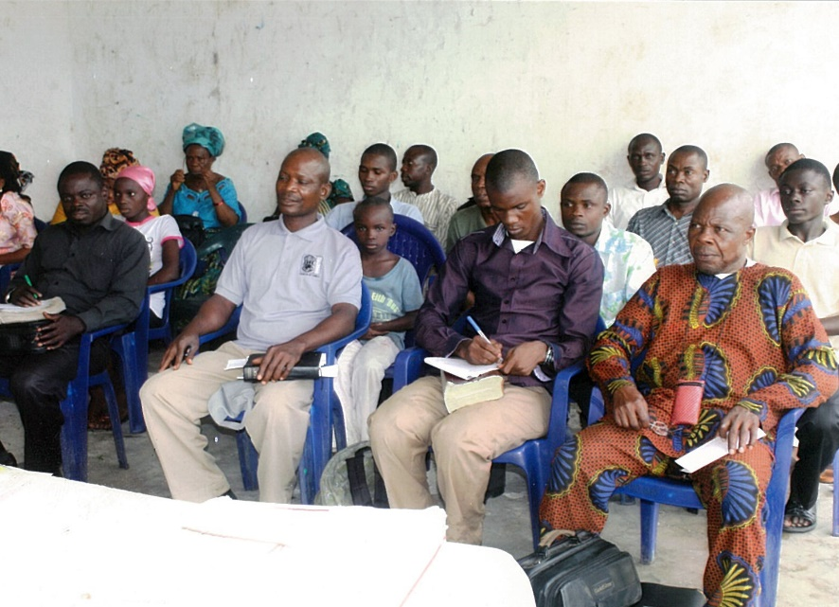
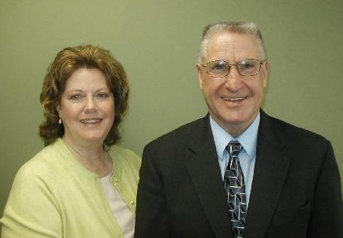
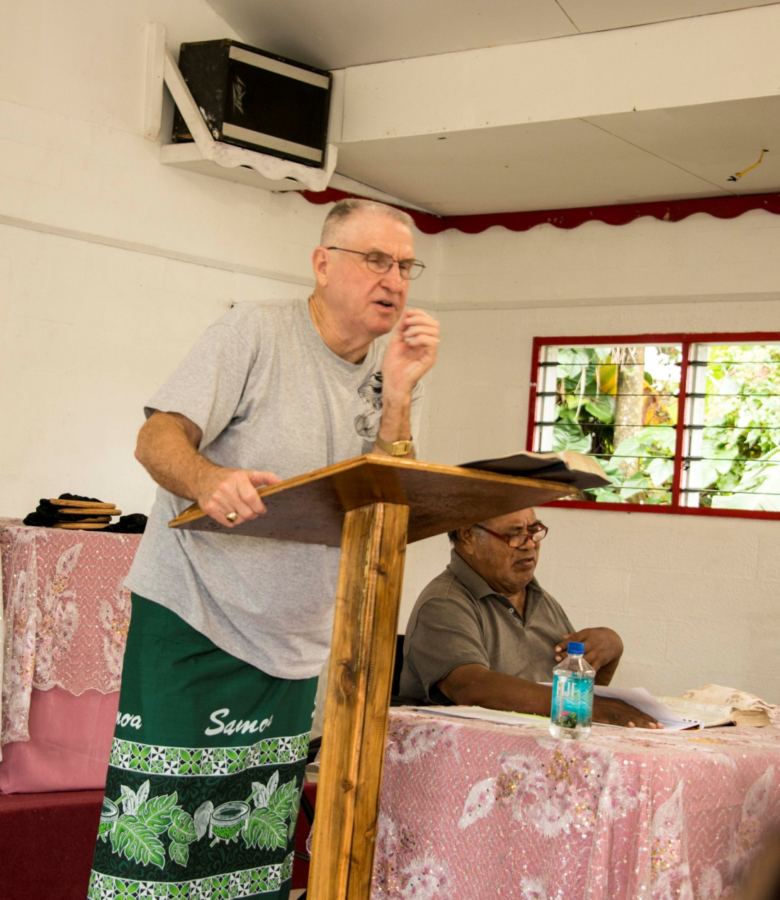
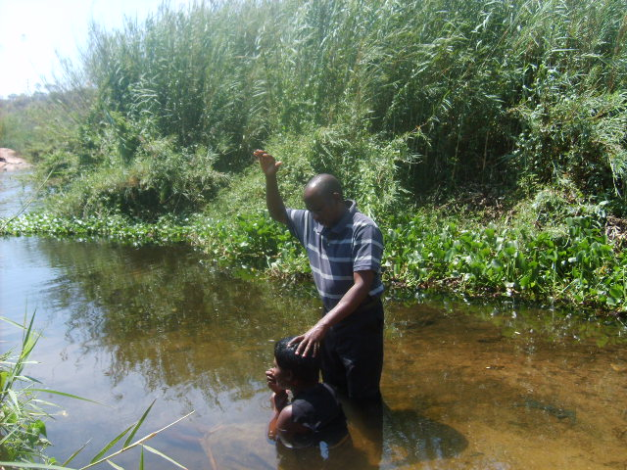
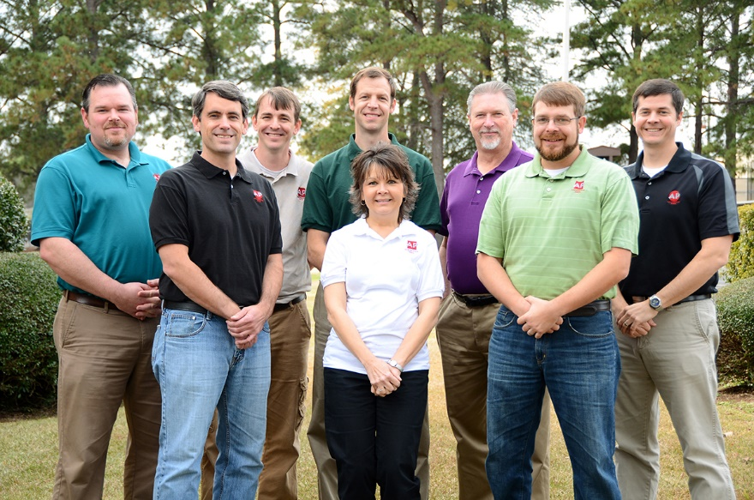
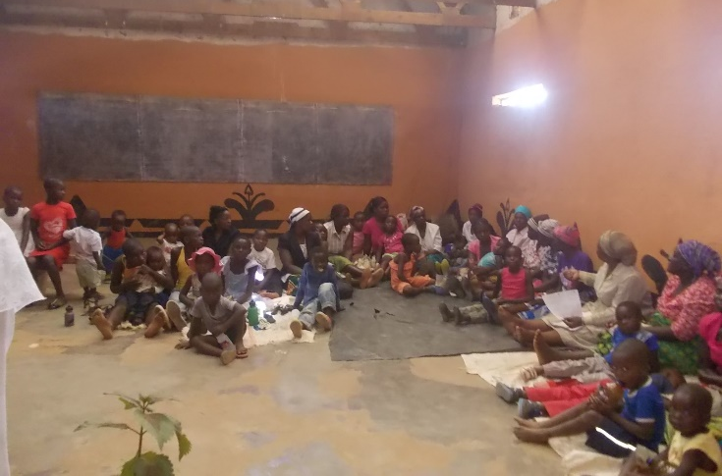


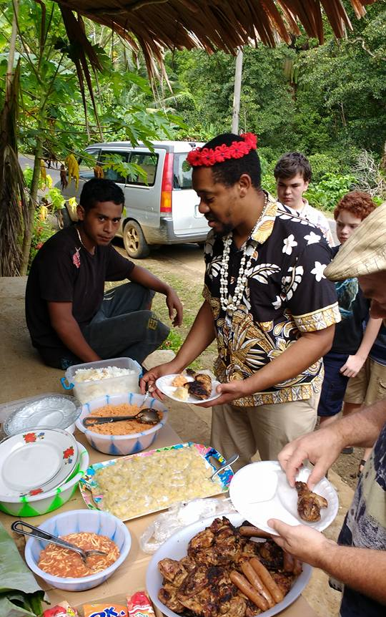


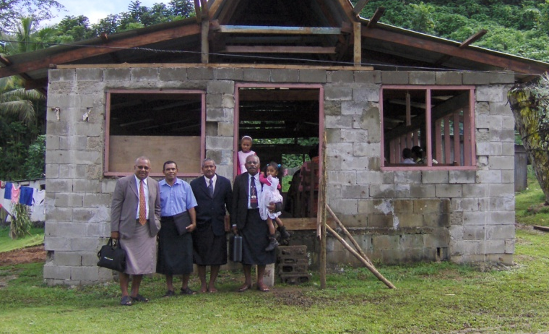
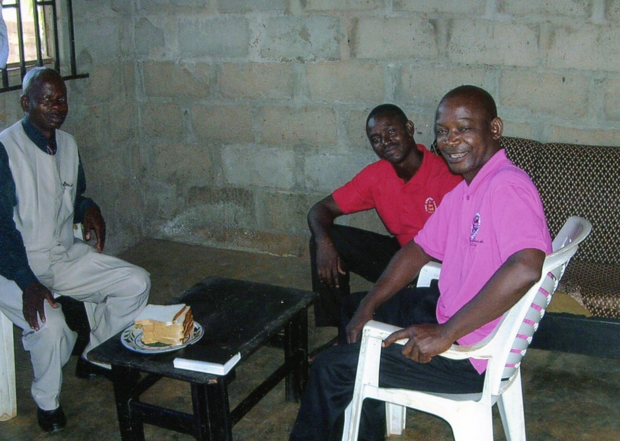
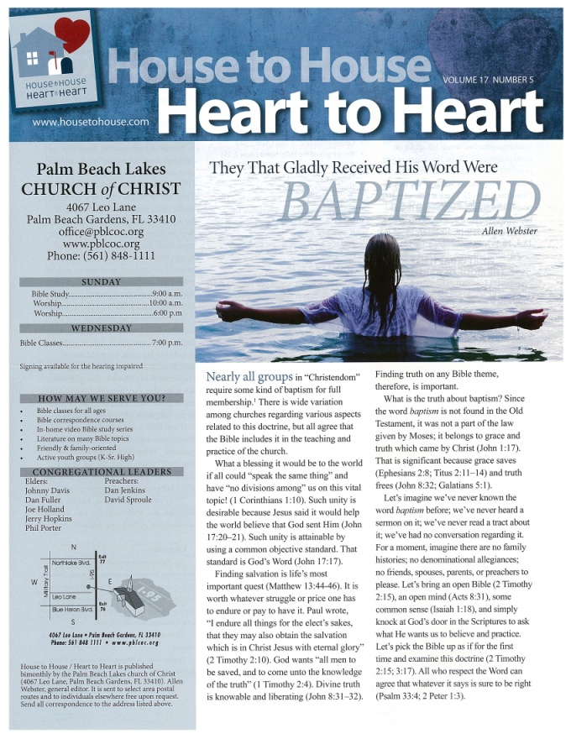
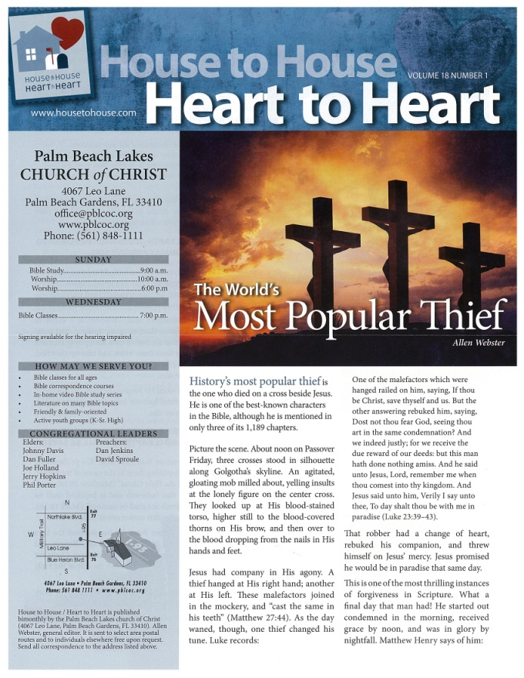
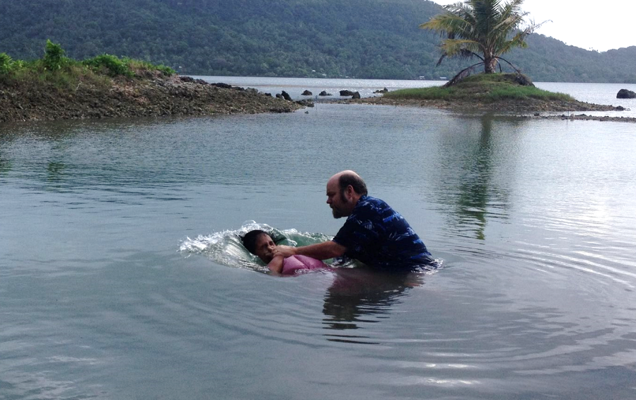
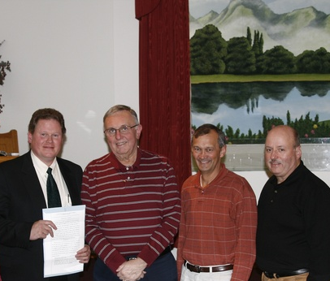
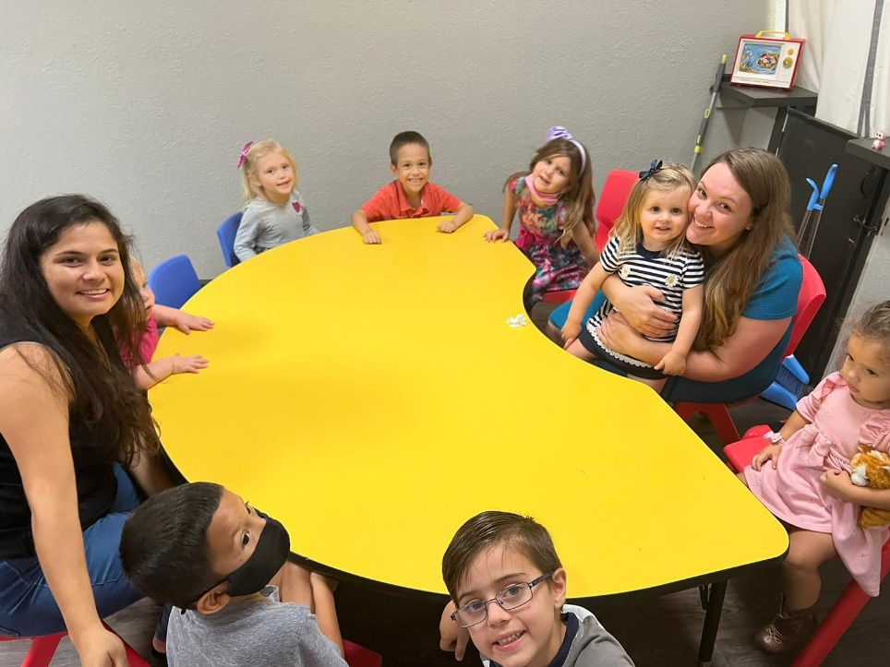
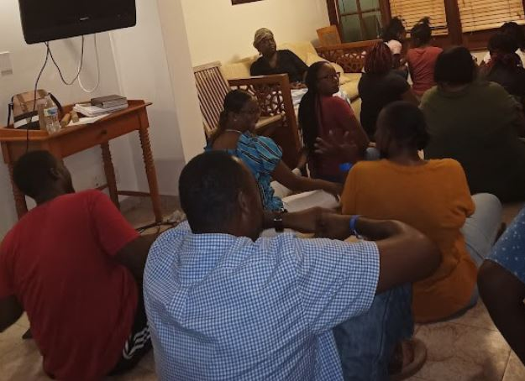
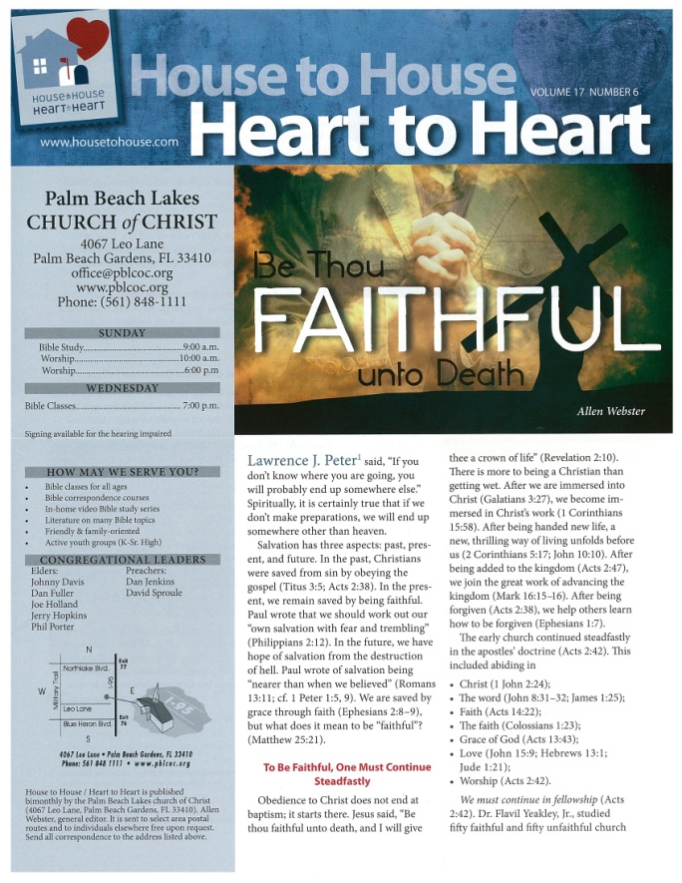
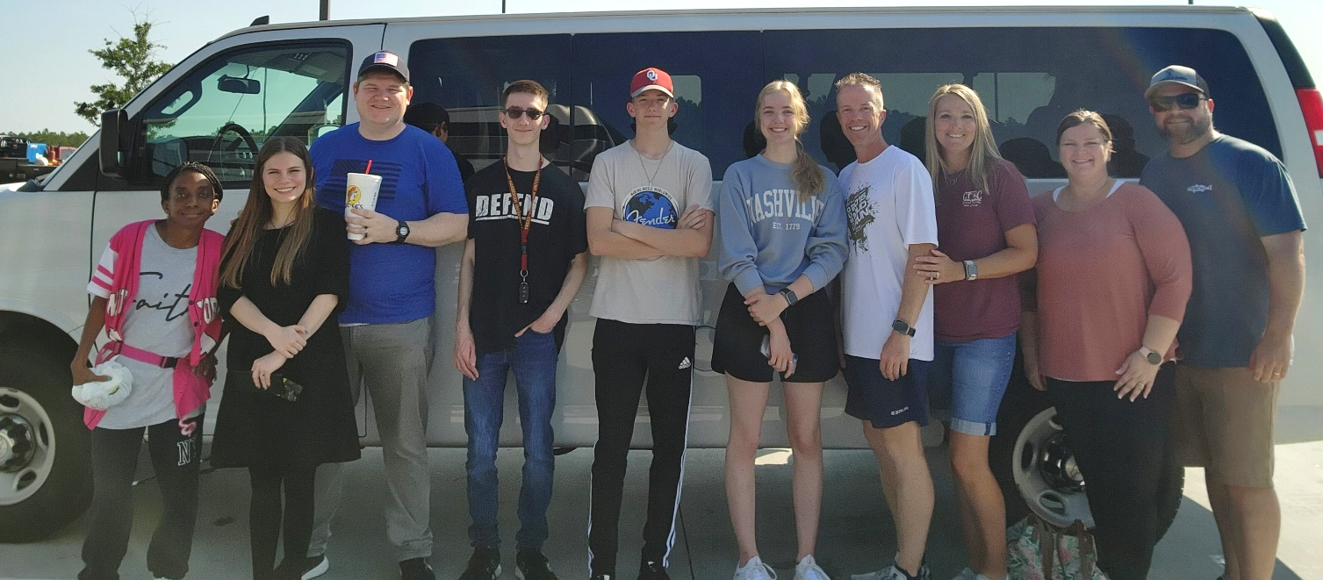
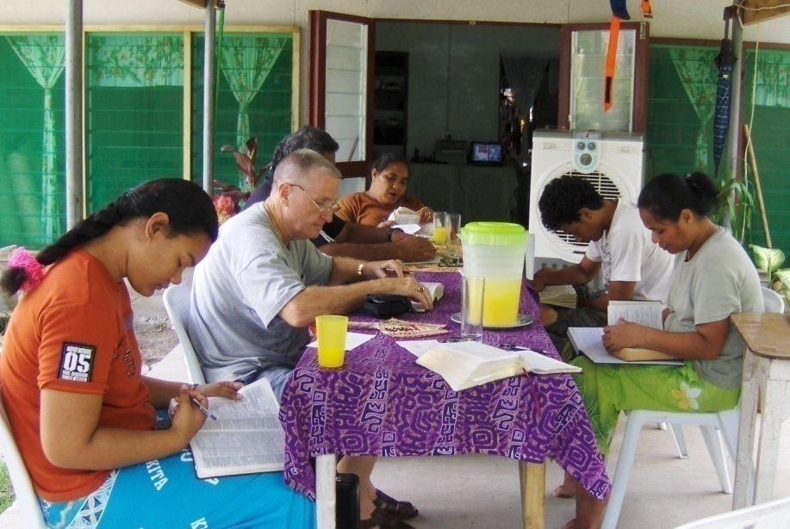
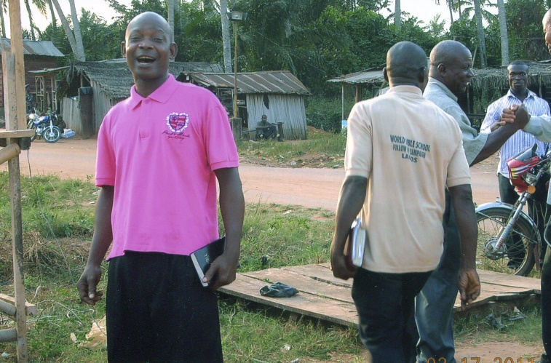
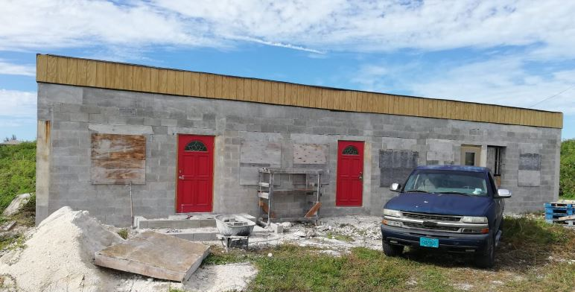
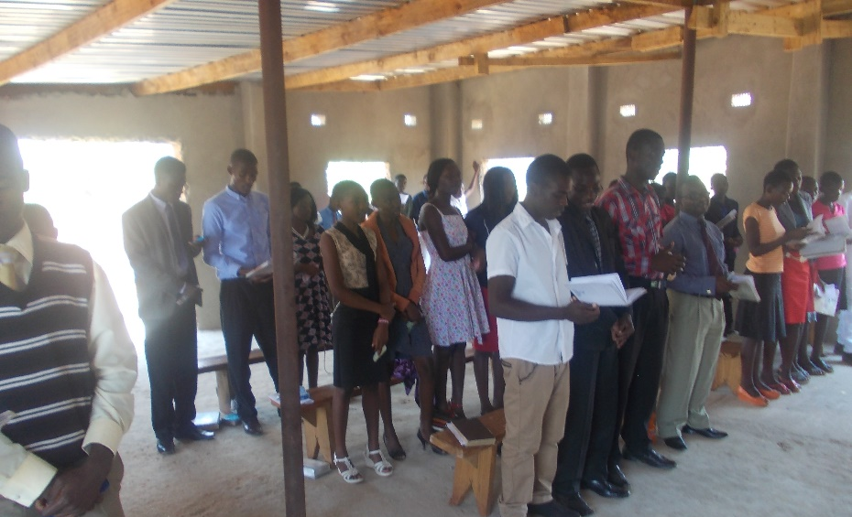
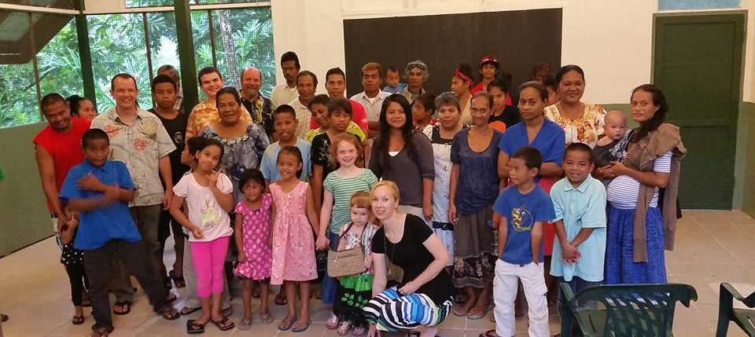
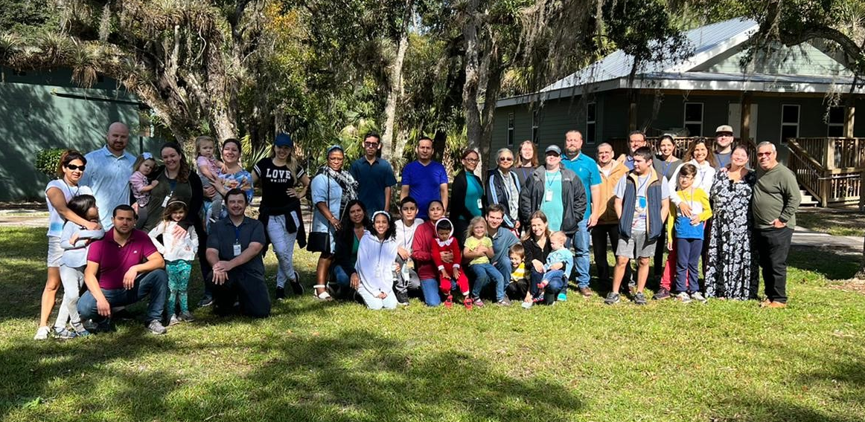

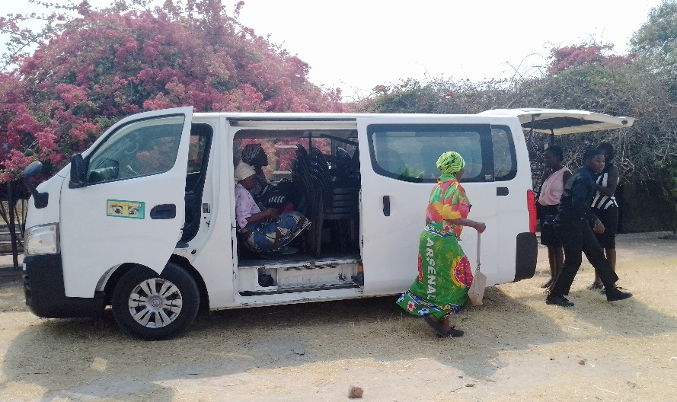
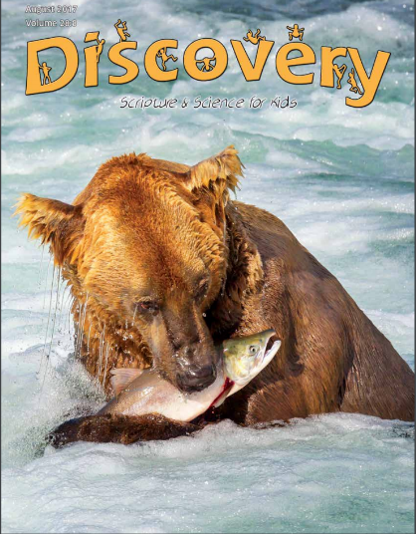

1,800 homes
EVERY month
Rotating Routes
Nnanna
Tamuka
Robert
Wayne
Tavaro
Mauricio
Robert C.
AP
Sr. High
H2H
AMC
Easter
Answering Macedonian Calls
Sr. High & Adult Mission Trip
House to House/Heart to Heart
$133,650
Apologetics Press
Robert C. Lupo (Sneedville, TN)
Tavaro Hanna (Bahamas)
Mauricio Yegros (Coral Springs)
Robert Martin (Pacific)
Wayne Parker (Pacific, Cyprus)
Nnanna Aforji (Nigeria)
Tamuka Arunashe (Zimbabwe)

Slide 10

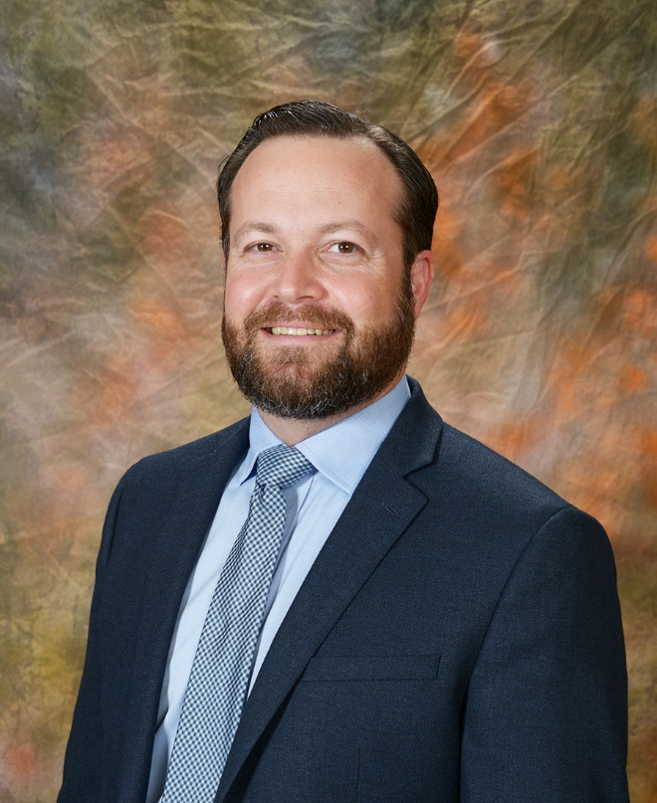
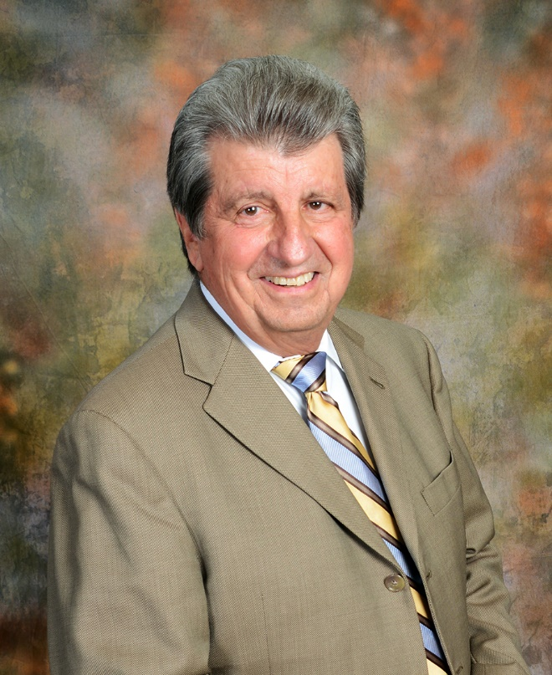
Josh Blackmer
Dan Jenkins
Mission Statement: Our mission is to labor with existing congregations and new works of the Lord’s church in evangelizing, edifying, and equipping the saints for greater service in domestic and foreign fields.
Assisting congregations around the United States
Assisting mission works on foreign soils

Slide 11
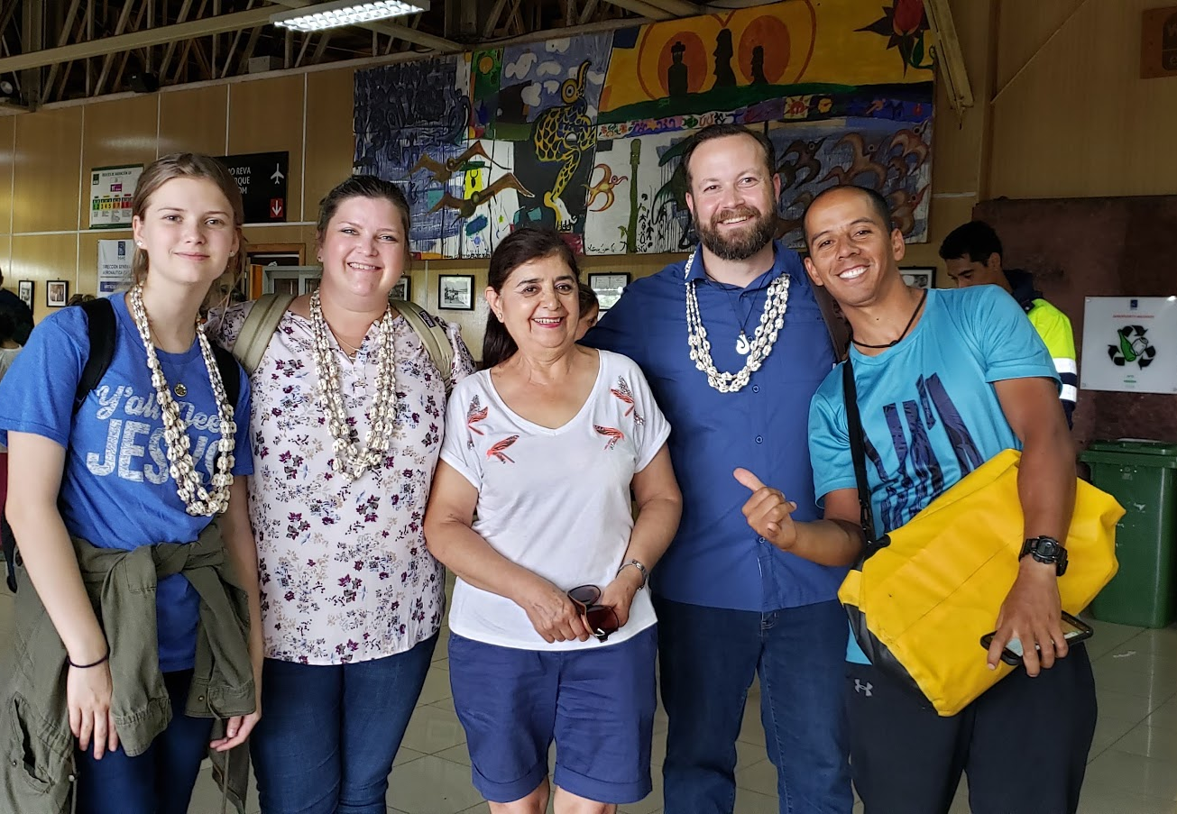
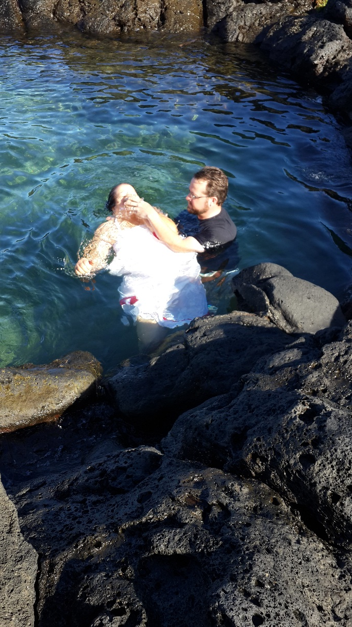
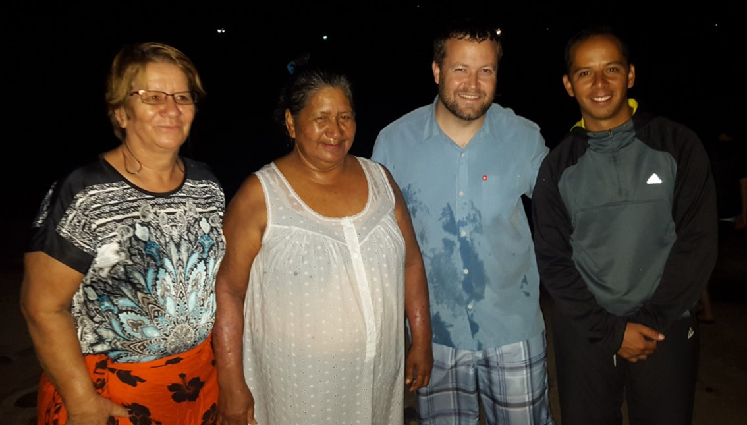
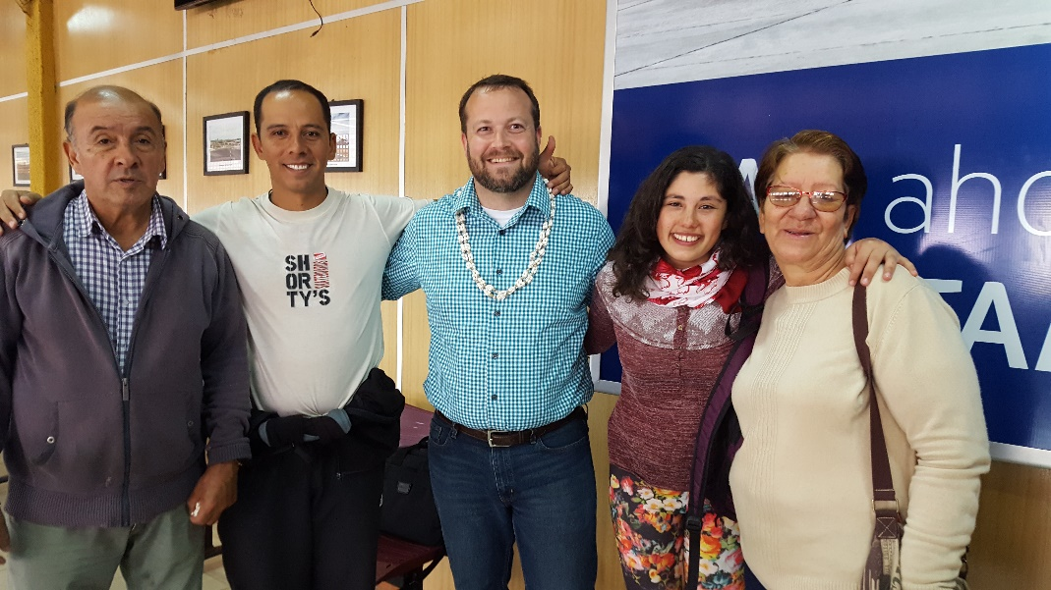
Nnanna
Tamuka
Robert
Wayne
Tavaro
Mauricio
Robert C.
AP
Sr. High
H2H
AMC
Easter
Answering Macedonian Calls
Easter Island
Sr. High & Adult Mission Trip
House to House/Heart to Heart
$133,650
Apologetics Press
Robert C. Lupo (Sneedville, TN)
Tavaro Hanna (Bahamas)
Mauricio Yegros (Coral Springs)
Robert Martin (Pacific)
Wayne Parker (Pacific, Cyprus)
Nnanna Aforji (Nigeria)
Tamuka Arunashe (Zimbabwe)

Slide 12
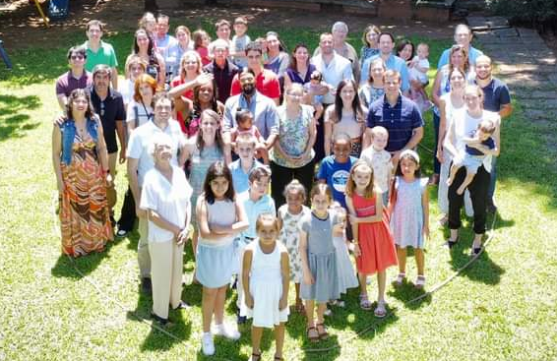
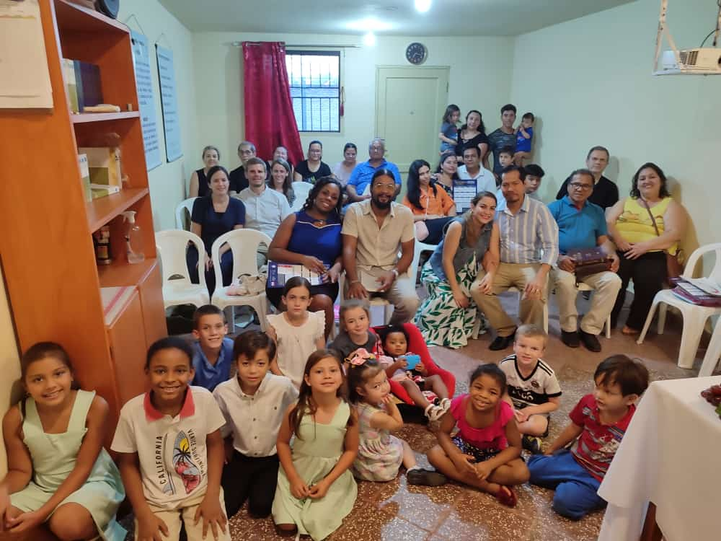
$141,150
Special Requests for
Mission Trips
Answering Macedonian Calls Trip to Paraguay
Answering Macedonian Calls
Easter Island
Sr. High & Adult Mission Trip
House to House/Heart to Heart
$133,650
Apologetics Press
Robert C. Lupo (Sneedville, TN)
Tavaro Hanna (Bahamas)
Mauricio Yegros (Coral Springs)
Robert Martin (Pacific)
Wayne Parker (Pacific, Cyprus)
Nnanna Aforji (Nigeria)
Tamuka Arunashe (Zimbabwe)

Slide 13
$151,150
House to House to Family & Friends
$141,150
Special Requests for
Mission Trips
Answering Macedonian Calls Trip to Paraguay
Answering Macedonian Calls
Easter Island
Sr. High & Adult Mission Trip
House to House/Heart to Heart
$133,650
Apologetics Press
Robert C. Lupo (Sneedville, TN)
Tavaro Hanna (Bahamas)
Mauricio Yegros (Coral Springs)
Robert Martin (Pacific)
Wayne Parker (Pacific, Cyprus)
Nnanna Aforji (Nigeria)
Tamuka Arunashe (Zimbabwe)

Slide 14
Mail House to House/Heart to Heart
to Your Friends & Family
Every member turn in names and addresses of 10 friends, family, neighbors, coworkers, etc. in this area
They will receive House to House every month
Add our visitors to the list

Slide 15
$151,150
House to House to Family & Friends
Assist Spanish Congregation
$141,150
Special Requests for
Mission Trips
Answering Macedonian Calls Trip to Paraguay
Answering Macedonian Calls
Easter Island
Sr. High & Adult Mission Trip
House to House/Heart to Heart
$133,650
Apologetics Press
Robert C. Lupo (Sneedville, TN)
Tavaro Hanna (Bahamas)
Mauricio Yegros (Coral Springs)
Robert Martin (Pacific)
Wayne Parker (Pacific, Cyprus)
Nnanna Aforji (Nigeria)
Tamuka Arunashe (Zimbabwe)

Slide 16
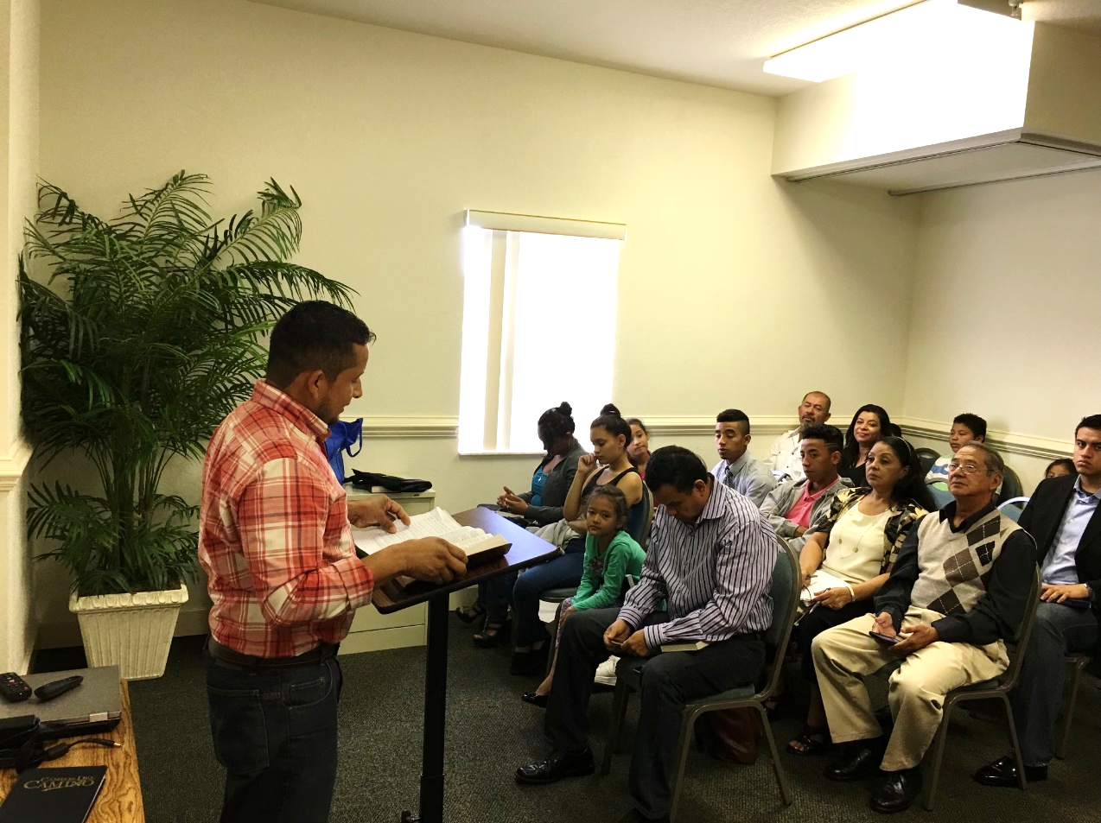
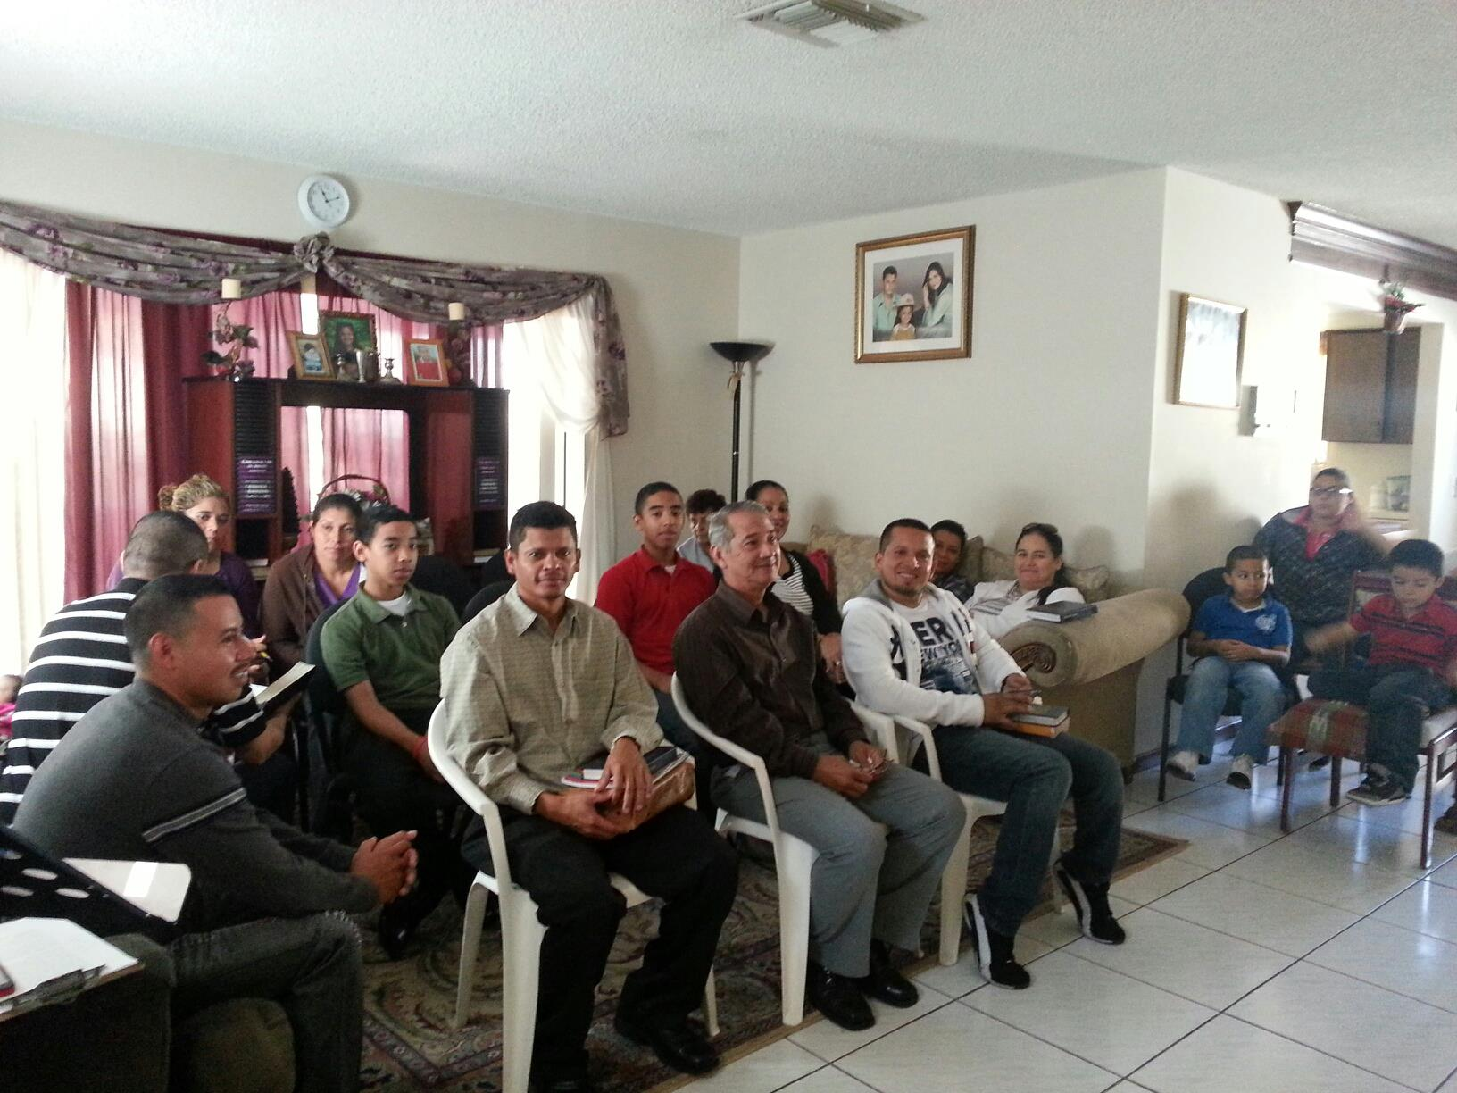
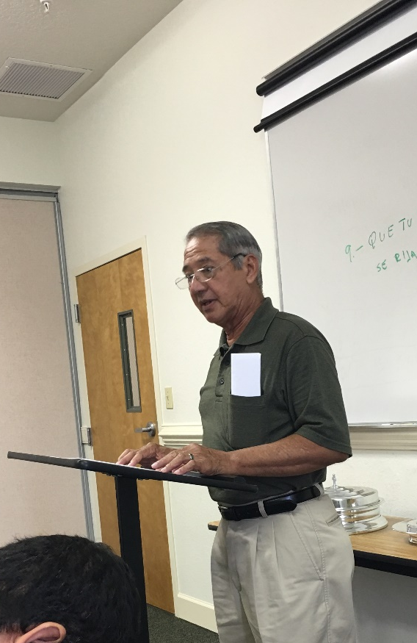
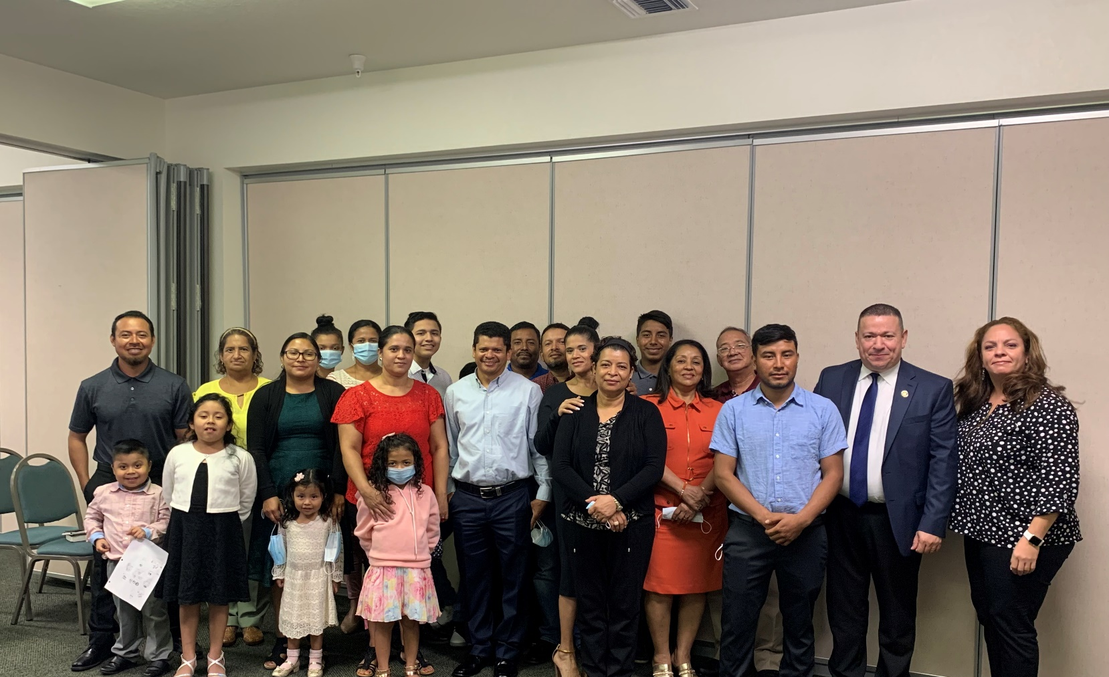
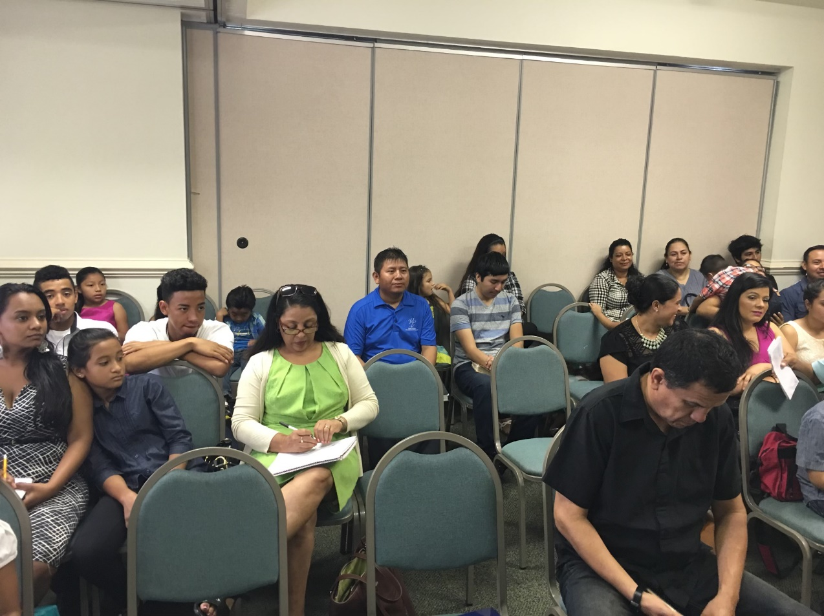

Slide 17
$160,150
PIBC Teacher’s Travel to Pacific
$151,150
House to House to Family & Friends
Assist Spanish Congregation
$141,150
Special Requests for
Mission Trips
Answering Macedonian Calls Trip to Paraguay
Answering Macedonian Calls
Easter Island
Sr. High & Adult Mission Trip
House to House/Heart to Heart
$133,650
Apologetics Press
Robert C. Lupo (Sneedville, TN)
Tavaro Hanna (Bahamas)
Mauricio Yegros (Coral Springs)
Robert Martin (Pacific)
Wayne Parker (Pacific, Cyprus)
Nnanna Aforji (Nigeria)
Tamuka Arunashe (Zimbabwe)

Slide 18

Training Christians for 25 years
Taking the school directly to the students
Our part: Assisting with travel expenses of teachers

Slide 19
$160,150
PIBC Teacher’s Travel to Pacific
Answering
Calls Trip to Cuba
$151,150
House to House to Family & Friends
Assist Spanish Congregation
$141,150
Special Requests for
Mission Trips
Answering Macedonian Calls Trip to Paraguay
Answering Macedonian Calls
Easter Island
Sr. High & Adult Mission Trip
House to House/Heart to Heart
$133,650
Apologetics Press
Robert C. Lupo (Sneedville, TN)
Tavaro Hanna (Bahamas)
Mauricio Yegros (Coral Springs)
Robert Martin (Pacific)
Wayne Parker (Pacific, Cyprus)
Nnanna Aforji (Nigeria)
Tamuka Arunashe (Zimbabwe)

Slide 20




Slide 21
$165,150
“Search” TV
$160,150
PIBC Teacher’s Travel to Pacific
Answering
Calls Trip to Cuba
$151,150
House to House to Family & Friends
Assist Spanish Congregation
$141,150
Special Requests for
Mission Trips
Answering Macedonian Calls Trip to Paraguay
Answering Macedonian Calls
Easter Island
Sr. High & Adult Mission Trip
House to House/Heart to Heart
$133,650
Apologetics Press
Robert C. Lupo (Sneedville, TN)
Tavaro Hanna (Bahamas)
Mauricio Yegros (Coral Springs)
Robert Martin (Pacific)
Wayne Parker (Pacific, Cyprus)
Nnanna Aforji (Nigeria)
Tamuka Arunashe (Zimbabwe)

Slide 22



Sunday Mornings
at 7:00 a.m.
Reaching 100 million homes in America every week
Phil Sanders

Slide 23
$165,150
“Search” TV
Truth for Today
$160,150
PIBC Teacher’s Travel to Pacific
Answering
Calls Trip to Cuba
$151,150
House to House to Family & Friends
Assist Spanish Congregation
$141,150
Special Requests for
Mission Trips
Answering Macedonian Calls Trip to Paraguay
Answering Macedonian Calls
Easter Island
Sr. High & Adult Mission Trip
House to House/Heart to Heart
$133,650
Apologetics Press
Robert C. Lupo (Sneedville, TN)
Tavaro Hanna (Bahamas)
Mauricio Yegros (Coral Springs)
Robert Martin (Pacific)
Wayne Parker (Pacific, Cyprus)
Nnanna Aforji (Nigeria)
Tamuka Arunashe (Zimbabwe)

Slide 24











Slide 25
$+++,+++
+
+
+
$165,150
“Search” TV
Truth for Today
$160,150
PIBC Teacher’s Travel to Pacific
Answering
Calls Trip to Cuba
$151,150
House to House to Family & Friends
Assist Spanish Congregation
$141,150
Special Requests for
Mission Trips
Answering Macedonian Calls Trip to Paraguay
Answering Macedonian Calls
Easter Island
Sr. High & Adult Mission Trip
House to House/Heart to Heart
$133,650
Apologetics Press
Robert C. Lupo (Sneedville, TN)
Tavaro Hanna (Bahamas)
Mauricio Yegros (Coral Springs)
Robert Martin (Pacific)
Wayne Parker (Pacific, Cyprus)
Nnanna Aforji (Nigeria)
Tamuka Arunashe (Zimbabwe)

Slide 26
Believe Jesus is the Son of God – John 8:24
Repent of your sins and turn toward God – Luke 13:3
Confess your faith in Jesus Christ – Romans 10:9
Be baptized into Christ – Galatians 3:27
  God will forgive all of your sins – Acts 2:38
  God will add you to His church – Acts 2:47
  God will enroll you in heaven – Hebrews 12:23
Remain faithful unto death – Revelation 2:10

Slide 27
$+++,+++
+
+
+
$165,150
“Search” TV
Truth for Today
$160,150
PIBC Teacher’s Travel to Pacific
Answering
Calls Trip to Cuba
$151,150
House to House to Family & Friends
Assist Spanish Congregation
$141,150
Special Requests for
Mission Trips
Answering Macedonian Calls Trip to Paraguay
Answering Macedonian Calls
Easter Island
Sr. High & Adult Mission Trip
House to House/Heart to Heart
$133,650
Apologetics Press
Robert C. Lupo (Sneedville, TN)
Tavaro Hanna (Bahamas)
Mauricio Yegros (Coral Springs)
Robert Martin (Pacific)
Wayne Parker (Pacific, Cyprus)
Nnanna Aforji (Nigeria)
Tamuka Arunashe (Zimbabwe)

