Slide 2
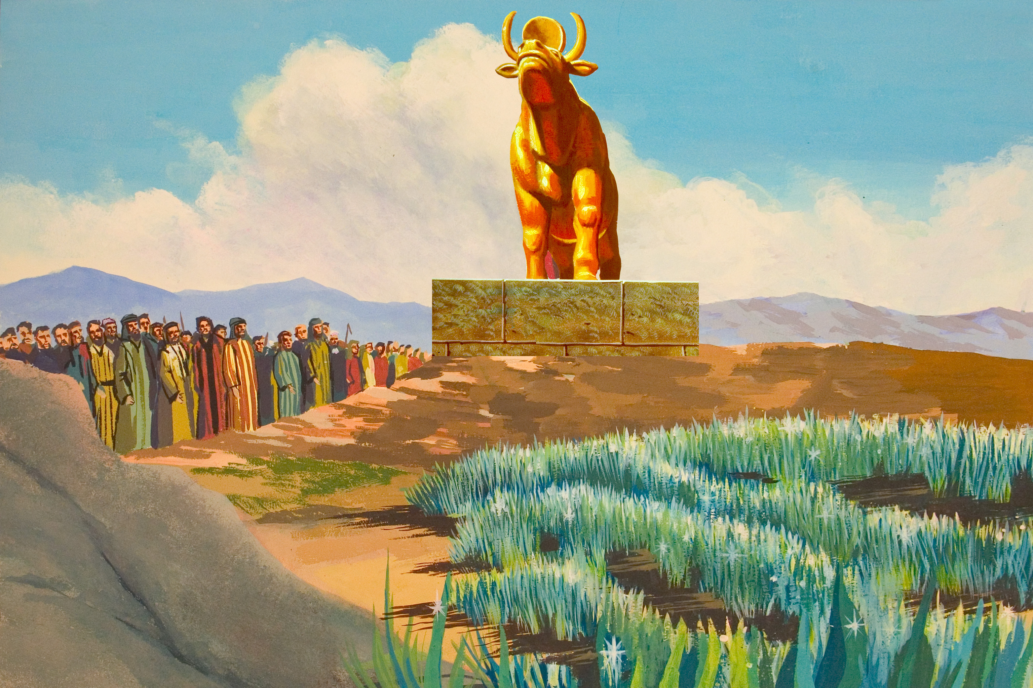

Slide 3
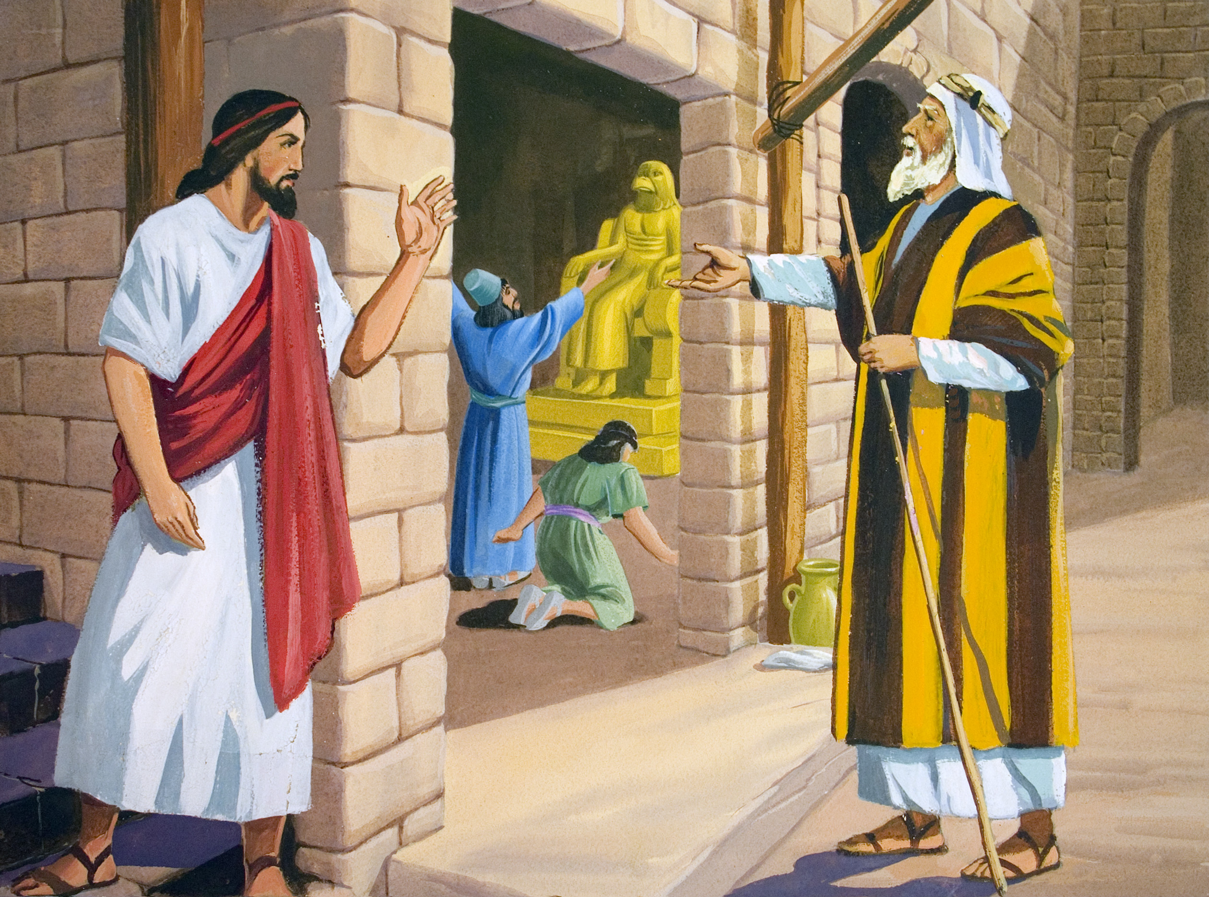

Slide 4
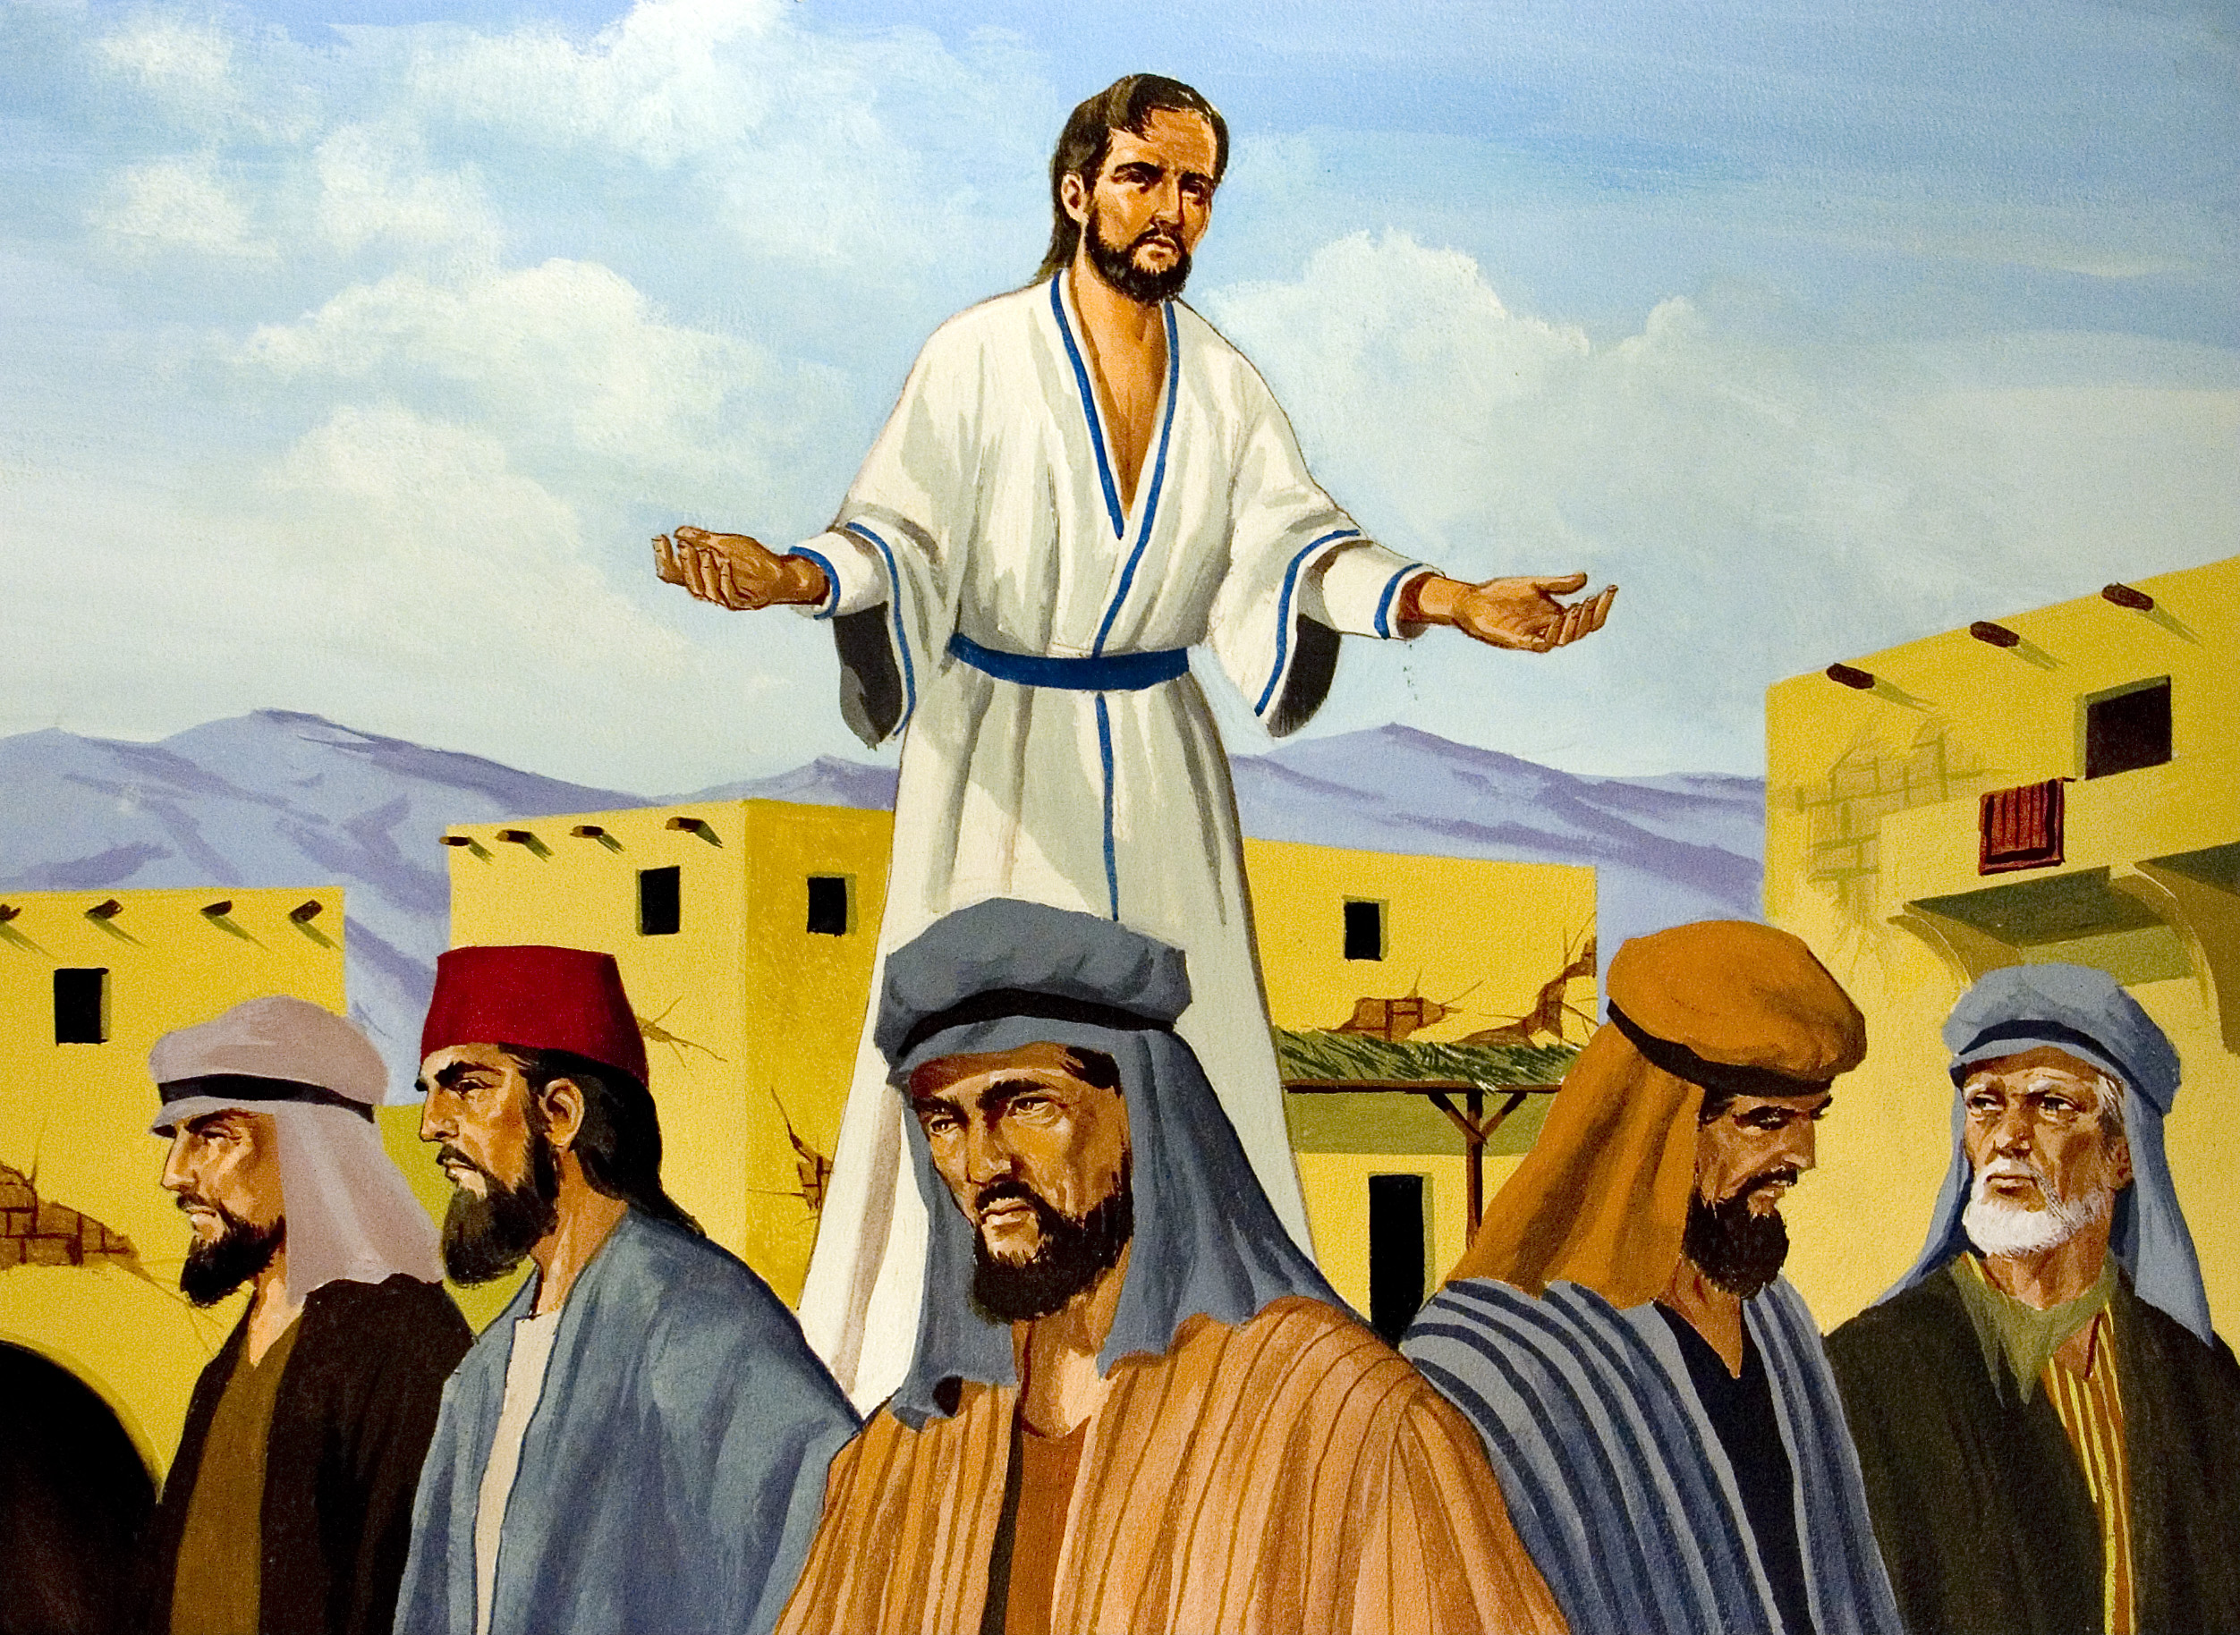

Slide 5
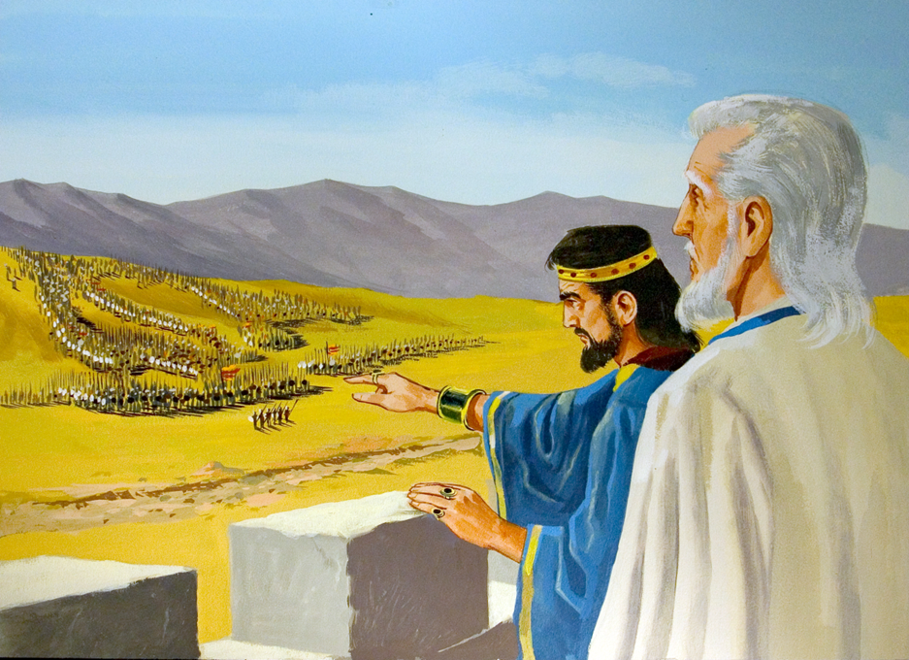

Slide 6
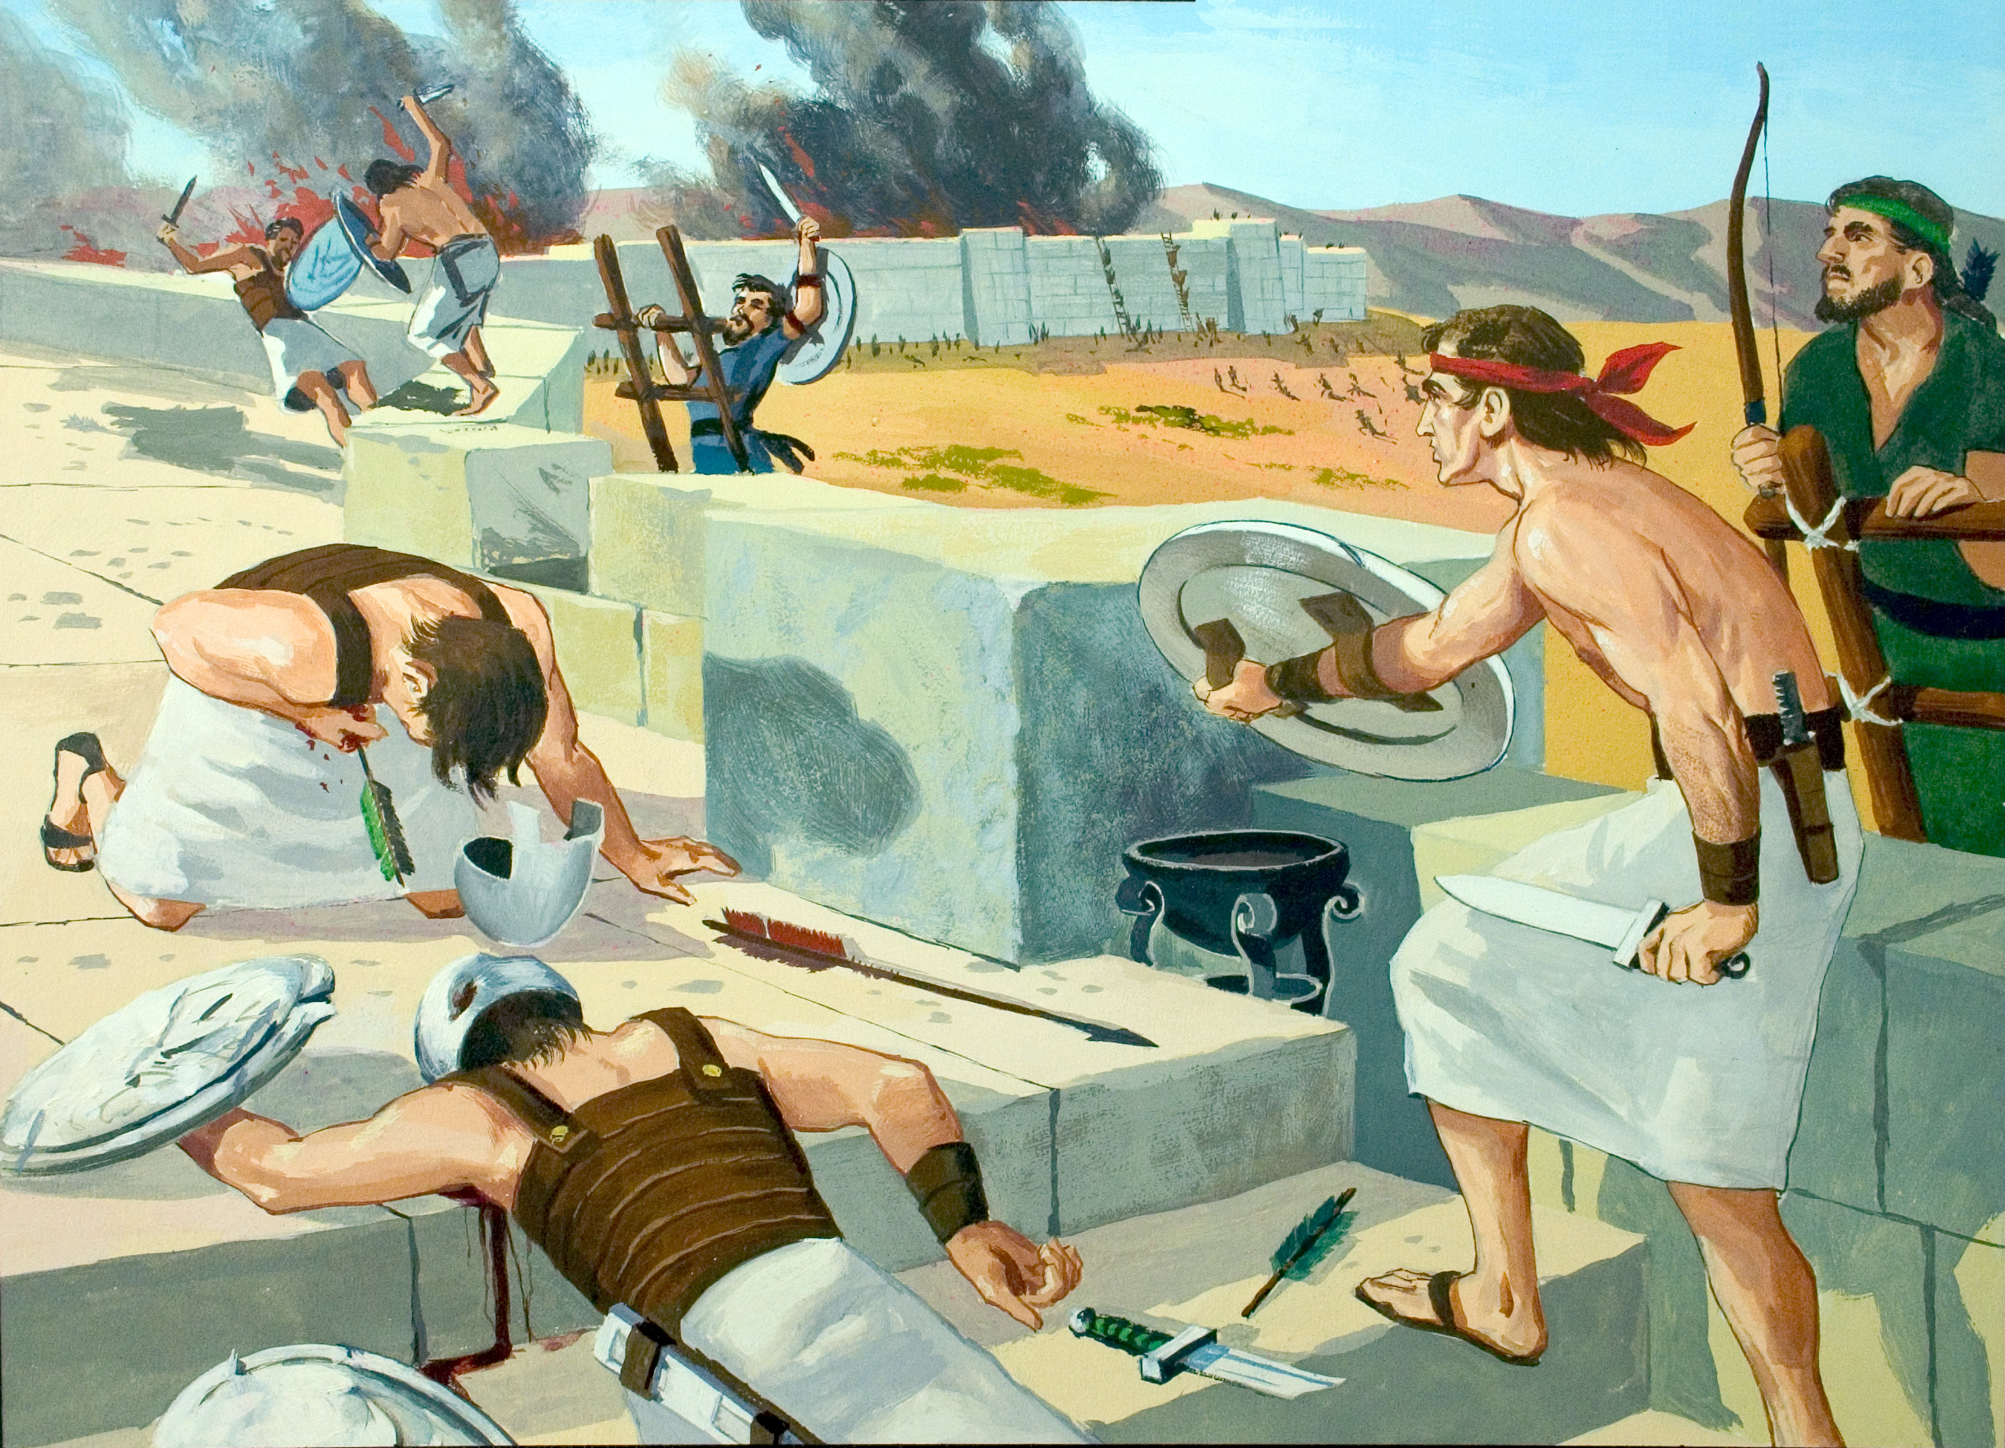

Slide 7
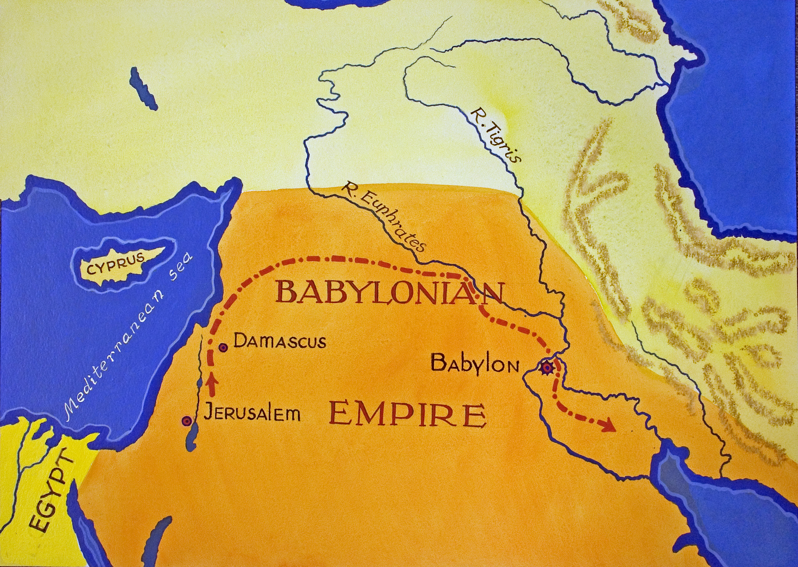
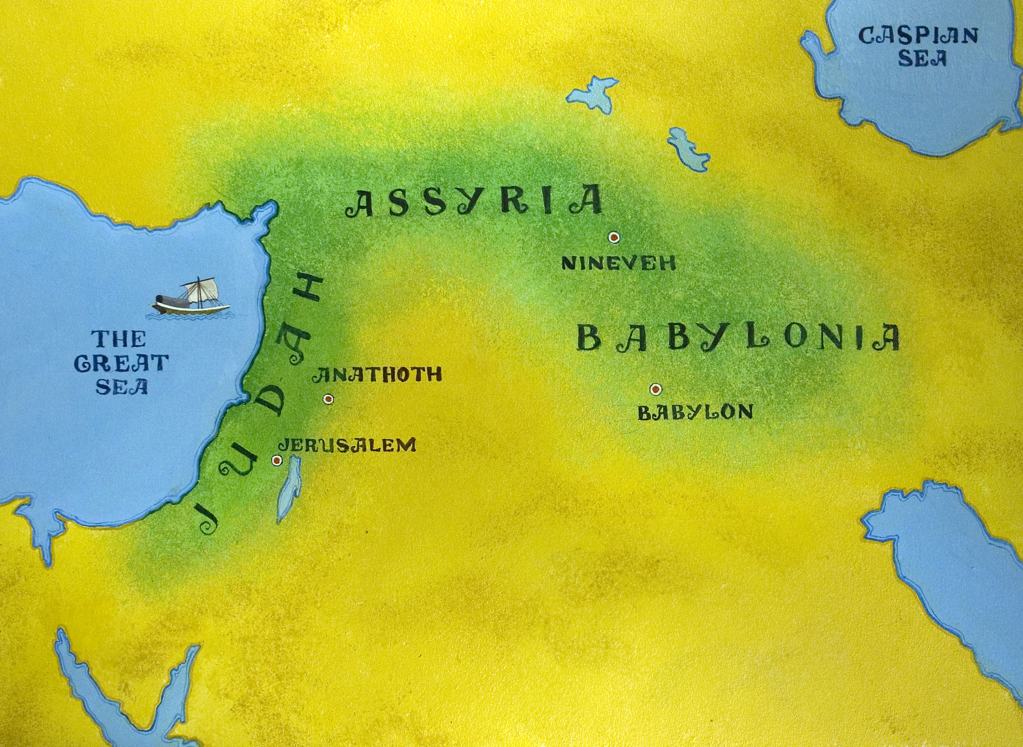

Slide 8
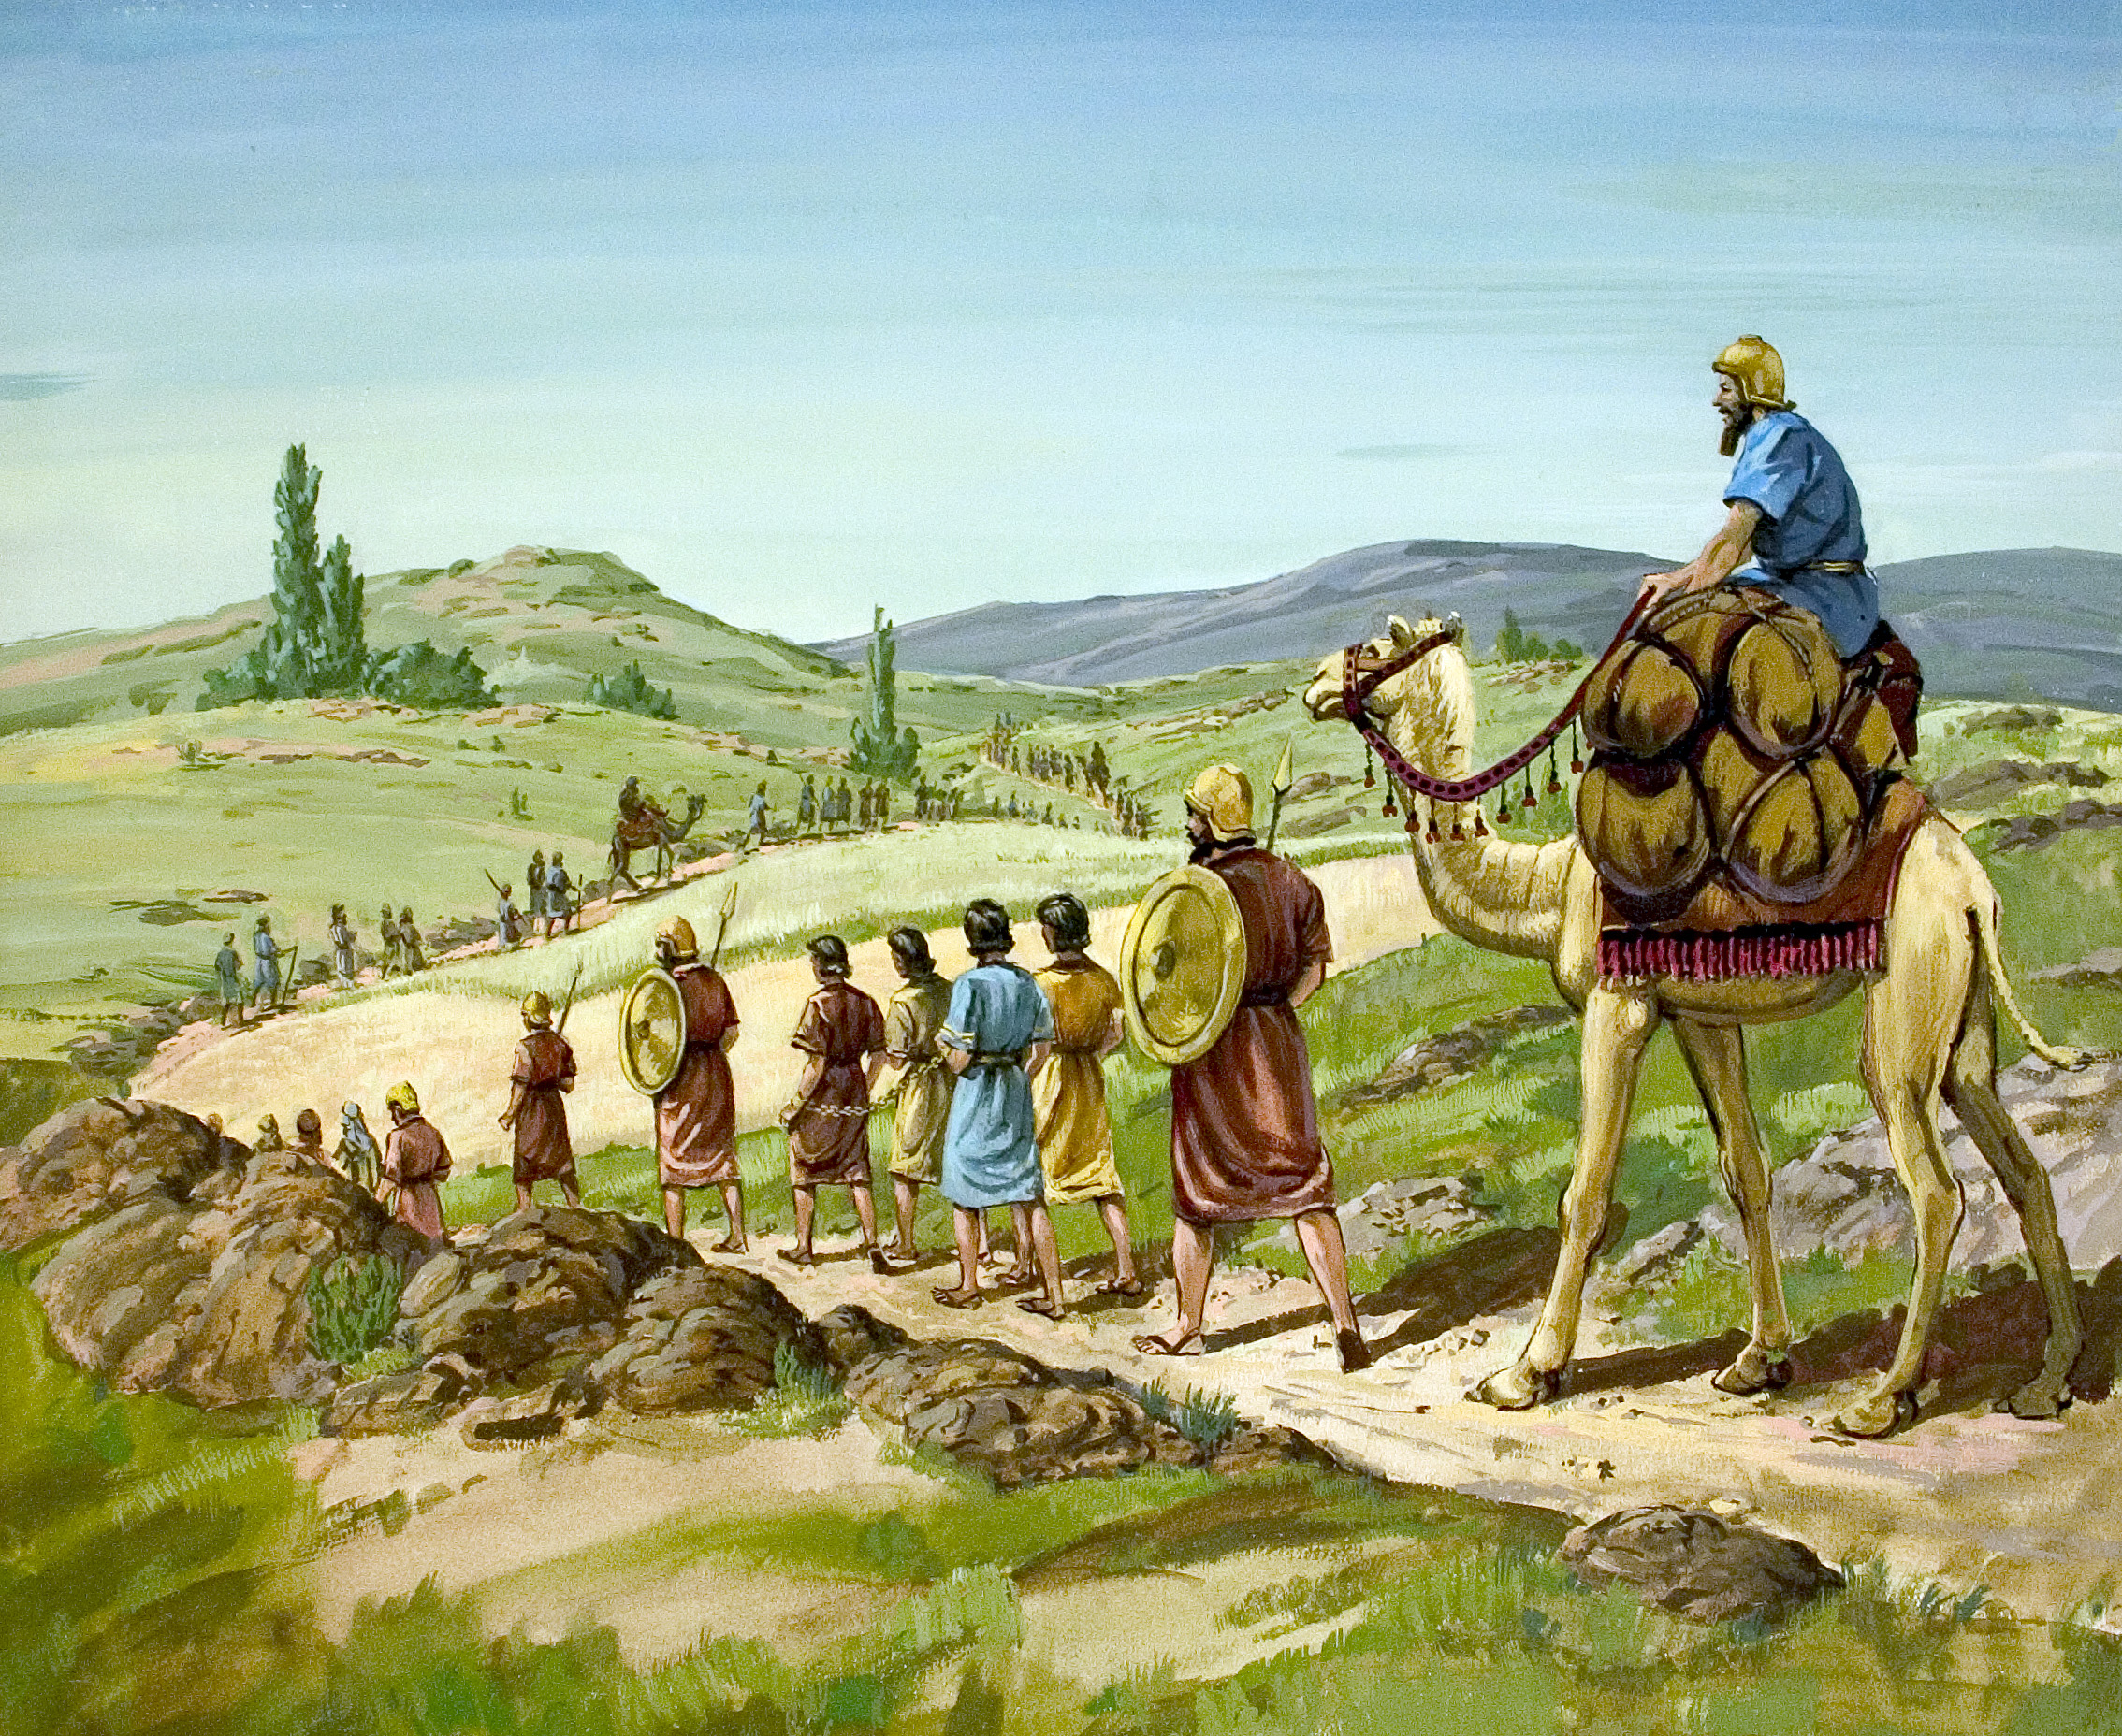

Slide 9
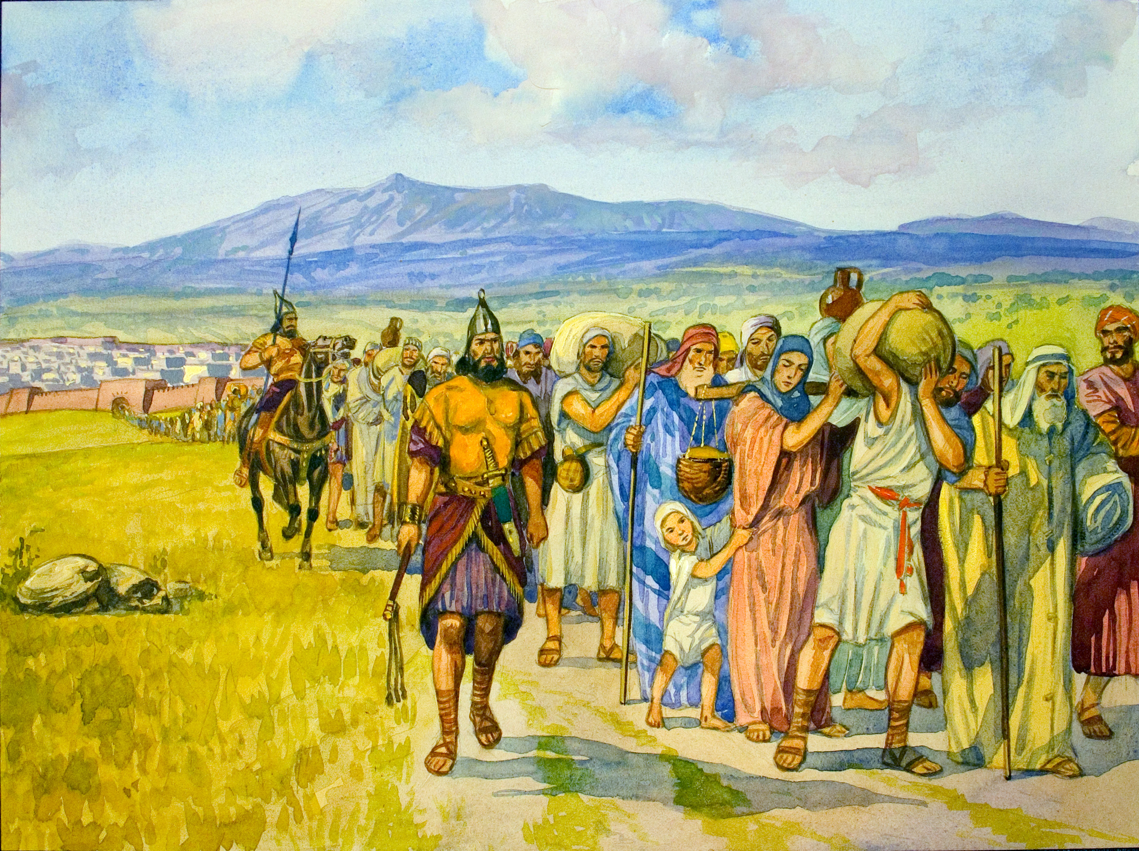

Slide 10
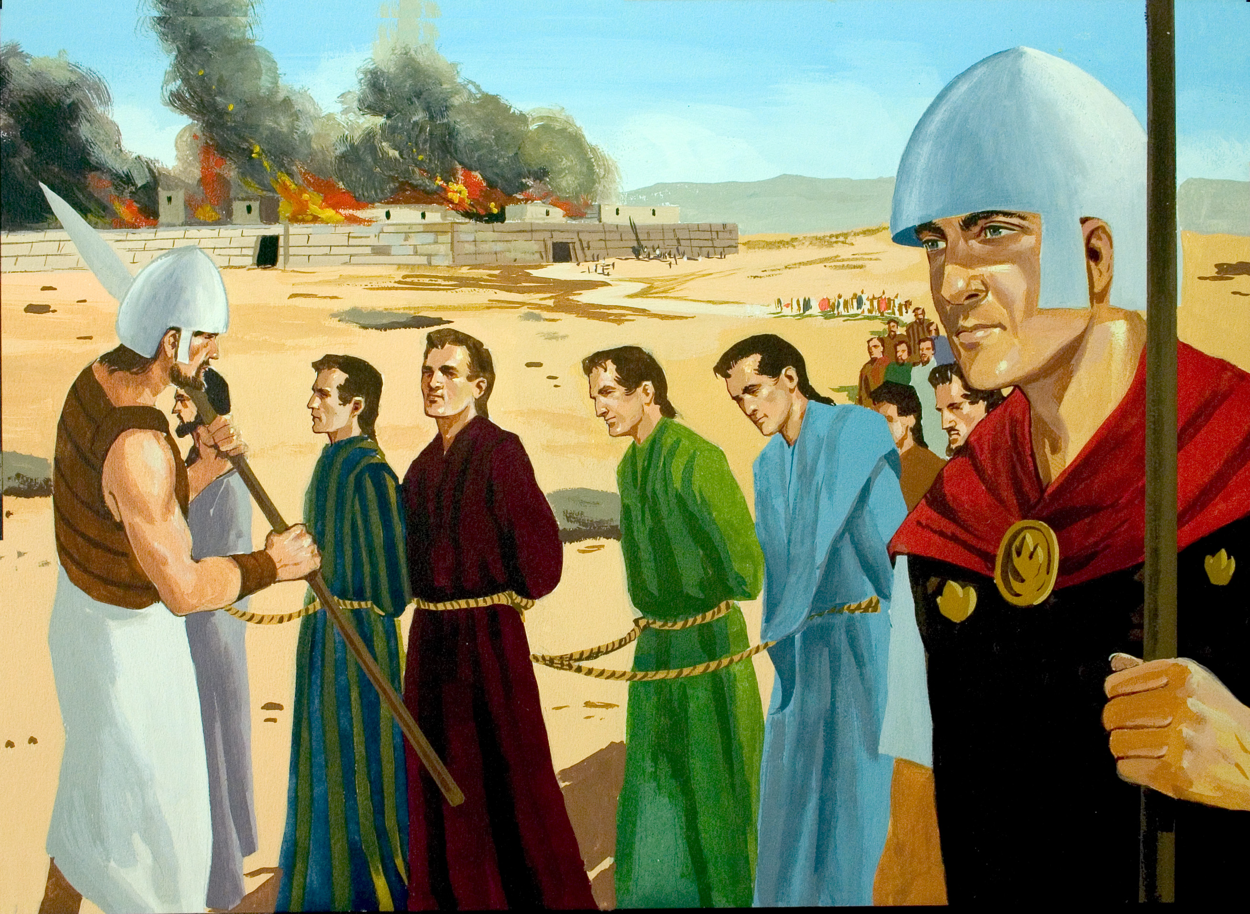

Slide 11
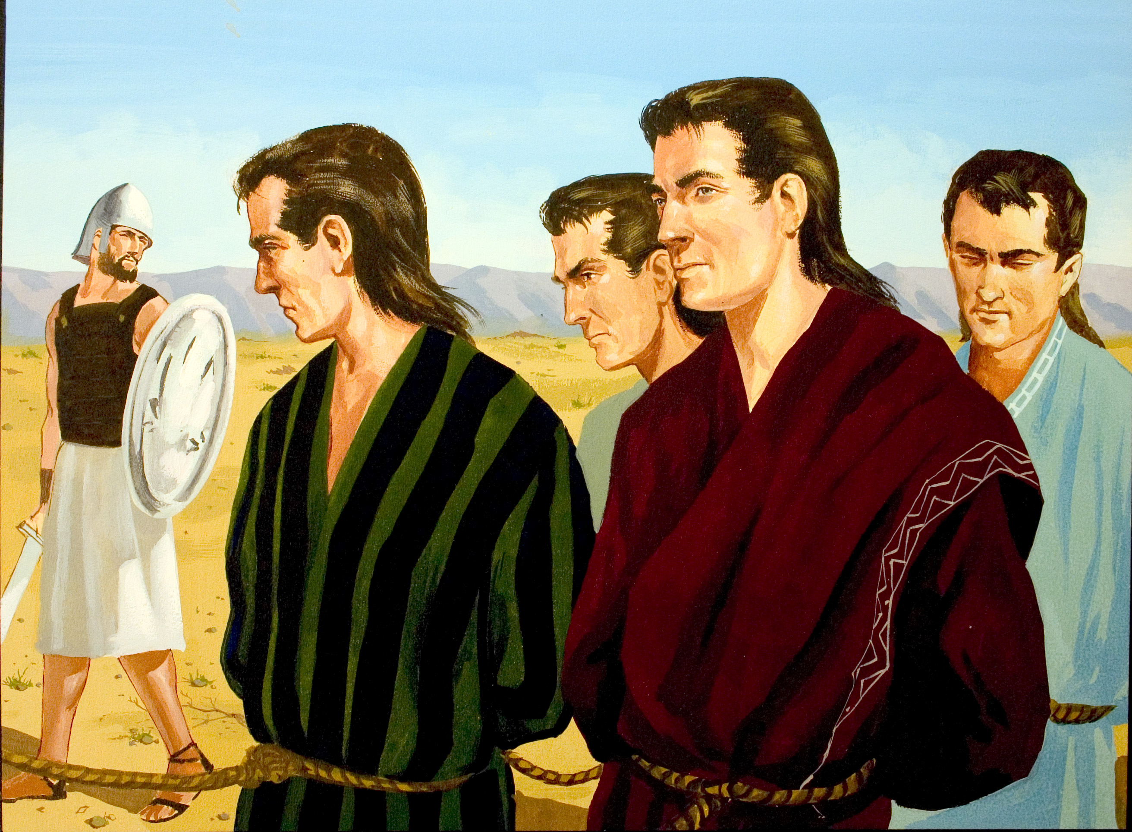

Slide 12
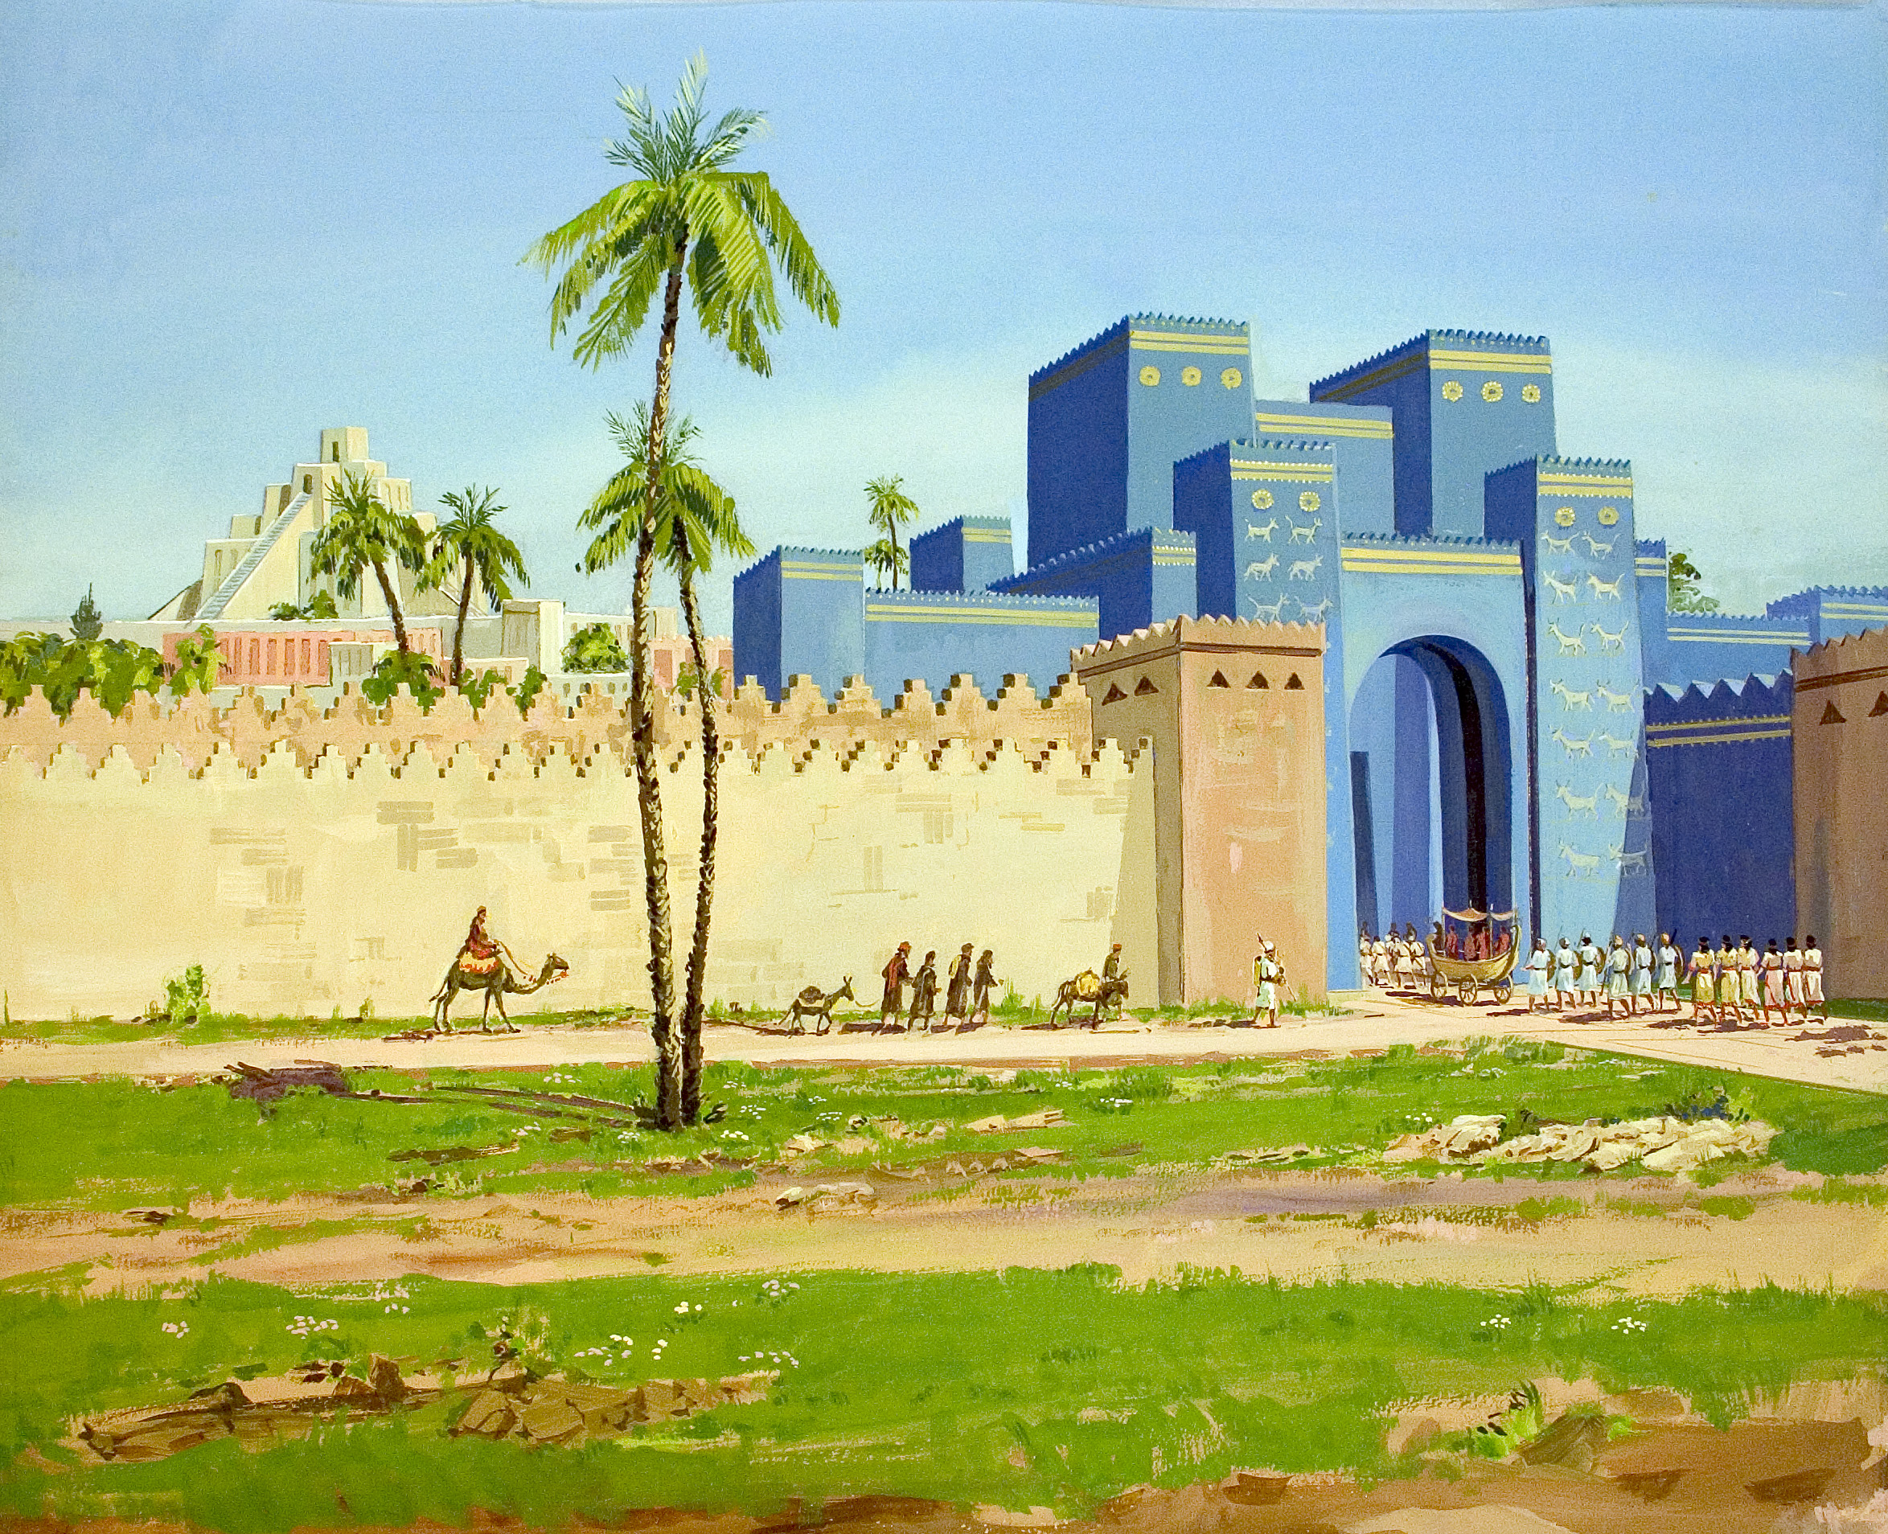

Slide 13
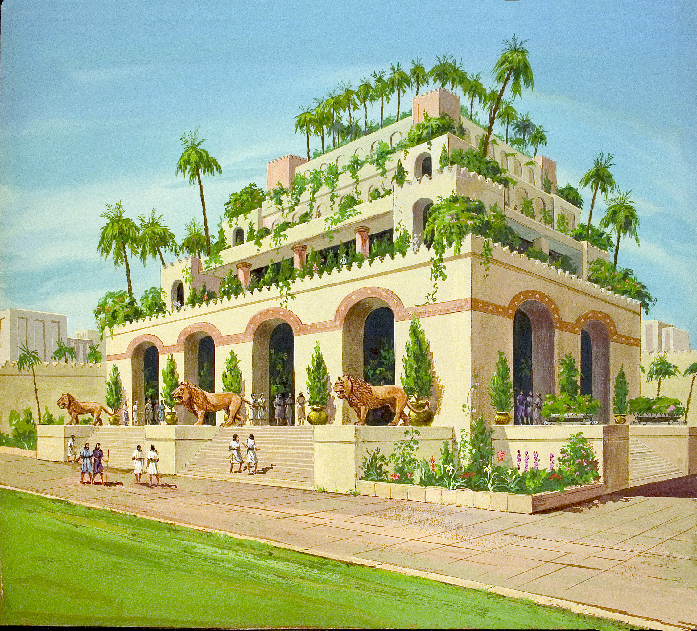

Slide 14
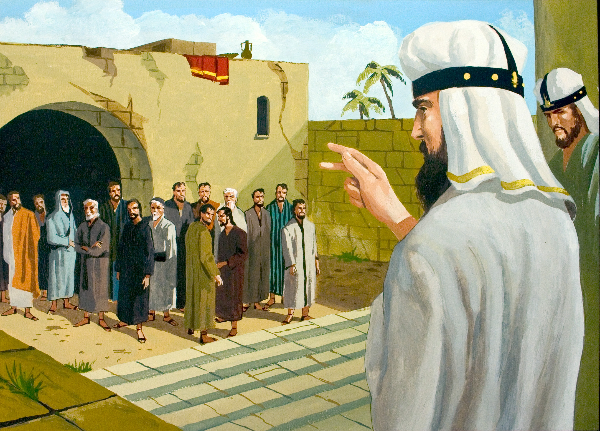

Slide 15
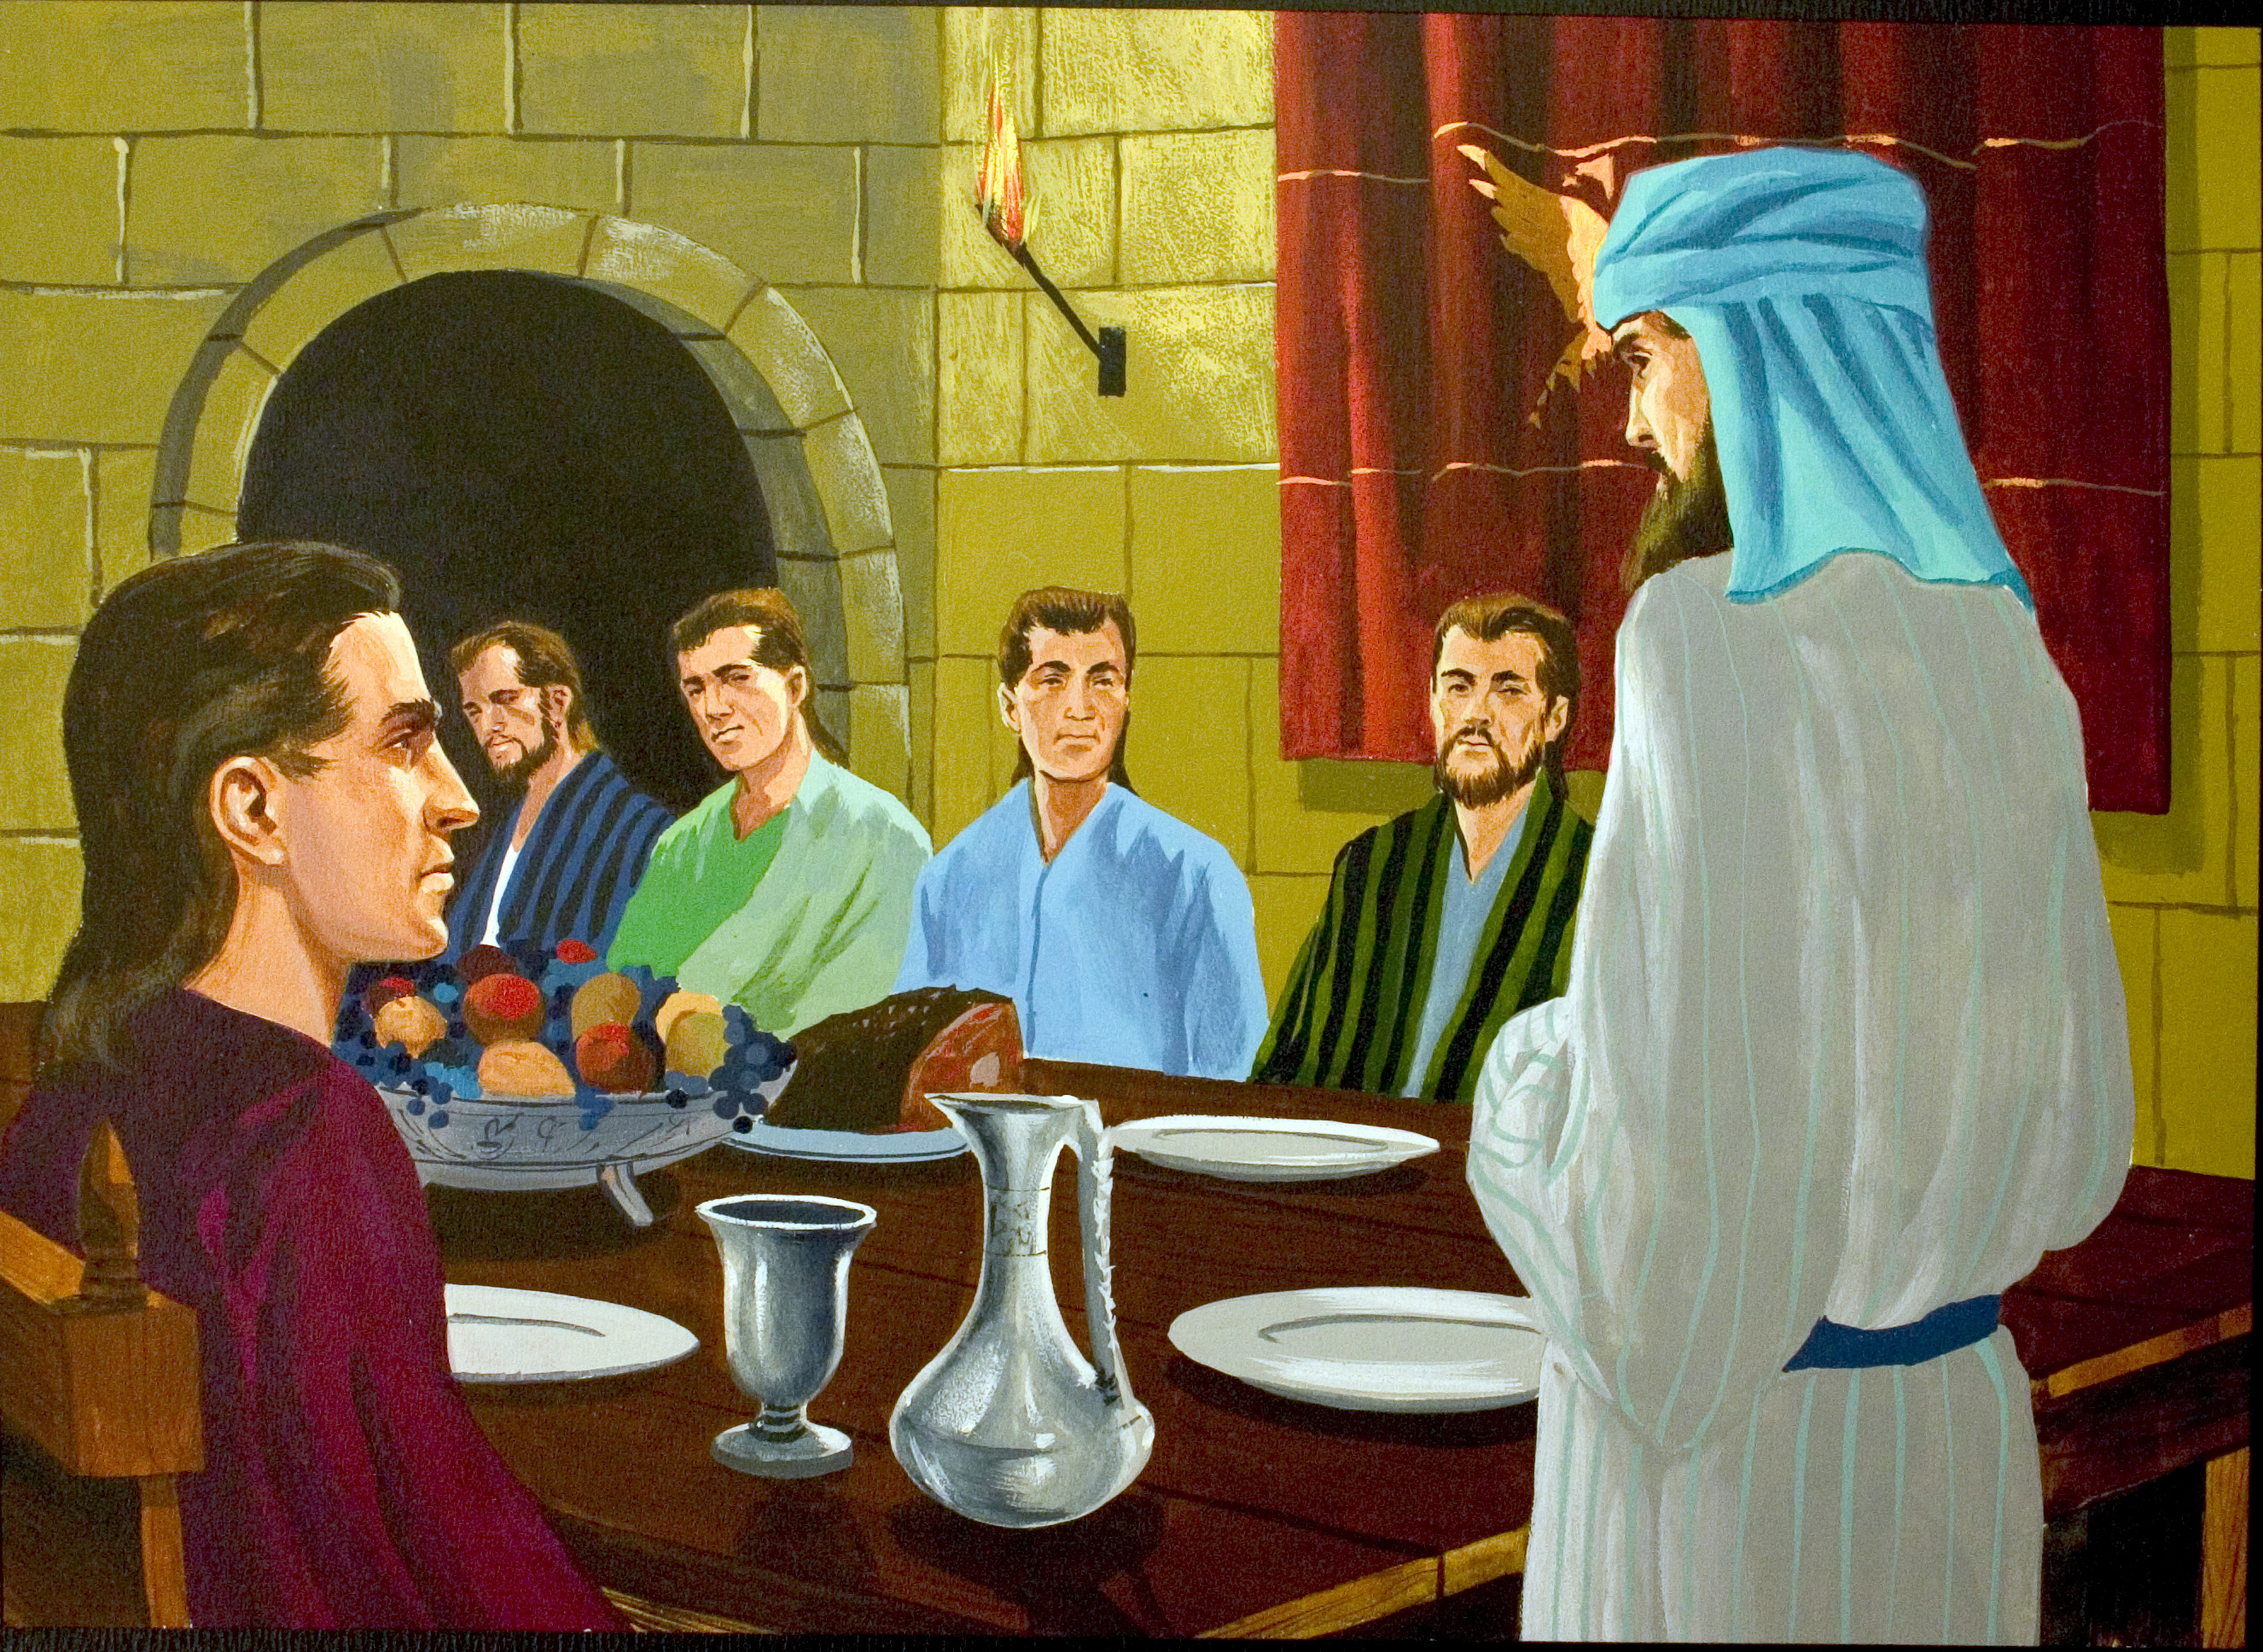

Slide 16
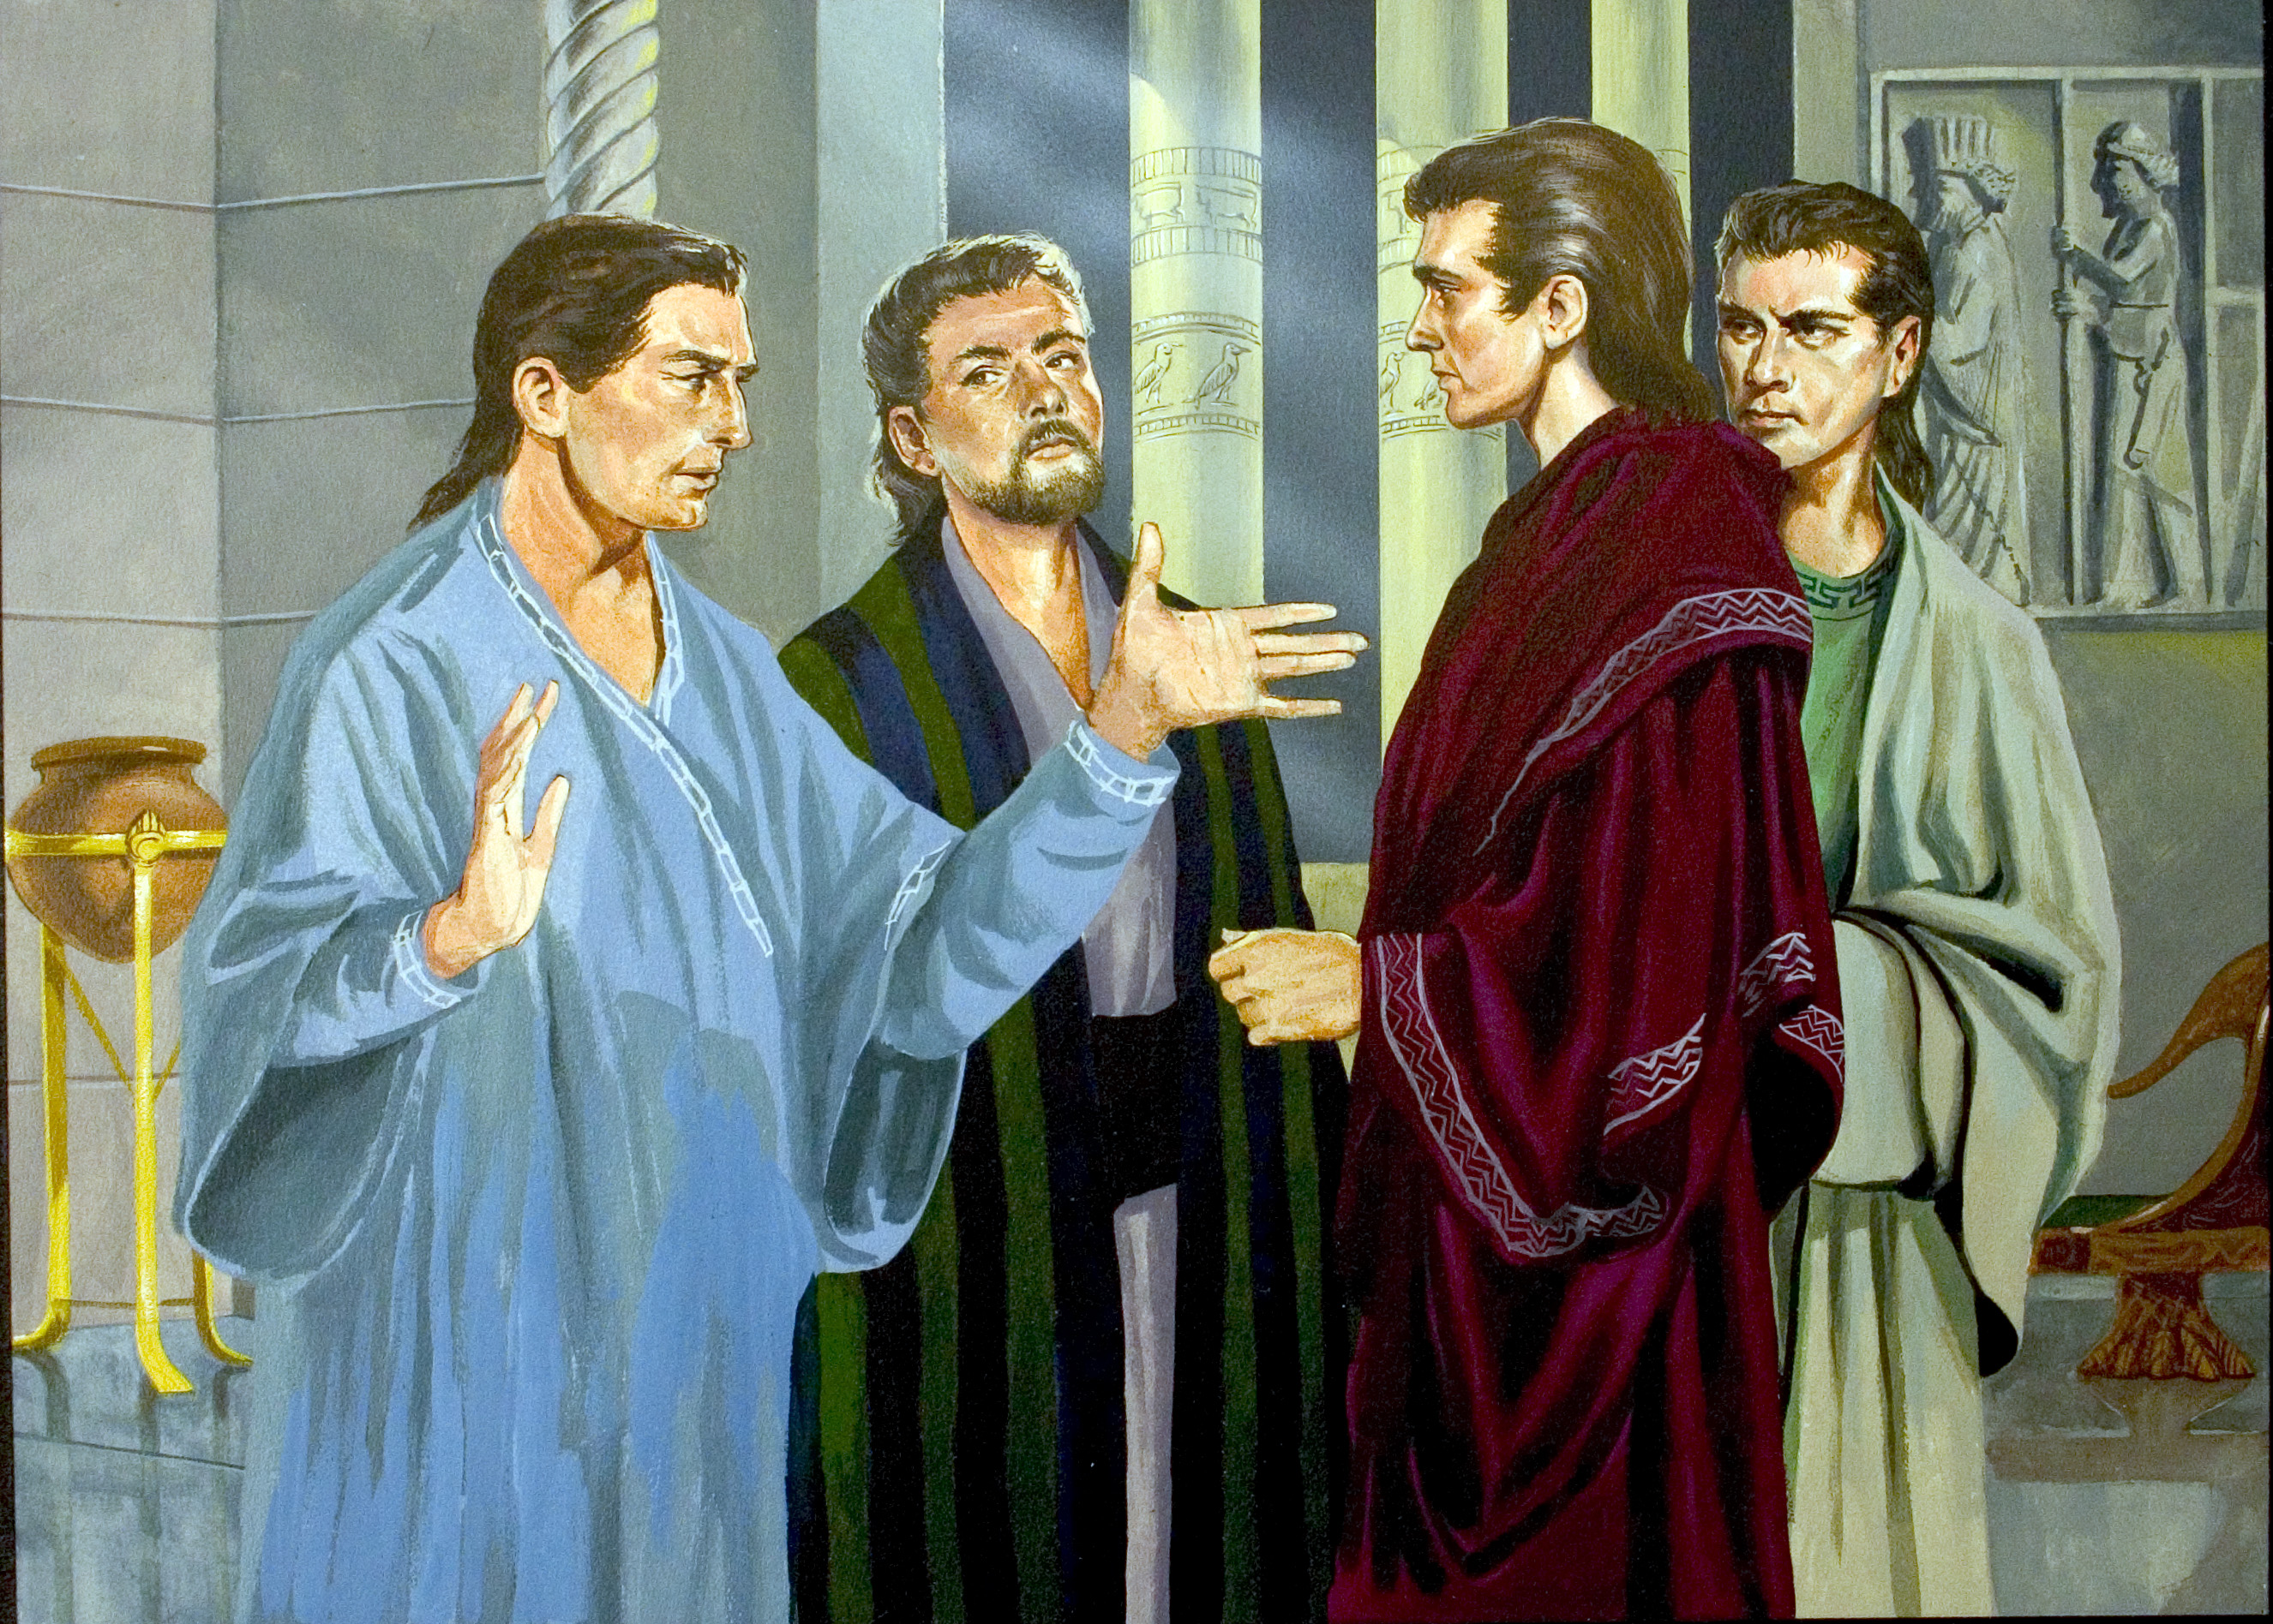

Slide 17
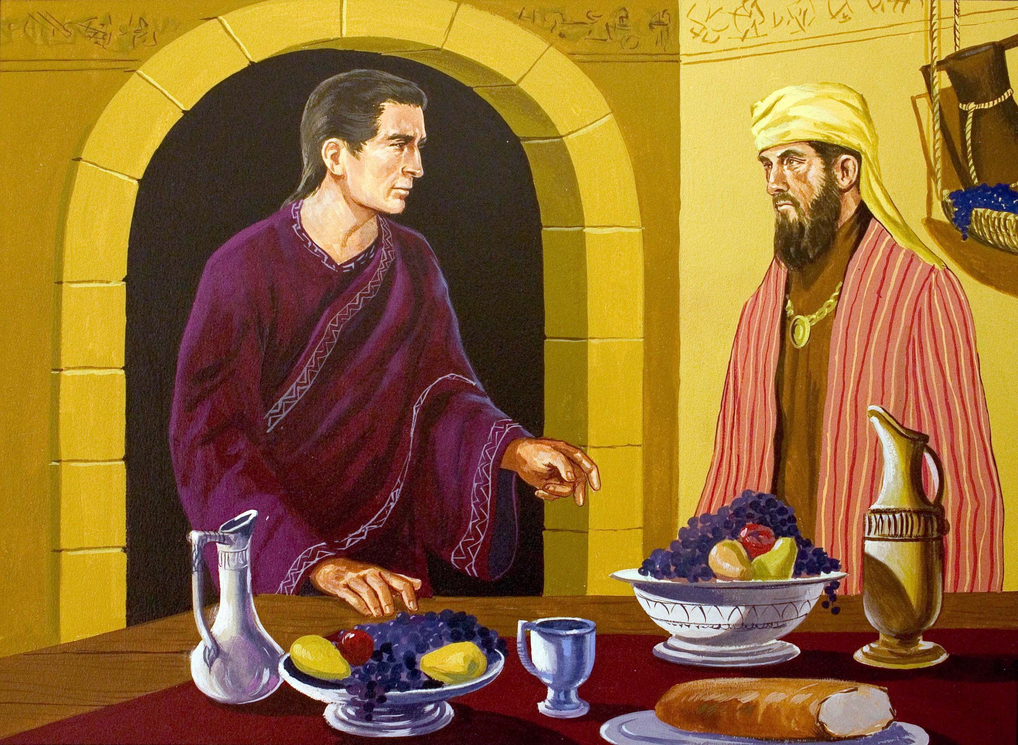

Slide 18
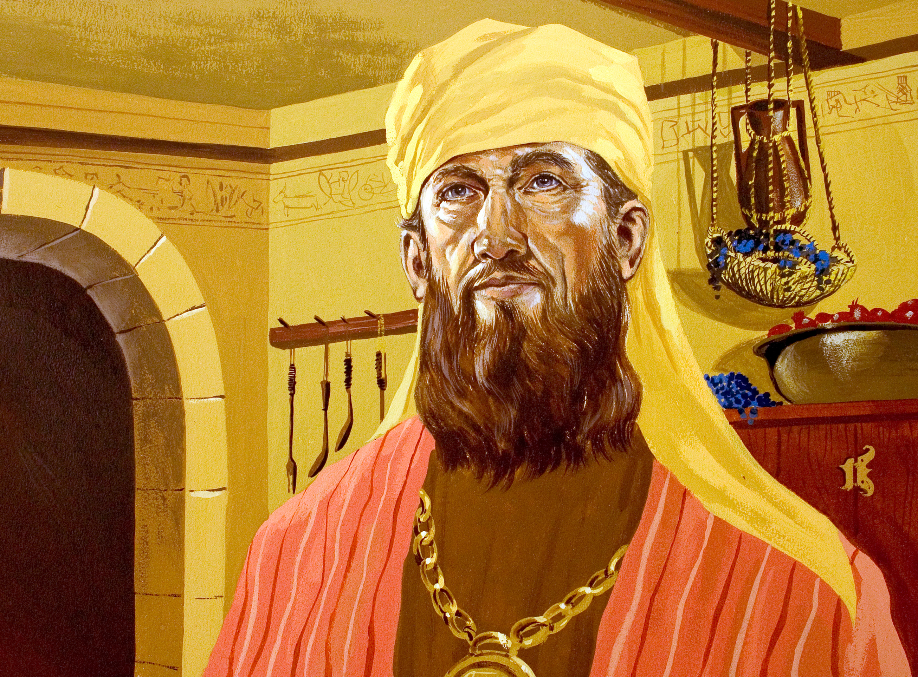

Slide 19
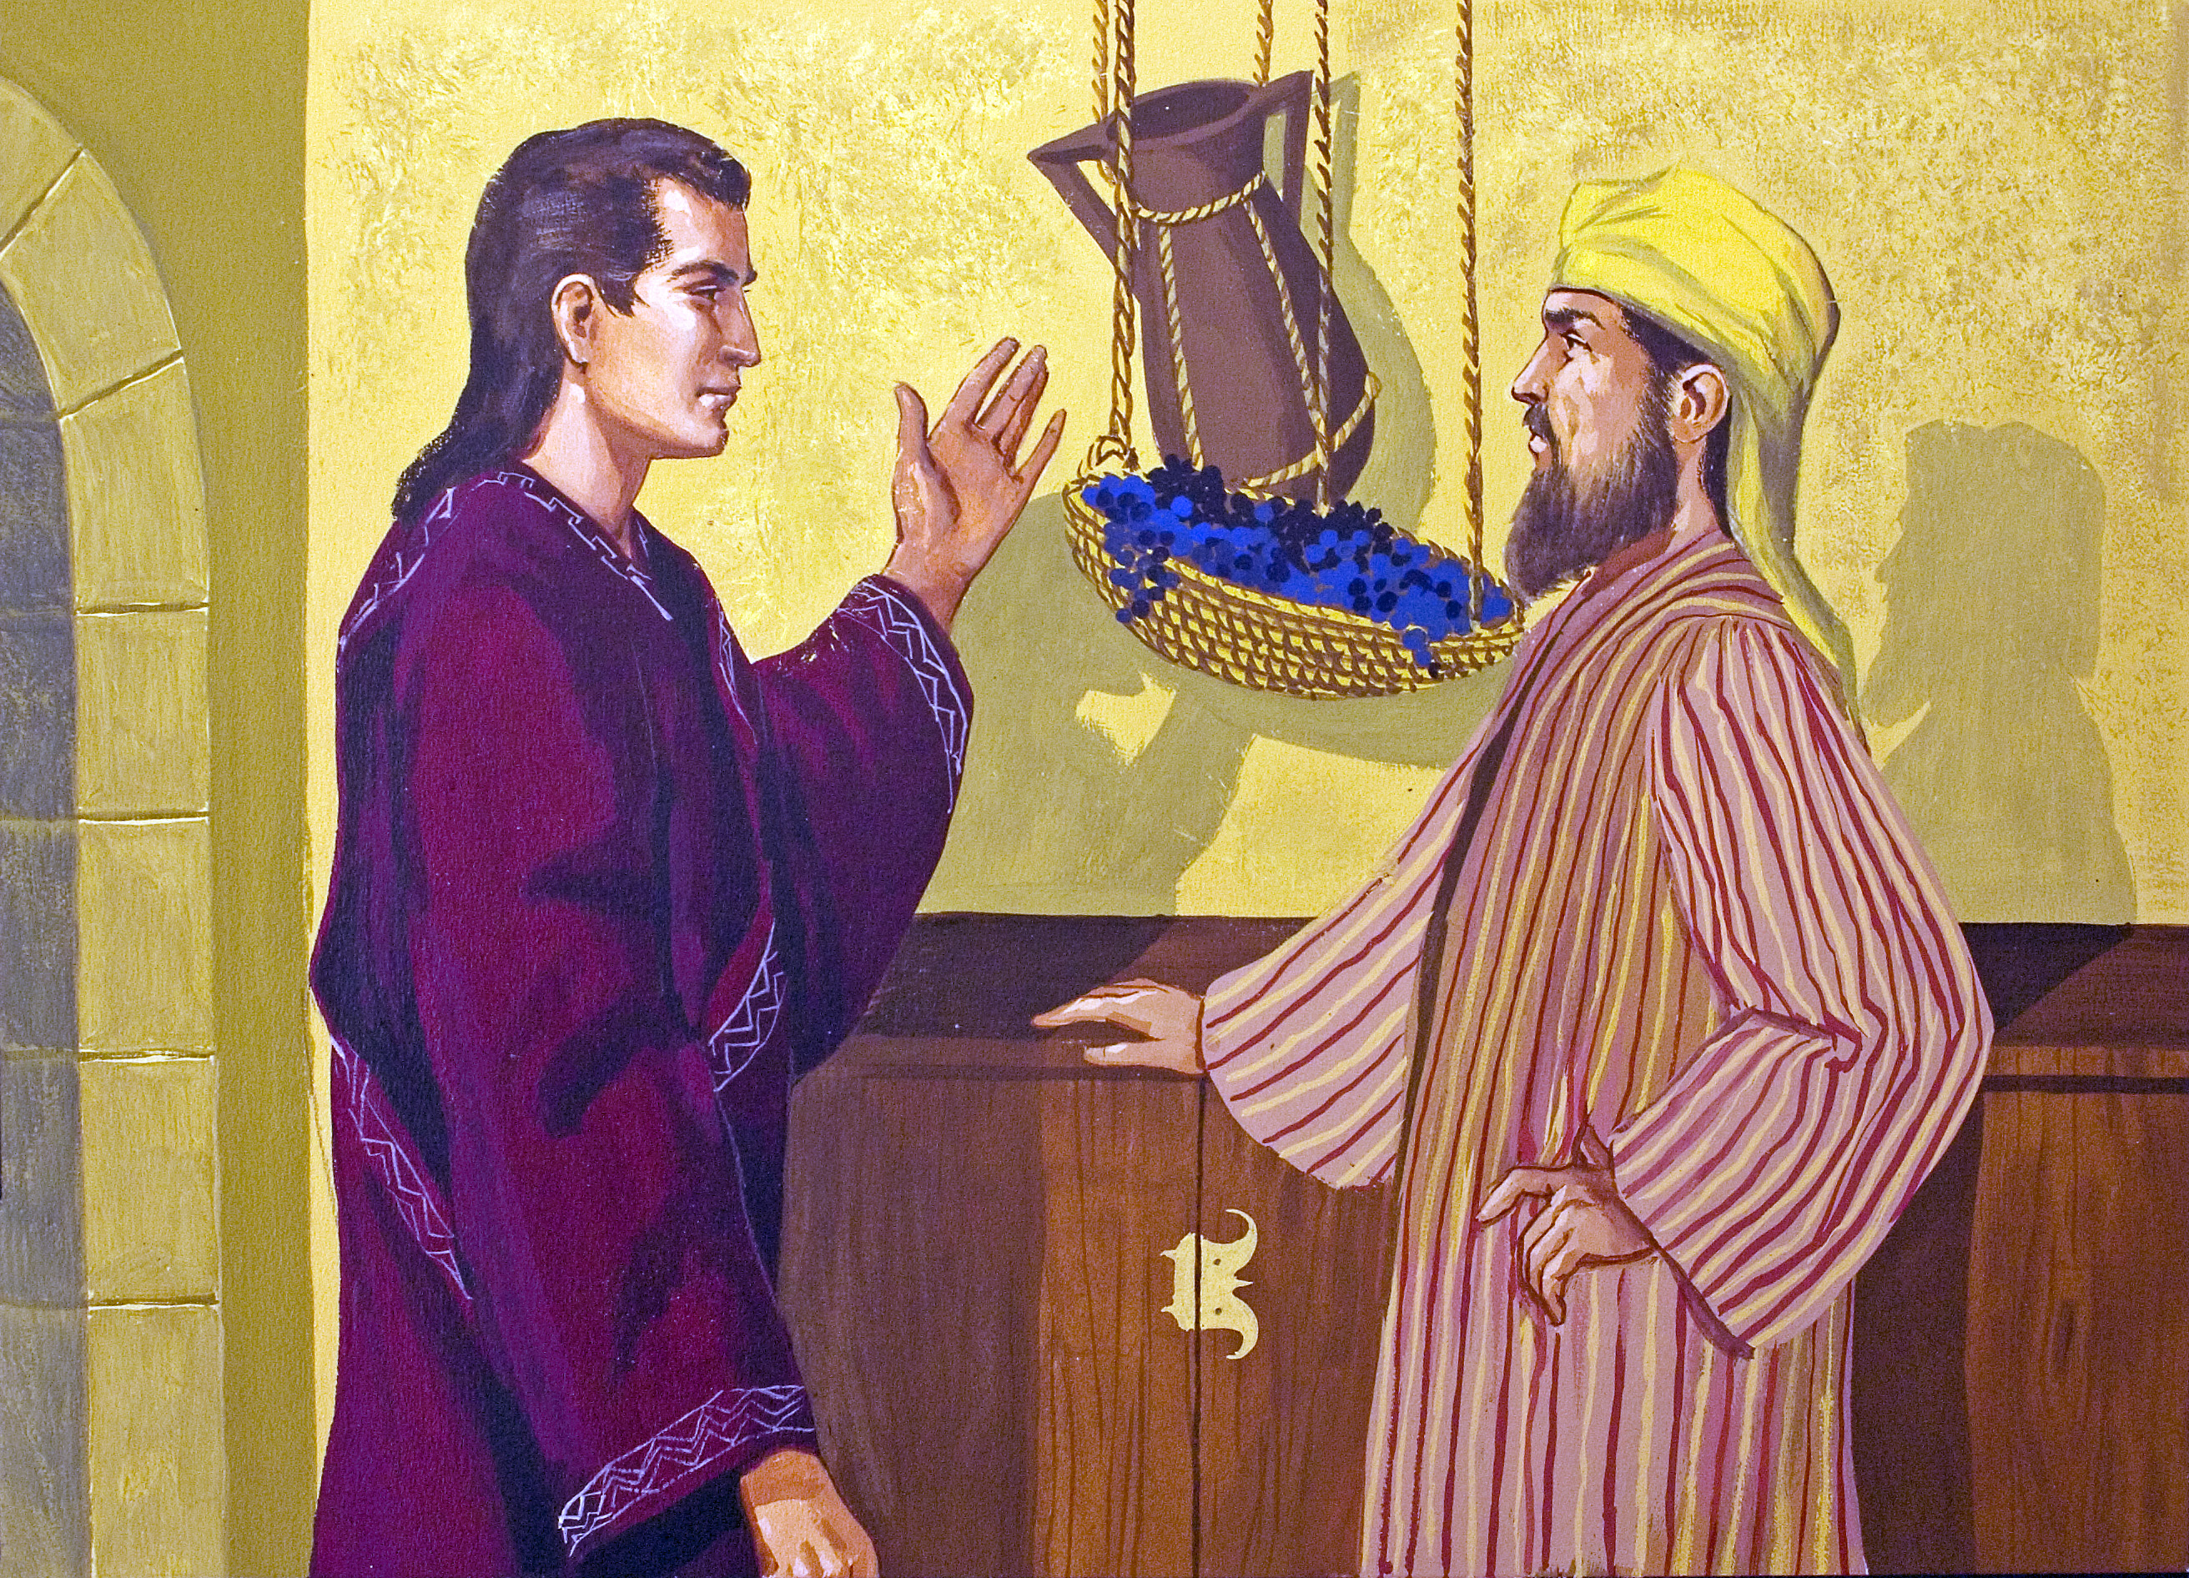

Slide 20
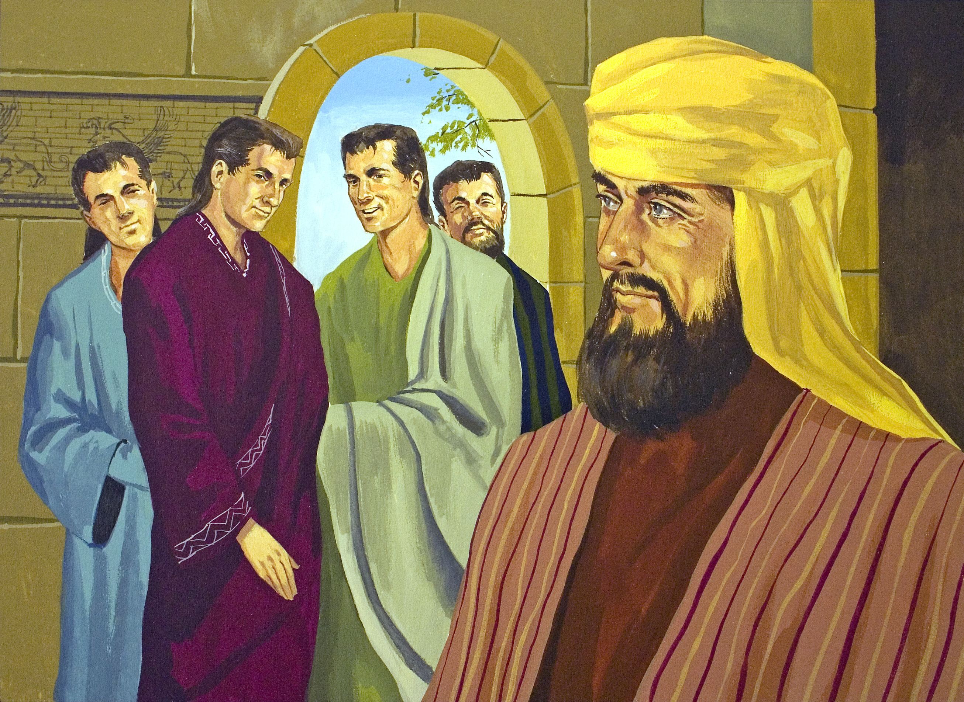

Slide 21
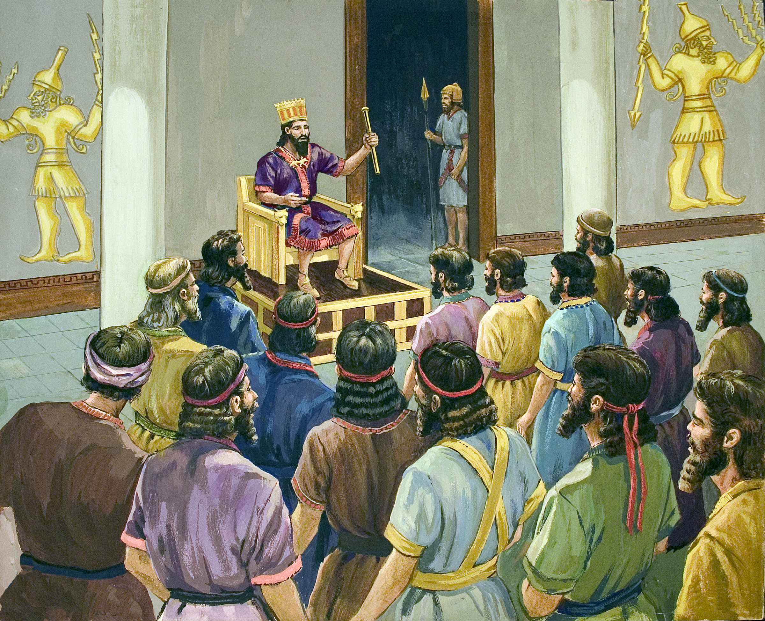

Slide 22
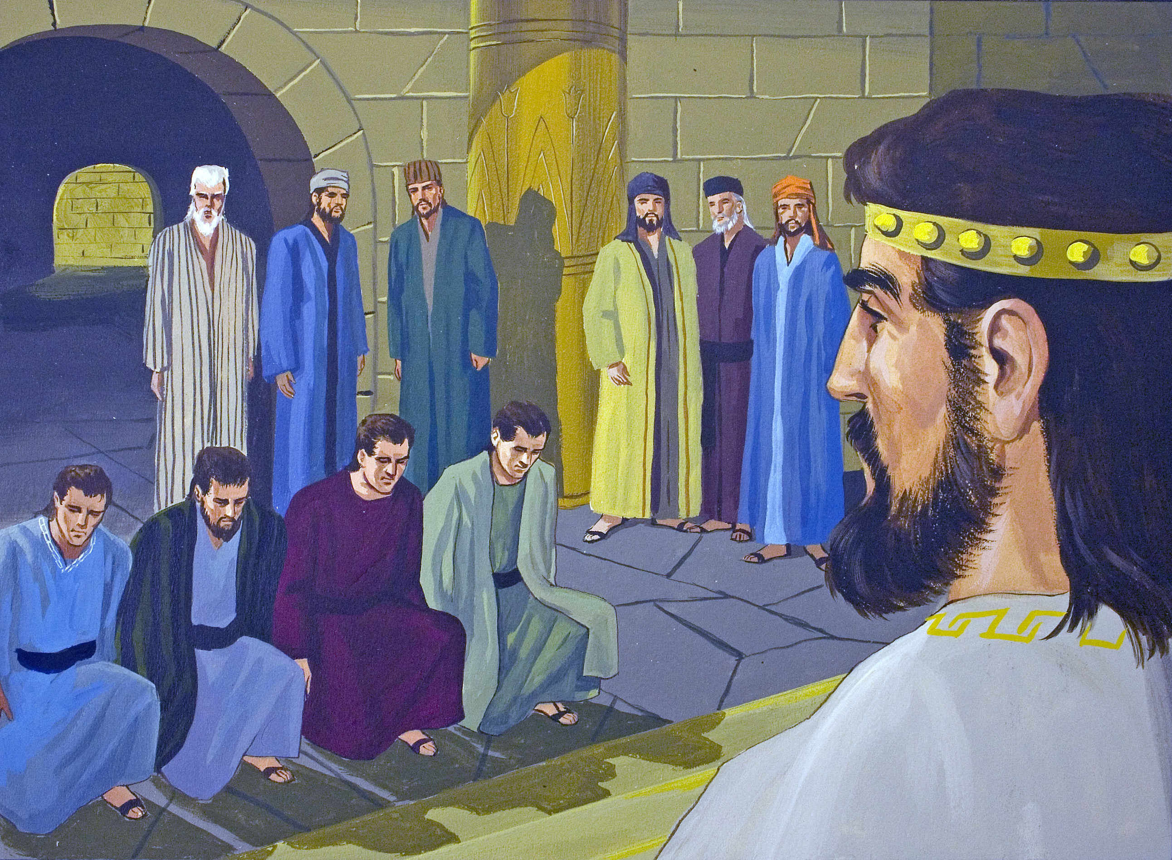

Slide 23
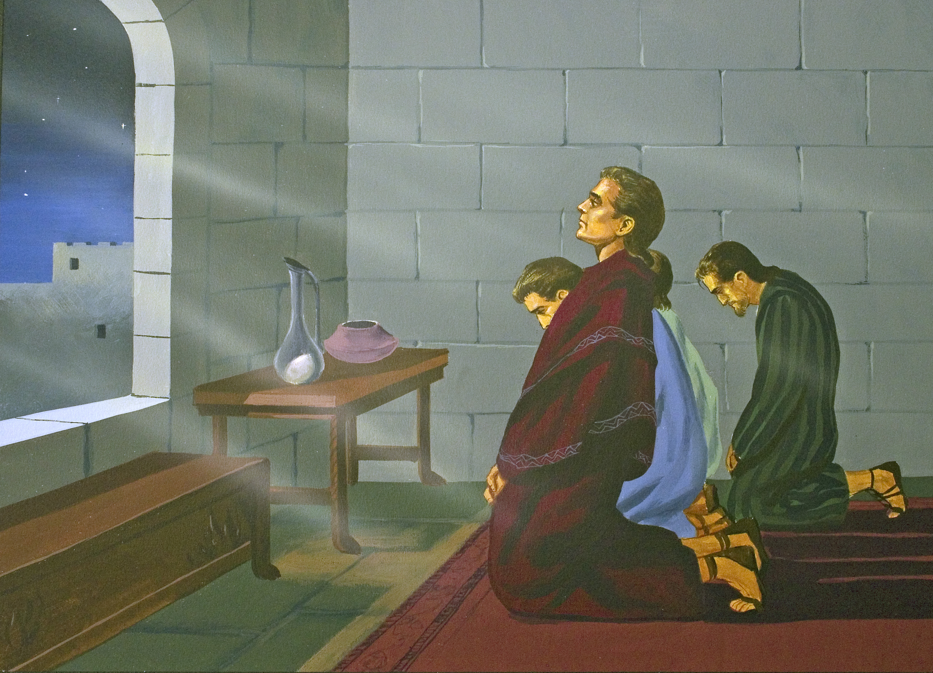

Slide 24
Challenged
By being taught and indoctrinated with falsehoods (1:4; cf. 1 Tim. 4:1-3; 2 Tim. 4:1-4; Acts 17:11; 1 John 4:1)
By having sin placed right in front of them and surrounded by “everyone else doing it” (1:5; cf. Judg. 21:25; Jas. 1:14; 2 Tim. 2:22; 1 Pet. 2:11)
By being called different names with different meanings (1:6-7; cf. 1 Kgs. 18:17-18; Matt. 10:25; 12:24; John 9:24; Heb. 11:24-26; 1 John 3:1)
By trying to change their religion, their worship and their God (1:1-7; 3:1-7; cf. Matt. 4:10; Rom. 1:16-17; 12:1-2; Acts 4:19; 5:29)

Slide 25
Committed
He was determined to not sin or compromise (1:8a; cf. Psa. 119:11; Gal. 2:5; 1 John 2:1)
He respectfully made a request to be excluded (1:8b; cf. Acts 4:19-20; Eph. 4:15)
He courageously offered an alternative with personal accountability (1:11-14; cf. Gal. 6:7; Eph. 6:19-20; Phil. 1:14, 20)
He trusted God’s providence, with confidence in God’s way over man’s way (1:9, 13; cf. Prov. 3:5-7; Gen. 50:20; Rom. 8:28)

Slide 26
Confirmed
God was with Daniel and his friends, and He helped them (1:15-17; cf. Heb. 13:6; 11:6; Psa. 118:6; 146:5; Josh. 1:5-9)
God’s way was proven superior (1:15; cf. Isa. 55:8-9; Ezek. 18:25; 1 John 4:4; 5:4)
God’s people were shown to be a higher caliber (1:19-20; cf. Acts 4:13; John 13:35; 1 Pet. 2:12; Tit. 2:8)
God was the focus of this event, not the young men (1:2, 9, 17; cf. Phil. 1:20)

Slide 27
Believe Jesus is God’s Son – John 8:24
Repent of your sins and turn to God – 2 Peter 3:9
Confess your faith in Jesus Christ – Matthew 16:16
Be immersed into Christ – Mark 16:16
God will forgive all of your sins – Acts 2:38
God will add you to His church – Acts 2:47
God will register you in heaven – Hebrews 12:23
Serve Him faithfully – 1 Corinthians 15:58

