Slide 2
There is a lot happening in our
nation right now.
sharply people have turned from
God and righteousness.
ways, God’s people have not been
immune, as some have been caught
up in the dangerous flood of
dissipation that has engulfed us.
Short of a wholesale change, and if
there is no definitive turn back to
God and righteousness,
peril lies ahead.
It’s scary how
In some
certain

Slide 3
The Nation Was Guilty Before God (22:1-12)
Shed innocent blood (22:1-4)
Made and served idols (22:3-4)
Became the laughingstock of other nations (22:5)
Ruled by corrupt politicians (22:6)
Mistreated precious people (22:7)
Profaned God’s holiness (22:8)
Committed lewdness openly (22:9)
Committed sexually vile and immoral acts (22:10-11)
Committed evil acts for money (22:12)
Forgot God (22:12)
The Nation Was Being Punished By God (22:13-22)
The vengeance of God (22:13-14)
The scattering by God (22:15-16)
The fire of God (22:17-22)

Slide 4
The Nation Was Guilty Before God (22:1-12)
The Nation Was Being Punished By God (22:13-22)
The Nation Was Corrupt from Top to Bottom (22:23-31)
The religious leaders: Prophets and priests (22:25, 26, 28)
The political leaders: Princes (22:27)
The people (22:29)

Slide 5
There is a lot happening in our nation right now. It’s scary how sharply people have turned from God and righteousness. In some ways, God’s people have not been immune, as some have been caught up in the dangerous flood of dissipation that has engulfed us. Short of a wholesale change, and if there is no definitive turn back to God and righteousness, certain peril lies ahead.

Slide 6
The Nation Was Guilty Before God (22:1-12)
The Nation Was Being Punished By God (22:13-22)
The Nation Was Corrupt from Top to Bottom (22:23-31)
Still, the Lord Yearned for His People to Be Saved (22:30)
The Lord searched for someone
The Lord found no one!

Slide 7
The world is corrupt from top to bottom
God’s people (the church) have not been immune and unaffected
So, the Lord is searching for someone today to stand in the gap
Some of God’s greatest champions have been those who stood in gap
Will you stand in the gap?

Slide 8
There is a lot happening in our nation right now. It’s scary how sharply people have turned from God and righteousness. In some ways, God’s people have not been immune, as some have been caught up in the dangerous flood of dissipation that has engulfed us. Short of a wholesale change, and if there is no definitive turn back to God and righteousness, certain peril lies ahead.

Slide 22
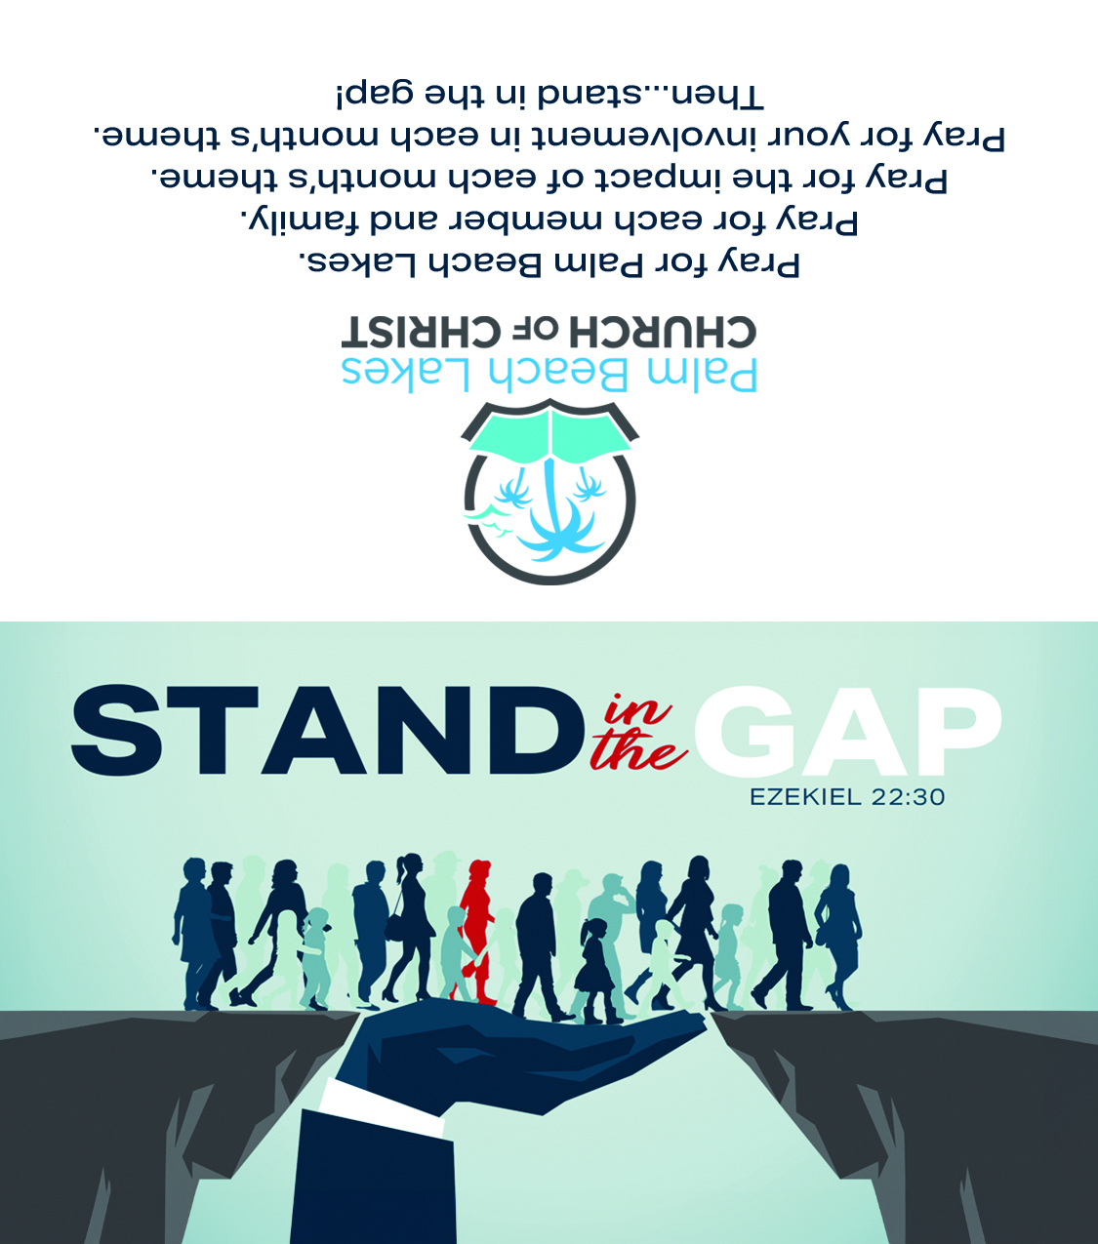

Slide 23
Sermon &
Bible Class
Notebook

Slide 25
Believe Jesus is the Son of God – John 1:12
Repent of your sins and turn to God – Acts 17:30
Confess your faith in Jesus Christ – Romans 10:9
Be baptized into Christ – Mark 16:16
God will forgive all of your sins – Acts 2:38
God will add you to His church – Acts 2:47
God will register you in heaven – Hebrews 12:23
Stand fast in the faith – 1 Corinthians 16:13

Slide 26
There is a lot happening in our nation right now. It’s scary how sharply people have turned from God and righteousness. In some ways, God’s people have not been immune, as some have been caught up in the dangerous flood of dissipation that has engulfed us. Short of a wholesale change, and if there is no definitive turn back to God and righteousness, certain peril lies ahead.

