Slide 1


Slide 2
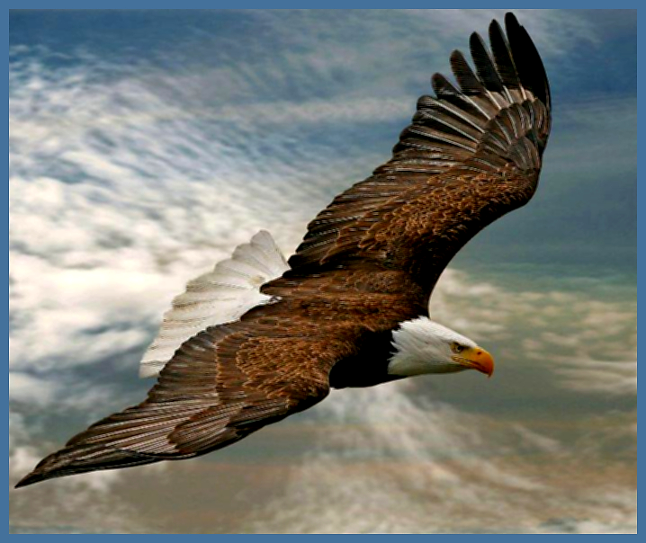
Isaiah 40:31> 31 But those who wait on the Lord shall renew their strength; They shall mount up with wings like eagles, They shall run and not be weary, They shall walk and not faint.

Slide 3
1. Renew our strength – Fearless.
2. Mount up on wings like eagles – Highflyers.
3. Run and not be weary – Tenacious.
4. Walk and not faint – Vitality.

Slide 4
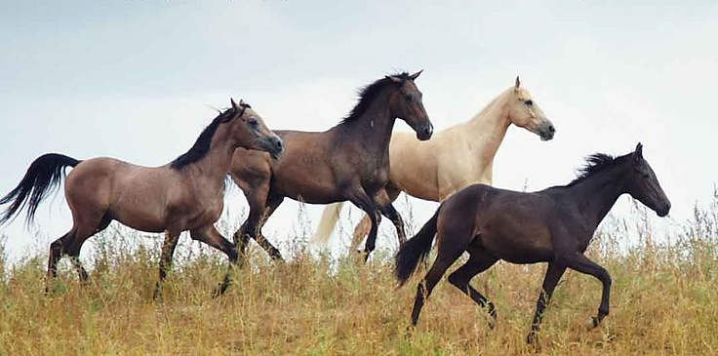
Jeremiah 12:5> 5 "If you have run with the footmen, and they have wearied you, Then how can you contend with horses? And if in the land of peace, In which you trusted, they wearied you,
Then how will you do in the floodplain of the Jordan?

Slide 5
1. Run with horses
2. Do not be weary

Slide 6

Joshua 14:11,12> 11 As yet I am as strong this day………………..12 Now therefore, give me this mountain of which the Lord spoke in that day……………………………

Slide 7
1. Have the attitude - give me this mountain

Slide 8

THERE ARE ALWAYS CHALLENGES BEFORE JESUS AND HIS CHURCH
THAT MEANS CHALLENGES ARE BEFORE US

Slide 9
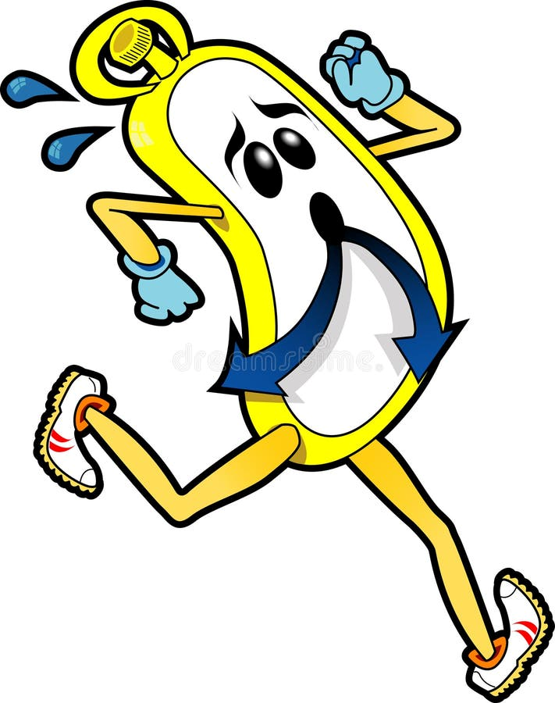
We cannot be mediocre and achieve GREAT THINGS for Jesus and His church

