Slide 1
Abraham, What Did You See?
Dale W. Manor, Ph.D.
Field Director of Tel Beth-Shemesh Excavations
Israel
Professor of Archaeology and Bible
Harding University
Notes:
S. Florida Lectureship; W. Palm Beach (11-4-23)

Slide 2
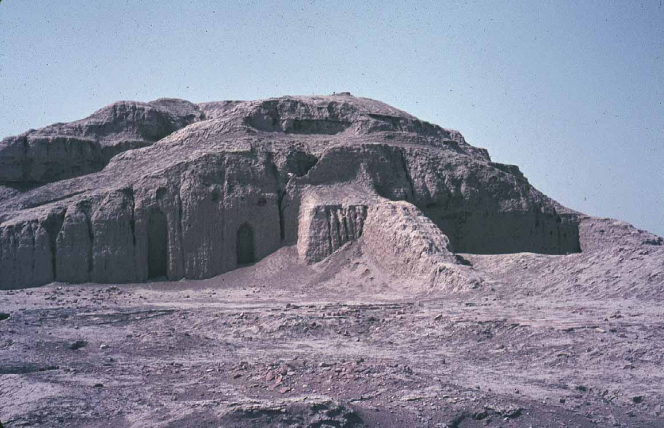
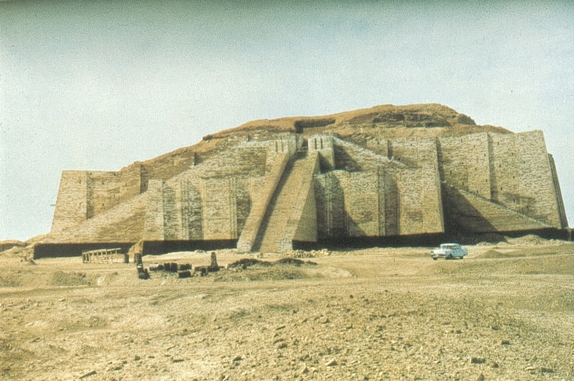
Ziggurat of Ur
Notes:
Ziggurat of Ur (artist reconstruction)

Slide 3
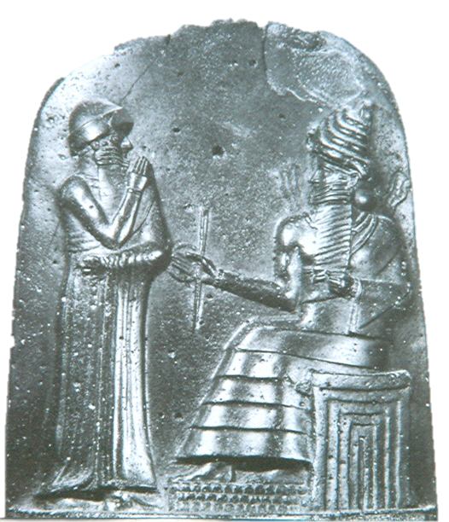
top of Code of
Hammurabi
Shamash
Hammurabi
Notes:
Shamash on right with rays radiating from shoulders and seated on throne with dais

Slide 4
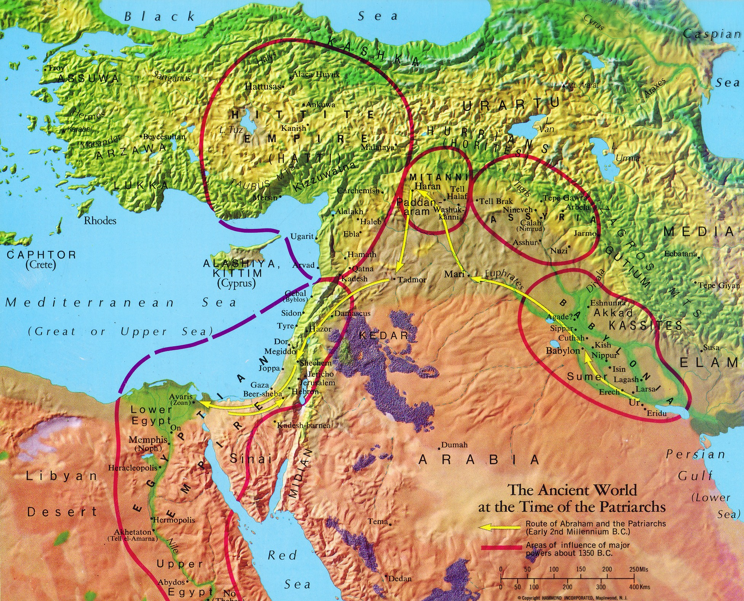
Haran
Shechem
Ur
Notes:
Mileage from Ur to Haran appr 550; from Haran to Shechem appr 400 = 950; 50 plus days of travel

Slide 5
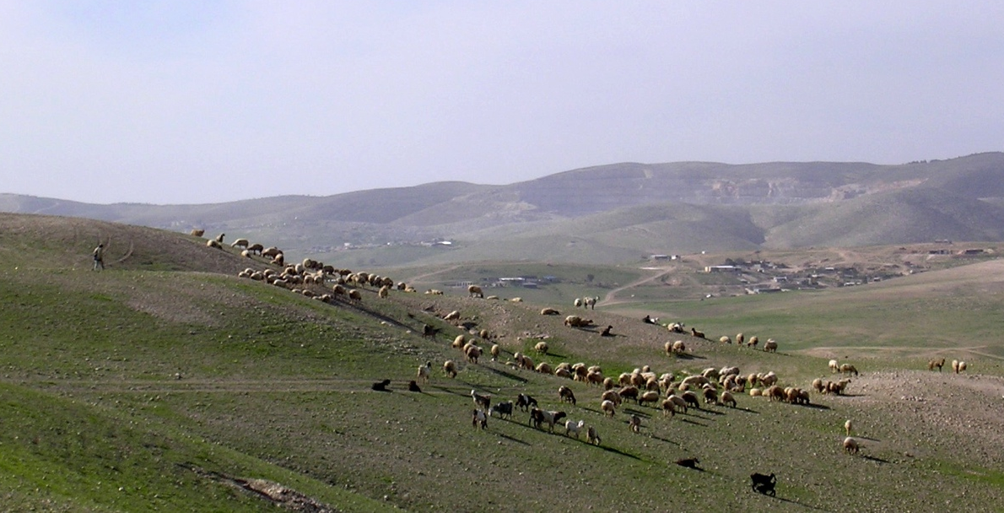
Notes:
Sheep and shepherd near Lahav

Slide 6
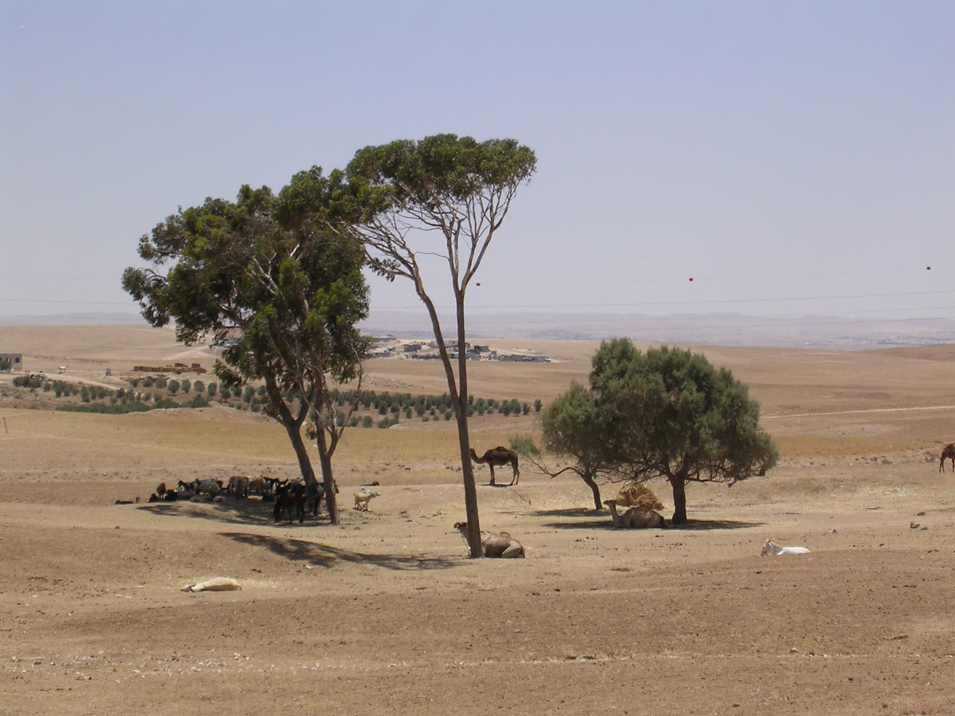

Slide 7
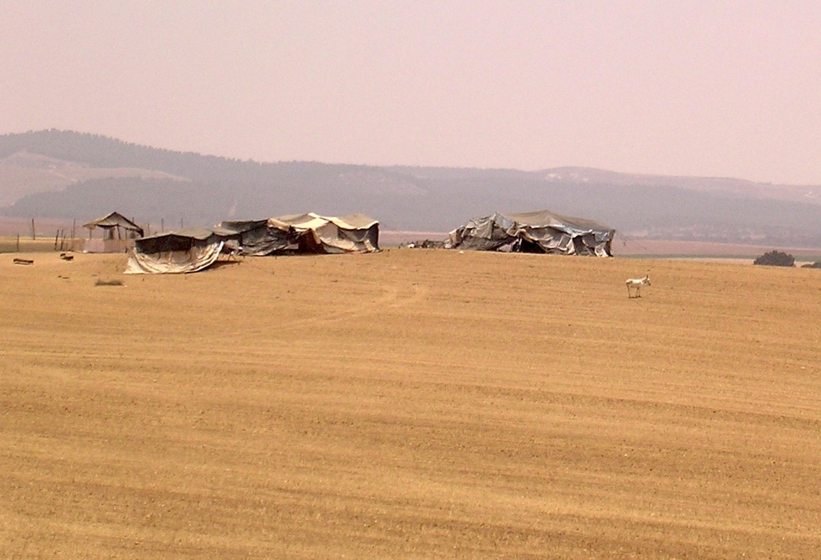
Notes:
Bedouin tent

Slide 8
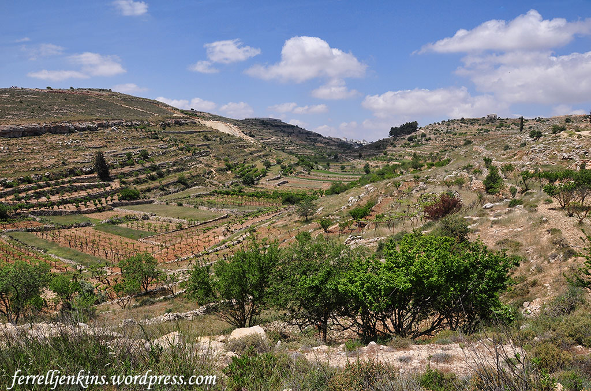

Slide 9
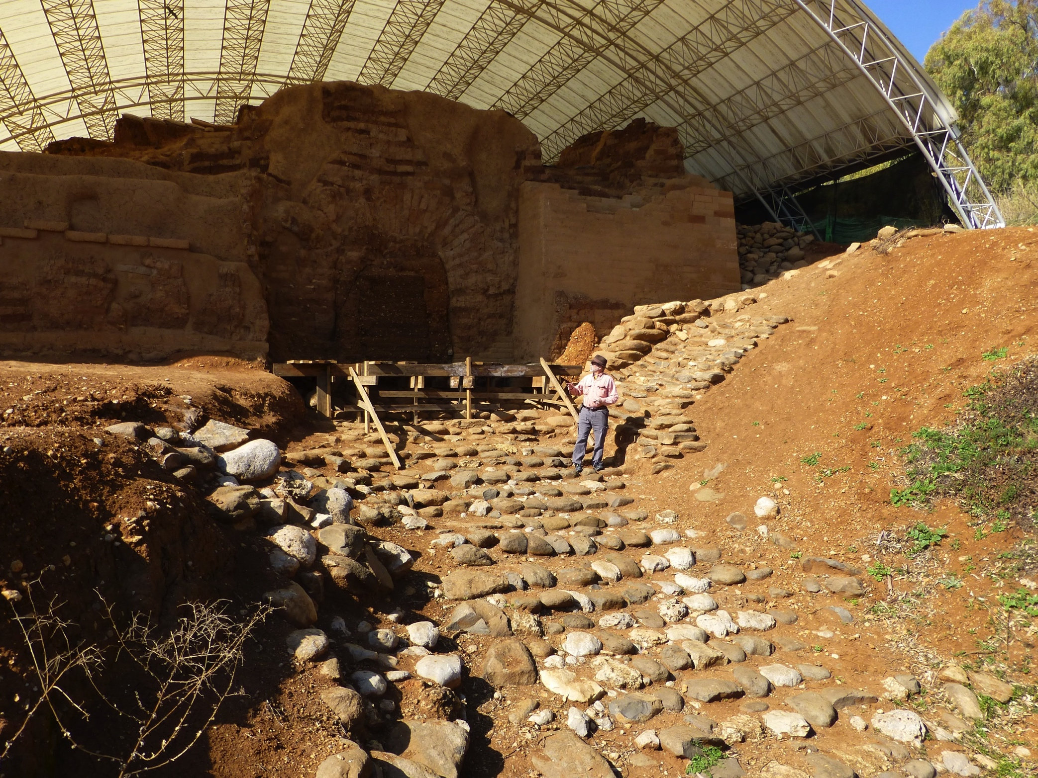
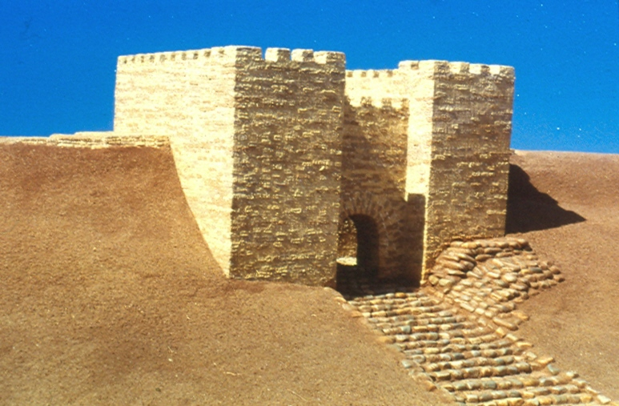
Mudbrick, arched gate
at Dan
Notes:
18th century MB mudbrick arched gate at Dan on SE corner of the site

Slide 10
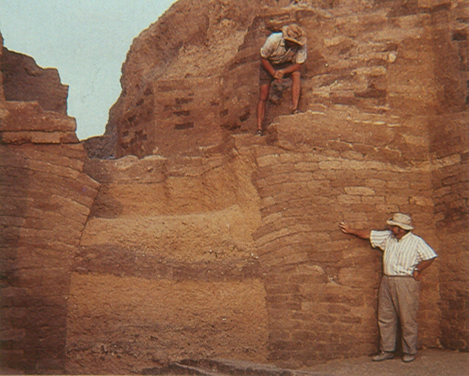
Ashkelon Middle Bronze Age mudbrick gate

Slide 11
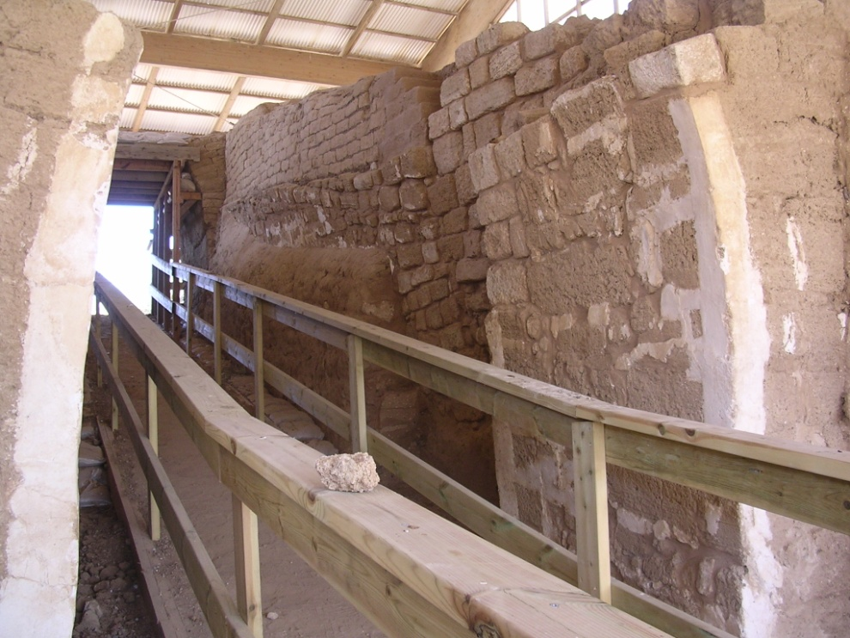
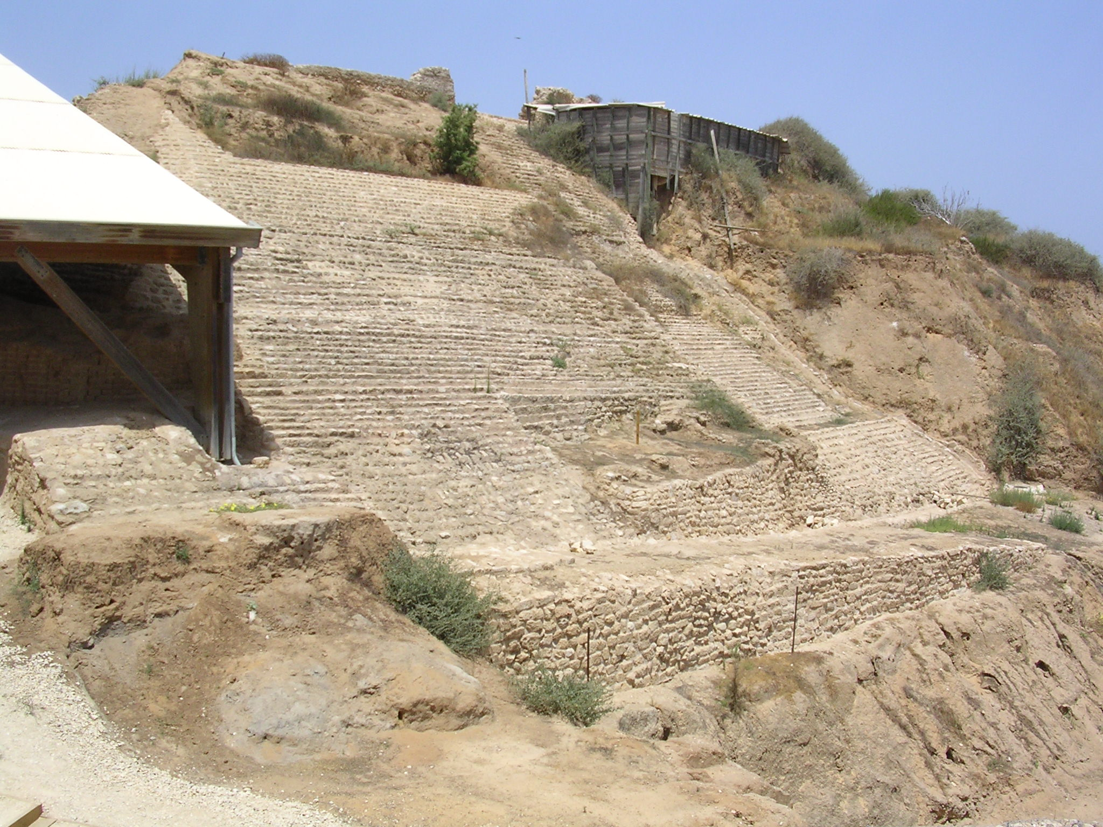
Ashkelon glacis

Slide 12
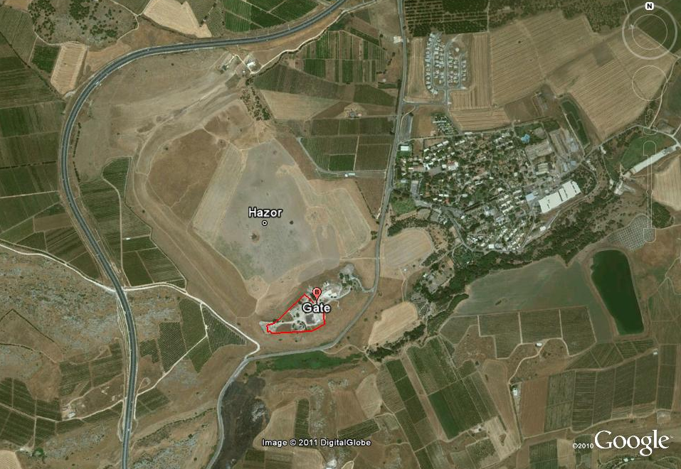
Middle Bronze Age
Hazor
Notes:
MB Hazor with moat on the left; ca. 200 acre site

Slide 13
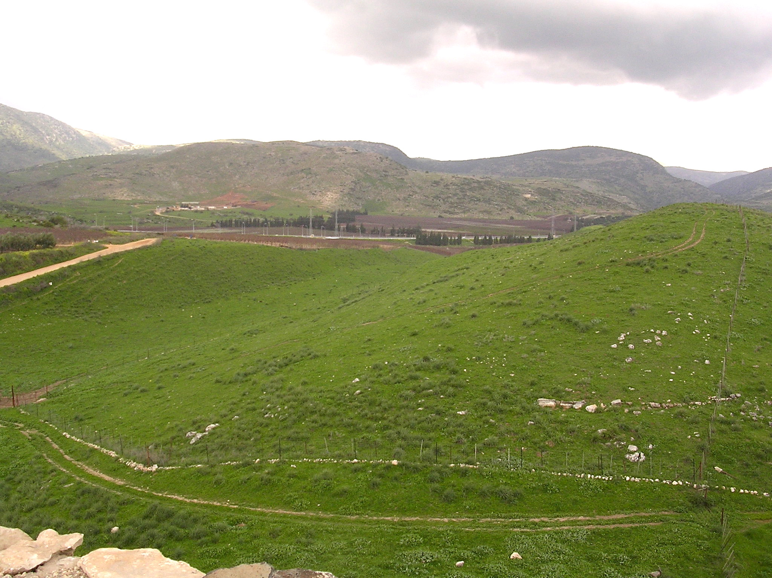
appr. 30 feet

Slide 14
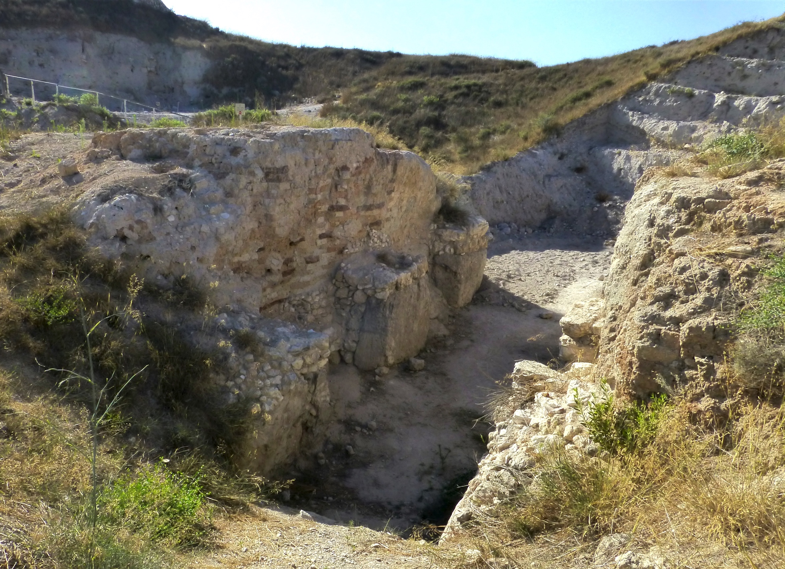
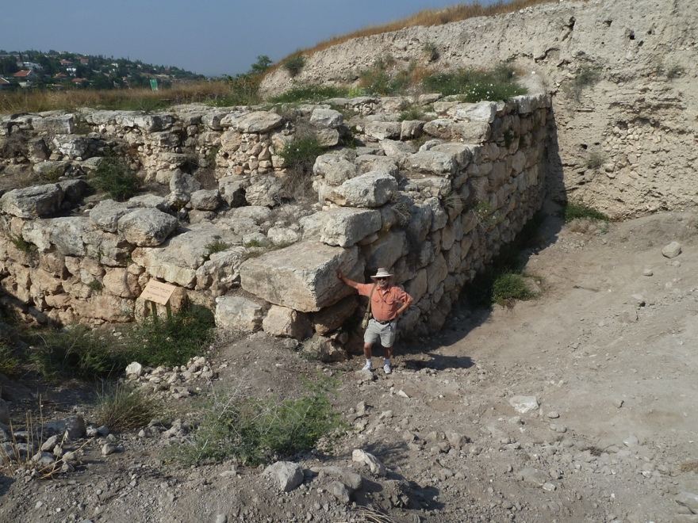
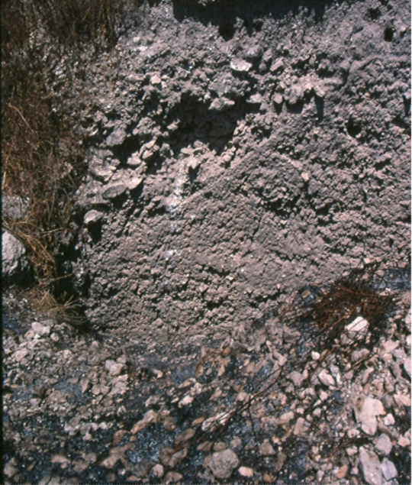
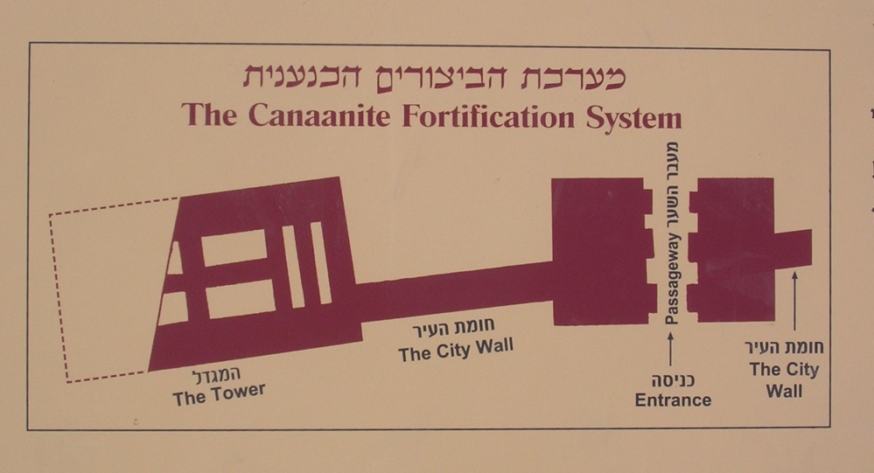
fortifications at Gezer

Slide 15
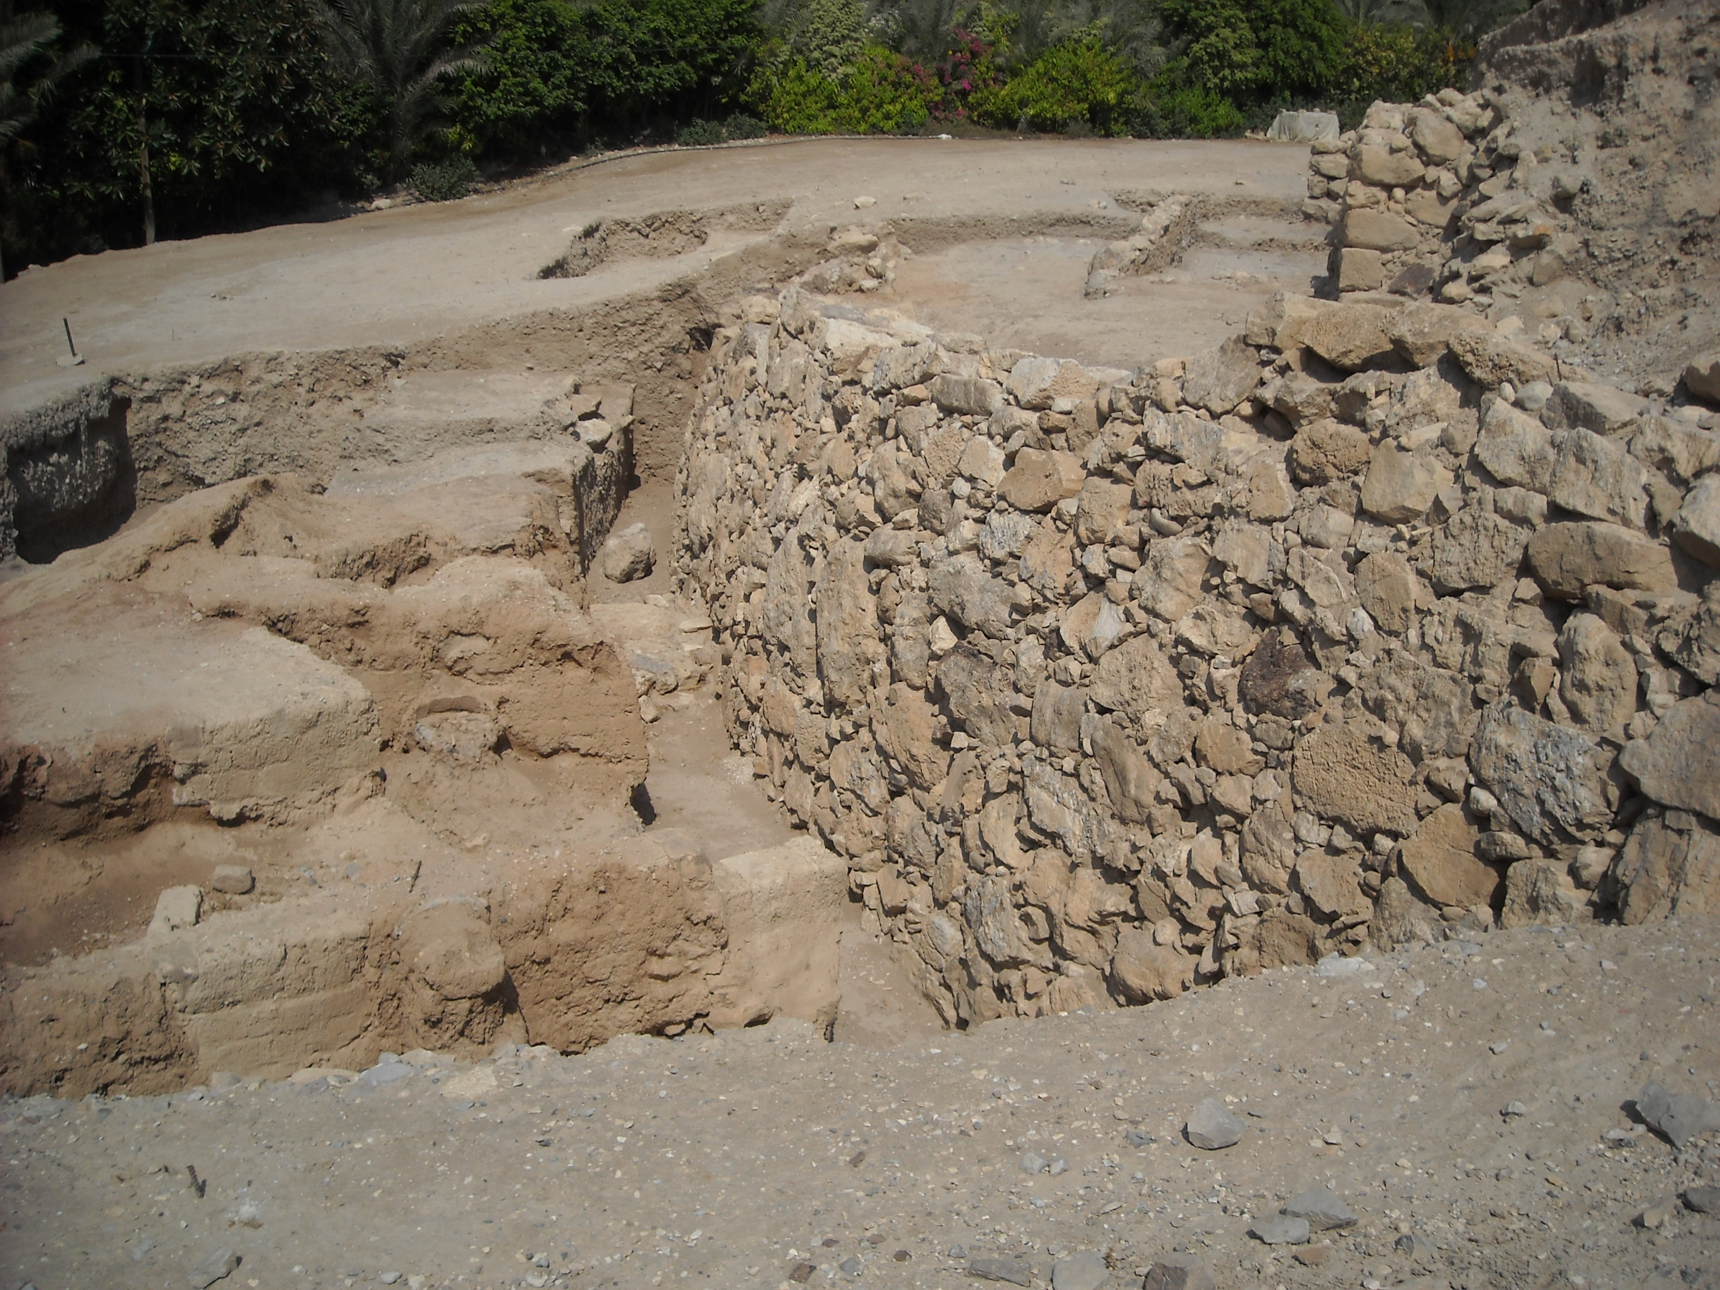
Middle Bronze Age Wall at Jericho

Slide 16
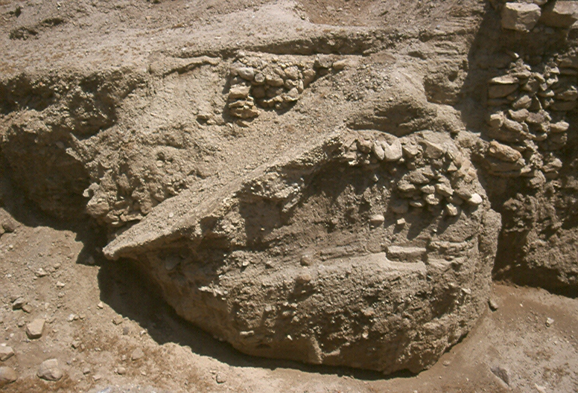
Middle Bronze Age Jericho glacis surface

Slide 17
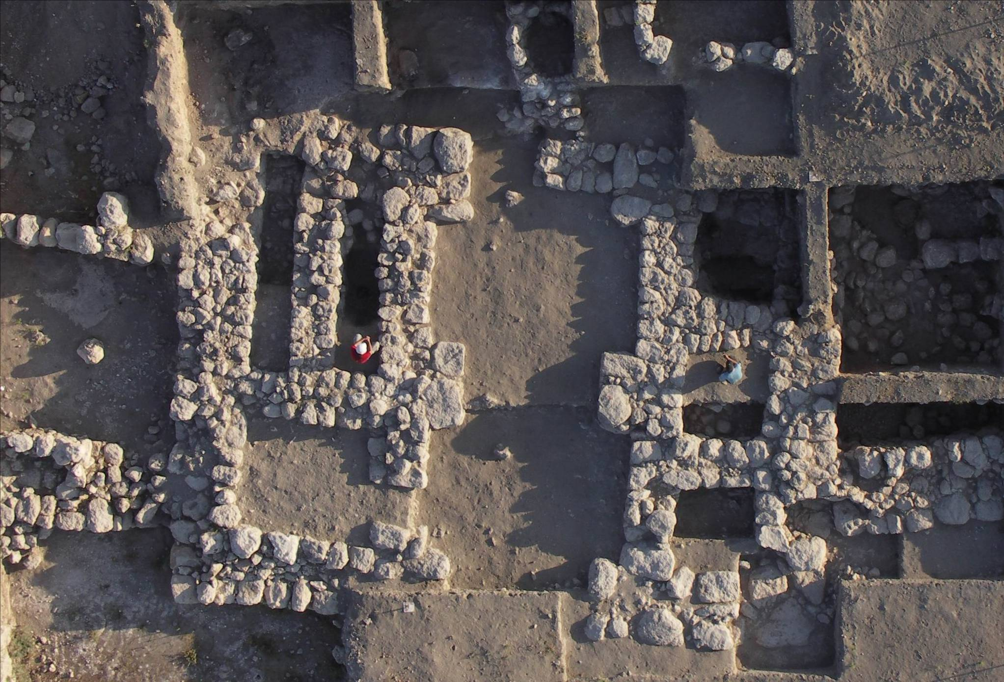
Tel Beth-Shemesh

Slide 18
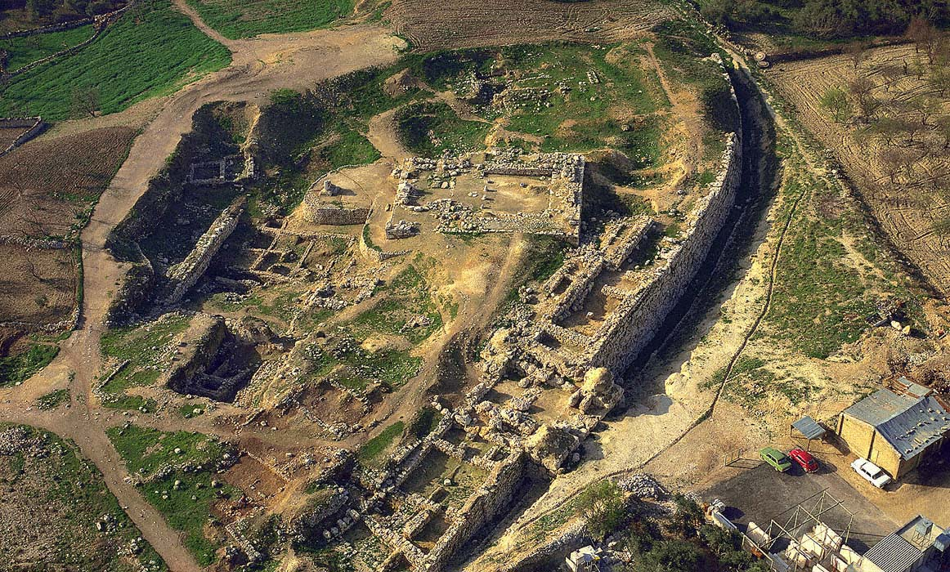
Migdol (fortress) temple at Shechem
Notes:
Megaron (fortress) temple at Shechem

Slide 19
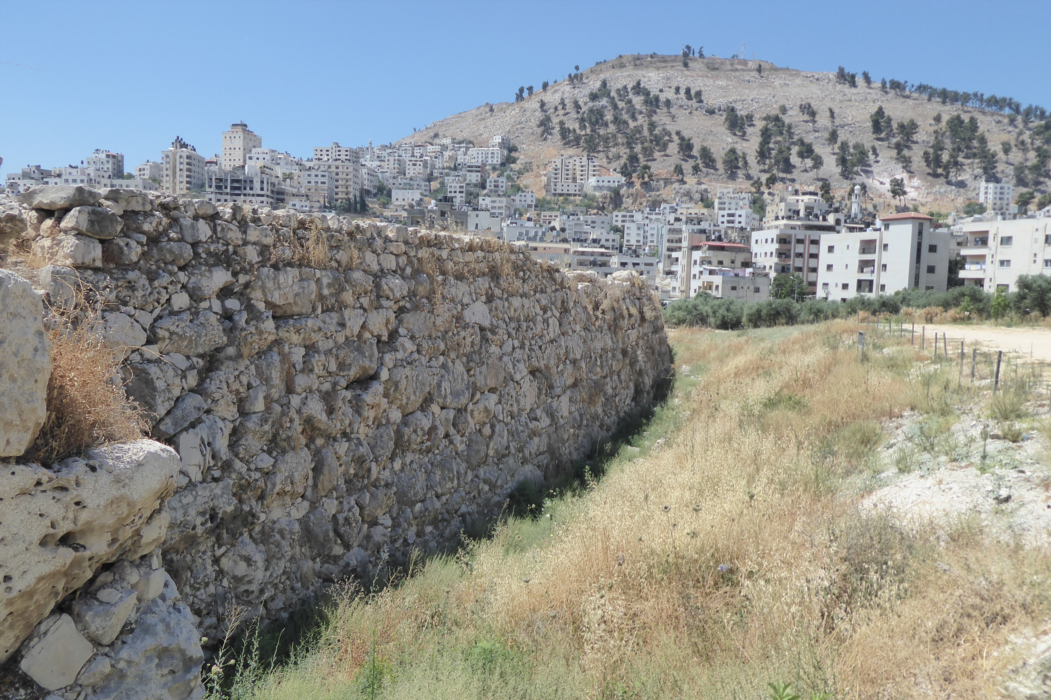
Middle Bronze Age wall at Shechem

Slide 20
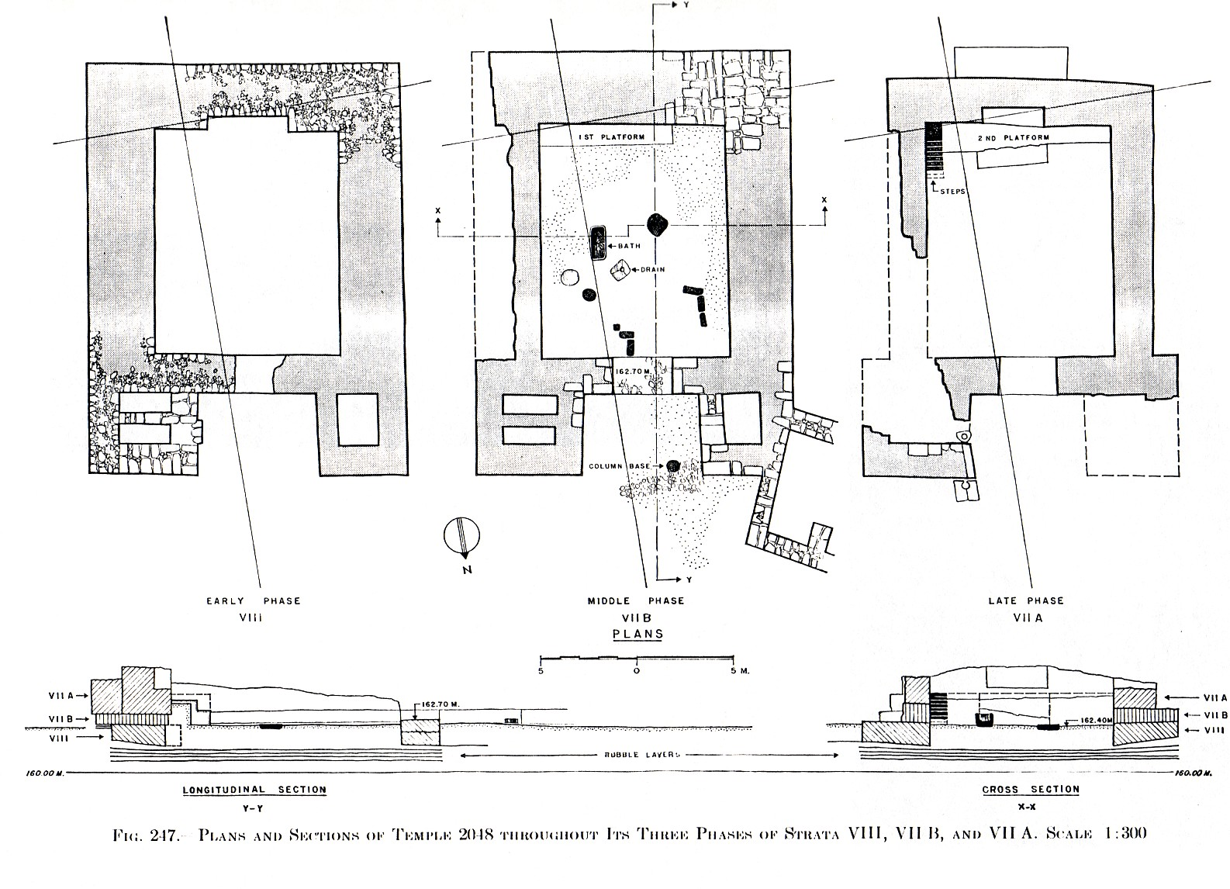
Series of migdol (fortress) temples at Megiddo

Slide 21
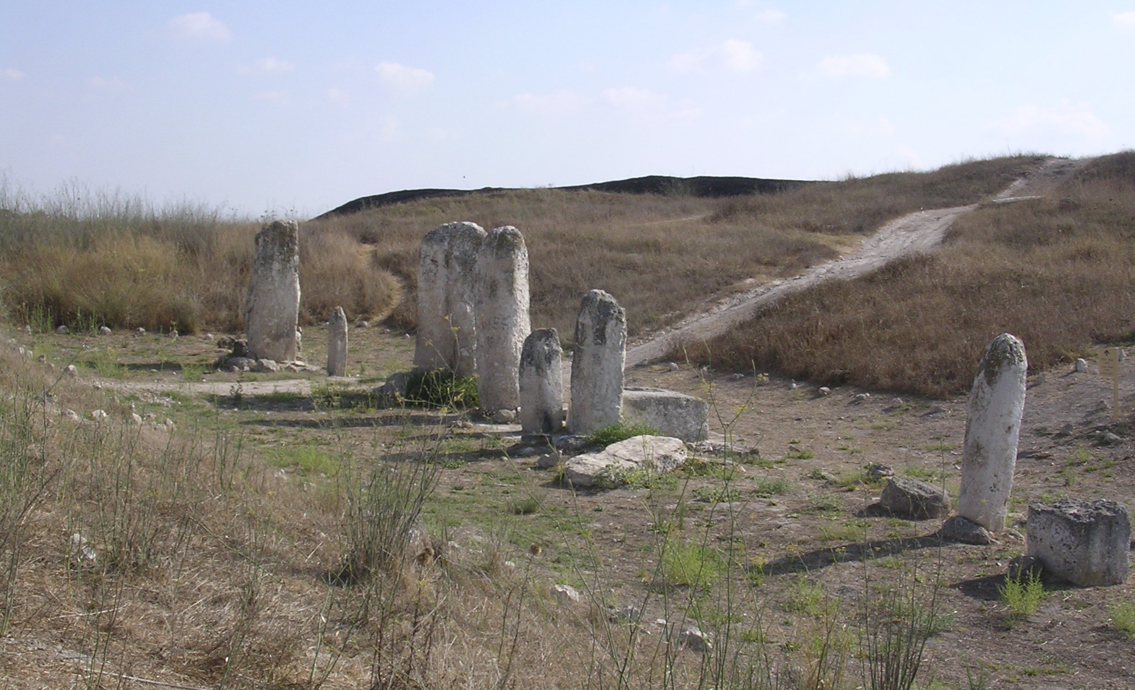
Gezer “High Place”
Notes:
Gezer High Place MBIIb/c (BAR 20/3 1994: 67)

Slide 22
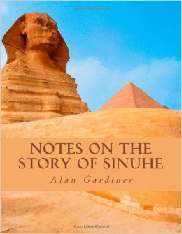
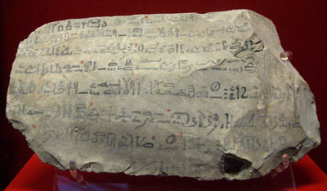
Photo by Ferrell Jenkins from British Museum

Slide 23
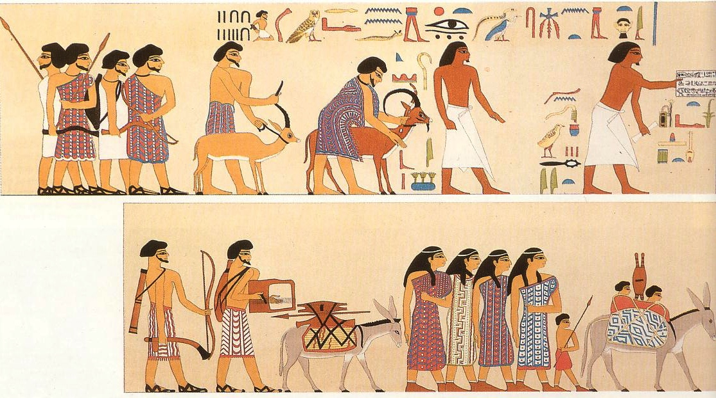
Beni Hasan Tomb Painting – Beni Hasan Egypt
Notes:
Beni Hasan tomb painting (ca. 1900 BC) full painting shows 37 people; weapons (spears, throwing sticks, bows/arrows); bellows (for metal working?); colorfully dressed people contra Egyptians

Slide 24
Tin trade from
Mari to Hazor;
Diplomats from
Babylon to Hazor
From Babylon to Mari, appr 250 miles
From Mari to Hazor, appr 300 miles
Maximum travel = ca. 20 miles/day
27 day trip minimum!
Notes:
8.33 minas of tin (=4.5 kg, = 10 pounds) to Laish/Dan; 70 minas (=35 kg, = 77 pounds) to Hazor through Mari

Slide 25
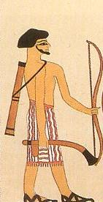
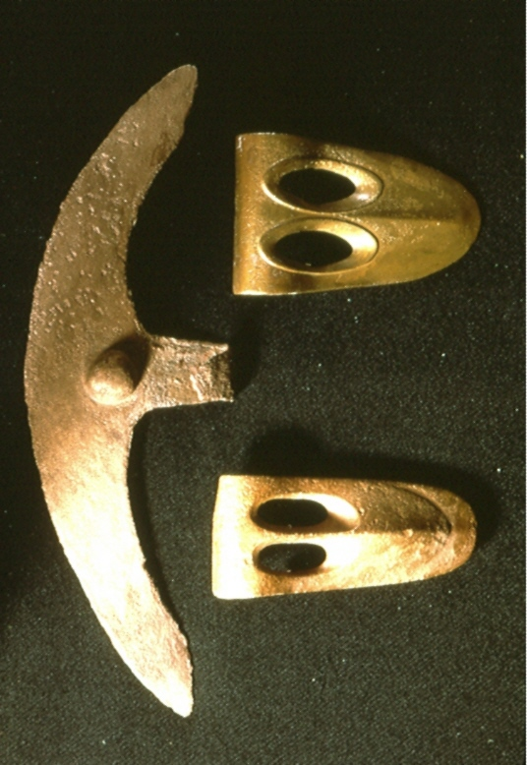
ll
crescentic and fenestrated
axe heads

Slide 26
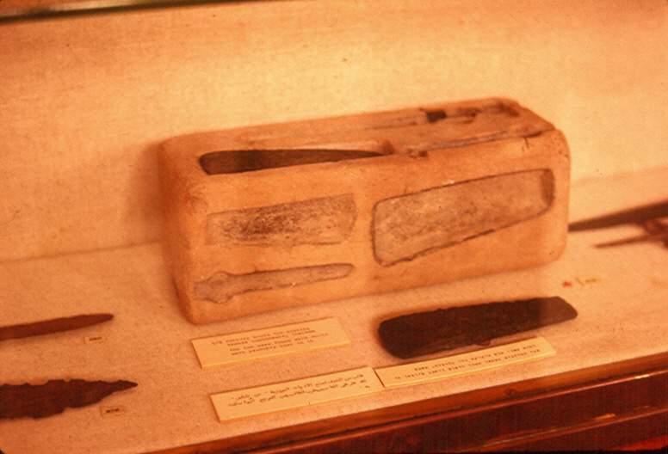
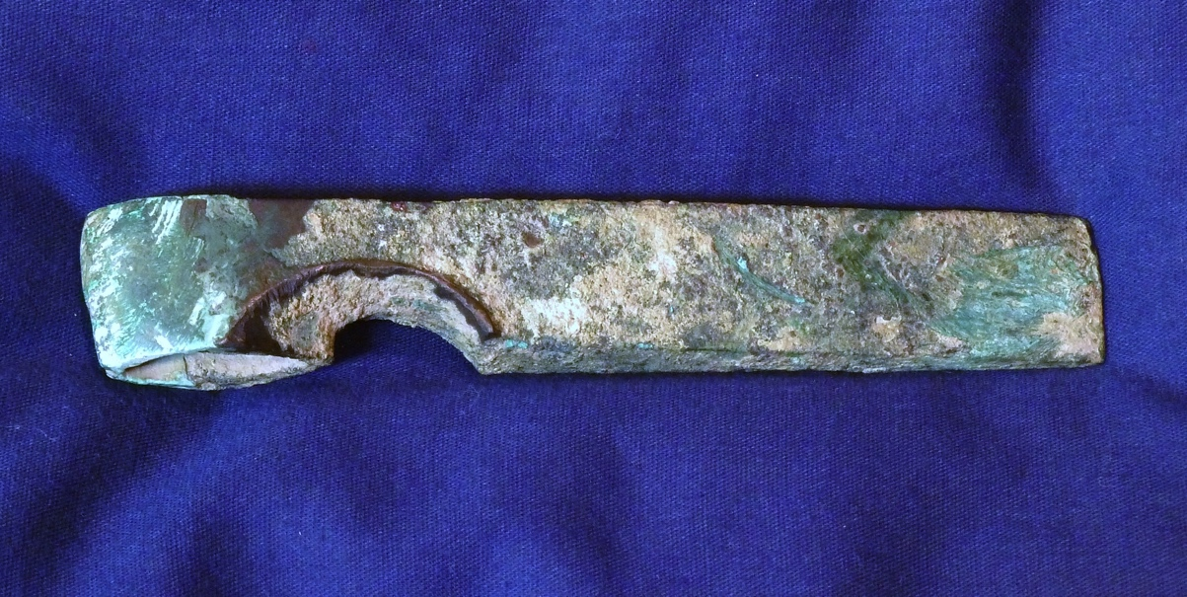
Notes:
MB axe mold from Shechem and notched axe from Tell el-Ajjul

Slide 27
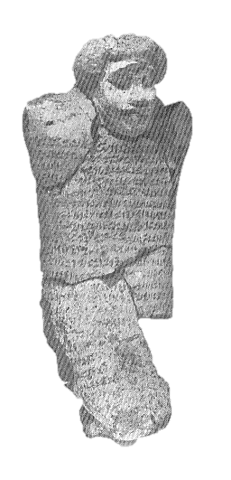
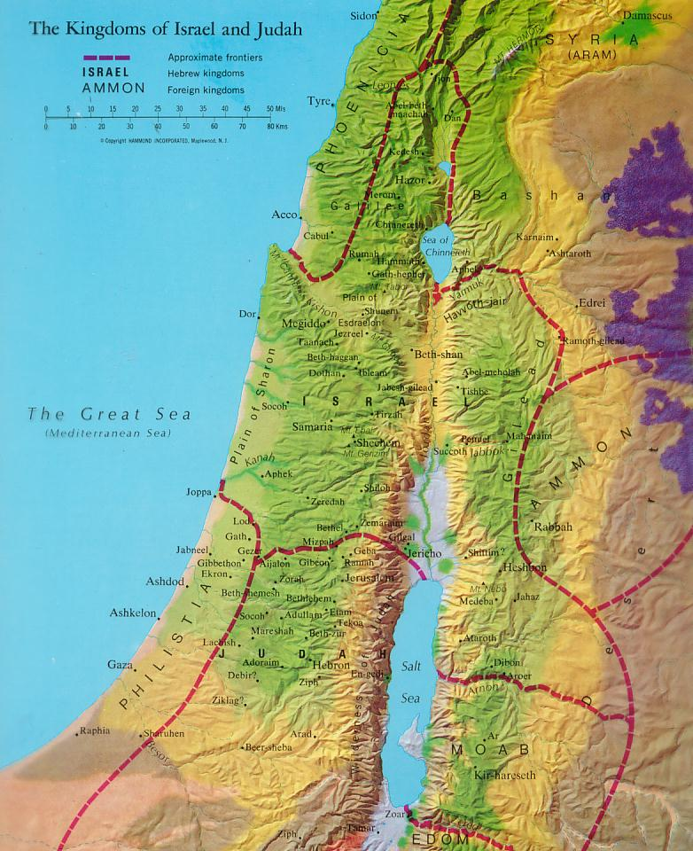
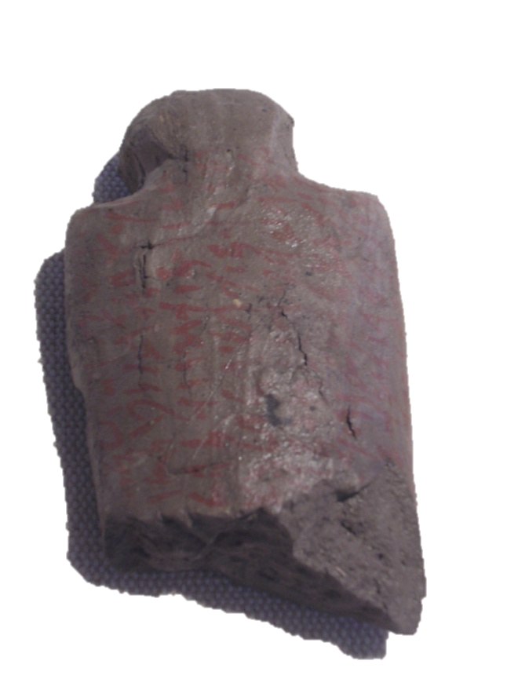
some sites with
fortification remains
from the time of the
Patriarchs
Execration
Texts
Notes:
Execration texts of MB period from Egypt

Slide 28
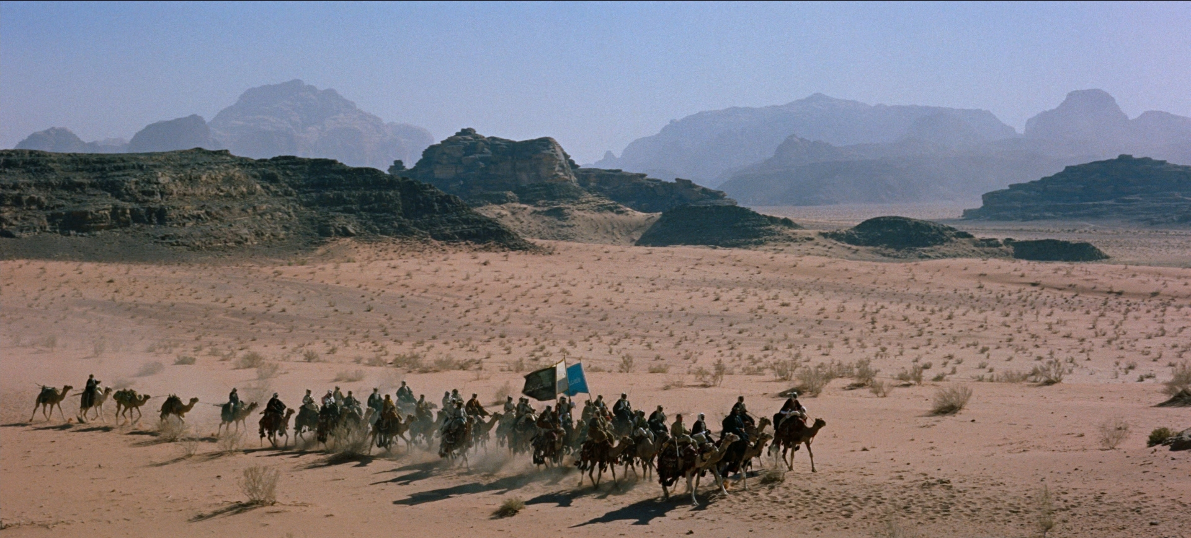
“When Abram heard that his kinsman had been taken captive, he led forth his trained men, born in his house, 318 of them, and went in pursuit as far as Dan.” (Gen. 14:14)

Slide 29
Middle Bronze Age Tomb from Jericho
Notes:
MB Tomb from Jericho at Rockefeller Museum Jerusalem

Slide 30
“By faith Abraham obeyed when he was called to
go out to a place that he was to receive as an
inheritance. And he went out, not knowing where
he was going. By faith he went to live in the land
of promise, as in a foreign land, living in tents with
Isaac and Jacob, heirs with him of the same promise. For he was looking forward to the city that has foundations, whose designer and building is God.”
Hebrews 11:8-10 (ESV)

