Slide 2
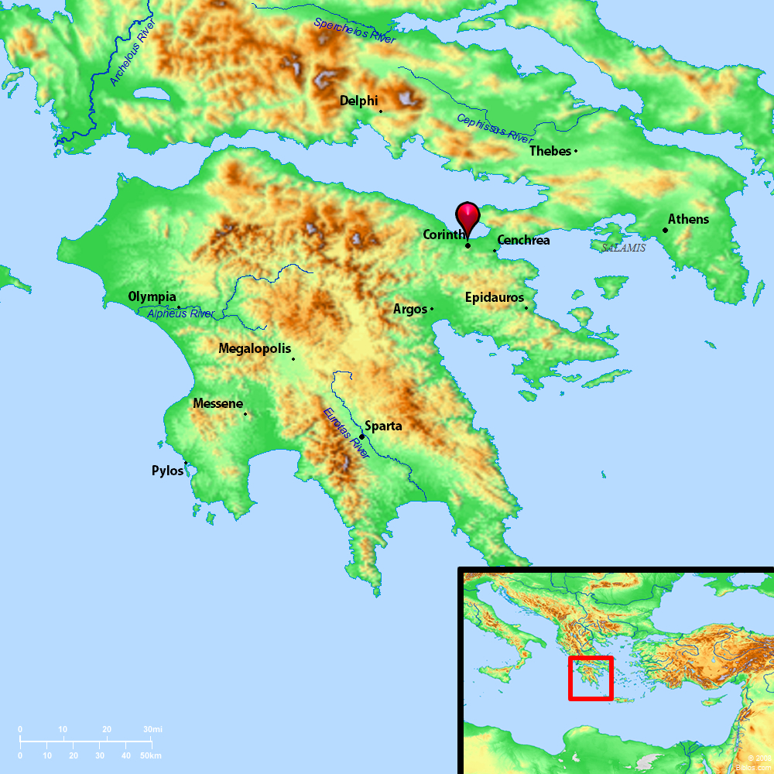
History of the City
Rebuilt by Julius Caesar in 46 B.C. as a Roman Colony – the capital city of Achaia
Strategic Location of the City
Located on the isthmus connecting lower Greece and upper Greece (major trade route)
Business of the City
Center for manufacturing and mining; a major Grecian banking center
Population of the City
Highly transient and mixed population with the heavily trafficked ports
Spiritual Condition of the City
Widely known for its perverted idolatry, shameful immorality and abundant vices
The mixed population from everywhere brought all of their evils to this one city
The name “Corinthian” became synonymous with a life of drunken, immoral debauchery
The temple to the Greek goddess Aphrodite was an iniquitous site

Slide 3
Paul came to Corinth on second missionary journey in 50 A.D. (Acts 18:1-18)
He wrote First & Second Thessalonians from Corinth
Paul labored in Corinth for 18 months (Acts 18:11)
He joined with Aquila & Priscilla in making tents (Acts 18:2-3)
He reasoned in the synagogue every Sabbath, persuading Jews & Greeks (Acts 18:4)
He converted several to Christ (Acts 18:8, 17; 1 Cor. 1:14, 16)
Paul was brought to trial by the Jews before Gallio (Acts 18:12-16)
Gallio’s verdict opened doors for Paul to preach the gospel all over the Roman Empire
Paul left Corinth in early 52 A.D. to return to Antioch (Acts 18:18-22)
Apollos came and “greatly helped” the church (Acts 18:27)
Paul visited again on his third missionary journey (Acts 20:1-2)

Slide 4
Paul worked in Ephesus for three years (Acts 19:8, 10; 20:31)
Paul began to receive troubling reports about the church in Corinth
Via oral reports from those of Chloe’s household (1 Cor. 1:11)
Via written questions to Paul from the church (1 Cor. 7:1)
Paul wrote our 1 Corinthians in 55 A.D. from Ephesus (1 Cor. 16:8)
Paul planned to personally visit them shortly to set the rest in order (1 Cor. 4:19, 21; 11:34; 16:2-5)

Slide 5
It is part of a series of letters to the church in Corinth (cf. 5:9)
It is part of a series of letters often called “The Salvation Epistles” (Romans, 1 & 2 Corinthians and Galatians)
Paul’s main purposes in writing 1 Corinthians was to:
Correct the errors being practiced and taught by the church in Corinth (chap. 1-6)
Answer the written questions the church had sent to him (chap. 7-16)

Slide 6
Division in the church
A faction spirit, exalting preachers
Enamored by the wisdom of the world
Carnality among the members
Lack of growth
Sexual immorality
Lack of church discipline
Tolerating sin in the church
Going to law against a brother
Marriage problems
Confusion over marriage & divorce issues
Eating meats offered to idols
Sinning against weaker brethren
Putting a stumbling block before brethren
Lusting after evil things
Murmuring against God
The woman’s covering and being holy
Perversion of the Lord’s Supper
Irregularities and disorder in public worship
Improper role of women in the church
Contention over and abuses of spiritual gifts
Creating confusion in the church
Mistaken view of the resurrection
Misunderstanding about the collection

Slide 7
Found in the second verse of the book: “To the church of God which is at Corinth, to those who are sanctified in Christ Jesus, called to be saints, with all who in every place call on the name of Jesus Christ our Lord, both theirs and ours” (1 Cor. 1:2)
“The church of God which is at Corinth”
“Those who are sanctified in Christ Jesus, called to be saints”
“Call on the name of Jesus Christ our Lord”
The theme of 1 Corinthians: JESUS CHRIST IS LORD!
“Lord” found 6 times in first 10 verses (“Christ” found 10 times in first 10 verses)
“Lord” found 70 times in the book

Slide 8
Introduction (1:1-4)
Greetings and Salutations (1:1-3)
Prayer of Thanksgiving (1:4-9)
Problem of Division (1:10-4:21)
Critical Appeal for Unity (1:10-17)

