Slide 1
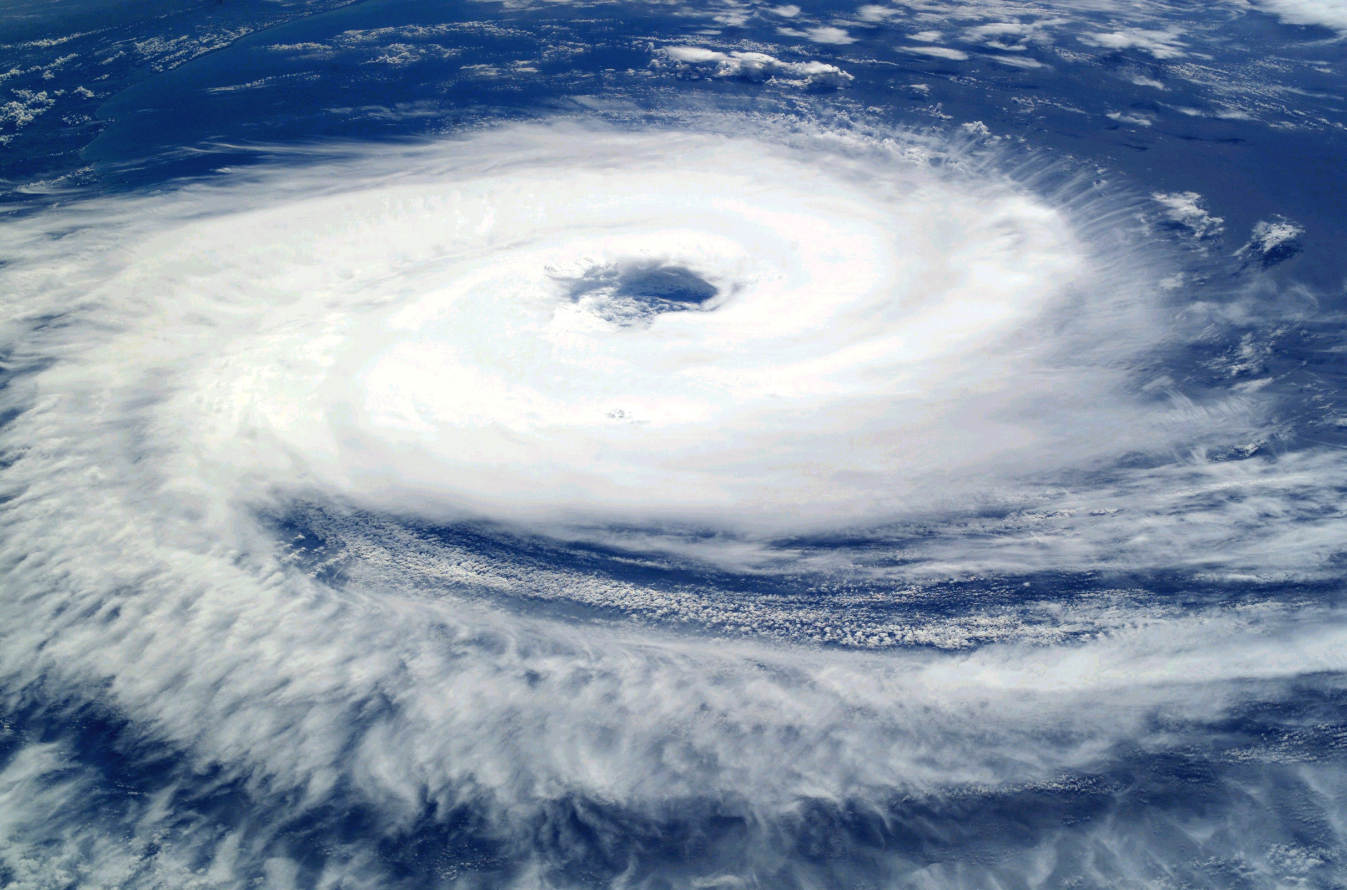

Slide 2
Barnabas being an encourager
Daniel’s courage
John’s Belief
Joseph’s endurance
David’s repentance
When Hezekiah realized God is the only option

Slide 3
And his faithfulness
noah

Slide 4

Have you ever been asked to do something you’ve never done before?
Do you remember how you responded?
Were you given instructions on how to accomplish it?
Do you know why you were asked?

Slide 5
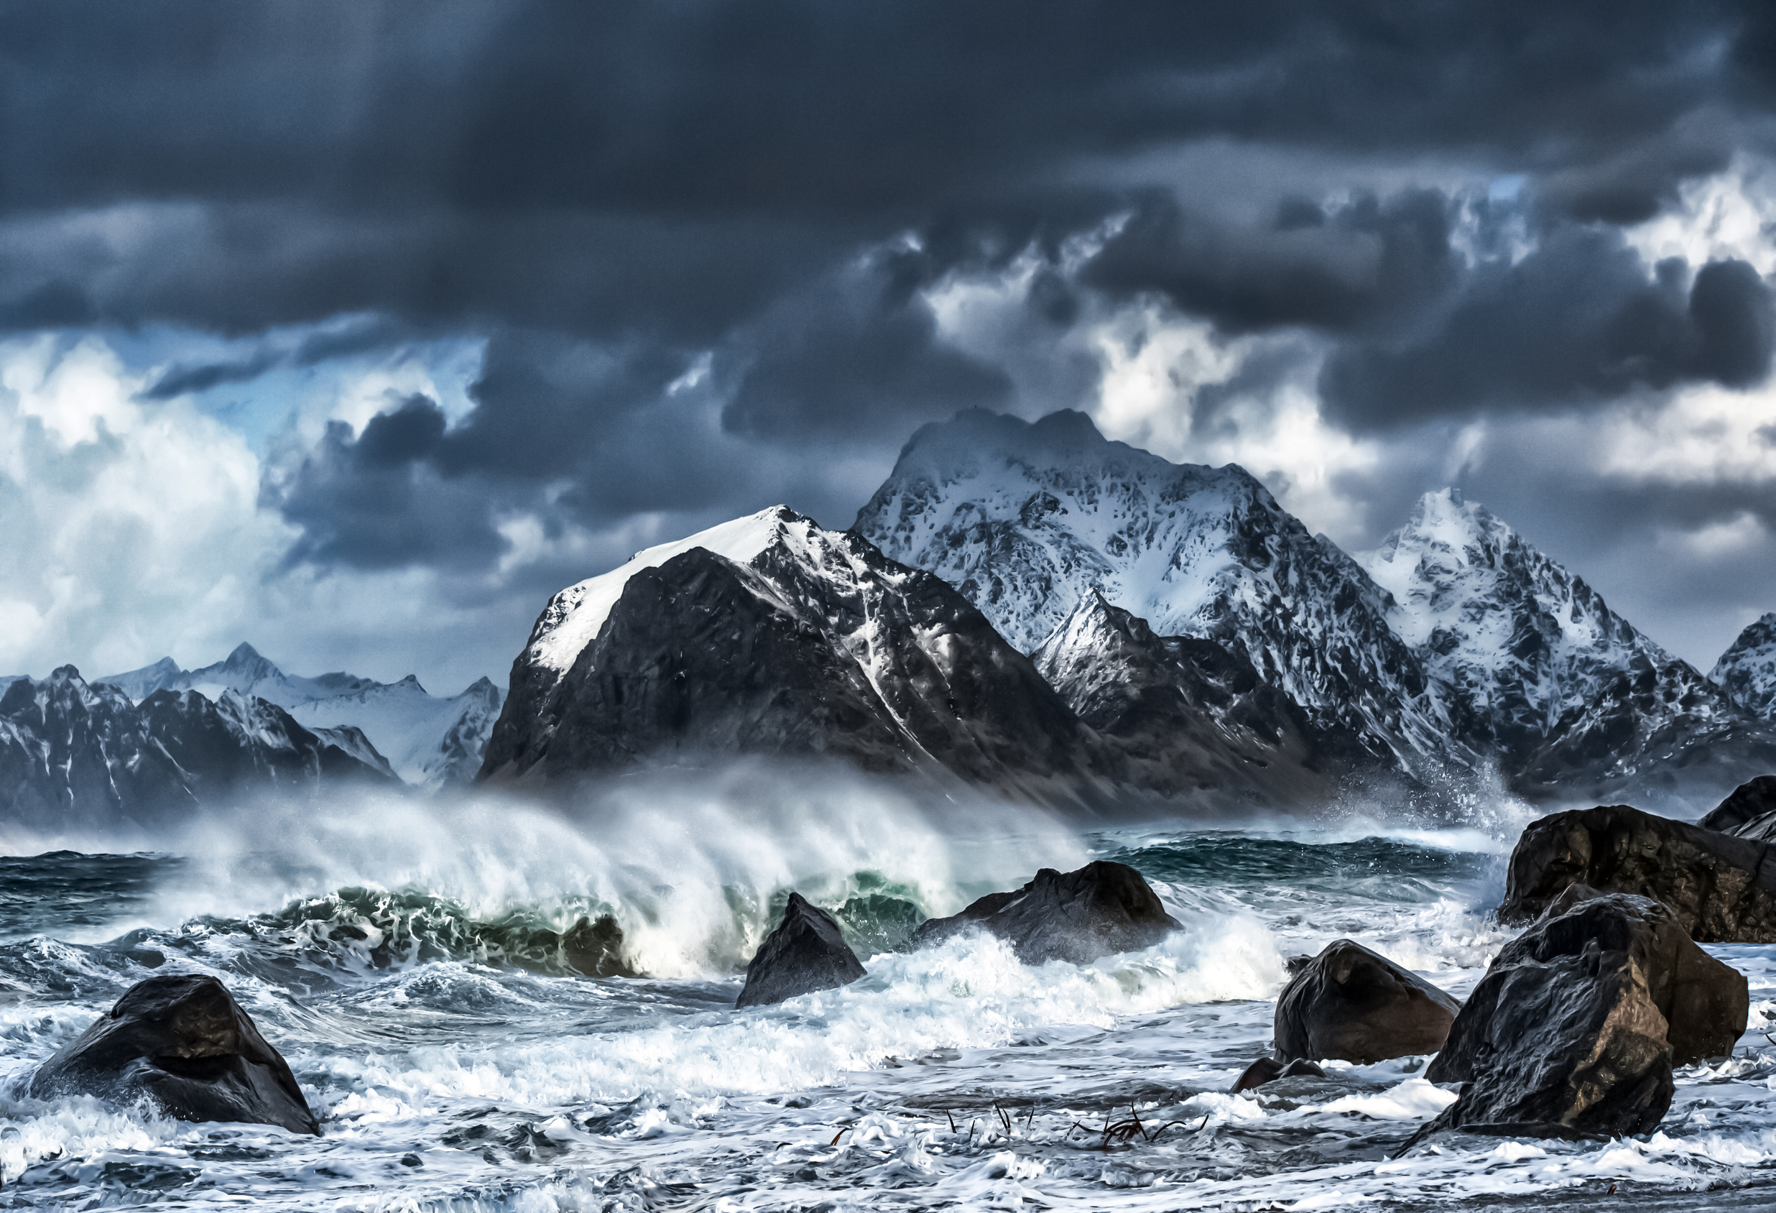
Noah was a righteous man who found grace in the eyes of the Lord.
– Genesis 6:8

Slide 6
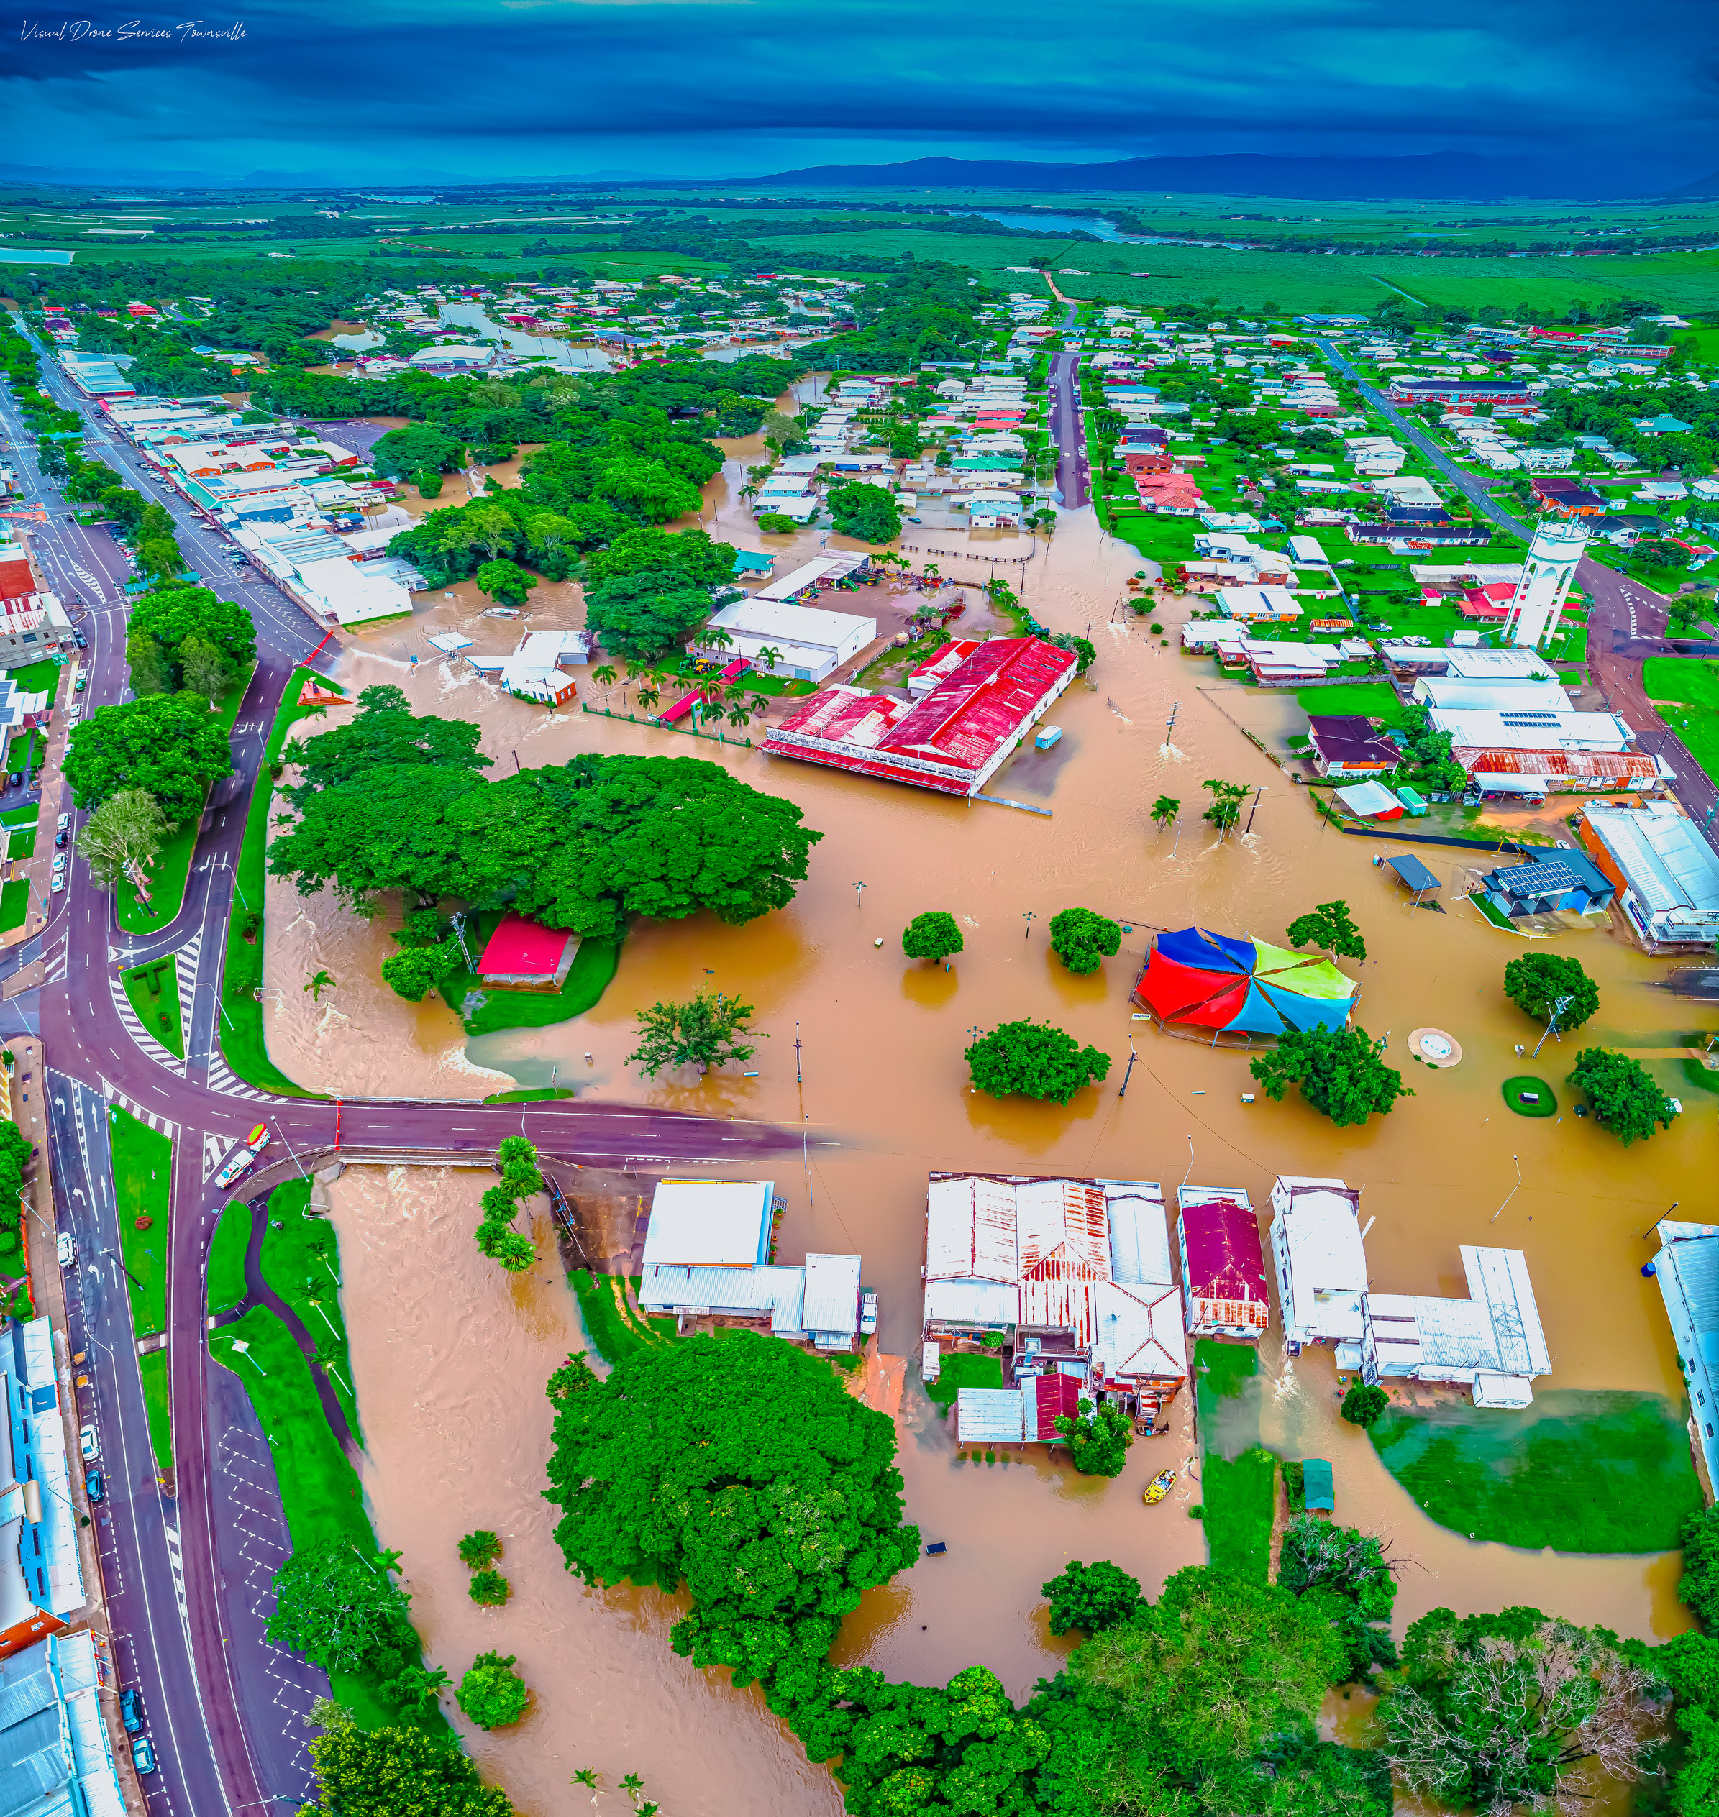
Why did the flood happen?
(Why was there a need to build an Ark?)

Slide 7
Genesis 6:5-12, 17
  “Then the Lord saw the wickedness of man was great in the earth,” – vs. 5
  “and that every intent of the thoughts of his heart was only evil continually” – vs. 5
  “The earth was also corrupt before God and the earth was filled with violence” – vs. 11
  “So God looked upon the earth, and indeed it was corrupt; for all flesh had corrupted their way on the Earth” – vs. 12

Slide 8
Genesis 6:5-12, 17
God saw that there was wickedness on the earth and decided to destroy men, beasts, creeping things, and birds of the air – vs. 17

Slide 9
“For all that is in the world—the lust of the flesh, the lust of the eyes, and the pride of life—is not of the Father but is of the world.”
1 John 2:16

Slide 10
Other historic events of the wickedness and judgement of man!
Sodom & Gomorrah – Genesis 18 – 19
David – 2 Samuel 11 – 12
The Israelites – Hebrews 3:7-11
These events shared similarities of spiritual corruption and destruction – 2 Peter 3:1-10
“But the heavens and the earth which are now preserved by the same word, are reserved for fire until the day of judgment and perdition of ungodly men.” – vs. 7

Slide 11
Reminder!!!
  2 Peter 3:11-15
  “Therefore, since all these things will be dissolved, what manner of persons ought you to be in holy conduct and godliness, looking for and hastening the coming of the day of God....
  Therefore, beloved, looking forward to these things, be diligent to be found by Him in peace, without spot and blameless; and consider that the longsuffering of our Lord is salvation....”

Slide 12
Noah pleased God
Genesis 6:9
  Perfect
  in his generations
  Walked with God
  A just man

Slide 13
Perfect doesn’t mean sinless!
- Romans 3:23 -
“But let patience have its perfect work, that you may be perfect and complete, lacking nothing.”
James 1:4

Slide 14
-THE PLAN-
DESIGN
AND
INTEGRATION

Slide 15
Genesis 6:14-17
  The Ark was to be constructed of “gopherwood”
  It was to measure 300 cubits long, 50 cubits wide, and 30 cubits high (with an 18-inch cubit = 450 x 75 x 45 feet)
  Three decks with “rooms”
  Covered in “pitch,” inside and out
  One door in the side
  One opening/”window” at the top
  A covering/awning over the opening

Slide 16
Did Noah have any experience on building an ark that size?
Did God give him a due date?
Did Noah have a valid/legit excuse to not build an ark that was approximately 450ft long, 75ft wide & 45ft high?
“Thus Noah did; according to all that God commanded him, so he did.” - Genesis 6:22
We know that Noah didn’t accomplish this built by himself.
God helped him!
What are some ways you can think God helped Noah with this plan?
Notes:
For the sake of the class, how do you think God helped Noah?

Slide 17
Genesis 7:1-5
  God told Noah to come inside the ark with his wife, his 3 sons and their wives.
  God said to bring 7 of every clean animal; 2 of every unclean animal (male and female).
  Noah didn’t complain!
  “And Noah did according to all that the Lord commanded him.” – vs 5

Slide 18
Noah’s
Faithfulness earned him salvation!

Slide 19
Genesis 8:1-19
“Then God remembered Noah, and every living thing, and all the animals that were with him in the ark”
“…eight souls, were saved through water.”
1 Peter 3:20
Notes:
Through out this journey, god was with Noah the whole time. Noah didn’t lose sight of the goal – Salvation!

Slide 20
Noah’s faith caused him to prepare an ark!
“By faith Noah, being divinely warned of things not yet seen, moved with godly fear, prepared an ark for the saving of his household, by which he condemned the world and became heir of the righteousness which is according to faith.”
Hebrews 11:7

Slide 21
The Bible defines faith as “the substance of things hoped for, the evidence of things not seen.”
Hebrews 11:1
Faith is Believe
Faith is Obedience
Faith is Action
Faith is Trust
Notes:
Faithfulness lead us to Salvation!

Slide 22
“But without faith it is impossible to please Him, for he who comes to God must believe that He is, and that He is a rewarder of those who diligently seek Him.”
Hebrews 11:6
“For since the creation of the world His invisible attributes are clearly seen, being understood by the things that are made, even His eternal power and Godhead, so that they are without excuse.”
Romans 1:20

Slide 23
What can we learn from noah’s faith?
Servant – Noah did as God commanded him
Leader – Noah lead his family
Optimistic – Noah didn’t get discouraged
Commitment – Noah committed to the plan
Communicate – Noah delegated
Courage - Listen - Believe - Trust - Responsible

Slide 24
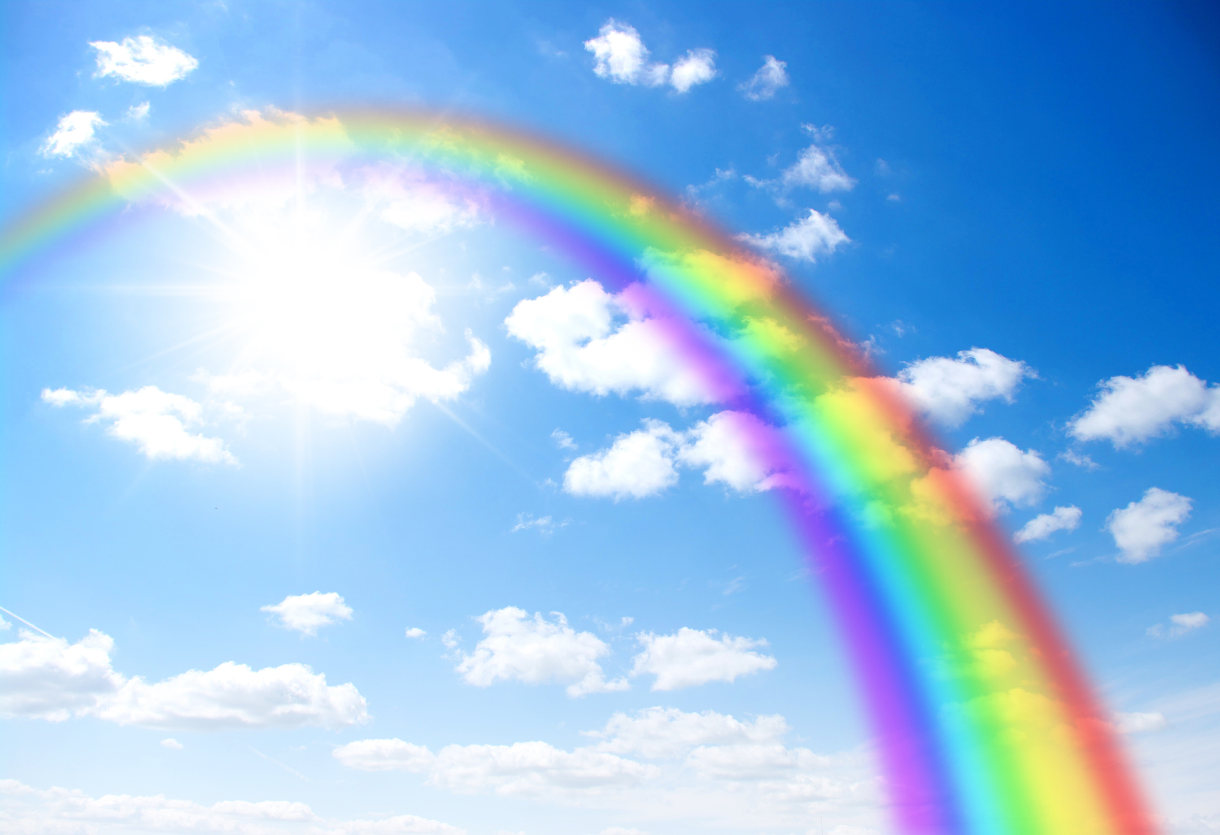
God’s promise
As a result of his faithfulness and
obedience God made a promise with
Noah to never destroy every living
creature with a flood.
The sign of this covenant was a rainbow.
Genesis 9:12-17

Slide 25
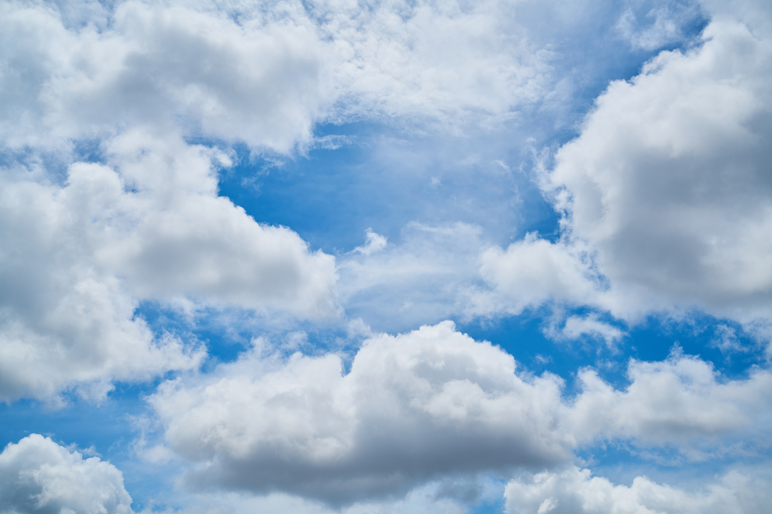
Abraham, Isaac, Jacob, and Joseph were faithful.
Sarah was faithful.
Moses was faithful.
Noah was faithful.
Are you faithful?

Slide 26

NOT ALL OF OUR QUESTIONS
ARE GOING TO HAVE ANSWERS
“The secret things belong to the Lord our God, but those things which are revealed belong to us and to our children forever, that we may do all the words of this law.”
DEUTERONOMY 29:29
2 PETER 1:3
2 TIMOTHY 3:16-17
ISAIAH 55:9

Slide 27
GOD DOES NOT - AND WILL NOT
ASK US TO DO THE IMPOSSIBLE
“No temptation has overtaken you except such as is common to man; but God is faithful, who will not allow you to be tempted beyond what you are able, but with the temptation will also make the way of escape, that you may be able to bear it.”
I CORINTHIANS 10:13
PSALM 103:14
MATTHEW 28:18-20
EPHESIANS 6:10-20
2 CORINTHIANS 12:7-10

Slide 28
IF WE DO OUR PART, GOD WILL DO HIS PART!
5 Who then is Paul, and who is Apollos, but ministers through whom you believed, as the Lord gave to each one?
6 I planted, Apollos watered, but God gave the increase.
7 So then neither he who plants is anything, nor he who waters, but God who gives the increase.
I CORINTHIANS 3:5-7
MATTHEW 18:15-20,35
ROMANS 8:26
PHILIPPIANS 2:13

Slide 29
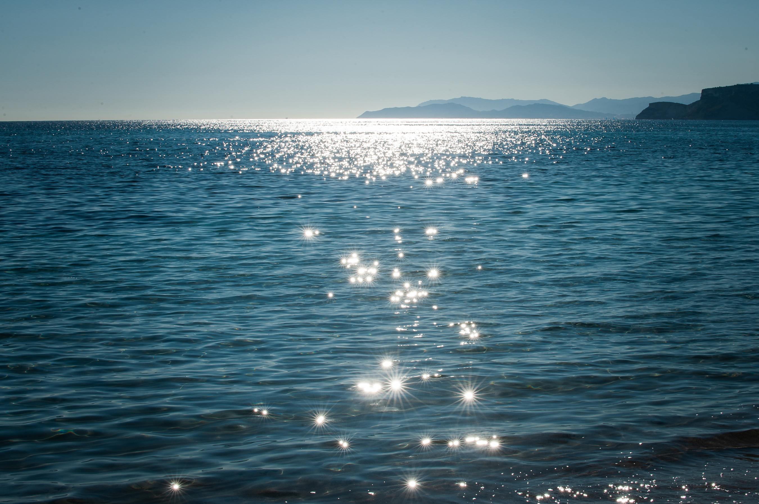
“Faith isn’t a feeling. It’s a choice to trust God even when the road ahead seems uncertain.”
Dave Willis

Slide 30
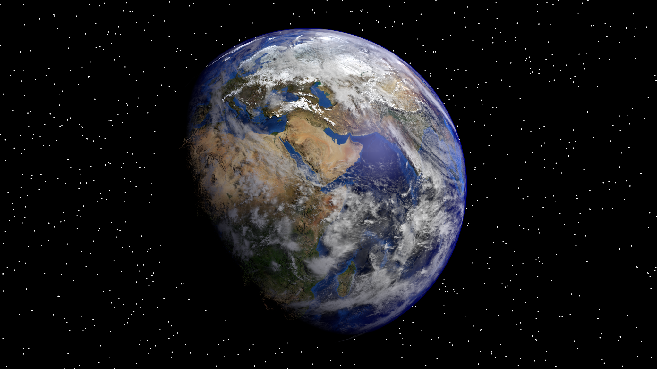
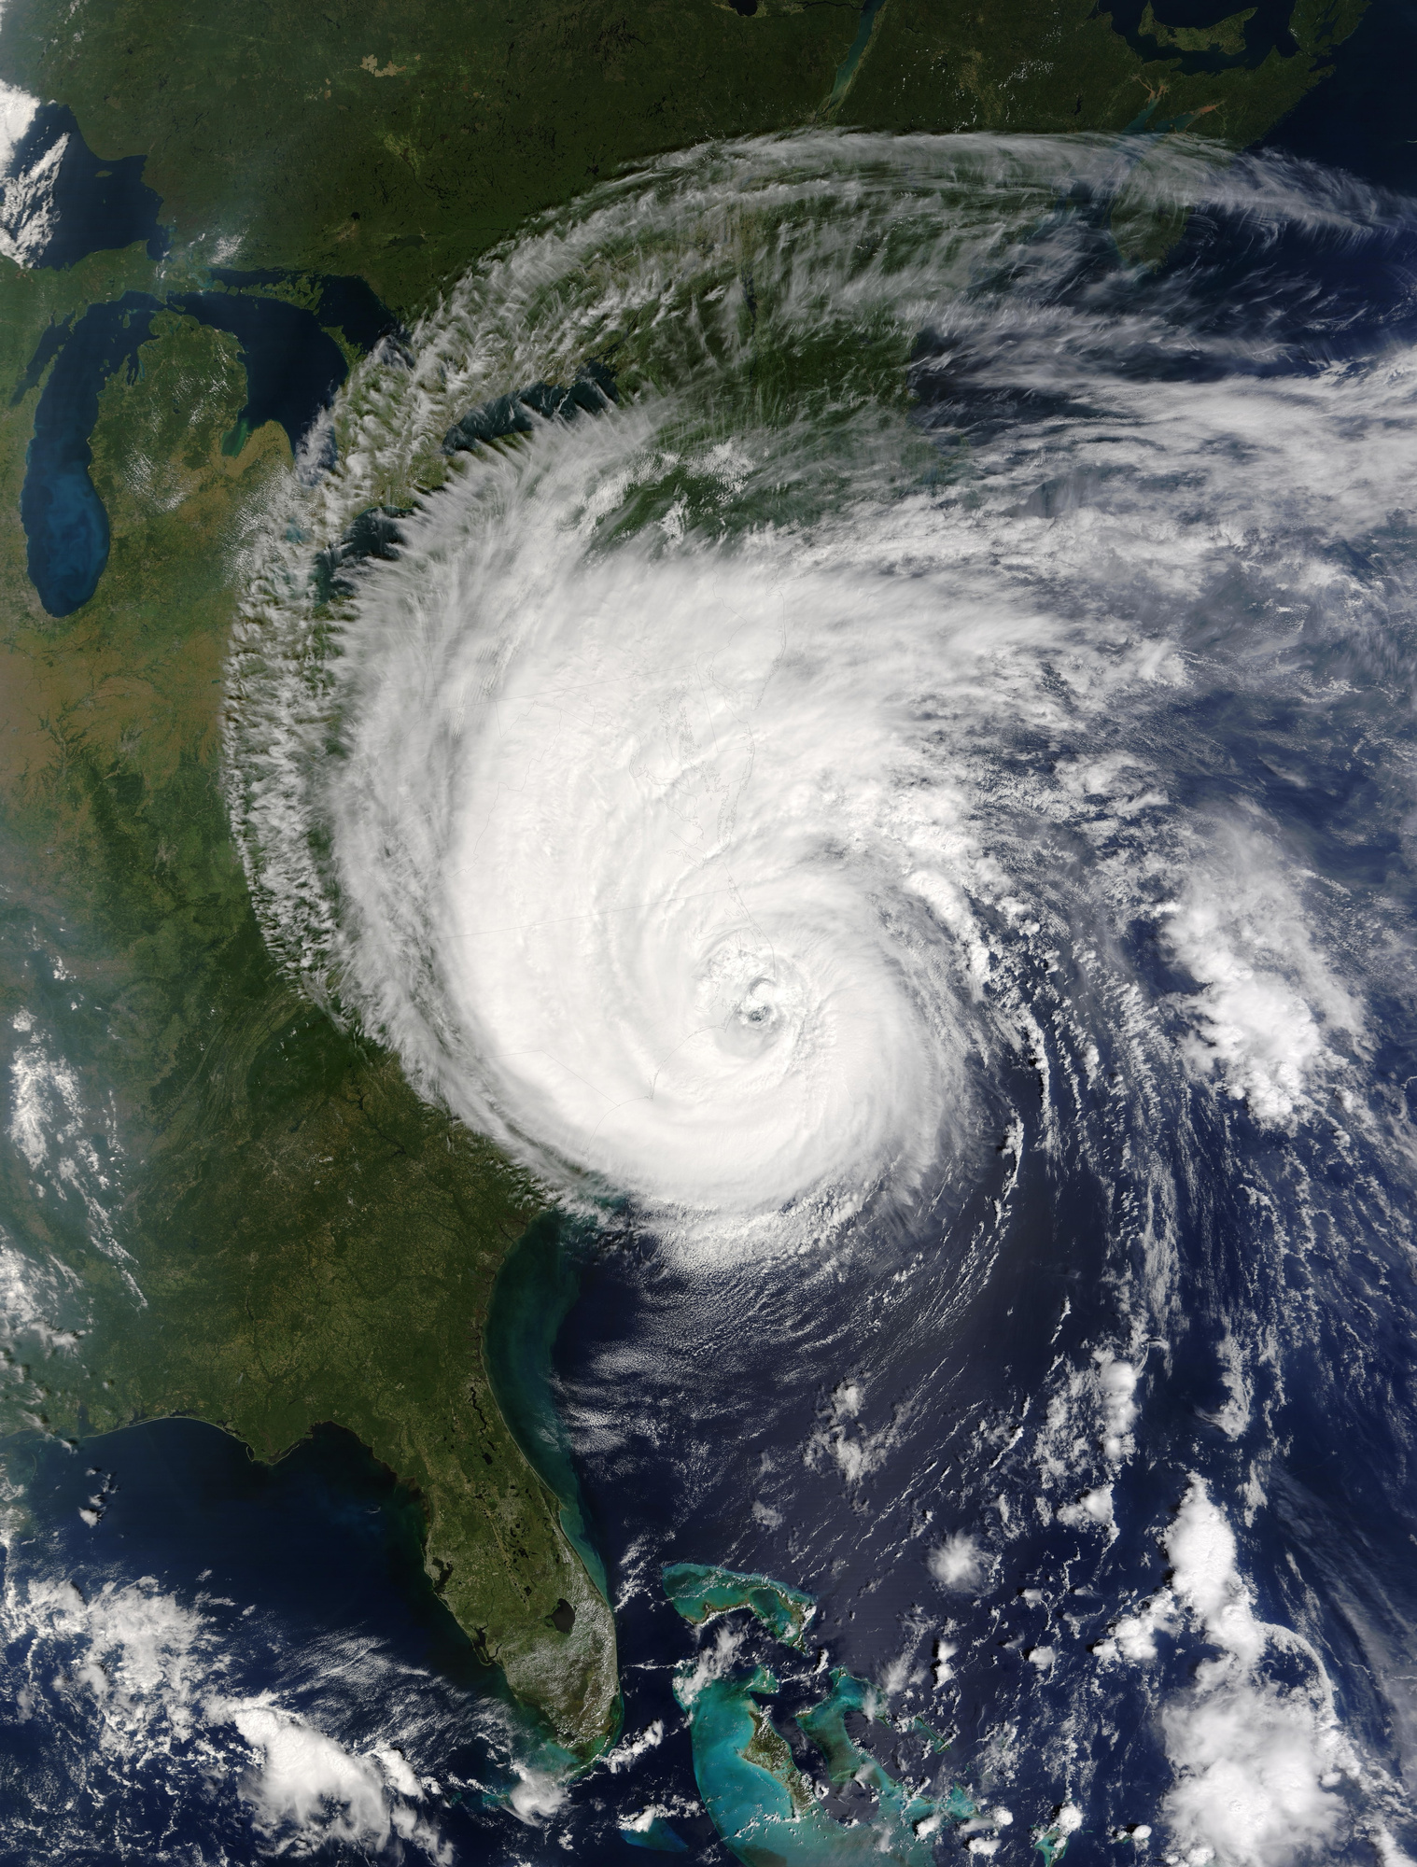
THANK YOU!

