Slide 1
CONVERSATIONS WITH GOD
But God ... I have a different plan

Slide 2
But God ... I have a different plan
The story of Jonah is in 4 parts
Chapter 1 The Prodigal Prophet
Chapter 2 The Praying Prophet
Chapter 3 The Preaching Prophet
Chapter 4 The Pouting Prophet

Slide 3
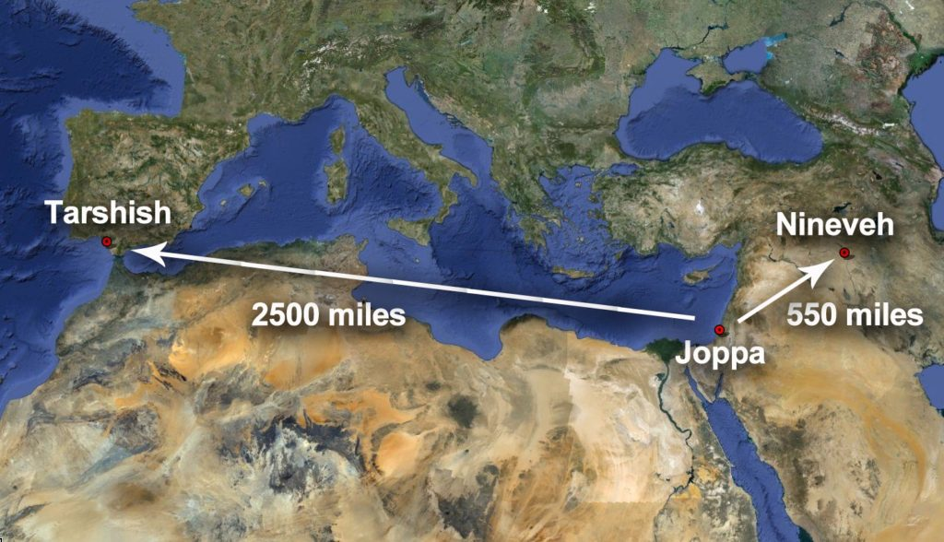

Slide 4
But God ... I have a different plan
God loves all mankind and wants to see them saved
Salvation is not possible without God
Salvation always includes genuine repentance
The storyline is about a prophet and a big fish but Jesus’ death, burial and resurrection are being foreshadowed

Slide 5
But God ... I have a different plan
Jonah’s 8 Word Sermon
Nineveh is the object of the sermon
A time limit of 40 days before destruction
The Ninevites have the obligation to repent
A refusal to repent yields destruction

Slide 6
But God ... I have a different plan
We must get out of our own way when praying to God
We must let God speak to us and accept His will
The Creator of the universe understands our needs
We have not because we ask not but it is possible to ask in the wrong way
There are times when God’s answer to our prayers might cause us discomfort (but consider the alternative)

