Slide 1
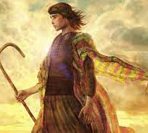
Joseph: A Study in Endurance
Sunday morning Bible class
Palm Beach Lakes church of Christ

Slide 2
Objectives
1. Recount the main events in the life of Joseph.
2. Appreciate Joseph’s faith as God was working in
the midst of his troubles.

Slide 3
Endurance
Define Endurance
Noun - the fact or power of enduring an unpleasant or
difficult process or situation without giving way.
Adjective - denoting or relating to a race or other sporting
event that takes place over a long distance.

Slide 4
Endurance
Bear Grylls
Crushed 3 vertebrates in a parachuting accident in Africa.
Became the youngest person to climb Mt. Everest.
“When times are tough, you really have to dig deep”
Juliane Koepcke
17-year-old went thru a plane crash. Survived for
10 days in the jungle with a broken collar bone and maggot infested
wounds.

Slide 5
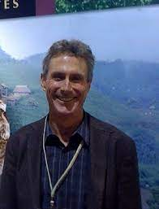
Endurance
Mark Allen
Greatest endurance athlete.
6-time winner of the Iron Man World Championship.
Won 20 straight triathlons.
Holds the fastest marathon split ever for Iron Man competition at 2:40:04.

Slide 6
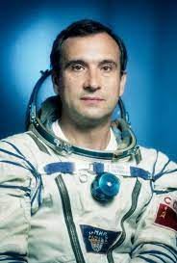
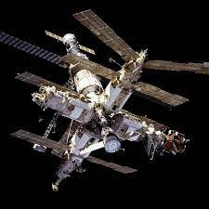
Endurance
Valeri Polyakov
Russian Cosmonaut
Logged 437 continuous days in space in Russia’s Mir Space Station

Slide 7
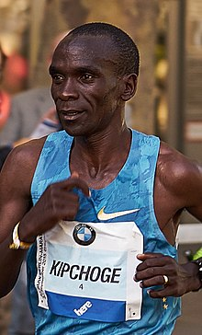
Endurance
Marathon - 26.21 miles
Eliud Kipchoge, Kenya.
1st place in 15 out of 18 Marathons.
In 2019, he ran a 1:59:40 marathon.

Slide 8
Endurance
Endurance Found in Animals
Artic turn - Migrate over 27,000 miles per year.
Ostrich - This big bird could run a marathon in 45 minutes.
Wolves - Can hunt for 30 miles a day. Speed up to 35 mph.
Grey Whales - Migrate 14,000 a year.
Great White Shark - 6,900 miles in 99 days.

Slide 9
Endurance
Other Acts of Endurance
70 years without food or water.
minutes without blinking.
622 minutes underwater with air apparatus.
8,264 hours without sleep.

Slide 10
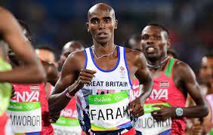
Endurance
The Bible Speaks About Perseverance and Endurance
Hebrews 12:1 Run with perseverance.
2 Timothy 2: 3-10 Endure hardship.
2 Timothy 4: 7 Fight the good fight.
1 Corinthians 9:24-27 Run in a way that you win.

Slide 11
Introduction - Joseph
Born in Mesopotamia, Haran
Parents: Jacob & Rachel. Rachel’s first born.
At six years old, the family moved to the land of Canaan.
Introduced to us at 17 years old (Genesis 37:2).

Slide 13
Introduction - Joseph
Historical Proof?
From the second millennium B.C.E. people from Canaan infiltrated the northeastern regions of Egypt. “Canaanites who had been living in the region had expanded and taken over much of the Eastern Nile Delta”
- Hallote , Purchase College of State University of New York.

Slide 14
Introduction - Joseph
Historical Proof?
In ancient Thebes, the tomb of an Egyptian ruler has paintings of slaves. Painted with the characteristics of previous tombs of Semitic people. One scene shows a man making bricks and overseeing them is a tall Egyptian.
- Paul Backholer, August 23, 2021

Slide 15
Introduction - Joseph
Historical Proof?
A canal was built from the Nile River to Lake Quarun. Built between 1850-1650 BC. In Arabic, the name of the canal is Bahr Yusef.
In English, The Waterway of Joseph.
BBC, July 6, 2009

Slide 16
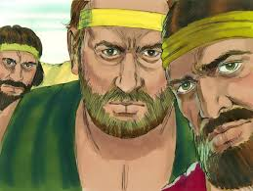
Endurance: Lesson 1
Joseph lived with his brothers that came from two different mothers (Gen. 37:2).
Jacob favored Joseph (Gen. 37:3).
His brothers were jealous (Gen. 37:4).
Joseph shares is dreams. His brothers became envious (Gen. 37: 5-11).

Slide 17
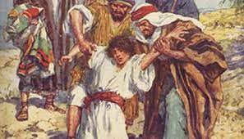
Endurance: Lesson 1
Joseph’s brothers were working. Joseph was not? (Gen. 37: 12-14)
Joseph’s brothers conspired to kill him (Gen. 37:18-20).
Reuben came to Joseph’s rescue (kind of) (Gen. 37:21-22).
The brothers carried out their plan (Gen. 37:23-35).
Joseph is sold to an Egyptian, Potiphar. God’s providence.

Slide 18
Endurance: Lesson 1
Endurance Takeaways
Endured hardship & jealousy.
Endured disgrace.
Endured separation and loneliness.
Never blamed God.

Slide 19
Endurance: Lesson 2
Joseph was a successful man and was in the house of his master (Gen. 39:2).
Joseph’s master saw that the Lord was with Joseph (Gen. 39:3).
Joseph was made an overseer of the house, and the house was blessed (Gen. 39:4,5).

Slide 20
Endurance: Lesson 2
Joseph was handsome (Gen. 39:6).
Potiphar’s wife desire him. Said, “lie with me” (Gen. 39:7).
Genesis 39:9 - Joseph refuses the advancements. And proclaims,” How can I do this great thing and sin against the Lord” (Isaiah 59:2; Romans 6:23; Galatians 5:19-21)
She came back again and again (Genesis 39:10).

Slide 21
Endurance: Lesson 2
Joseph is accused (Gen. 39:11-19).
Joseph is in prison, again (Gen. 39:21).
The Lord blessed Joseph (Gen. 39: 22-23).

Slide 22
Endurance Lesson 2
Endurance Takeaways
Joseph was able to stay away from sexual immorality.
Jospeh said that he couldn’t sin against God.
Joseph knew that all sin against God (Psalm 51:4).
Joseph demonstrates what “the fear of Lord” is all about (Psalm 111:10). That fear is the beginning of wisdom.

Slide 23
Endurance Lesson 3
Chapter 40 tells us a story of dreams being correctly
interpreted by Joseph. And Jospeh making a plea to be
remembered. But in Genesis 40:23 the chief butler did not remember
Joesph.
Takeaway: Joseph's faith caused him to not stumble or
torn away from God.

Slide 24
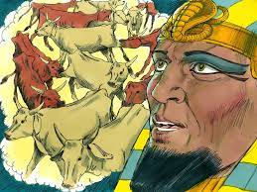
Endurance Lesson 4
Pharoah has a dream
Chapter 41.
Look at what Joseph said in verse 17.
“It is not in me; God will give Pharoah an answer of peace.”

Slide 25
Endurance Lesson 4
Joseph tells Pharoah the meaning of his dream.
7 years of plenty and 7 years of famine.
And God gave Pharoah a plan (Gen. 41: 34-36).
Pharoah appoints Joesph to a high position (Gen. 41:37-46).

Slide 26
Endurance & Forgiveness Lesson 5
Chapters 42-50
Joseph is confronted with his brothers’ presence.
Joseph had a very important decision to make.

Slide 27
Endurance & Forgiveness Lesson 5
Joseph decided to forgive his brothers
Once again, Joseph gave God the credit.
Genesis 50:20
“But as for you, you meant evil against me; but God meant it for good,
in order to bring it about as it is this day, to save many people
alive”.

Slide 28
Endurance & Forgiveness Lesson 5
What do would we call “in order to bring it about” ?

Slide 29
Endurance & Forgiveness Lesson 5
What do would we call “in order to bring it about”
Providence

Slide 30
Endurance & Forgiveness Lesson 5
Endurance in Forgiveness
It is commanded and your salvation is dependent on it (Matt 6:14,15).
Christ forgave us, we forgive others (Colossians 3:13).
Forgive and you will be forgiven (Luke 6:37).
Peter’s question about forgiveness (Matthew 18:21-22).
Parable of the unforgiving servant (Matthew 18).

Slide 31
More on Endurance
Endurance in faithfulness
Endurance in evangelism
Endurance in good works.
Endurance in patience.

Slide 32
Apologetics Press App

