Slide 1
My Favorite Bible Character Daniel: A Man of Great Courage
August 13, 2023
Dan McLeod
Notes:
Some good thoughts on Daniel
Daniel
Kingdoms in Conflict
Andrew Reid
A book by Aquila Press
First published by the Anglican Information Office in August 1993
Republished by Aquila Press in August 2004
Reprinted 2018
© Copyright Andrew Reid 1993
Andrew Reid, Daniel: Kingdoms in Conflict, ed. Paul Barnett, Reading the Bible Today Series (Sydney, South NSW: Aquila Press, 2004), i–ii.

Slide 2
Background Setting
Definition of Courage
Daniel’s Courage
Building Courage
Daniel’s source of courage

Slide 3
Background of Daniel
Captivity (Daniel 1: 1-7) 603 BC
Jerusalem captured, great massacre’s, removed articles of worship from the Temple, Temple and all of Jerusalem destroyed. Jerusalem left desolate!
Young Boys: Daniel, Hananiah, Mishael, Azariah brought to Babylon
Notes:
Star Trek “Borgs”: You will be assimilated; Resistance is Futile!

Slide 4
Background of Daniel
Assimilation into Chaldean Culture; Stripping them of their Distinctiveness as Israelites
Separated from their families
Learned Babylonian Language
Segregated from the outside: inside the Kings court
Must eat the food of the Kings
Renamed using Babylonian names; Belteshazzar, Shadrach, Meshach, Abed-Nego
Educated in the Babylonian ways
Dressed in Babylonian clothing
Surrounded by pagan worship
Temple articles placed in pagan temples
Led by a great King who thought that it was HIS accomplishments that made Babylon great
How did these young Boys attain and retain their faith?
Notes:
Star Trek “Borgs”: You will be assimilated; Resistance is Futile!

Slide 5
What were these young men experiencing?
Shock from the capture and destruction of God’s People?
Separation from family, fellowship, religion, culture, clothing, language, food, traditions, feasts, worship, reading of the scriptures
Questioning!
Why did God let this happen to His nation?
Where is God now?
When will God bring justice to this pagan nation?
When will God establish His everlasting Kingdom?
God gives Daniel answers to these questions!

Slide 6
Courage
Definition
Hebrew: Be Strong, Strengthen, let grow strong, make firm (Num 13:17-20; Deut 31:1-8; 22-23; Joshua 1:1-9 IBID
Deuteronomy 31:6 (NKJV)
⁶ Be strong and of good courage, do not fear nor be afraid of them; for the Lord your God, He is the One who goes with you. He will not leave you nor forsake you.”
Modern English: mental or moral strength to venture, persevere, and withstand danger, fear, or difficulty
We will see the characteristics of Courage as we study

Slide 7
Daniel's Courage before the chief of the eunuchs
Daniel 1:8 (NKJV)
⁸ But Daniel purposed in his heart that he would not defile himself with the portion of the king’s delicacies, nor with the wine which he drank; therefore he requested of the chief of the eunuchs that he might not defile himself.
Turn in your Bibles to Daniel 1:8-21
V8 Daniel purposed in his hear!
V9 God brought Daniel into the favor and goodwill of the chief of the eunuchs
V11-12 Daniel took the initiative
V17 God gave them knowledge and skill, and Daniel understanding in visions and dreams
God is working His will against earthly kingdoms through Daniel

Slide 8
Daniel’s Courage before Nebuchadnezzar
Daniel 2:10–13 (NKJV)
¹⁰ The Chaldeans answered the king, and said, “There is not a man on earth who can tell the king’s matter; therefore no king, lord, or ruler has ever asked such things of any magician, astrologer, or Chaldean. ¹¹ It is a difficult thing that the king requests, and there is no other who can tell it to the king except the gods, whose dwelling is not with flesh.” ¹² For this reason the king was angry and very furious, and gave the command to destroy all the wise men of Babylon. ¹³ So the decree went out, and they began killing the wise men; and they sought Daniel and his companions, to kill them.

Slide 9
Daniel’s Courage before Nebuchadnezzar
Daniel 2:14–16 (NKJV)
14 Then with counsel and wisdom Daniel answered Arioch, the captain of the king’s guard, who had gone out to kill the wise men of Babylon; 15 he answered and said to Arioch the king’s captain, “Why is the decree from the king so urgent?” Then Arioch made the decision known to Daniel. 16 So Daniel went in and asked the king to give him time, that he might tell the king the interpretation.

Slide 10
Daniel 2:17–19 (NKJV)
¹⁷ Then Daniel went to his house, and made the decision known to Hananiah, Mishael, and Azariah, his companions, ¹⁸ that they might seek mercies from the God of heaven concerning this secret, so that Daniel and his companions might not perish with the rest of the wise men of Babylon. ¹⁹ Then the secret was revealed to Daniel in a night vision. So Daniel blessed the God of heaven.
Daniel took the initiative with counsel and wisdom
Daniel asked the King for time
Daniel and his friends sought mercies from the God of heaven
Daniel blessed the God of heaven

Slide 11
Daniel 2:27–30 (NKJV)
²⁷ Daniel answered in the presence of the king, and said, “The secret which the king has demanded, the wise men, the astrologers, the magicians, and the soothsayers cannot declare to the king. ²⁸ But there is a God in heaven who reveals secrets, and He has made known to King Nebuchadnezzar what will be in the latter days. Your dream, and the visions of your head upon your bed, were these: ²⁹ As for you, O king, thoughts came to your mind while on your bed, about what would come to pass after this; and He who reveals secrets has made known to you what will be. ³⁰ But as for me, this secret has not been revealed to me because I have more wisdom than anyone living, but for our sakes who make known the interpretation to the king, and that you may know the thoughts of your heart.
Daniel proclaimed the living God in heaven and gave God the preeminence

Slide 12
Daniel 2:27–30 (NKJV)
⁴⁴ And in the days of these kings the God of heaven will set up a kingdom which shall never be destroyed; and the kingdom shall not be left to other people; it shall break in pieces and consume all these kingdoms, and it shall stand forever. ⁴⁵ Inasmuch as you saw that the stone was cut out of the mountain without hands, and that it broke in pieces the iron, the bronze, the clay, the silver, and the gold—the great God has made known to the king what will come to pass after this. The dream is certain, and its interpretation is sure.”
Daniel proclaimed the living God in heaven and gave God the preeminence

Slide 13
Daniel's Courage before Belshazzar
Daniel 5:22–23 (NKJV)
²² “But you his son, Belshazzar, have not humbled your heart, although you knew all this. ²³ And you have lifted yourself up against the Lord of heaven. They have brought the vessels of His house before you, and you and your lords, your wives and your concubines, have drunk wine from them. And you have praised the gods of silver and gold, bronze and iron, wood and stone, which do not see or hear or know; and the God who holds your breath in His hand and owns all your ways, you have not glorified.
Daniel spoke the forceful truth without fear
Daniel condemned the profane actions using the vessels of His house
Daniel proclaimed the living God and judge of Belshazzar

Slide 14
Daniel's Courage before Darius
Turn in your Bibles to Daniel 6:1-28
Daniel 6:10 (NKJV)
¹⁰ Now when Daniel knew that the writing was signed, he went home. And in his upper room, with his windows open toward Jerusalem, he knelt down on his knees three times that day, and prayed and gave thanks before his God, as was his custom since early days.
Daniel fearlessly continued his prayers to God in the plain sight of all
Daniel Trusted his God
Daniel gave thanks before his God

Slide 15
Daniel's Courage before Darius
Turn in your Bibles to Daniel 6:1-28
Daniel 6:18–23 (NKJV)
¹⁸ Now the king went to his palace and spent the night fasting; and no musicians were brought before him. Also his sleep went from him. ¹⁹ Then the king arose very early in the morning and went in haste to the den of lions. ²⁰ And when he came to the den, he cried out with a lamenting voice to Daniel. The king spoke, saying to Daniel, “Daniel, servant of the living God, has your God, whom you serve continually, been able to deliver you from the lions?” ²¹ Then Daniel said to the king, “O king, live forever! ²² My God sent His angel and shut the lions’ mouths, so that they have not hurt me, because I was found innocent before Him; and also, O king, I have done no wrong before you.” ²³ Now the king was exceedingly glad for him, and commanded that they should take Daniel up out of the den. So Daniel was taken up out of the den, and no injury whatever was found on him, because he believed in his God.
Daniel fearlessly continued his prayers to God in the plain sight of all
Daniel Trusted his God
Daniel gave thanks before his God

Slide 16
What builds Godly Courage?
Knowledge: of God’s Word
Firmness of Mind: Applying God’s word and will in our lives
Servitude: Completely subject to God
Trust: Dependence on God
Fortitude: strength of mind that enables a person to encounter danger or bear pain or adversity with courage; Our willingness to suffer to achieve the objective
Temperament: personality traits that determine how someone reacts to the world; Building our temperament toward Godly actions
Tenacity: mental or moral strength to resist opposition, danger, or hardship. NEVER Give UP! Stand fast!
Prayer: Petitioning our Father to give us Courage

Slide 17
Daniel’s Prayer—His source of Courage
Daniel 9:3–7 (NKJV)
³ Then I set my face toward the Lord God to make request by prayer and supplications, with fasting, sackcloth, and ashes. ⁴ And I prayed to the Lord my God, and made confession, and said, “O Lord, great and awesome God, who keeps His covenant and mercy with those who love Him, and with those who keep His commandments, ⁵ we have sinned and committed iniquity, we have done wickedly and rebelled, even by departing from Your precepts and Your judgments. ⁶ Neither have we heeded Your servants the prophets, who spoke in Your name to our kings and our princes, to our fathers and all the people of the land. ⁷ O Lord, righteousness belongs to You, but to us shame of face, as it is this day—to the men of Judah, to the inhabitants of Jerusalem and all Israel, those near and those far off in all the countries to which You have driven them, because of the unfaithfulness which they have committed against You.

Slide 18
Daniel’s Prayer
Daniel 9:13–19 (NKJV)
¹³ “As it is written in the Law of Moses, all this disaster has come upon us; yet we have not made our prayer before the Lord our God, that we might turn from our iniquities and understand Your truth. ¹⁴ Therefore the Lord has kept the disaster in mind, and brought it upon us; for the Lord our God is righteous in all the works which He does, though we have not obeyed His voice. ¹⁵ And now, O Lord our God, who brought Your people out of the land of Egypt with a mighty hand, and made Yourself a name, as it is this day—we have sinned, we have done wickedly! ¹⁶ “O Lord, according to all Your righteousness, I pray, let Your anger and Your fury be turned away from Your city Jerusalem, Your holy mountain; because for our sins, and for the iniquities of our fathers, Jerusalem and Your people are a reproach to all those around us. ¹⁷ Now therefore, our God, hear the prayer of Your servant, and his supplications, and for the Lord’s sake cause Your face to shine on Your sanctuary, which is desolate. ¹⁸ O my God, incline Your ear and hear; open Your eyes and see our desolations, and the city which is called by Your name; for we do not present our supplications before You because of our righteous deeds, but because of Your great mercies. ¹⁹ O Lord, hear! O Lord, forgive! O Lord, listen and act! Do not delay for Your own sake, my God, for Your city and Your people are called by Your name.”

Slide 19
Applying Daniel's Courage
2 Corinthians 4:7–18 (NKJV)
⁷ But we have this treasure in earthen vessels, that the excellence of the power may be of God and not of us. ⁸ We are hard-pressed on every side, yet not crushed; we are perplexed, but not in despair; ⁹ persecuted, but not forsaken; struck down, but not destroyed—¹⁰ always carrying about in the body the dying of the Lord Jesus, that the life of Jesus also may be manifested in our body. ¹¹ For we who live are always delivered to death for Jesus’ sake, that the life of Jesus also may be manifested in our mortal flesh. ¹² So then death is working in us, but life in you. ¹³ And since we have the same spirit of faith, according to what is written, “I believed and therefore I spoke,” we also believe and therefore speak, ¹⁴ knowing that He who raised up the Lord Jesus will also raise us up with Jesus, and will present us with you. ¹⁵ For all things are for your sakes, that grace, having spread through the many, may cause thanksgiving to abound to the glory of God.
¹⁶ Therefore we do not lose heart. Even though our outward man is perishing, yet the inward man is being renewed day by day. ¹⁷ For our light affliction, which is but for a moment, is working for us a far more exceeding and eternal weight of glory, ¹⁸ while we do not look at the things which are seen, but at the things which are not seen. For the things which are seen are temporary, but the things which are not seen are eternal.

Slide 21
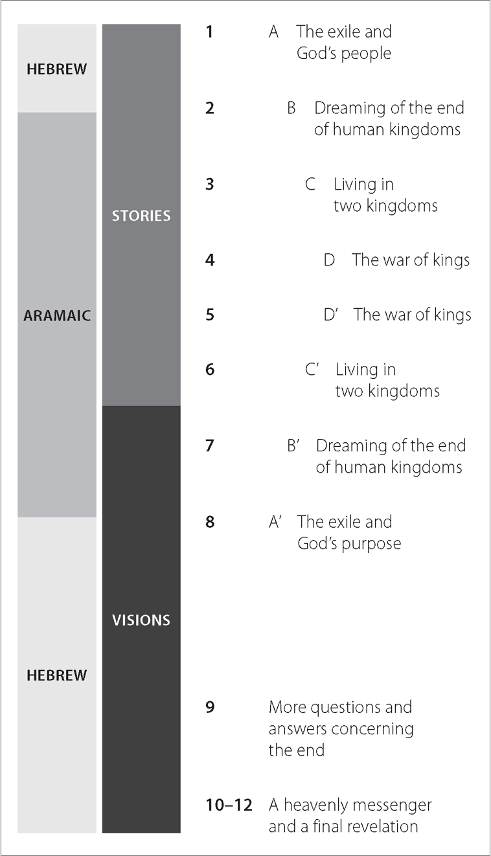
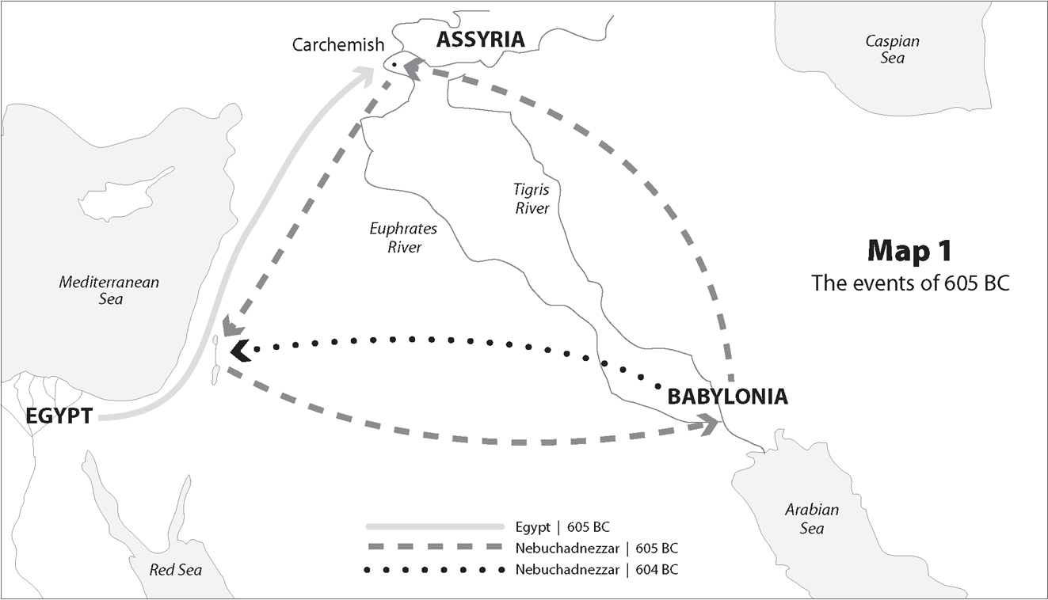
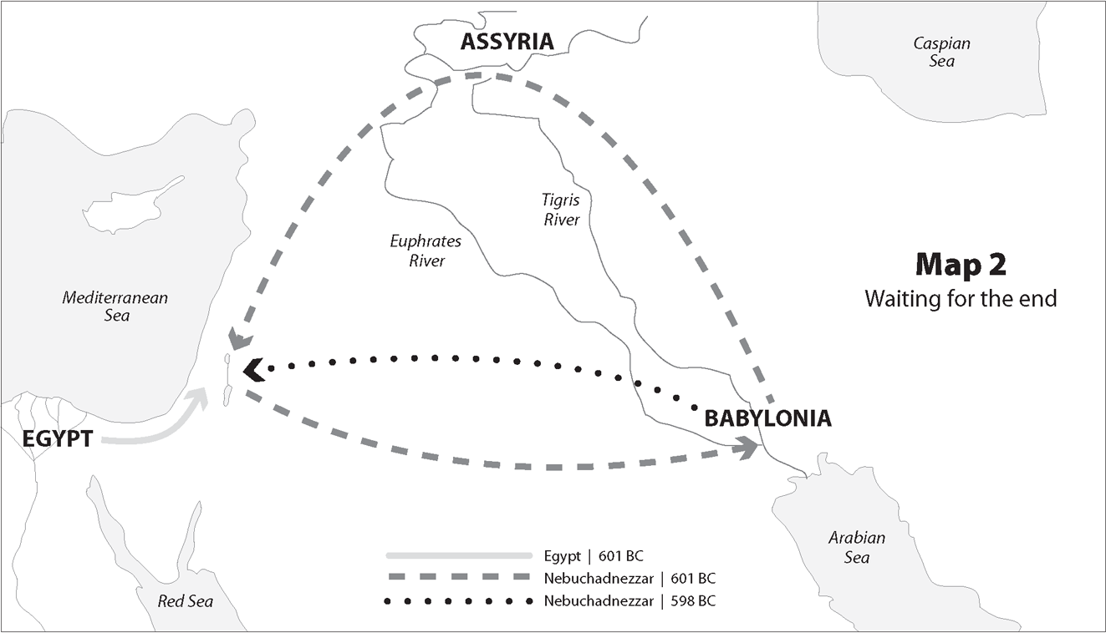
Footnotes

