Slide 2
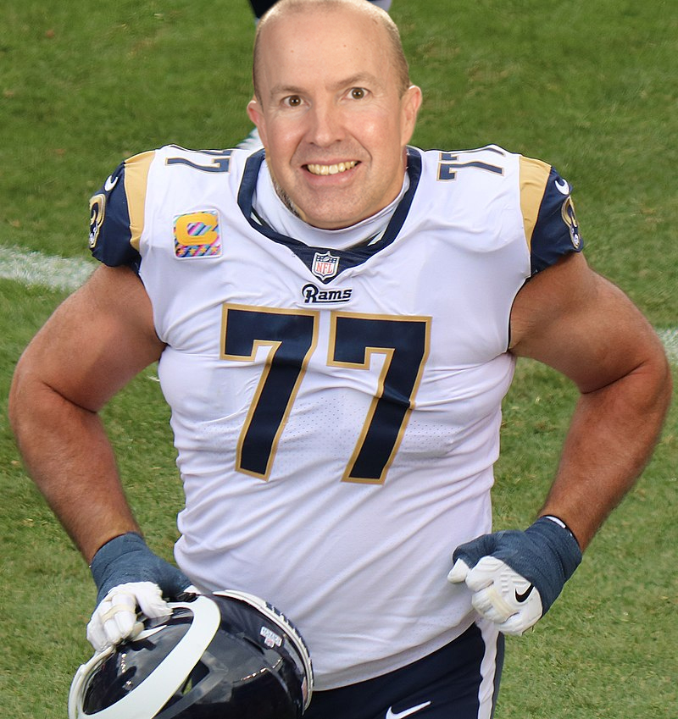
When it comes to…Possessions?
When it comes to…Income?
When it comes to…Driving?
When it comes to…Behaviors?
When it comes to…Requirements?
When it comes to…Identity?
When it comes to…Religion? (Acts 26:9-11)

Slide 3
Feelings can be (usually are) sincere and feel right (Acts 23:1)
Feelings can be (often are) deeply imbedded (Acts 10:13-16, 28; Gal. 2:11-13)
Feelings can be (often are) influenced by other people (Acts 12:3; John 12:43)
Feelings can be (often are) misguided and manipulated (Gen. 37:31-34)
Feelings can be (often are) subject to conditions (Gen. 37:3-8)
Feelings can (often do) change (Gen. 45:15; 50:15-21)
Feelings can (usually do) vary by person (Gen. 37:18-30)
Feelings make me feel right when I am wrong (1 Tim. 1:13, 15; Eph. 3:8)

Slide 4
Putting my ideas above God’s (cf. 2 Kgs. 5:11; Rom. 10:3)
“I myself thought”
Making myself the authority, not God (cf. Matt. 7:22)
“I must do many things contrary to the name of Jesus of Nazareth”
Elevating what others say over what God says (cf. 1 Kgs. 13:15-26)
“having received authority from the chief priests”
Going along with the crowd (cf. Acts 19:29, 32; Ex. 23:2)
“I cast my vote against them”
Using my influence to press my feelings on others (cf. Gal. 6:3; 1 John 4:1)
“I punished them often in every synagogue”
Forcing my opinion on others (cf. Rev. 13:15-17)
“I tried to force them to blaspheme…I kept pursuing them”

Slide 5
My feelings do not change objective realities
My feelings do not change or determine anything about God (Acts 17:29)
Not the will of God – His intended life for me (Tit. 2:11-14; 1 Pet. 3:8-12)
Not the Word of God – His objective truth to me (Psa. 119:89; 1 Pet. 1:23-25)
Not the weight of God – His supreme authority over me (Col. 3:17; Matt. 28:18)
Not the work of God – His created design of me (Matt. 19:4; Psa. 139:13-16)
My feelings can & must be controlled and trained (1 Cor. 6:9-11; Gal. 5:19-24)
My feelings must be conformed to God’s will (Luke 22:42; Rom. 12:2; Jas. 4:7)
My feelings, if not controlled, can (and will) lead me to hell (Prov. 14:12)
Feelings are not a safe or reliable guide!
When something is set by definition, properties and authority, nothing I feel can change it! Right is always right!

Slide 6
Someone may say, “I feel like I’m on the right path and going to heaven.”
Someone may say, “I feel like I’m in the right church.”
Someone may say, “I feel like I’m saved.”
There is only one way to know you are saved, in the right church and on the only path to heaven = follow God’s truth + compare what you did to it
Believe Jesus is God’s Son – Acts 16:31
Repent of your sins and turn to God – Acts 17:30
Confess your faith in Jesus Christ – Romans 10:9
Be immersed into Christ – Acts 2:38
Then, you are saved, in Christ’s church and enrolled in heaven – Hebrews 12:23
Serve the Lord faithfully – 1 Corinthians 15:58

