Slide 1
Creating Community
In The
Church

Slide 2
We have responsibilities
Toward our God
Toward our neighbor
Toward our brother/sister
Toward ourselves

Slide 3
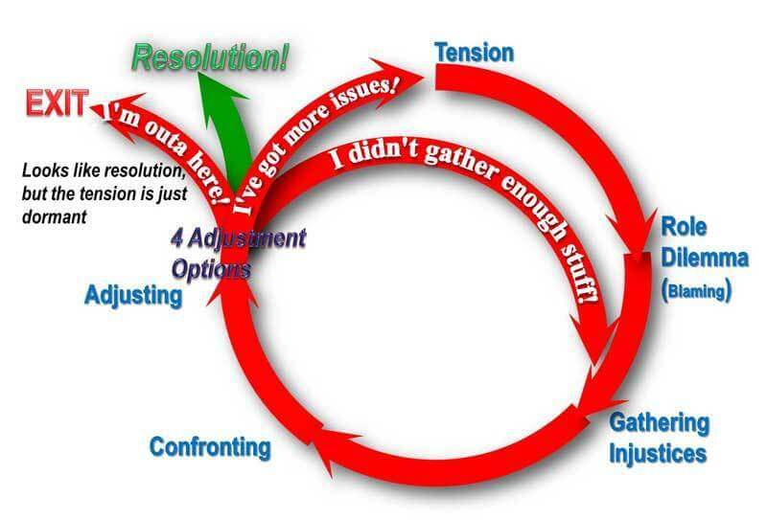

Slide 4
When Conflict Happens
What do I take away from this?
I might need to talk with someone.
How I deal with conflict could be better.
Am I vilifying anyone right now?
How is my communication?
Would I be considered a peacemaker?
Am I using conflict as a weapon?
I can be assertive and a Christian.

Slide 5
Responsibilities Towards the New & Visiting
If I love God and my neighbor?
I need to rejoice with heaven (Luke 15:7)
Be a part of someone finding truth (Matthew 7:7-8)
Help someone grow (Colossians 1:28-29)

Slide 6
Responsibilities Towards the New & Visiting
Cultural Adaptation Curve
Happiness Meter | High
 | Normal
 | Low
 | 1 |  | 2 | 3 | 4 | 5 | 6
 | Months
At Home
Honeymoon
Hostility
Humor

Slide 7
Responsibilities Towards the New & Visiting
How can these help with culture shock?
Love
Devoted to
Give preference to
Same mind toward
Consider
Encourage
Tolerate
Hospitable
Build up
Admonish
Serve
Bear the burdens of
Forgive
Pray for

Slide 8
Responsibilities Towards the New & Visiting
Some passages to consider
Romans 14:1-23
1 Corinthians 8:1-13
Colossians 2:16-23
Galatians 2:15-21
Colossians 3:5-10

Slide 9
Responsibilities Towards the New & Visiting
Some Do’s and Don’ts
Do Greet them. Don’t stand there with your friends, point, and ask, “Who are those people?” Go up and say hello. Give them your name.
Do offer to show them to class, and help their kids find class if they have any.
Don’t simply tell them where the classes are, take them. While you are going tell them the order of services, how long till Bible class starts, and how long is the break between services. Also, about special programs for their kids, or for their age group.

Slide 10
Responsibilities Towards the New & Visiting
Some Do’s and Don’ts
Do introduce them to people, especially to people that they would have something in common.
Don’t overdo it. Be sensitive to their comfort. If they say they don’t want to do something don’t insist.
Do ask them if they have any questions. Often people will share about their biggest fear, or greatest need if we simply ask, “Do you have any questions, or needs that I can help you with?”
Don’t try to convert them in the foyer. Let them become comfortable.

Slide 11
Responsibilities Towards the New & Visiting
Some Do’s and Don’ts
Do ask them what brought them to our church today? Did a friend invite them? Did they see a sign? Was it advertising? Was it a personal need? A local visitor comes to church for a reason. Again by asking them we may find out how to meet their needs.
Don’t let them walk out without getting their contact information. Ask them to lunch, if they can’t go today, see if they would like to go next week.
Do give them some information from the foyer that would pertain to them.

