Slide 1

Creating
Community
In The
Church

Slide 2

We have responsibilities
Toward our God
Toward our neighbor
Toward our brother/sister
Toward ourselves

Slide 3
Responsibilities
Towards One Another
Love
Devoted to
Give preference to
Same mind toward
Consider
Encourage
Tolerate
Hospitable
Build up
Admonish
Serve
Bear the burdens of
Forgive
Pray for

Slide 4
Responsibilities
Towards One Another
“having been knit together in love” (Col. 2:2)
“and have put on the new self who is being renewed to a true knowledge according to the image of the One who created him— a renewal in which there is no distinction between Greek and Jew, circumcised and uncircumcised, barbarian, Scythian, slave and freeman, but Christ is all, and in all” (Col. 3:10-11)

Slide 5
When Conflict Happens
Things that work against us
Human nature
Wrong examples/understanding
Anger/emotions
Misconceptions of meekness
Fear of conflict
Bottling

Slide 6
When Conflict Happens
What does the Bible say about it?
Matthew 5:23-24; 18:15-17
Luke 17:3-4
James 1:19-20; Ephesians 4:26
Galatians 2:11-14; 6:1
1 Corinthians 6:1-8
Hebrews 12:14-15
Romans 12:21
1 Corinthians 13:4-7

Slide 7
When Conflict Happens
Proverbs About Conflict
A gentle answer turns away wrath, But a harsh word stirs up anger. (Pro 15:1)
A hot-tempered man stirs up strife, But the slow to anger calms a dispute. (Pro 15:18)
When a man's ways are pleasing to the LORD, He makes even his enemies to be at peace with him. (Pro 16:7)

Slide 8
When Conflict Happens
Proverbs About Conflict
A man's discretion makes him slow to anger, And it is his glory to overlook a transgression. (Pro 19:11)
A brother offended is harder to be won than a strong city, And contentions are like the bars of a citadel. (Pro 18:19)
A worthless man digs up evil, While his words are like scorching fire. A perverse man spreads strife, And a slanderer separates intimate friends. (Pro 16:27-28)

Slide 9
When Conflict Happens
Proverbs About Conflict
He who gives an answer before he hears, It is folly and shame to him. (Pro 18:13)
Do not go out hastily to argue your case; Otherwise, what will you do in the end, When your neighbor humiliates you? Argue your case with your neighbor, And do not reveal the secret of another, Or he who hears it will reproach you, And the evil report about you will not pass away. (Pro 25:8-10)

Slide 10
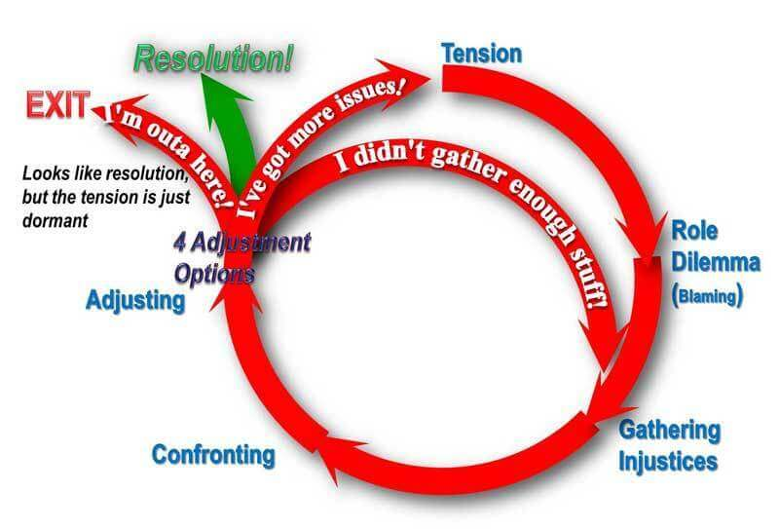

Slide 11
When Conflict Happens
What do I take away from this?
I might need to talk with someone.
How I deal with conflict could be better.
Am I vilifying anyone right now?
How is my communication?
Would I be considered a peacemaker?
Am I using conflict as a weapon?
I can be assertive and a Christian.

