Slide 1
The Book of Ruth
Palm Beach Lakes
May-July, 2023
Dan Jenkins

Slide 2
Background Study of the Book

Slide 3
Background Study of the Book
From Moses, the Exodus to the Promised Land

Slide 4
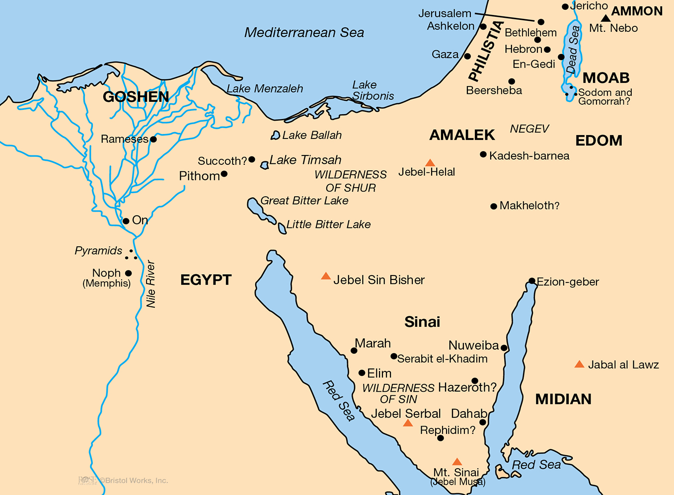

Slide 6
Events at Mt. Sinai
One Year at Mt. Sinai
Mt. Sinai

Slide 7
Events at Mt. Sinai
Giving of Law
Golden Calf
Building Tabernacle
First Numbering
One Year at Mt. Sinai
Mt. Sinai

Slide 8
Events at K-Barnea
Twelve spies sent out
Returned 40 days later
Land of milk & honey
Evil report by ten
Lack of faith
Mt. Sinai

Slide 9
Events at K-Barnea
Twelve spies sent out
Returned 40 days later
Land of milk & honey
Evil report by ten
Lack of faith
God’s response
Mt. Sinai

Slide 10
Return to K-Barnea
Forty years later
Wandering & deaths
Mt. Sinai

Slide 11
Background Study of the Book
From Moses, the Exodus to the Promised Land
Entrance to the Promised Land to Judges & Ruth

Slide 12
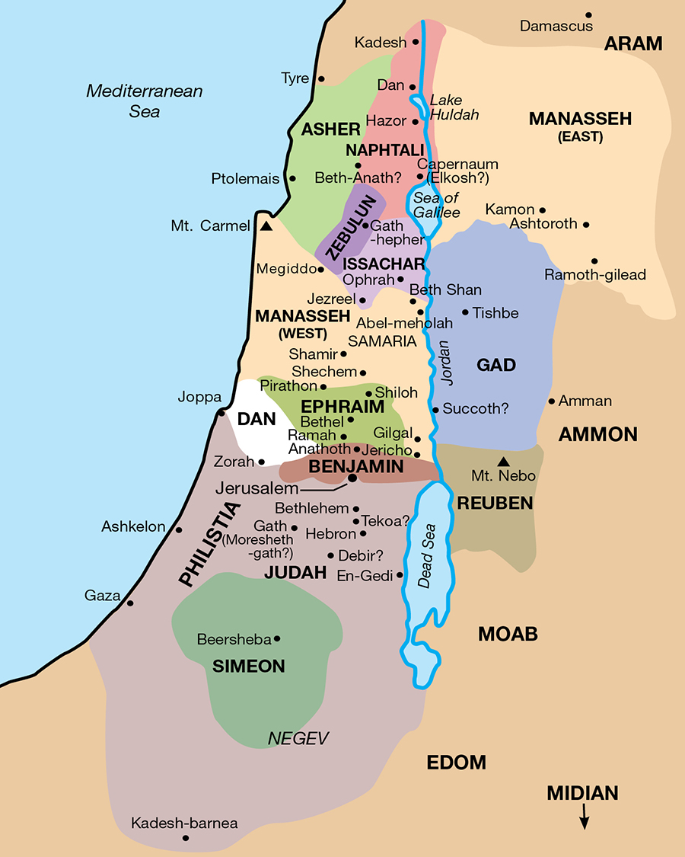
Kadesh-Barnea to Jordan
Moses captures East Bank
Request by Gad, Reuben and half of tribe of Manasseh
Deuteronomy speeches

Slide 13
Kadesh-Barnea to Jordan
Moses captures East Bank
Request by Gad, Reuben and half of tribe of Manasseh
Deuteronomy speeches
Death of Moses at Mt. Nebo
Mt. Nebo

Slide 14
Exodus-Red Sea-Mt. Sinai-
-Promised Land
Kadesh-Barnea
40 Years Wandering
Return to K-Barnea
Mt. Sinai

Slide 15
Background Study of the Book
From Moses, the Exodus to the Promised Land
Entrance to the Promised Land to Judges & Ruth

Slide 16
Land Conquered
Land Divided Judges—350 Years
Ruth During Judges

Slide 17
Background Study of the Book
From Moses, the Exodus to the Promised Land
Entrance to the Promised Land to Judges & Ruth
List of Names and Places in Ruth

Slide 18
List of Names and Places in Ruth
Bethlehem-, Judah
Moab
Elimelech & Naomi
Mahlon & Chilion
Orpah & Ruth
No longer Naomi, but Mara
Boaz
Obed, Jesse, David

