Slide 2
3 Key Questions
Where do I need to put the Bible?
“Your word I have hidden in my heart, That I might not sin against You!” (Psalm 119:11)
What does the Bible do for me?
“Your word is a lamp to my feet And a light to my path.” (Psalm 119:105)
Why do I need to study the Bible?
“Study to shew thyself approved unto God, a workman that needeth not to be ashamed, rightly dividing the word of truth.” (2 Timothy 2:15)

Slide 3
Overview of the Bible
Prophet | Theme of the Bible | Jesus Christ
Priest | Three-Sentence Summary of the Bible | Someone is coming. Someone is here. Someone is coming again.
Introduction to the New Testament
Prophet | Name the Four Accounts of the Gospel | Matthew, Mark, Luke, John
Prophet | "Gospel" Means | Good News
Prophet | The Four Accounts of the Gospel Tell About | The Life of Jesus Christ

Slide 4
Key Chapters
Prophet | John 1 | The Eternal Nature of Jesus
King | Luke 1 | Birth of John the Baptist
King | Luke 2 | Birth & Early Years of Jesus
Prophet | Matthew 1 | Genealogy and Birth of Jesus
Prophet | Matthew 3 | The Baptism of Jesus
Prophet | Matthew 4 | Jesus Tempted By the Devil
Priest | John 2 | Jesus Cleanses the Temple
Priest | John 3 | Jesus Talks to Nicodemus
Priest | John 4 | Jesus & the Woman at the Well
Key Locations
Priest | Jesus Was Born of a Virgin | Matthew 1:23
Priest | Jesus Is Jehovah, for John Prepared the Way for Jehovah | Matthew 3:3
Prophet | Jesus Is Eternal | John 1:1
Prophet | Jesus Created All Things | John 1:3
Priest | Baptism (Being Born Again) Is Essential to Enter God’s Kingdom | John 3:3-5
Prophet | True Worship Must Be Done in Spirit and in Truth | John 4:24

Slide 5
Key Facts: Overview of Jesus’ Early Life
Prophet | In the Beginning, Jesus Was | With God and Was God
Prophet | Christ's Role in Creation | All Things Were Made Thru Him
Prophet | The Word (Jesus) Became | Flesh and Dwelt Among Us
Prophet | Immanuel Means | “God With Us”
Prophet | Three Anointed Roles Fulfilled By Christ | Prophet, Priest and King
Prophet | Number of O.T. Prophecies About Jesus | 332
Prophet | Forerunner of Jesus | John the Baptist
Prophet | Birthplace of Jesus | Bethlehem
Prophet | Hometown of Jesus | Nazareth
Prophet | Baptized Jesus | John the Baptist
Prophet | Reason Jesus Was Baptized | “To fulfill all righteousness”
Prophet | How Jesus Effectively Responded to Every Temptation of the Devil | He Quoted Scripture
Priest | N.T. Word for O.T. Word "Messiah" | The Christ
Prophet | Man Who Came to Jesus By Night | Nicodemus
Prophet | Person Jesus Spoke to at Jacob's Well | The Woman of Samaria

Slide 6
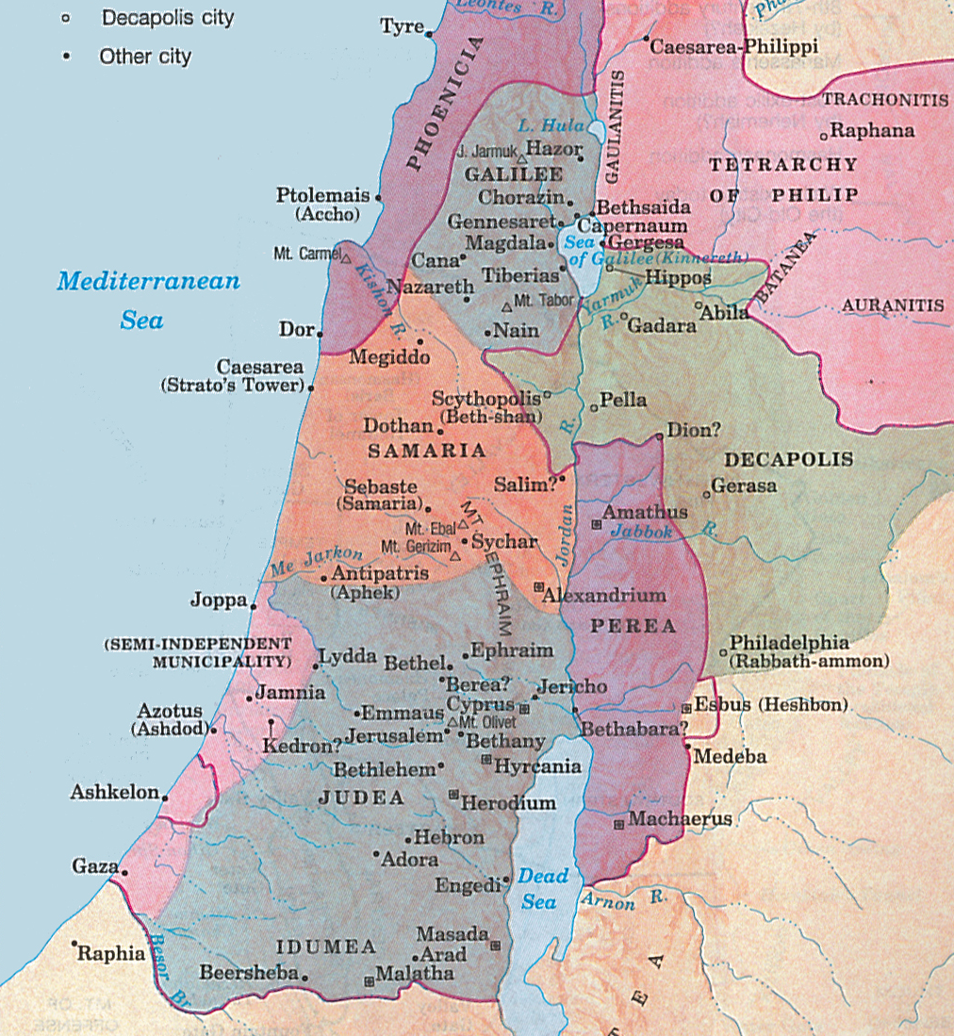

Slide 7
Jesus Calls Four Fishermen
Priest | Area Where Jesus Did Most of His Preaching | Galilee
Prophet | Four Fishermen Called By Jesus | Peter, Andrew, James & John
Prophet | Jesus' Calling of Four Fishermen, "Follow Me, and I will make you…" | "Fishers of men."
Being a DISCIPLE of Jesus – JESUS’ PART in Our Discipleship
Jesus INITIATES the Relationship – Jesus “saw, said, called”
Jesus IDENTIFIES those who are active and working – “saw them casting…mending”
Jesus POSITIONS the disciples to follow “after” – He is the authority, the leader, Lord
Jesus PATTERNS Himself as the standard of imitation – Follow ME
Jesus ENROLLS into a life of work and service – working now as fishers of men
Jesus EQUIPS His disciples for the work – “I will make you to become…”

