Slide 2
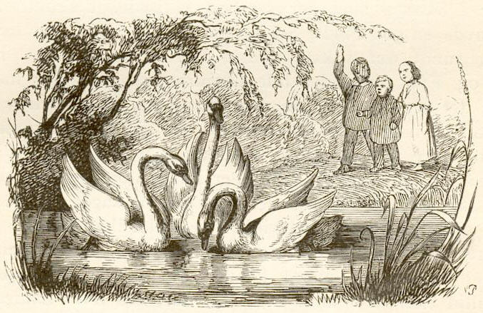

Slide 3
You are associated with Jesus (John 15:18, 20-21)
You love Jesus
You keep Jesus’ commandments
You do things with Jesus and for Jesus
You are not “of the world” (not “of them”) (15:19; 17:14-16)
They will hate you for no justifiable or sensible reason at all (15:25)

Slide 4
Jesus loves you (15:9, 12)
Jesus prays for you (17:9, 15, 20-23)
Jesus wants you…in heaven with Him (17:24)
Jesus knows all things that are happening (16:30)
Jesus was hated first and hated more (15:18, 20)
Jesus still loves the world (17:23)
Jesus overcame the world and you can too (16:33)

Slide 5
Choose: Love JESUS rather than the world (14:6, 15, 21, 23, 24, 28; cf. Matt. 6:24; 1 John 2:15)
Choose: Love the LOVE of Jesus rather than the love of the world (15:9, 12; cf. John 12:42-43)
Choose: Love the FRIENDSHIP of Jesus rather than the friendship of the world (15:14-15; cf. Jas. 4:4)
Choose: Love the DESIRES of Jesus rather than the desires of the world (14:15, 21, 23, 24; 15:10, 12, 14, 17)
Choose: Love the TRUTH of Jesus rather than the “truth” of the world (14:6, 17; 16:13; 17:17, 19)
Choose: Love the RELATIONSHIP with Jesus more than relationships of the world (14:23; 15:5,8,16; Lk. 14:26)
Choose: Love the JOY of Jesus rather than the joy of the world (15:11; 16:20-24; 17:13; cf. Luke 8:14)
Choose: Love the LIFESTYLE of Jesus rather than the lifestyle of the world (15:3-7; 17:17, 19; cf. 1 Pet. 2:9-12)
Choose: Love the MISSION of Jesus rather than the mission of the world (15:2, 5, 8; 17:4, 18, 21, 23)
Choose: Love the PEOPLE of Jesus more than the people of the world (13:34-35; 15:12, 13, 17; cf. Gal. 6:10)
Choose: Love the UNITY of Jesus rather than the unity of the world (17:11, 20-23)
Choose: Love the REWARD of Jesus rather than the reward of the world (14:1-3, 19; 17:2, 24)

Slide 6
Believe JESUS is God’s Son – John 8:24
Repent of your sins and turn toward JESUS – Acts 17:30-31
Confess your faith in JESUS CHRIST – Romans 10:9
Be immersed into JESUS CHRIST – Galatians 3:27
JESUS will wash away all of your sins – Acts 22:16
JESUS will add you to His church – Acts 2:47
JESUS will enroll you in heaven – Hebrews 12:23
Live for JESUS and don’t worry about anyone else – Revelation 2:10

