Slide 1
Jesus Our Loving Shepherd
John 10:1-18

Slide 3
Jesus Our Loving Shepherd
John 10:1-18

Slide 4
What we know about the Pharisees from the Gospels:
They accuse Jesus of performing miracles by the power of Satan (Matthew 9:34, 12:24)
They conspired to destroy Jesus (Matthew 12:14)
They valued tradition over Scripture (Matthew 15:1-3)
They tested Jesus publicly (Matthew 16:1)
Jesus viewed them as a dangerous influence (Matthew 16:6)
They were hypocrites (Matthew 23:13)

Slide 5
What we know about the Pharisees from the Gospels:
They ignored the heart of the law (Matthew 23:23)
They rejected God’s purpose (Luke 7:30)
They sought the praise of men (Luke 11:43)
They were lovers of money (Luke 16:14)
They made people afraid to follow Jesus (John 12:42)
They have already tried to arrest Jesus (John 7:32)

Slide 6
Greater Context of John 10:
9:1-5 – Jesus heals a man born blind
9:8-12 – People are astounded and looking for Jesus
9:13-34 – The Pharisees get involved, and cast the man out of the synagogue
9:35-41 – Jesus finds the man, reveals himself as the Son of Man, and accepts the man’s worship

Slide 7
John 9:40-41
“Some of the Pharisees near him heard these things, and said to him, ‘Are we also blind?’ Jesus said to them, ‘If you were blind, you would have no guilt, but now that you say, ‘We see,’ your guilt remains.”

Slide 8
Cast of Characters:
Gatekeeper: The one tasked with guarding the door to the sheep
The sheep: Those who follow Jesus
The thief/robber: The one who sneaks in, but the sheep recognize as an imposter
The shepherd: Jesus

Slide 9
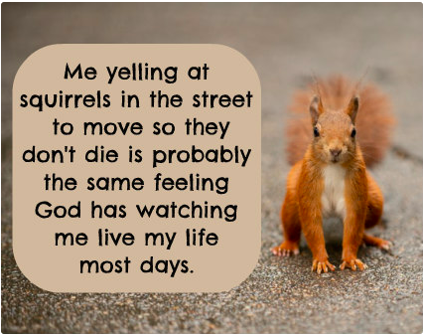

Slide 10
Why didn’t they understand?
They didn’t understand Jesus
They were oblivious to how Jesus’ teaching applied to them

Slide 11
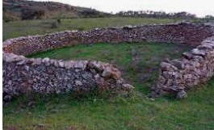

Slide 12
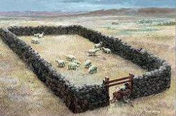

Slide 13
John 10:1-6
Shepherd:
Enters by the door
The sheep follow
The sheep know his voice
Sheep hear him
He calls the sheep
He brings his own out
He goes before the sheep
Thief:
Climbs in another way
The sheep flee
The sheep do not know his voice

Slide 14
John 10:7-18
Shepherd:
Sheep listen to him
Door
Sheep enter by him
Saves the sheep
Find the sheep pasture
Gives abundant life
Good
Lays down his life
Brings the sheep out
Thief
Sheep do not listen
Came before
Steals
Kills
Destroys

Slide 15
If we could erase everything we have learned from others; everything from Bible classes, sermons, our parents, ladies’ days, what would be left?
THAT is how well we know the Shepherd’s voice

Slide 17
Action Verbs
The thief:
Came
Comes
Steals
Kills
Destroys
The Hired Hand:
Sees
Flees
Leaves
Cares nothing for the sheep

Slide 18
Action Verbs
Jesus:
Enters
Calls
Leads
Brought
Goes
Came
Knows his sheep
Knows the father
Brings
Received his charge from the Father
Lays down his life (5X)
Takes up his life (2X)
The Sheep:
Hear
Follow
Know
Flee from the stranger
Do not know the stranger
Do not listen to the thief
Enter
Are saved
Go
Find
Know Jesus
Listen

Slide 19
Have we done good Bible
study tonight?

