Slide 2
3 Key Questions
Where do I need to put the Bible?
“Your word I have hidden in my heart, That I might not sin against You!” (Psalm 119:11)
What does the Bible do for me?
“Your word is a lamp to my feet And a light to my path.” (Psalm 119:105)
Why do I need to study the Bible?
“Study to shew thyself approved unto God, a workman that needeth not to be ashamed, rightly dividing the word of truth.” (2 Timothy 2:15)

Slide 3
Overview of the Bible
Prophet | Theme of the Bible | Jesus Christ
Priest | Three-Sentence Summary of the Bible | Someone is coming. Someone is here. Someone is coming again.
Introduction to the New Testament
Prophet | Name the Four Accounts of the Gospel | Matthew, Mark, Luke, John
Prophet | "Gospel" Means | Good News
Prophet | The Four Accounts of the Gospel Tell About | The Life of Jesus Christ

Slide 4
Key Chapters
Prophet | John 1 | The Eternal Nature of Jesus
King | Luke 1 | Birth of John the Baptist
King | Luke 2 | Birth & Early Years of Jesus
Prophet | Matthew 1 | Genealogy and Birth of Jesus
Prophet | Matthew 3 | The Baptism of Jesus
Prophet | Matthew 4 | Jesus Tempted By the Devil
Priest | John 2 | Jesus Cleanses the Temple
Priest | John 3 | Jesus Talks to Nicodemus
Priest | John 4 | Jesus & the Woman at the Well
Key Locations
Priest | Jesus Was Born of a Virgin | Matthew 1:23
Priest | Jesus Is Jehovah, for John Prepared the Way for Jehovah | Matthew 3:3
Prophet | Jesus Is Eternal | John 1:1
Prophet | Jesus Created All Things | John 1:3
Priest | Baptism (Being Born Again) Is Essential to Enter God’s Kingdom | John 3:3-5
Prophet | True Worship Must Be Done in Spirit and in Truth | John 4:24

Slide 5
Key Facts: Overview of Jesus’ Early Life
Prophet | In the Beginning, Jesus Was | With God and Was God
Prophet | Christ's Role in Creation | All Things Were Made Thru Him
Prophet | The Word (Jesus) Became | Flesh and Dwelt Among Us
Prophet | Immanuel Means | “God With Us”
Prophet | Three Anointed Roles Fulfilled By Christ | Prophet, Priest and King
Prophet | Number of O.T. Prophecies About Jesus | 332
Prophet | Forerunner of Jesus | John the Baptist
Prophet | Birthplace of Jesus | Bethlehem
Prophet | Hometown of Jesus | Nazareth
Prophet | Baptized Jesus | John the Baptist
Prophet | Reason Jesus Was Baptized | “To fulfill all righteousness”
Prophet | How Jesus Effectively Responded to Every Temptation of the Devil | He Quoted Scripture
Priest | N.T. Word for O.T. Word "Messiah" | The Christ
Prophet | Man Who Came to Jesus By Night | Nicodemus
Prophet | Person Jesus Spoke to at Jacob's Well | The Woman of Samaria

Slide 6
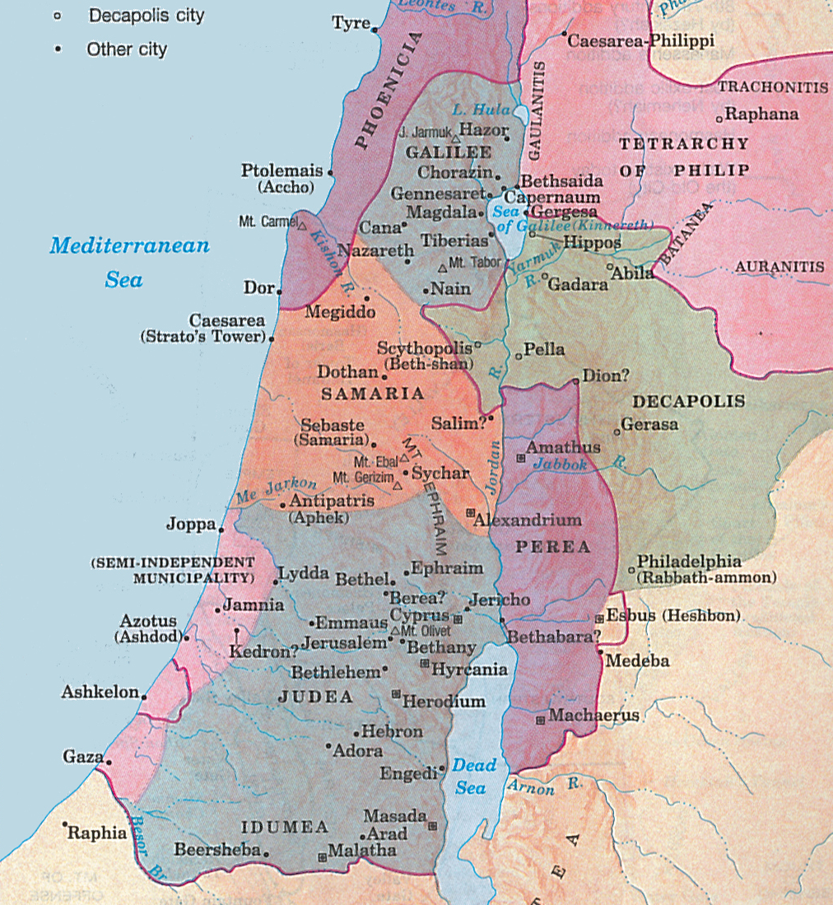

Slide 7
Jesus and His Teaching in Galilee
Priest | Area Where Jesus Did Most of His Preaching | Galilee
King | Response of Jesus' Hometown of Nazareth | Not Receive Him, But Cast Him Out
King | Where a Prophet Receives No Honor | In His Hometown, Own Household
Priest | Message Preached By Jesus
Prophet | First Public Discourse of Jesus in the N.T. | The Sermon on the Mount
Prophet | Reason Many Astonished at Jesus’ Teaching | He Taught with Authority
"Repent, for the kingdom of heaven is at hand!"
TEN THINGS TO KNOW ABOUT JESUS’ TEACHING:
Jesus taught the truth, which is like shining a light in a dark place (Matt. 4:16)
Jesus taught the same thing everywhere He went (Matt. 4:17)
Jesus did NOT change His message when people rejected Him (Luke 4:31)
Jesus commanded people to change, in order to be right with God (Matt. 4:17)
Jesus preached a lot about His church (Matt. 4:17, 23)
Jesus taught that His church was about to come from heaven (Matt. 4:17)
Jesus taught that being in His church is required to go to heaven (Matt. 4:17)
Jesus taught that being right with God requires both heart and action (Matt. 5-7)
Jesus was God, and He taught with the authority of God (Matt. 7:28-29)
Obeying Jesus leads to heaven; disobeying Jesus leads to hell (Matt. 7:13-29)

