Slide 1
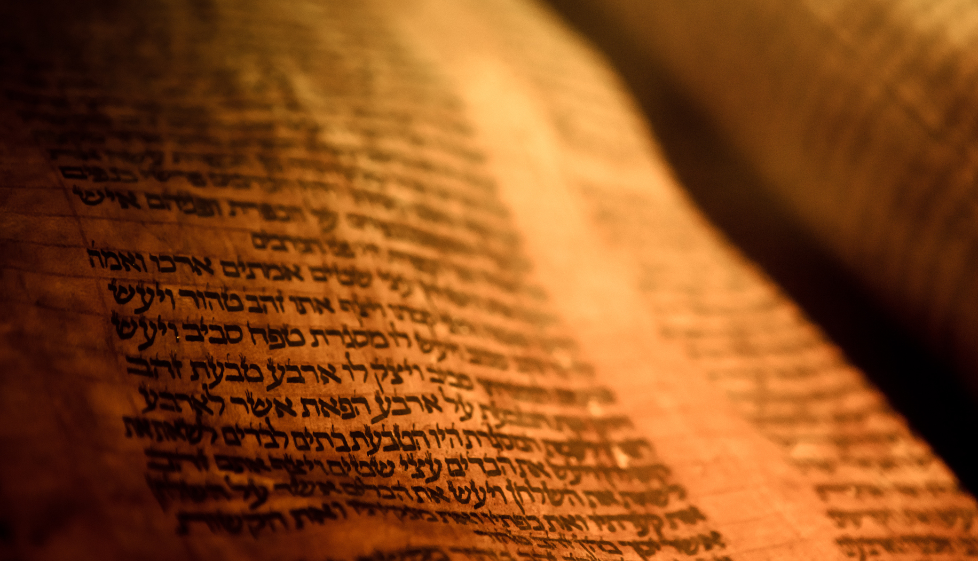
Deuteronomy
The Second Giving of the Law

Slide 2
Outline
A Brief Background to the Speech 1:1-4
The Speech 1:5-26:19
  Historical Prologue 1:5-4:49
  The Law 5-26
    The Great Commandments 5-6
    The Great Relationship between God and Israel 7-11
    The Many Commandments 12-26
The Epilogue of the Speech 27-34
  Curses and Blessings 27-30
  A Look to the Future 31
  A Song for the Future 32
  A Final Blessing 33
  The Death of a Prophet 34

Slide 3
The Speech 1:5-26:19
A Look to the Future 31
Moses Promises the Help of the Lord (31:1-13)
Israel Will Fall Away (31:14-23)
Installation of Joshua (31:24-30)

Slide 4
The Speech 1:5-26:19
A Song For the Future 32
The Song Of Moses (32:1-43)
  1-5 Intro and Righteousness
  6-18 Folly of Rebellion
  19-33 Punishment of the Rebellious
  34-36 God’s Vengeance
  37-38 Folly of False Gods
  39-43 God Alone is the True God

Slide 5
The Speech 1:5-26:19
A Final Blessing 33
Introduction of Moses (33:1-5)
Blessing of the Tribes (33:6-25)
Conclusion (33:26-29)

Slide 6
The Speech 1:5-26:19
The Death of a Prophet 34
Moses Goes Up On the Mountain (34:1-8)
Joshua Takes Up His Role (34:9-12)

