Slide 1
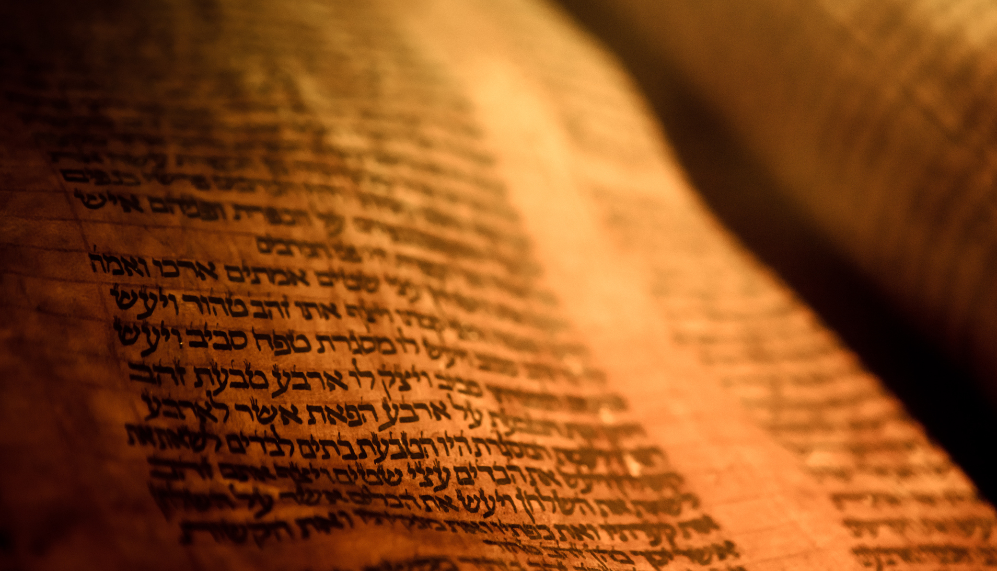
Deuteronomy
The Second Giving of the Law

Slide 2
Outline
A Brief Background to the Speech 1:1-4
The Speech 1:5-26:19
  Historical Prologue 1:5-4:49
  The Law 5-26
    The Great Commandments 5-6
    The Great Relationship between God and Israel 7-11
    The Many Commandments 12-26
The Epilogue of the Speech 27-34
  Curses and Blessings 27-30
  A Look to the Future 31
  A Song for the Future 32
  A Final Blessing 33
  The Death of a Prophet 34

Slide 3
The Speech 1:5-26:19
The Many Commandments 12-26
Offering First Fruits 26:1-19
  1-11 First fruits of the ground
  12-15 The delivery of the tithes
  16-19 Admonition

Slide 4
The Epilogue of the Speech 27-34
Curses and Blessings 27-30
Mount Ebal 27
  1-10 The stones
  11-26 The Curses
Mount Gerizim 28
  1-14 The Blessing
  15-68 The Curse
    15-19 Sixfold curse
    20-26 All the forms of curses
    27-37 Diseases and plunder
    38-46 Attack on cultivation
    47-57 Horrors of the heathen nations
    58-68 Destruction at God’s Hand

Slide 5
The Epilogue of the Speech 27-34
Curses and Blessings 27-30
Covenant at Moab 29
  1-9 All that God had done for them
  10-18 Summons to the covenant
  19-29 Reminder of the consequence of disobedience
Promise of Restoration 30
  1-14 Promise of restoration
  15-20 Life and Death

