Slide 1
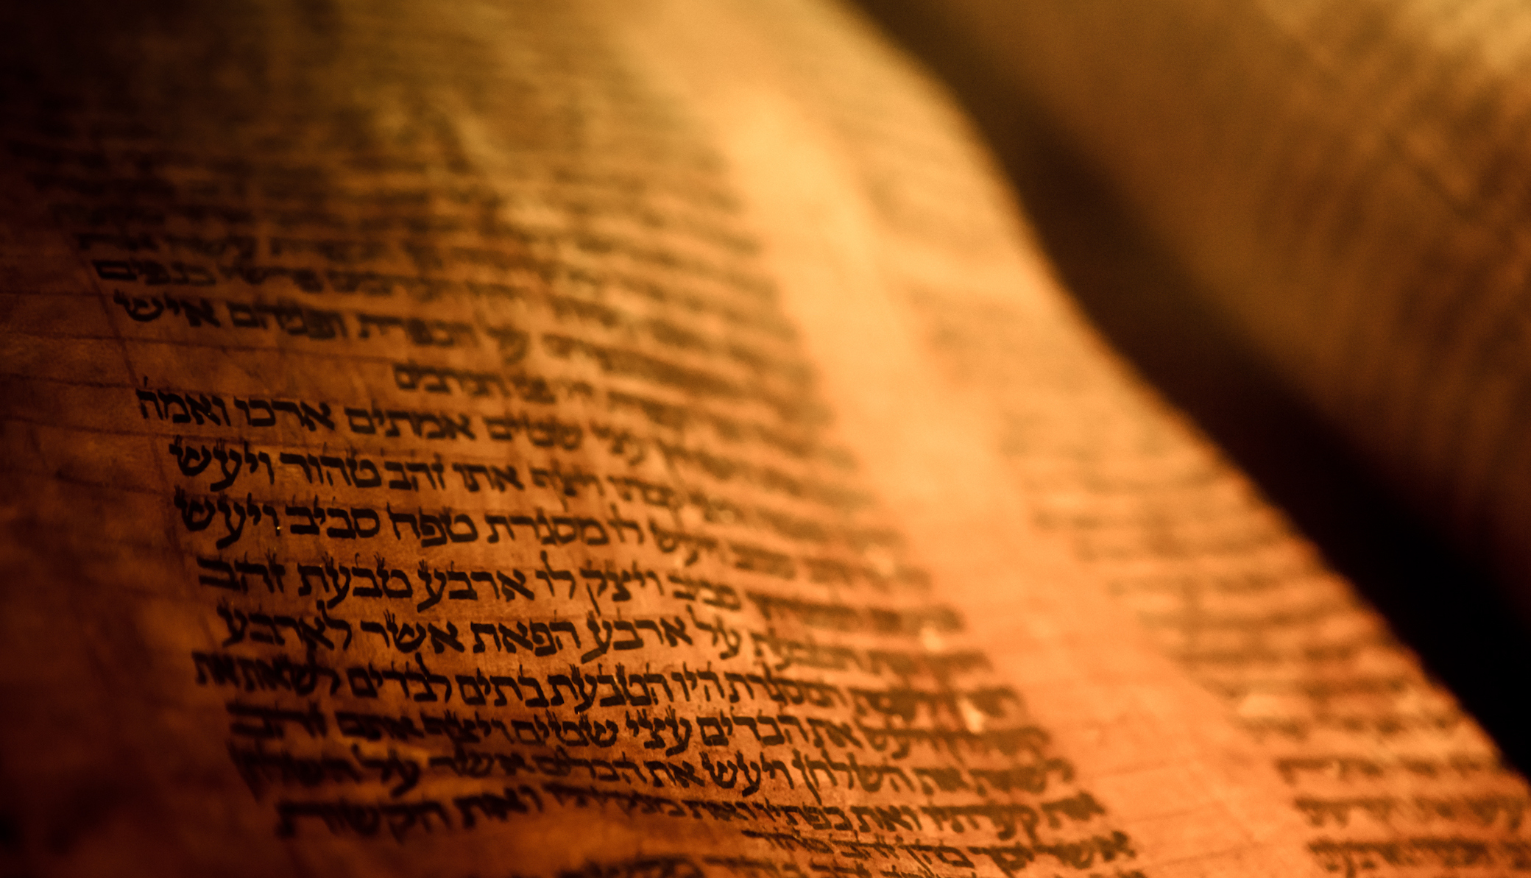
Deuteronomy
The Second Giving of the Law

Slide 2
Outline
A Brief Background to the Speech 1:1-4
The Speech 1:5-26:19
  Historical Prologue 1:5-4:49
  The Law 5-26
    The Great Commandments 5-6
    The Great Relationship between God and Israel 7-11
    The Many Commandments 12-26
The Epilogue of the Speech 27-32
  Curses and Blessings 27-30
  A Look to the Future 31
  A Song for the Future 32
  A Final Blessing 33
  The Death of a Prophet 34

Slide 3
The Speech 1:5-26:19
The Many Commandments 12-26
Sundry Laws 22:1-12
  1-4 Neighbor’s animals
  5 Proper clothing
  6-7 Birds in the field
  8 Safety
  9-11 No mixing
  12 Tassels

Slide 4
The Speech 1:5-26:19
The Many Commandments 12-26
Laws of Morality 22:13-30
  13-21 Accusations about virginity
  22 -30 Indecent sexual encounters
Those Excluded From the Assembly 23:1-8
Purity of the Camp In War 23:9-14

Slide 5
The Speech 1:5-26:19
The Many Commandments 12-26
Community Laws 23:15-25
  15-16 Run away slave
  17-18 Temple forbidden acts
  19-20 No interest
  21-23 Vows
  24-25 Your neighbor’s fields
Law of Putting Away 24:1-5

Slide 6
The Speech 1:5-26:19
The Many Commandments 12-26
Sundry Laws 24:6-25:19
  6-9 Various prohibitions
  10-15 Warnings against oppressing the poor
  16-18 Warnings against injustice
  1-3 Corporal punishment
  4 Don’t muzzle the ox (1 Cor. 9:9; 1 Tm. 5:18)
  5-10 Levirate marriage
  11-12 Wife could not deliver her husband, this way
  13-19 Integrity in trade

Slide 7
The Speech 1:5-26:19
The Many Commandments 12-26
Offering First Fruits 26:1-19
  1-11 First fruits of the ground
  12-15 The delivery of the tithes
  16-19 Admonition

