Slide 2
3 Key Questions
Where do I need to put the Bible?
“Your word I have hidden in my heart, That I might not sin against You!” (Psalm 119:11)
What does the Bible do for me?
“Your word is a lamp to my feet And a light to my path.” (Psalm 119:105)
Why do I need to study the Bible?
“Study to shew thyself approved unto God, a workman that needeth not to be ashamed, rightly dividing the word of truth.” (2 Timothy 2:15)

Slide 3
Overview of the Bible
Prophet | Theme of the Bible | Jesus Christ
Priest | Three-Sentence Summary of the Bible | Someone is coming. Someone is here. Someone is coming again.
Introduction to the New Testament
Prophet | Name the Four Accounts of the Gospel | Matthew, Mark, Luke, John
Prophet | "Gospel" Means | Good News
Prophet | The Four Accounts of the Gospel Tell About | The Life of Jesus Christ

Slide 4
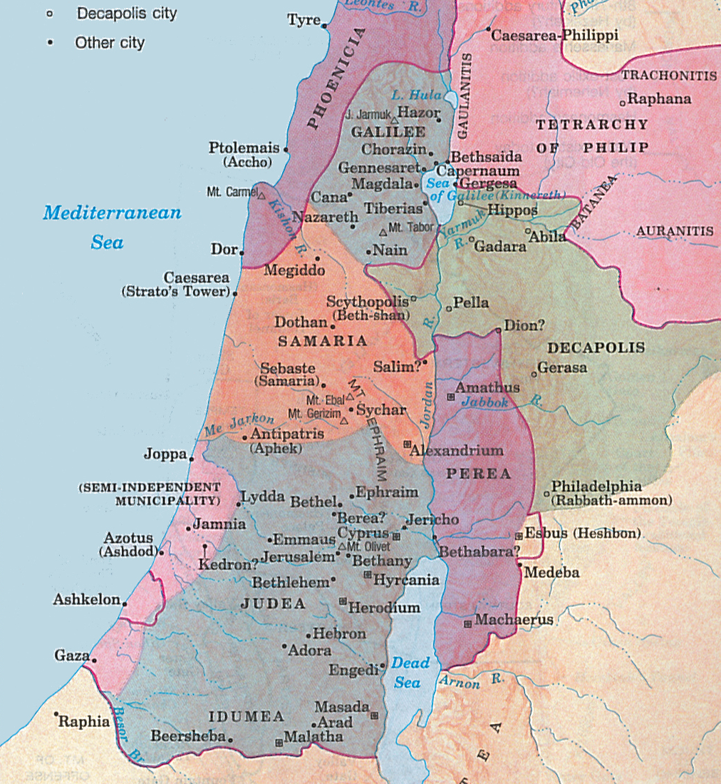

Slide 5
Jesus and His Ministry in Galilee
Priest | 3 Geographical Divisions of Palestine | Galilee, Samaria and Judea
Priest | Area Where Jesus Did Most of His Preaching | Galilee
King | Response of Jesus' Hometown of Nazareth | Not Receive Him, But Cast Him Out
King | Where a Prophet Receives No Honor | In His Hometown, Own Household
Priest | Message Preached By Jesus | "Repent, for the kingdom of heaven is at hand!"
TEN THINGS TO KNOW ABOUT JESUS’ MISSION:
Jesus’ work involved teaching and preaching (Luke 4:15)
Jesus’ habit was to assemble in the synagogue on the Sabbath (Luke 4:16)
Jesus’ respect for God’s Word is seen in standing when it was read (Luke 4:20)
Jesus’ concern was particularly for those often overlooked (Luke 4:18-19)
Jesus’ identity as the promised Messiah was fulfilled (Luke 4:17-21; Matt. 4:13-16)
Jesus brings blessings that no one else can (Luke 4:18-19)
Jesus was rejected by those who should have accepted Him (Luke 4:22-29; John 1:11)
Jesus came to save all, including outsiders who were hated (Luke 4:25-27)
Jesus could not be stopped from fulfilling His mission (Luke 4:28-30)
Jesus preached, “Repent, for the kingdom of heaven is at hand” (Matt. 4:17)

