Slide 1
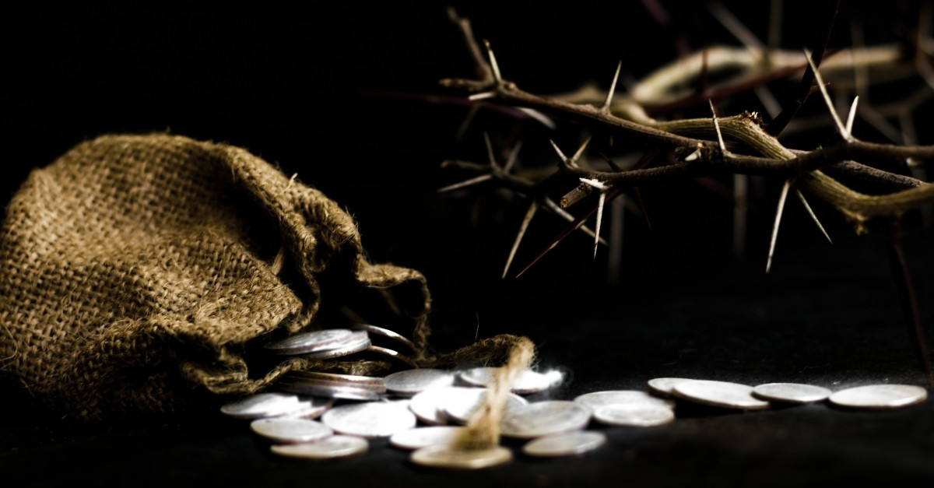
Even My Own
Familiar Friend
Psalm 41:7-9

Slide 2
Judas Iscariot
He is numbered among the 12 – Mark 3:19
He kept the money box – John 13:29
He was a thief pilfering from the money – John 12:6
He betrayed Jesus to the chief priests – Matthew 26:14-16
He was known by Jesus as the traitor – John 6:71; 13:11,26
He betrays Jesus with a kiss – Matthew 26:49-50
He felt some remorse – Matthew 27:3
He tried to return the money – Matthew 27:3-4
He confessed his sin but to avail – Matthew 27:4
He hung himself – Matthew 27:5
He “turned aside to go to his own place” – Acts 1:25

Slide 3
Judas Iscariot in Prophecy
Zechariah 11:12-13 I said to them, “If it is good in your sight, give me my wages; but if not, never mind!” So they weighed out thirty shekels of silver as my wages. (13) Then the LORD said to me, “Throw it to the potter, that magnificent price at which I was valued by them.” So I took the thirty shekels of silver and threw them to the potter in the house of the LORD.

Slide 4
Judas Iscariot in Prophecy
Psalm 41:7-9 All who hate me whisper together against me; Against me they devise my hurt, saying, (8) A wicked thing is poured out upon him, That when he lies down, he will not rise up again. (9) Even my close friend in whom I trusted, Who ate my bread, Has lifted up his heel against me.

Slide 5
Judas Iscariot Didn’t Know
Who Jesus was
  “If you know Me you know the Father” – John 14:7
  “Believe because of the works themselves” – John 14:11
How to be a true disciple
  “If anyone wishes to come after Me, he must deny himself, and take up his cross and follow Me” – Mark 8:34
  “I have been crucified with Christ. It is no longer I who live, but Christ who lives in me” – Galatians 2:20

Slide 6
Judas Iscariot Didn’t Know
The power of the cross
  “By His wounds, we are healed” – Isaiah 53:5
  “As Moses lifted up the serpent in the wilderness, even so must the Son of Man be lifted up; (15) so that whoever believes will in Him have eternal life” – John 3:14-15
  “It is the power of God” – 1 Corinthians 1:18
  “through death He might render powerless him who had the power of death” – Hebrews 2:14
The love of God
  “For God so loved the world, that He gave His only begotten Son, that whoever believes in Him shall not perish, but have eternal life” – John 3:16

Slide 7
Judas Iscariot and Me
Could I…
Be named among the believers, a familiar friend, yet my heart be distracted?
Have my own agenda, by seeking an opportune time to betray?
Spurn God’s grace by what we think we know?
Could I turn to things of this world instead One who could save?

Slide 8
Judas Iscariot and Me
Hebrews 6:4-8
For in the case of those who have once been enlightened and have tasted of the heavenly gift and have been made partakers of the Holy Spirit, (5) and have tasted the good word of God and the powers of the age to come, (6) and then have fallen away, it is impossible to renew them again to repentance, since they again crucify to themselves the Son of God and put Him to open shame. (7) For ground that drinks the rain which often falls on it and brings forth vegetation useful to those for whose sake it is also tilled, receives a blessing from God; (8) but if it yields thorns and thistles, it is worthless and close to being cursed, and it ends up being burned.

Slide 9
Jesus Christ and You
Hebrews 6:9
But, beloved, we are convinced of better things concerning you, and things that accompany salvation, though we are speaking in this way.
Believe: John 8:24
Confess: Mathew 10:32-33
Repent: Luke 13:1-5
Be Baptized: Mark 16:15-16
Live Faithfully: Revelation 2:10

