Slide 1
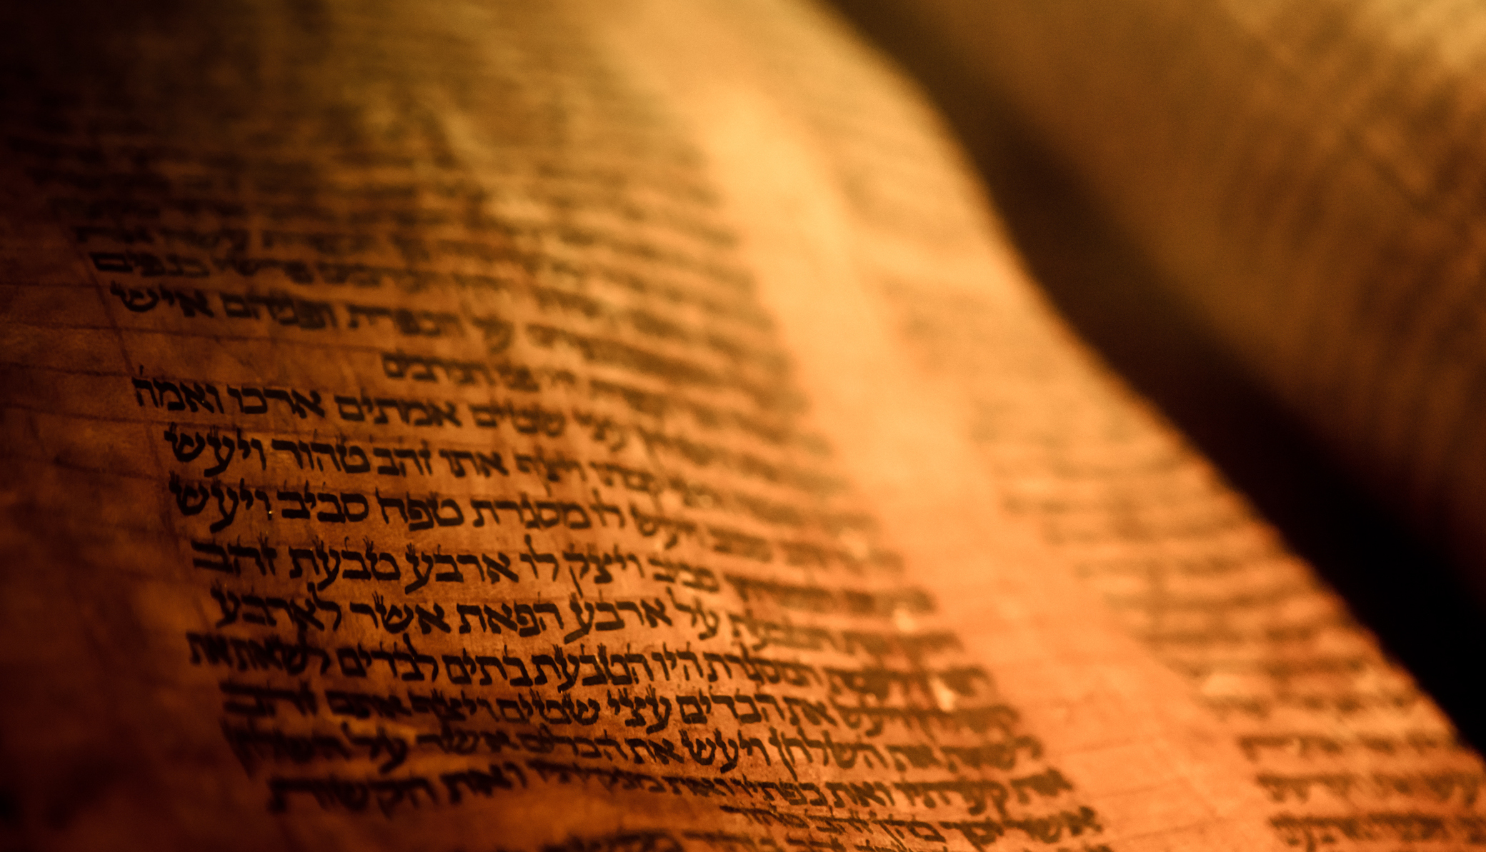
Deuteronomy
The Second Giving of the Law

Slide 2
Outline
A Brief Background to the Speech 1:1-4
The Speech 1:5-26:19
  Historical Prologue 1:5-4:49
  The Law 5-26
    The Great Commandments 5-6
    The Great Relationship between God and Israel 7-11
    The Many Commandments 12-26
The Epilogue of the Speech 27-32
  Curses and Blessings 27-30
  A Look to the Future 31
  A Song for the Future 32
  A Final Blessing 33
  The Death of a Prophet 34

Slide 3
The Speech 1:5-26:19
The Many Commandments 12-26
Laws Concerning the Sanctuary 12:1-32
Warnings Against Sources of Apostacy 13:1-18
Clean and Unclean 14:1-29
  1-2 Funerary Laws
  3-21 Clean and Unclean foods
  22-27 Tithe of Produce
  28-29 Third Year Provisions

Slide 4
The Speech 1:5-26:19
The Many Commandments 12-26
The Year of Release 15:1-23
  1-6 Debts Suspended
  7-11 The Poor
  12-18 Slaves
  19-23 First Born of the Flock
Three Feasts 16:1-22
  1-8 Passover
  9-12 Feast of Weeks
  13-17 Feast of Booths
  18-22 Town Judges and Alters

