Slide 1
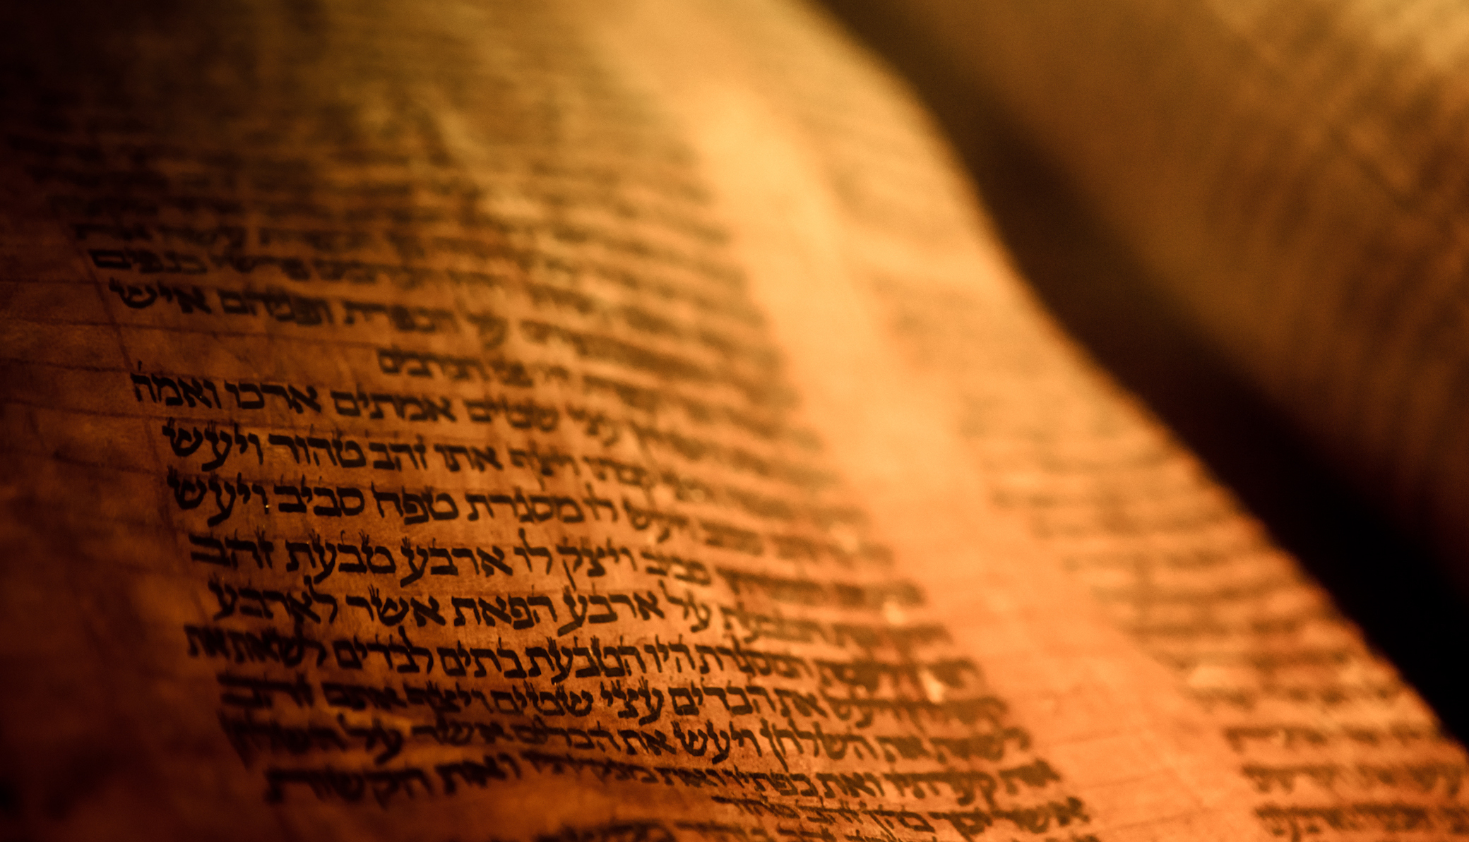
Deuteronomy
The Second Giving of the Law

Slide 2
Outline
A Brief Background to the Speech 1:1-4
The Speech 1:5-26:19
  Historical Prologue 1:5-4:49
  The Law 5-26
    The Great Commandments 5-6
    The Great Relationship between God and Israel 7-11
    The Many Commandments 12-26
The Epilogue of the Speech 27-32
  Curses and Blessings 27-30
  A Look to the Future 31
  A Song for the Future 32
  A Final Blessing 33
  The Death of a Prophet 34

Slide 3
The Speech 1:5-26:19
The Great Relationship Between God and Israel 7:1-11:32
Call to Holiness 7:1-11
The Promises of God’s Covenant 7:12-26
  The Covenant Relationship 7:12-16
  God’s Power Remembered 7:17-26
Remember 8:1-10
If You Forget 8:11-20
Not for Your Righteousness 9:1-6
Remember Your Stubbornness 9:7-29

Slide 4
The Speech 1:5-26:19
The Great Relationship Between God and Israel 7:1-11:32
The Authority Over the People 10:1-11
What Does the Lord Require? 10:12-22
Reward of Obedience 11:1-12
Second Part of the Shema 11:13-25
Blessing and a Curse 11:26-32

Slide 5
Outline
A Brief Background to the Speech 1:1-4
The Speech 1:5-26:19
  Historical Prologue 1:5-4:49
  The Law 5-26
    The Great Commandments 5-6
    The Great Relationship between God and Israel 7-11
    The Many Commandments 12-26
The Epilogue of the Speech 27-32
  Curses and Blessings 27-30
  A Look to the Future 31
  A Song for the Future 32
  A Final Blessing 33
  The Death of a Prophet 34

Slide 6
The Speech 1:5-26:19
The Many Commandments 12-26
Laws Concerning the Sanctuary 12:1-32
Warnings Against Sources of Apostacy 13:1-18

