Slide 1
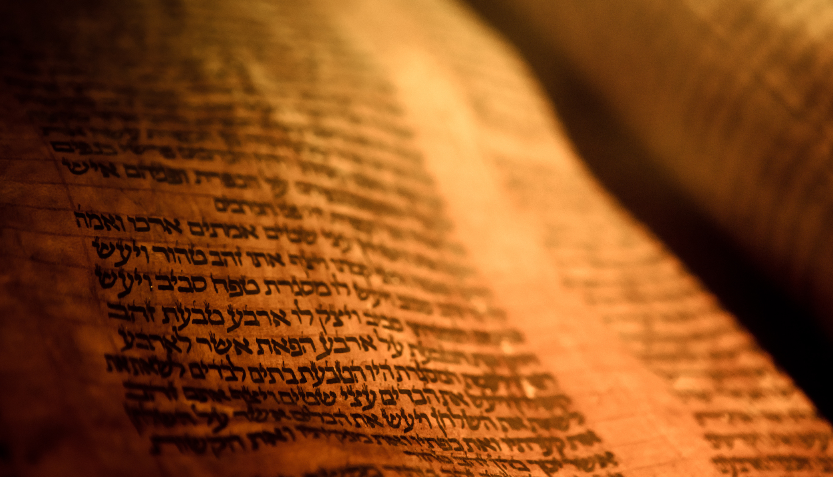
Deuteronomy
The Second Giving of the Law

Slide 2
Introduction
Deuteronomy, the second law, comes from chapter 17:18
The Talmud refers the book as Mishneh Torah, or repetition of the Torah.
The book is a series of lessons given possibly over the time span of 5 weeks.
Two purposes of the book
  To call the younger generation to remember
  To lead them into obedience
The book opens with, “These are the words which Moses spoke to all Israel across the Jordan in the wilderness” and closes with, “Since that time no prophet has risen in Israel like Moses, whom the Lord knew face to face.”
There is a plea to…
  Remember and not forget
  To teach future generations
  To keep and practice what was taught them.

Slide 3
Outline
A Brief Background to the Speech 1:1-4
The Speech 1:5-26:19
  Historical Prologue 1:5-4:49
  The Law 5-26
    The Great Commandments 5-6
    The Great Relationship between God and Israel 7-11
    The Many Commandments 12-26
The Epilogue of the Speech 27-32
  Curses and Blessings 27-30
  A Look to the Future 31
  A Song for the Future 32
  A Final Blessing 33
  The Death of a Prophet 34

Slide 4
A Brief Background to the Speech 1:1-4
Authority 1:1
  “The words Moses spoke”
  Numbers opens with, “Then the LORD spoke to Moses”
  We are not given a reason for the difference and verse 3 tells us that this is given by the commandment of God.
Location 1:1-2
  We don’t know where all these locations are currently located
  It would have given those of that time a location
Time stamp 1:3-4
  1st day of 11th month of the 40th year after leaving Egypt
  Another documentation of authority 1:3
  After they had cleared out the kings to the East of the Jordan 1:4

Slide 5
The Speech 1:5-26:19
Historical Prologue 1:5-4:49
Horeb/Sinai to Kadesh 1:5-21
The Spies and Rebellion 1:22-46
Wandering In the Wilderness 2:1-15
The First Generation is Dead 2:16-25
Demise of Sihon 2:26-37
Demise of Og 3:1-17
Pact Made with Jair, Gad, and Reuben 3:18-22
Moses Sees the Promised Land 3:23-29
A Call to Obedience 4:1-9
Remember Horeb 4:10-20
The Anger vs the Love of the Lord 4:21-40
Cities of Refuge and the Eastern Conquest 4:41-49

Slide 6
The Speech 1:5-26:19
The Great Commandment 5:1-6:25
Reminder of the Covenant 5:1-5
The Ten Commandments 5:6-21
Fear and a Warning 5:22-33
Teach, Fear, and Be Careful 6:1-3
Hear, O Israel 6:4-9
Watch Yourself 6:10-15
Do Not Test the Lord 6:16-19
When Your Son Asks 6:20-25
Notes:
10 Commandments in the NT.
Romans 13:8-10
1 Timothy 1:8–10: “But we know that the Law is good, if one uses it lawfully, realizing the fact that law is not made for a righteous person, but for those who are lawless and rebellious, for the ungodly and sinners, for the unholy and profane, for those who kill their fathers or mothers [5th and 6th commandments], for murderers [6th commandment] and immoral men and homosexuals [7th commandment] and kidnappers [8th commandment] and liars and perjurers [9th commandment], and whatever else is contrary to sound teaching”.
1) Do not worship any other gods (1 Corinthians 8:6; 1 Timothy 2:5)
2) Do not make idols (1 John 5:21)
3) Do not misuse the name of the LORD (1 Timothy 6:1)
4) Remember the Sabbath day and keep it holy (Colossians 2:16-17, Hebrews 4:9-11; 3:14)
5) Honor your father and your mother (Ephesians 6:1–2)
6) Do not murder (Romans 13:9; 1 Peter 4:15)
7) Do not commit adultery (1 Corinthians 6:9–10)
8) Do not steal (Ephesians 4:28)
9) Do not give false testimony (Revelation 21:8)
10) Do not covet (Colossians 3:5)

