Slide 2
See the great multitude of people in need of Jesus (Matt. 14:14; cf. John 4:35)
Be moved with compassion for the multitude of people (Matt. 14:14; Mark 6:34; cf. 2 Cor. 5:11)
Teach others about the kingdom of God (Mark 6:34; Luke 9:11; cf. Acts 8:4, 5, 12)
Never expect the multitude to feed themselves (Matt. 14:15-16; Mark 6:36; cf. Rom. 10:14)
Give what we have to the Lord (Matt. 14:17-18; Mark 6:38; John 6:9; cf. 2 Cor. 8:12; Mark 12:43-44)
Acknowledge and thank the Lord for His gifts (Matt. 14:19; John 6:11; cf. Jas. 1:17; 2 Cor. 9:11)
Know the power is in Jesus’ hands, not in us (Matt. 14:19; Mark 6:41; cf. 1 Cor. 3:6-7; 2 Cor. 3:5)
Give to others what Christ has given to us (Matt. 14:19; John 6:11; cf. 1 Cor. 15:3-4; Mark 16:15)
Remember that no effort for the Lord is ever wasted (Mt. 14:20; Jn. 6:12; cf. Isa. 55:11; 1 Cor. 15:58)
Know that the Lord will bless us abundantly (Matt. 14:20-21, 17; cf. Prov. 11:24; 19:17; 2 Cor. 9:6)

Slide 3

January 29
Every dollar given on Mission Sunday
goes toward mission work.

Slide 4

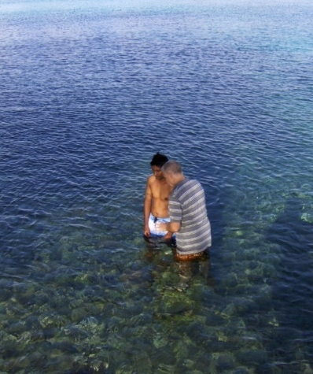
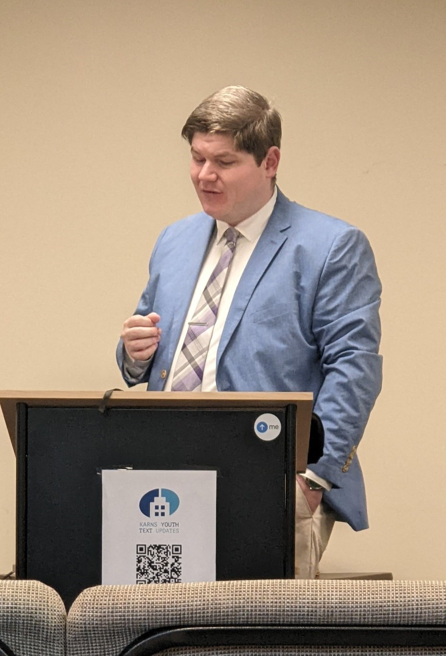

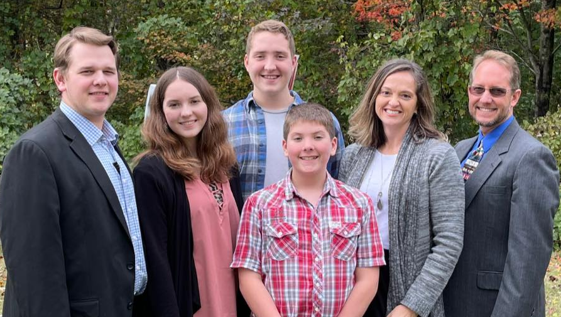
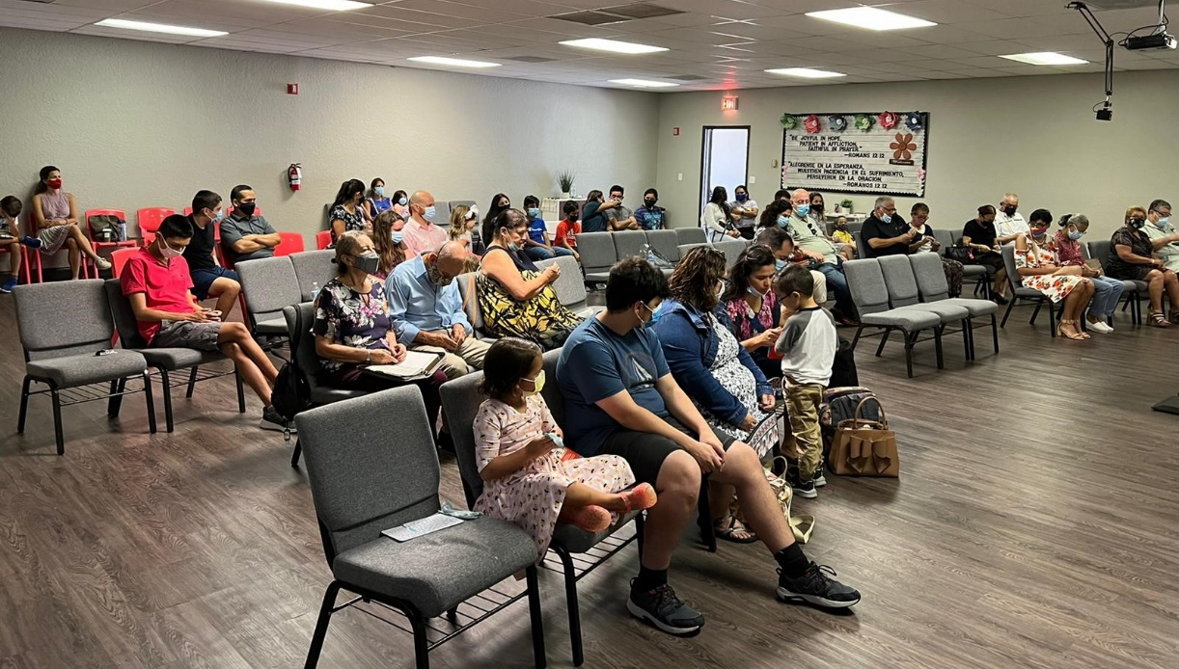
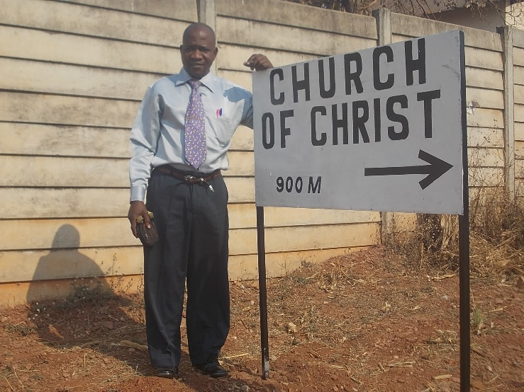
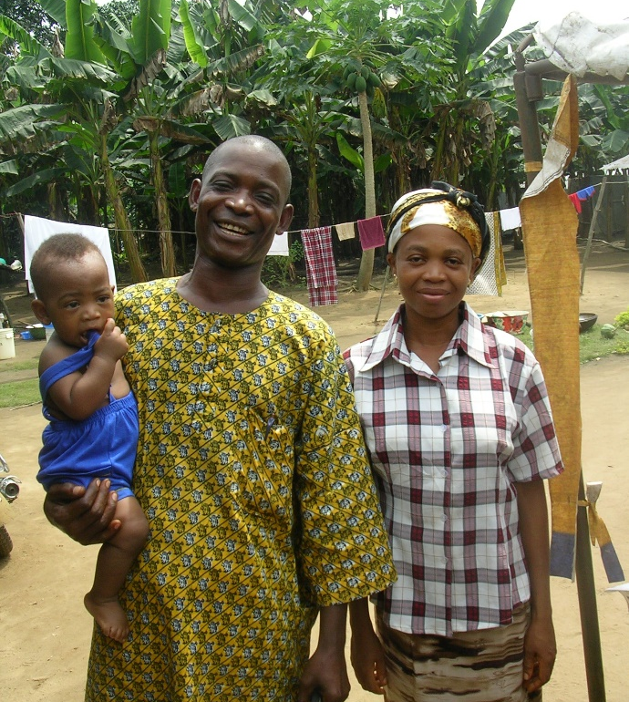
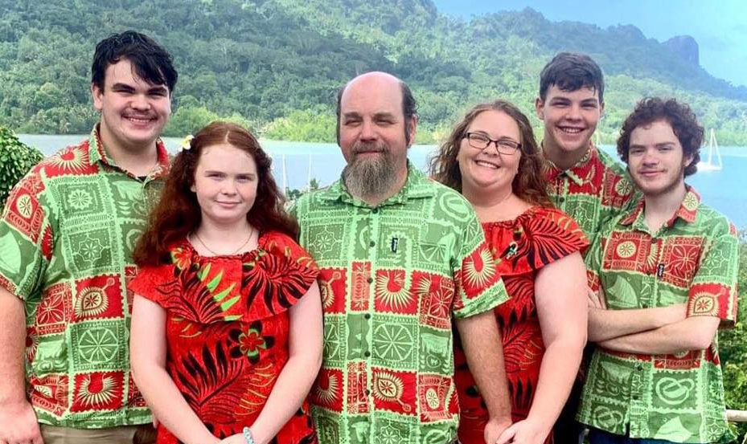
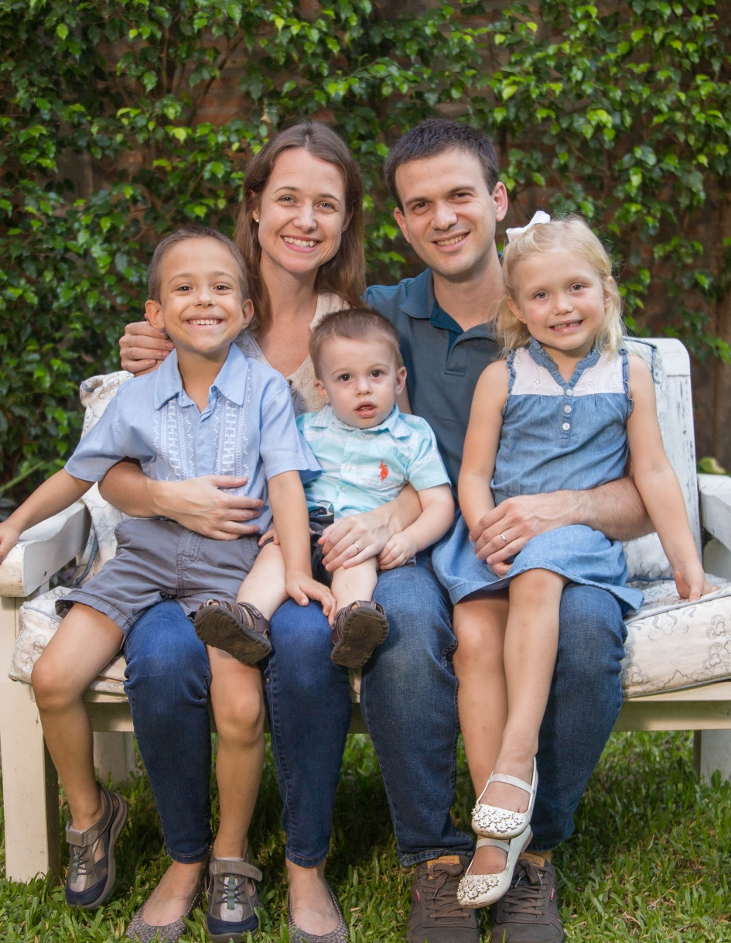
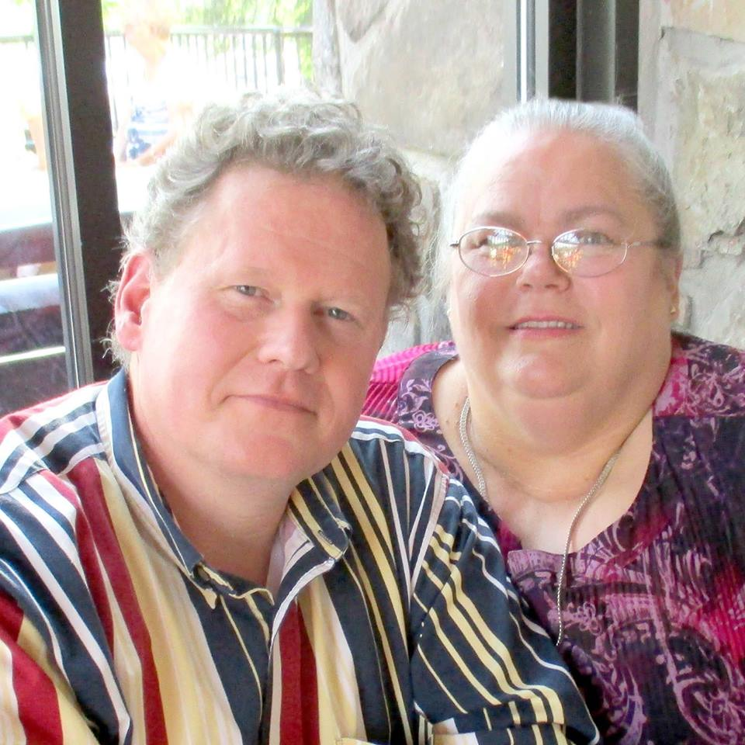
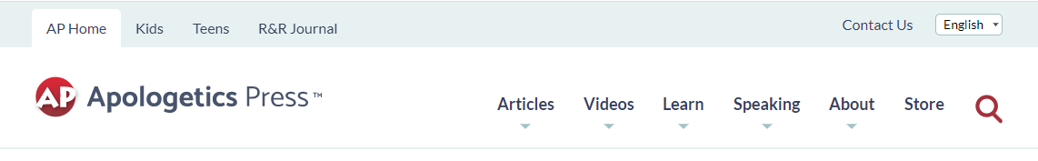
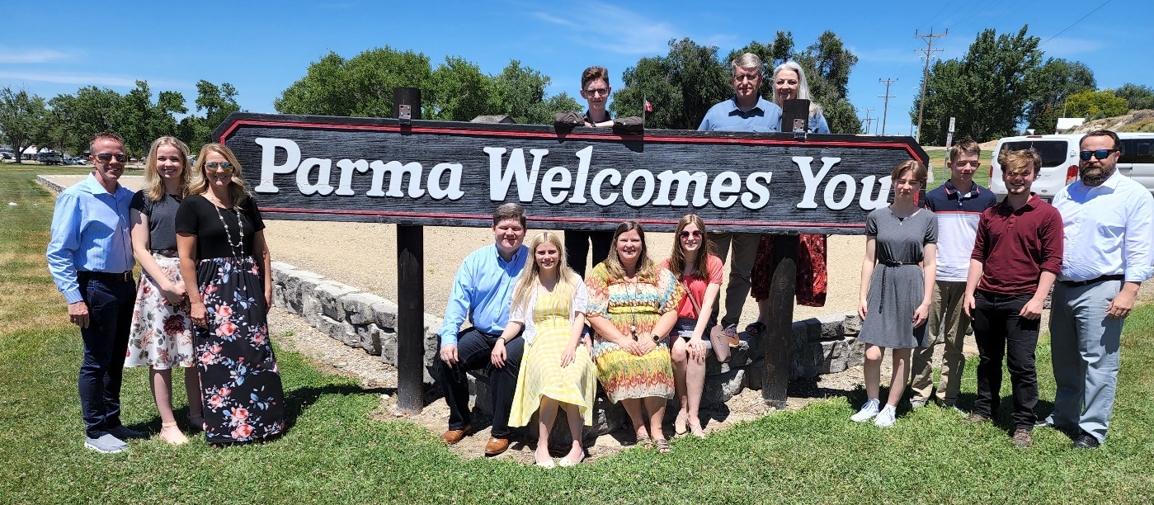
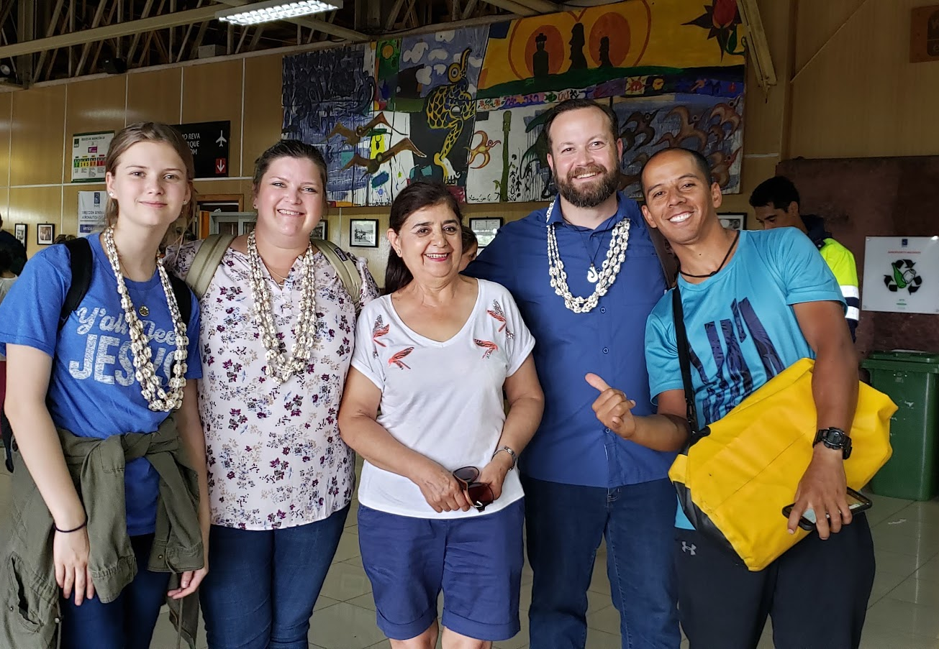
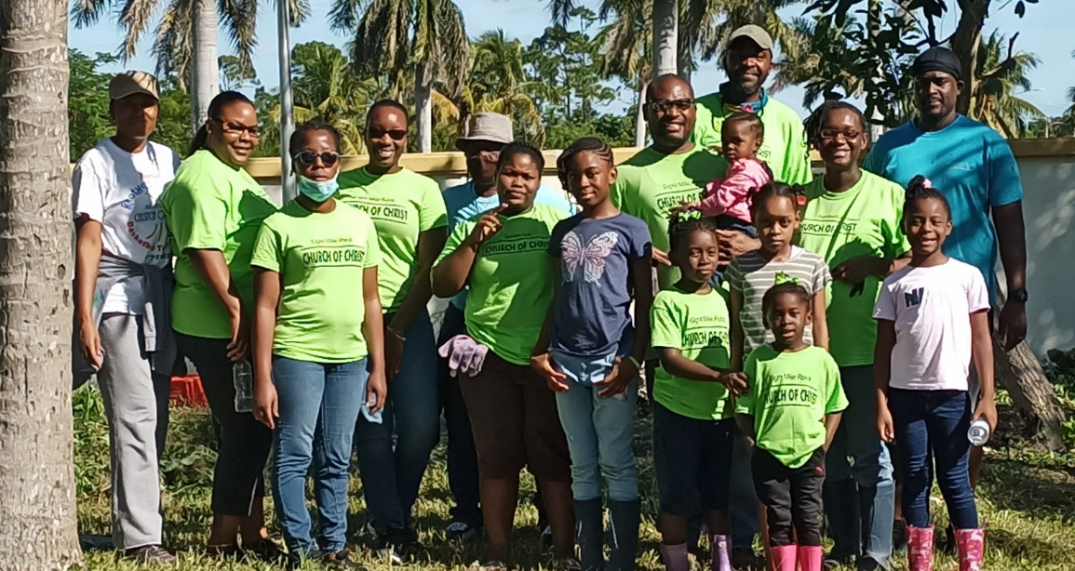
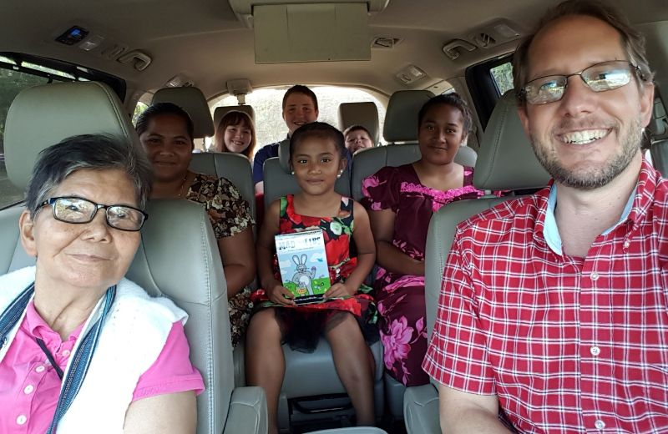
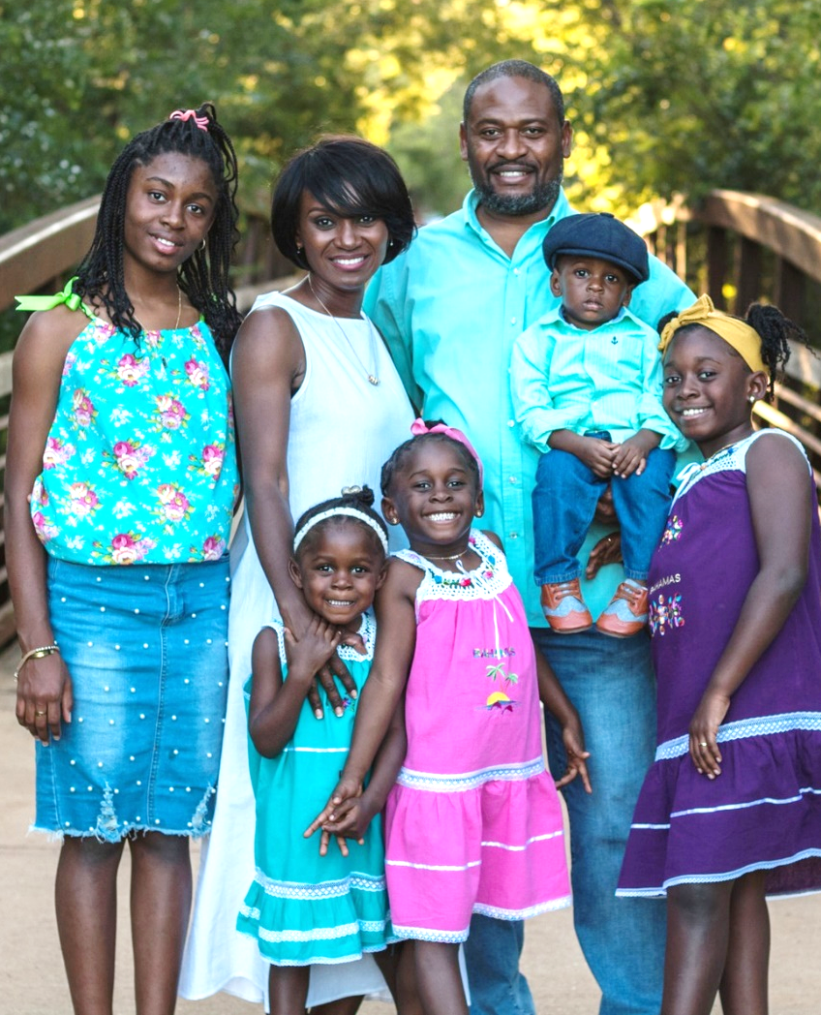
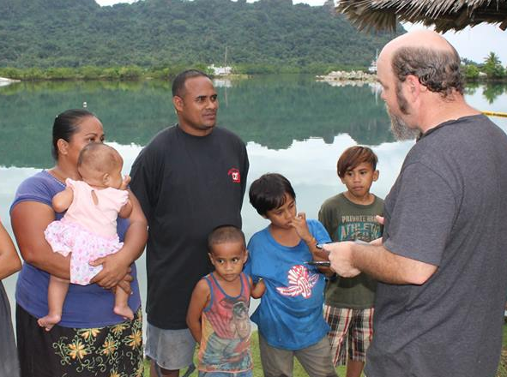
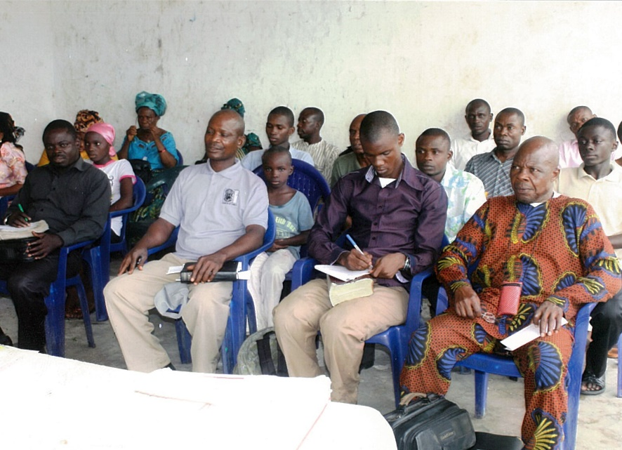
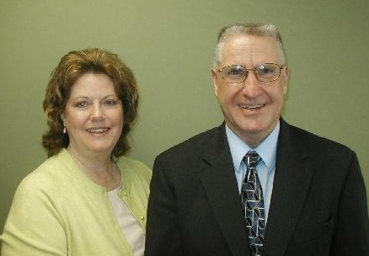
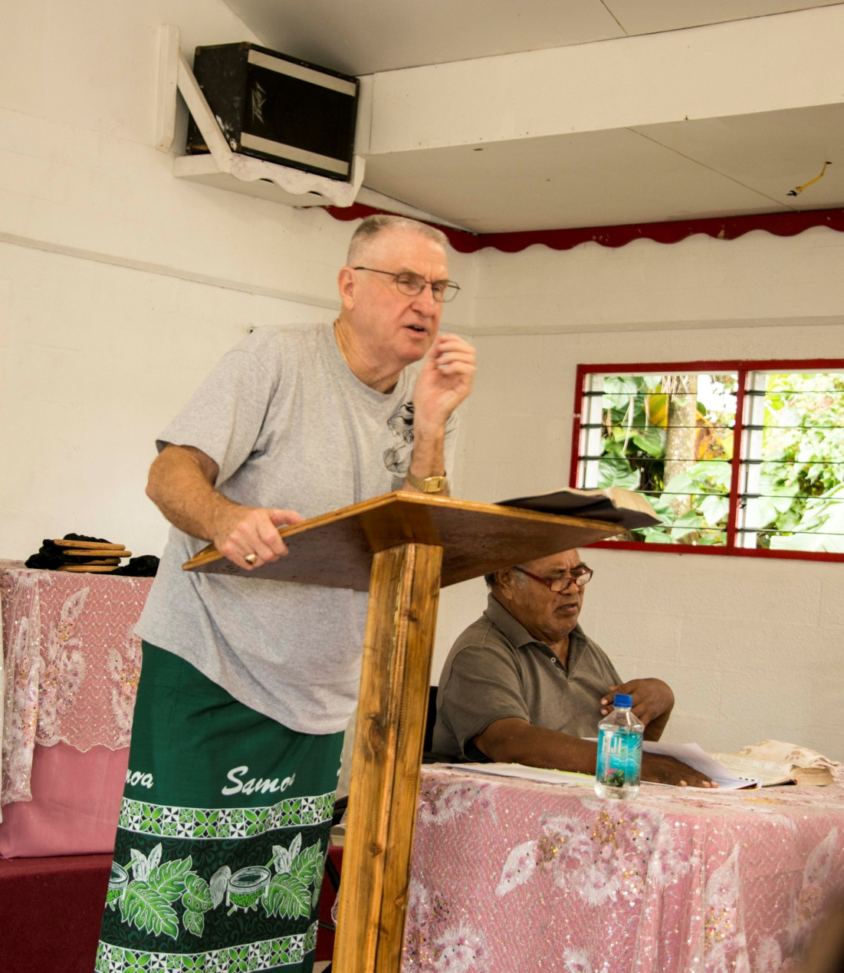

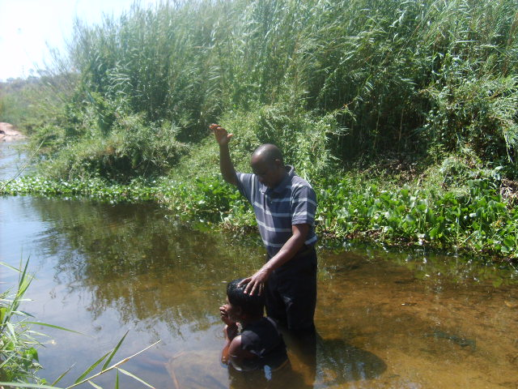
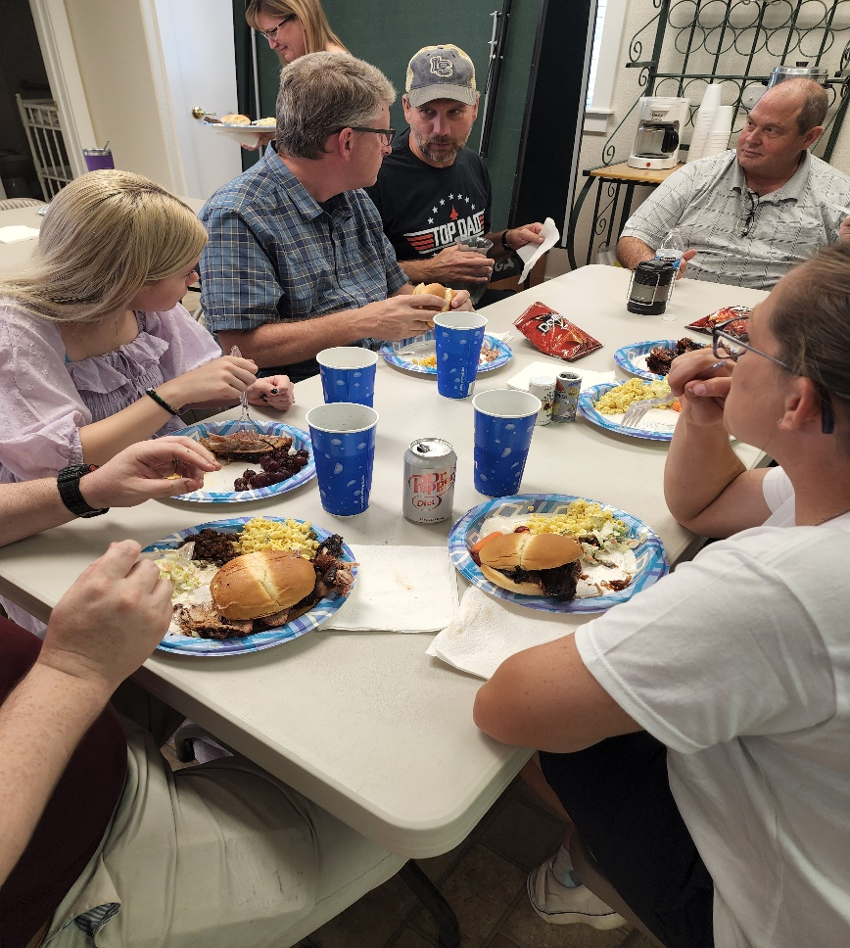
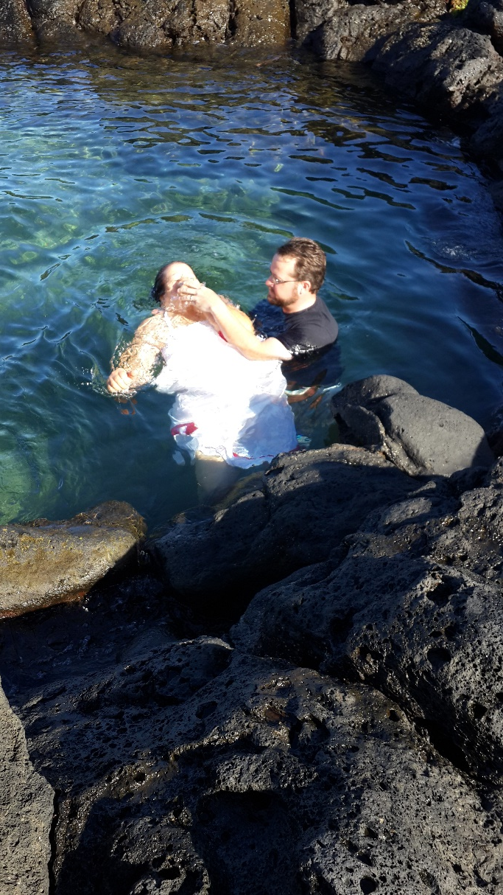
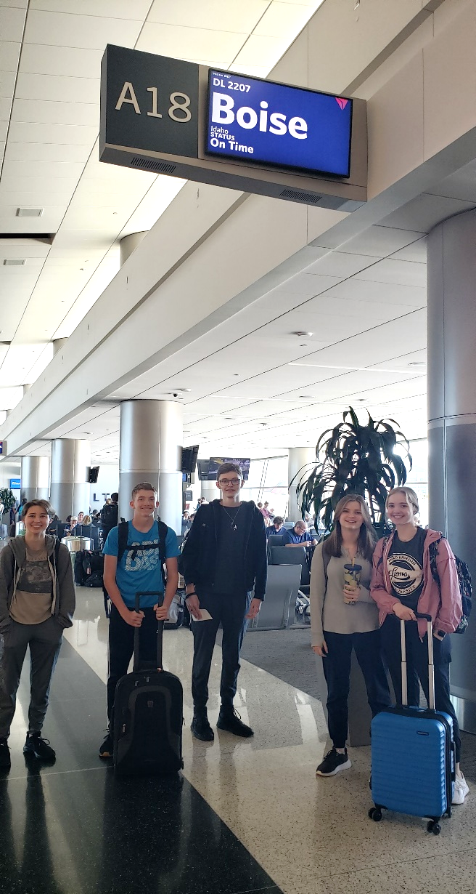
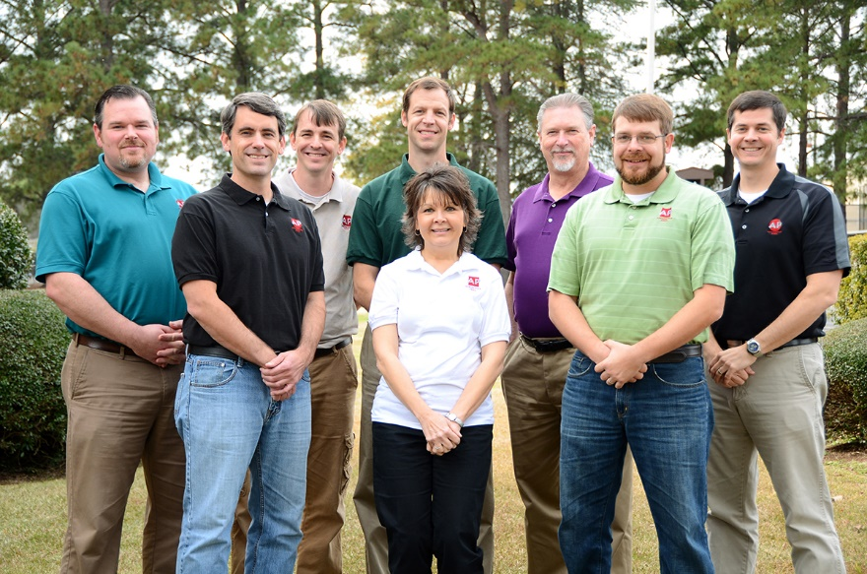
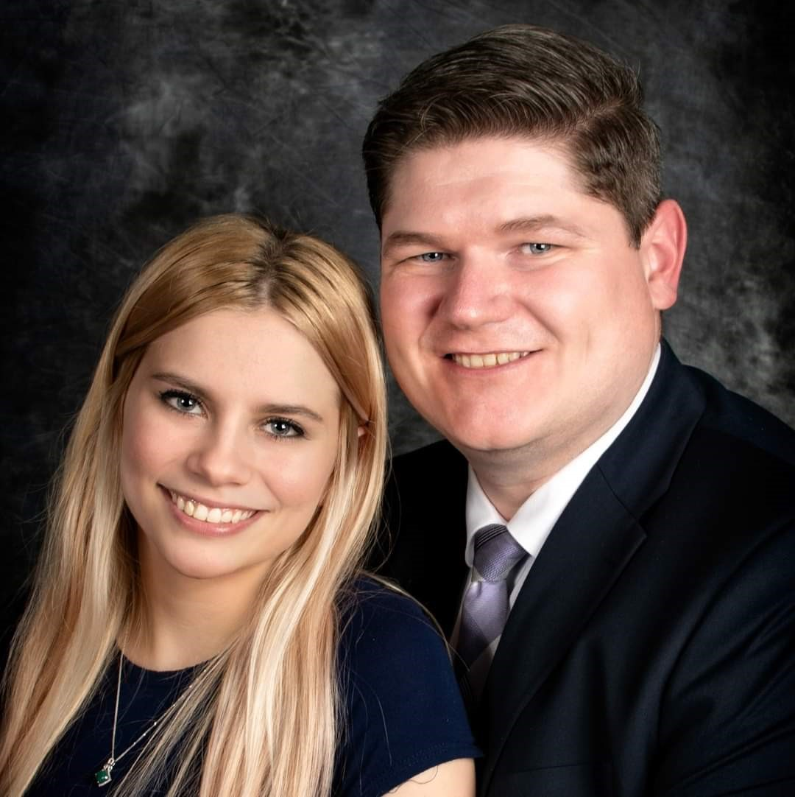
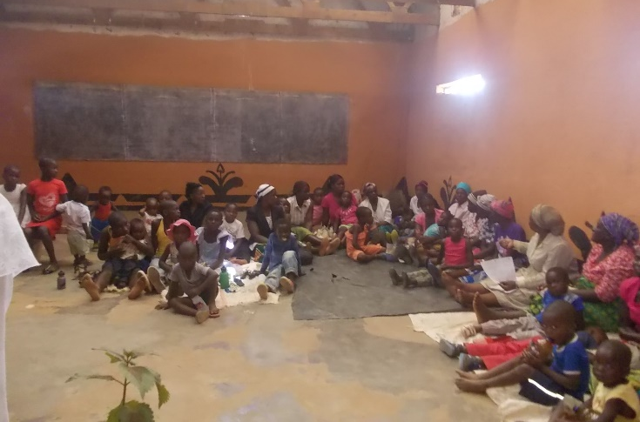


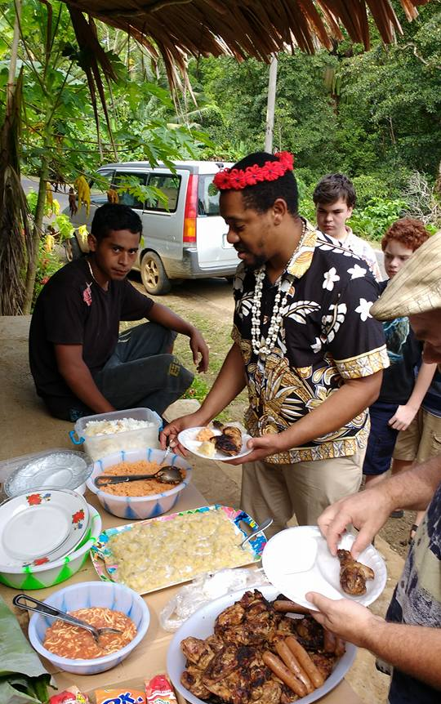


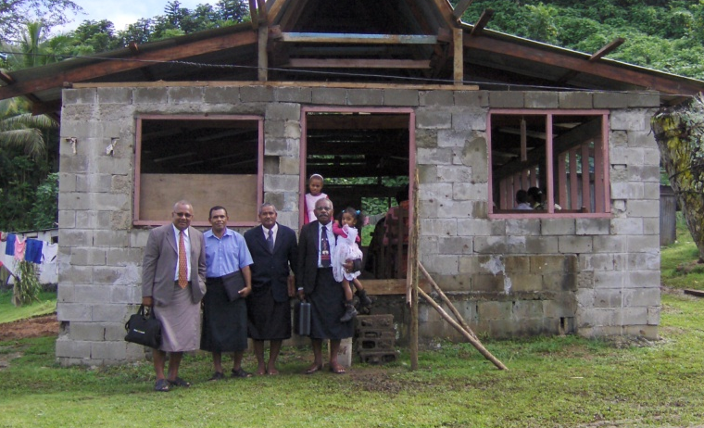
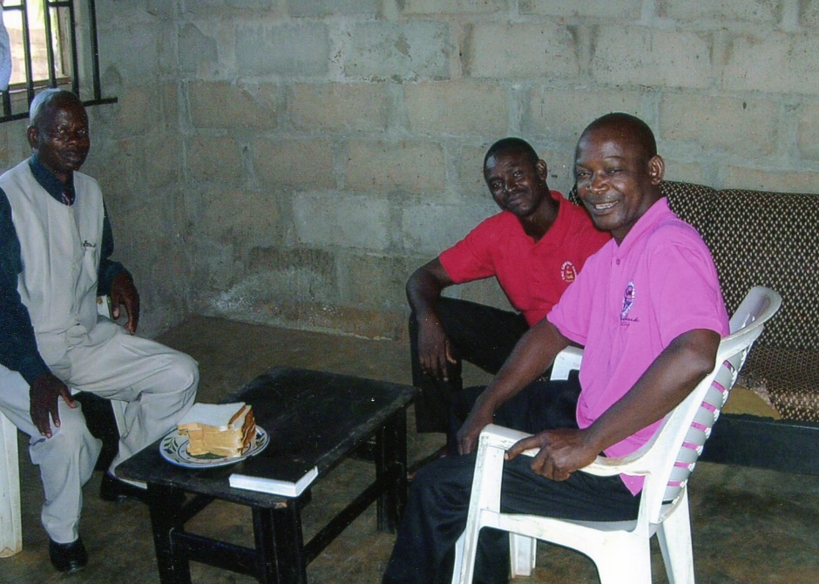
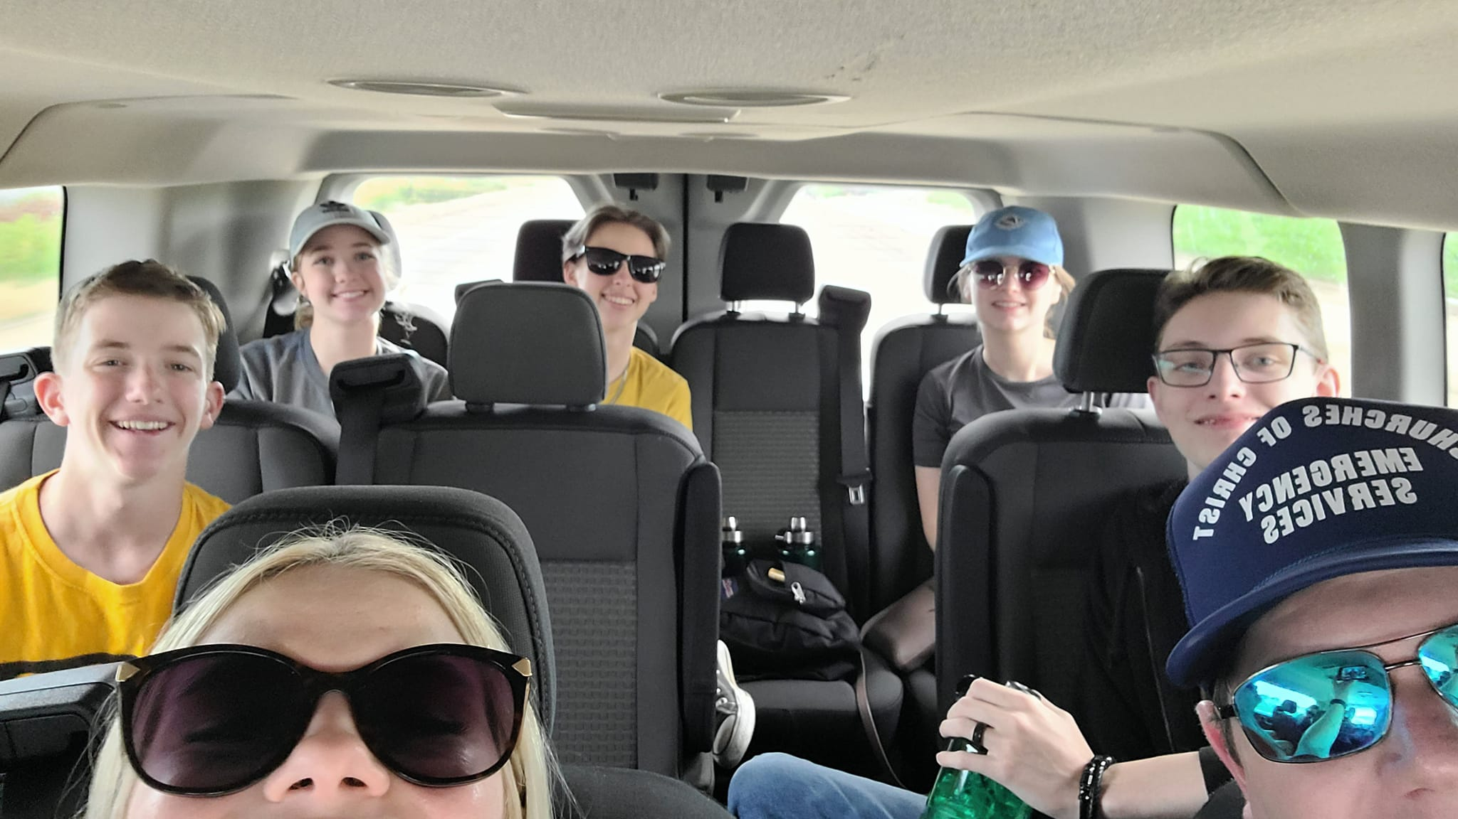
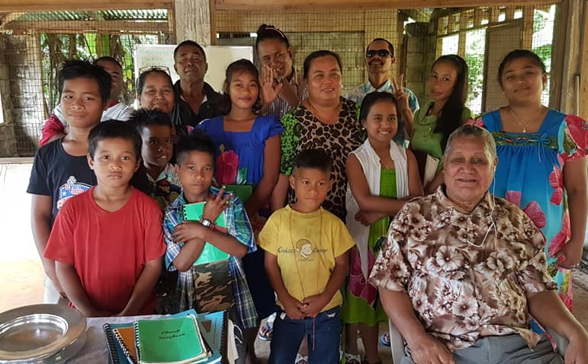
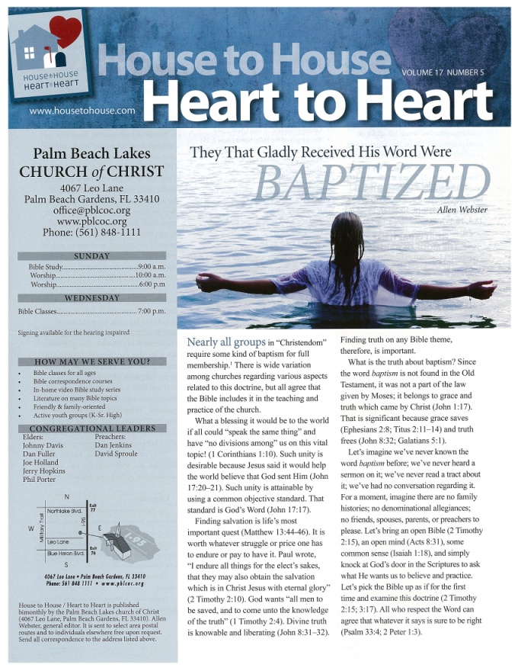
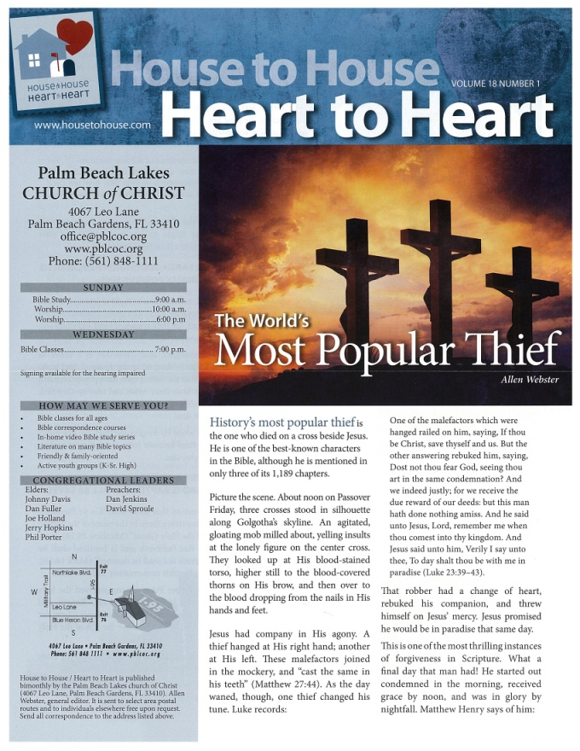
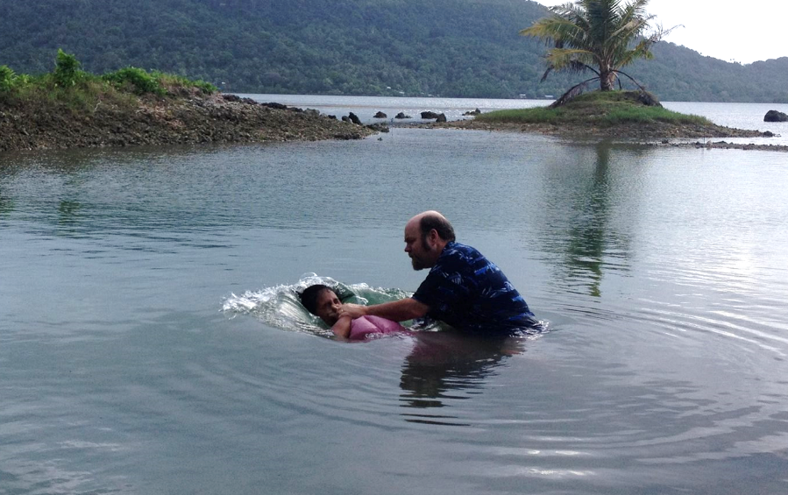
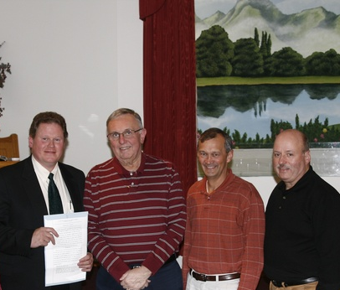
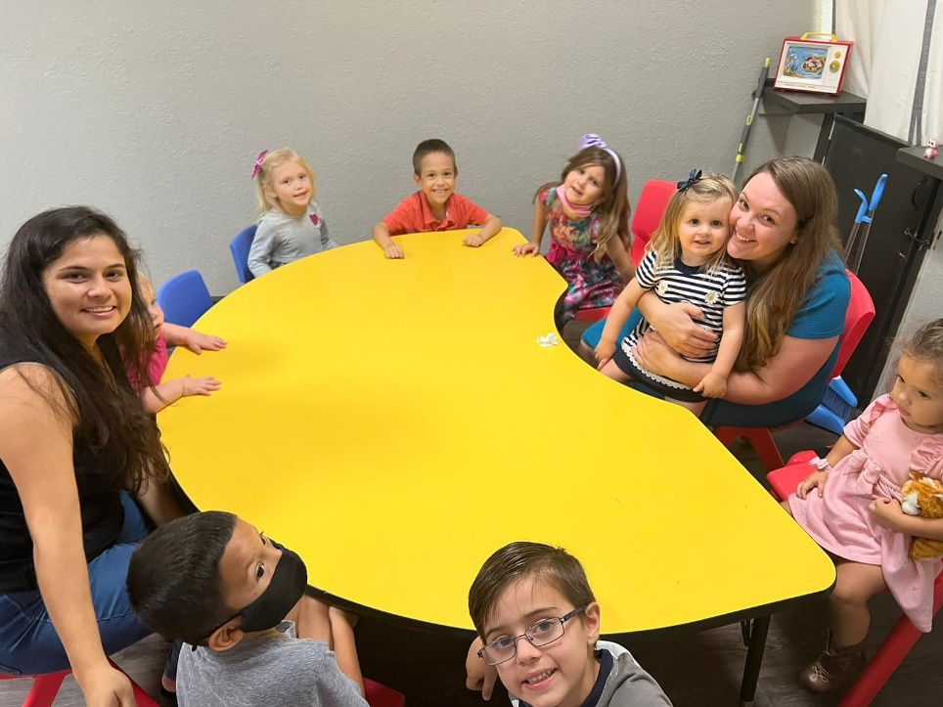
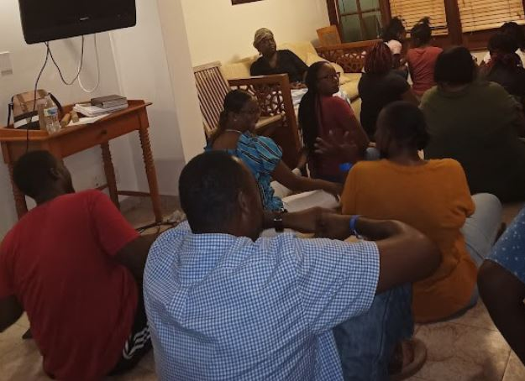
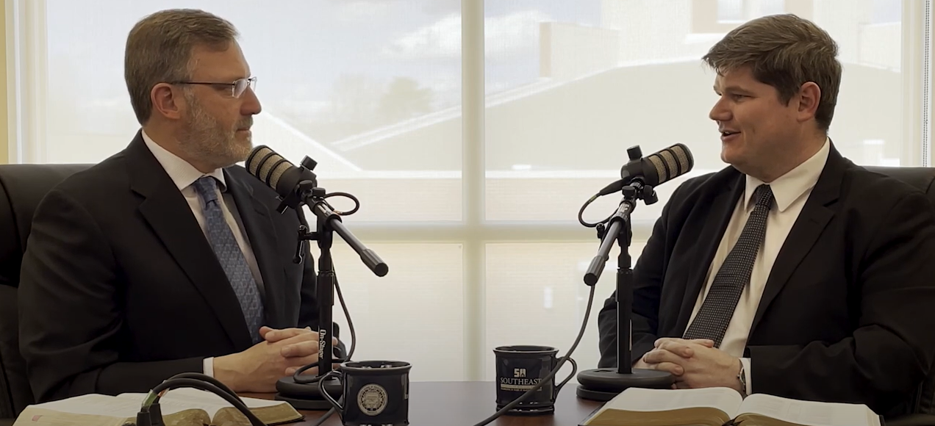
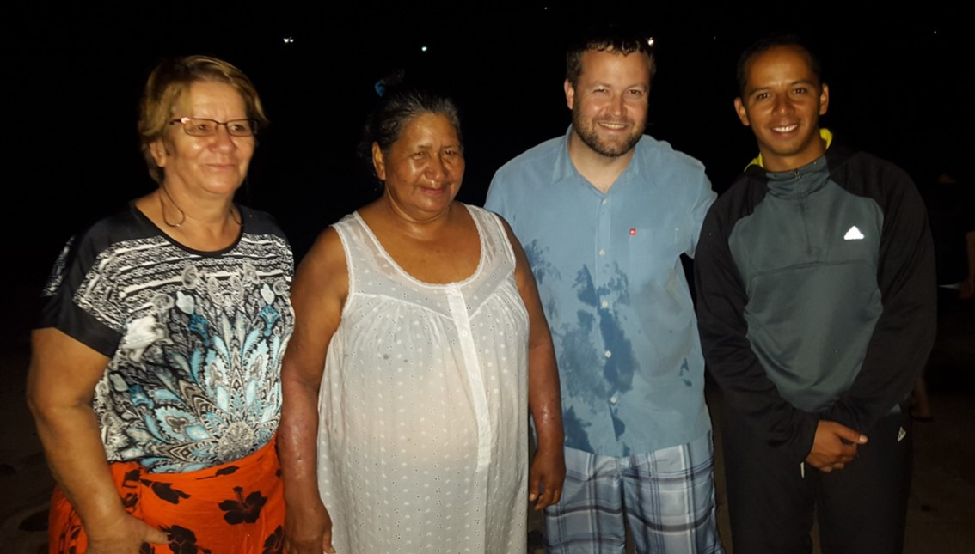
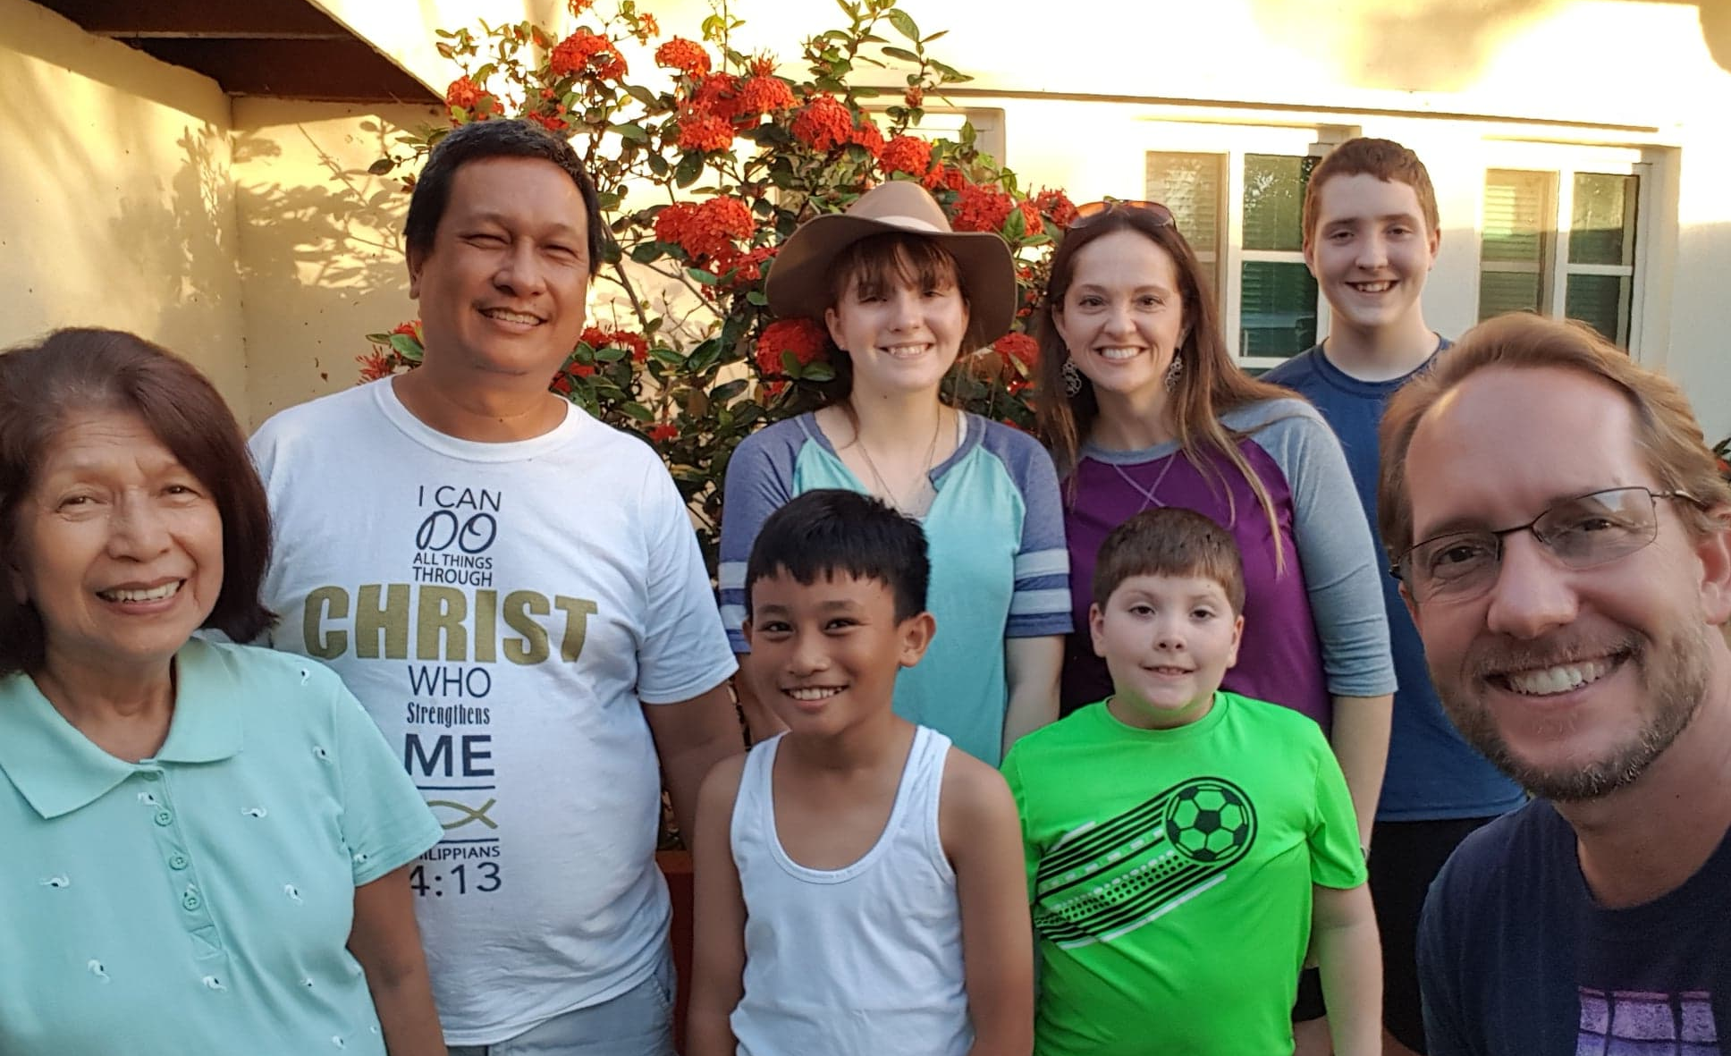
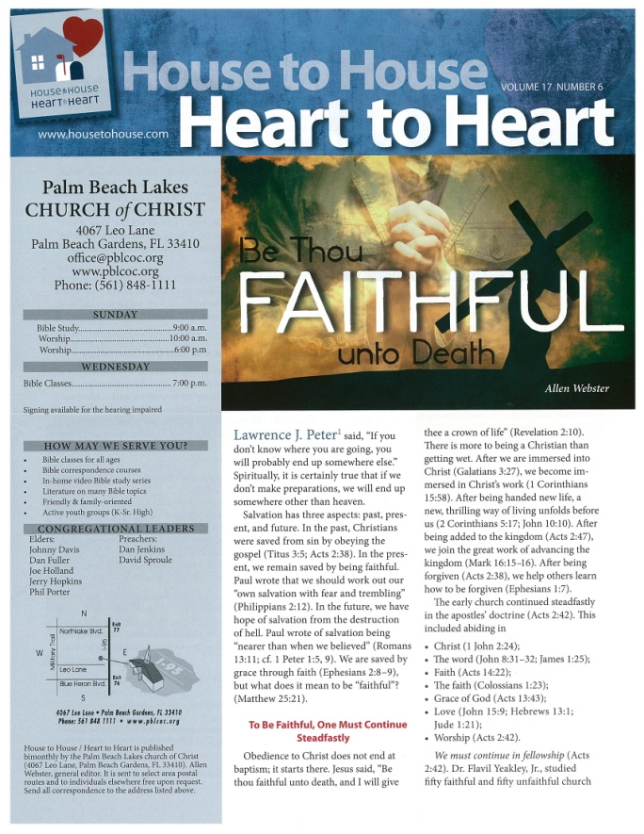
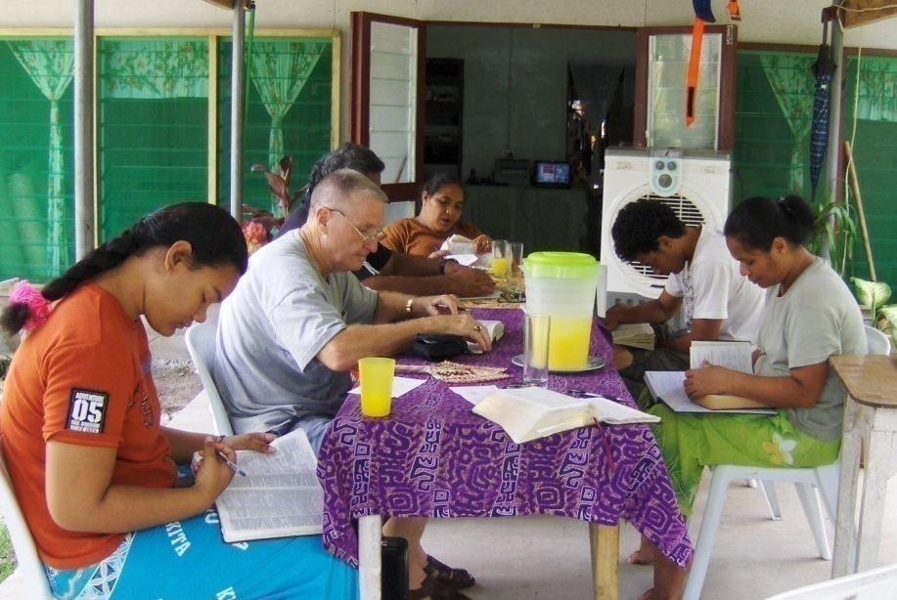
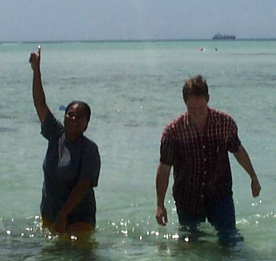
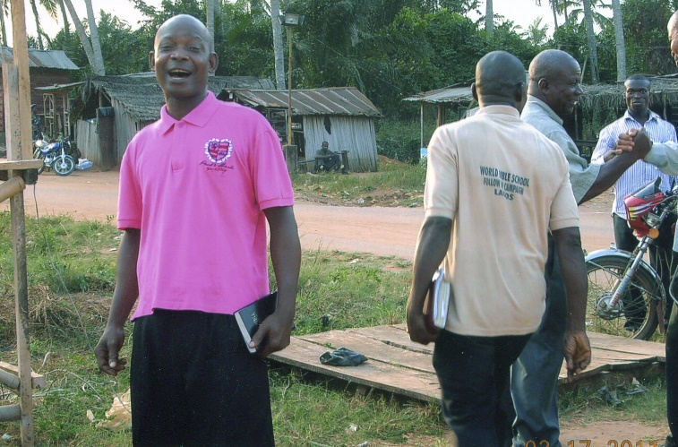
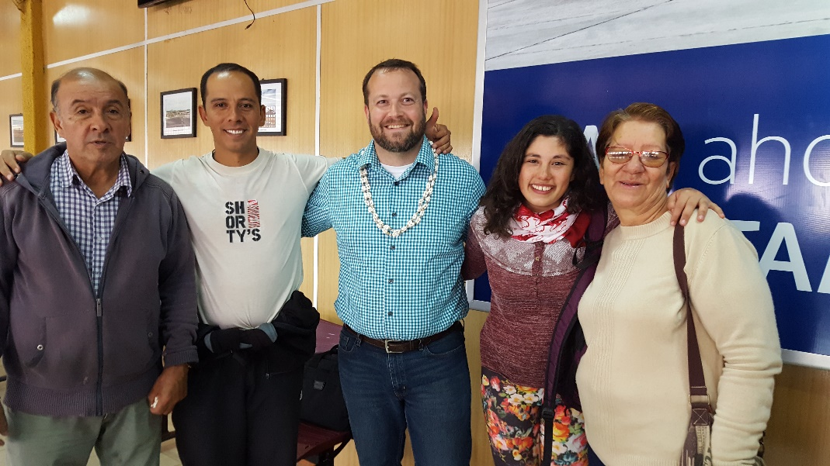
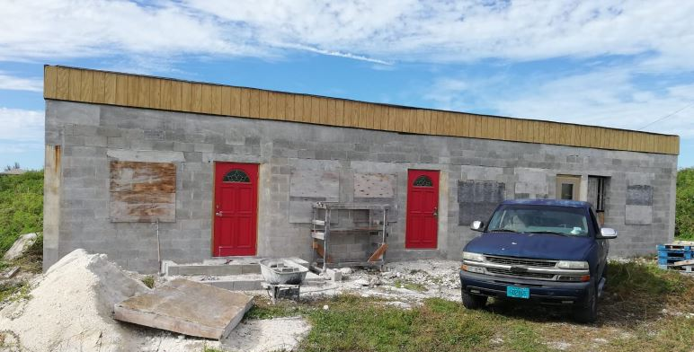
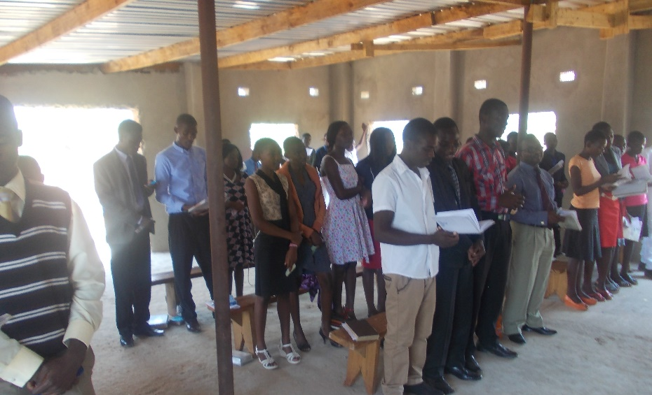
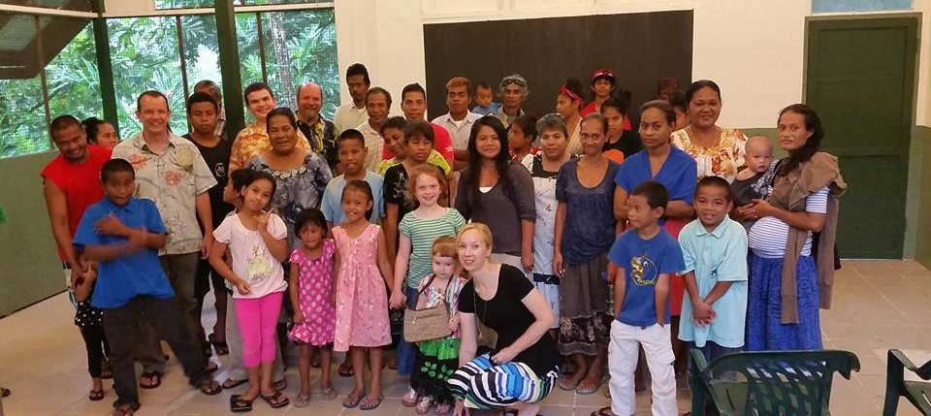
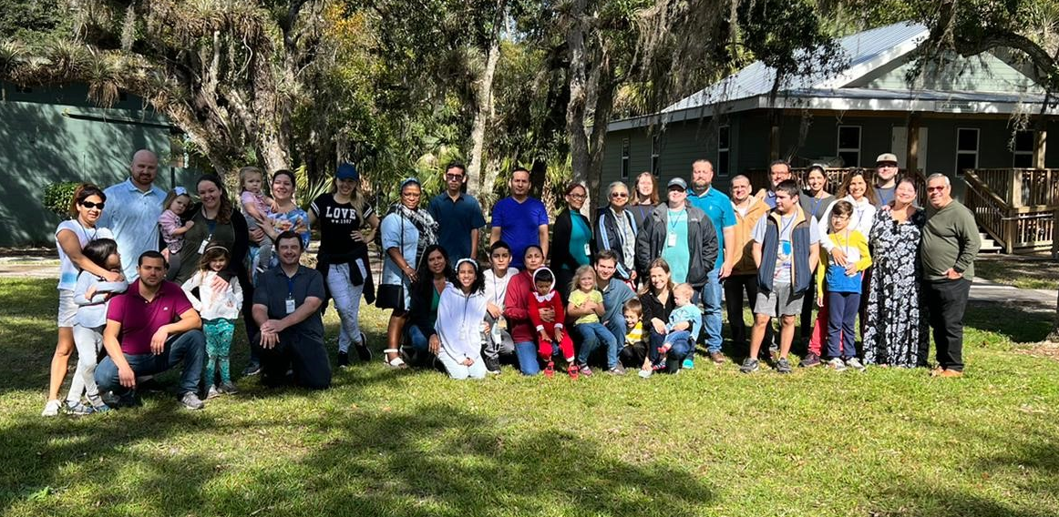
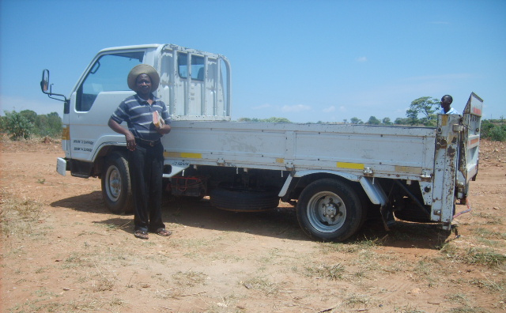




3,300 homes
EVERY month
Rotating Routes
Robert J. Lupo (SEIBS)
House to House/Heart to Heart
Easter
Island
Apologetics Press
Sr. High & Adult Mission Trip
$92,350
Tavaro Hanna (Bahamas)
Robert C. Lupo (Sneedville, TN)
Wayne Parker (Pacific)
Mauricio Yegros (Coral Springs)
Robert Martin (Pacific)
Joey Treat (Pacific)
Nnanna Aforji (Nigeria)
Tamuka Arunashe (Zimbabwe)

Slide 5
$107,350
Special Requests for
Mission Trips
Palm Beach Lakes
“World Missions”
Robert J. Lupo (SEIBS)
House to House/Heart to Heart
Easter
Island
Apologetics Press
Sr. High & Adult Mission Trip
$92,350
Tavaro Hanna (Bahamas)
Robert C. Lupo (Sneedville, TN)
Wayne Parker (Pacific)
Mauricio Yegros (Coral Springs)
Robert Martin (Pacific)
Joey Treat (Pacific)
Nnanna Aforji (Nigeria)
Tamuka Arunashe (Zimbabwe)

Slide 6




Josh Blackmer
Dan Jenkins
Mission Statement: Our mission is to labor with existing congregations and new works of the Lord’s church in evangelizing, edifying, and equipping the saints for greater service in domestic and foreign fields.
Assisting congregations around the United States
  Workshops, Gospel Meetings, Training, Encouragement, etc.
Assisting mission works on foreign soils

Slide 7
$122,350
Assist Spanish Congregation
$107,350
Special Requests for
Mission Trips
Palm Beach Lakes
Answering Macedonian Calls
Robert J. Lupo (SEIBS)
House to House/Heart to Heart
Easter
Island
Apologetics Press
Sr. High & Adult Mission Trip
$92,350
Tavaro Hanna (Bahamas)
Robert C. Lupo (Sneedville, TN)
Wayne Parker (Pacific)
Mauricio Yegros (Coral Springs)
Robert Martin (Pacific)
Joey Treat (Pacific)
Nnanna Aforji (Nigeria)
Tamuka Arunashe (Zimbabwe)

Slide 8






Slide 9
$122,350
Assist Spanish Congregation
Increase Digital
Marketing Locally
$107,350
Special Requests for
Mission Trips
Palm Beach Lakes
Answering Macedonian Calls
Robert J. Lupo (SEIBS)
House to House/Heart to Heart
Easter
Island
Apologetics Press
Sr. High & Adult Mission Trip
$92,350
Tavaro Hanna (Bahamas)
Robert C. Lupo (Sneedville, TN)
Wayne Parker (Pacific)
Mauricio Yegros (Coral Springs)
Robert Martin (Pacific)
Joey Treat (Pacific)
Nnanna Aforji (Nigeria)
Tamuka Arunashe (Zimbabwe)

Slide 10
$137,350
PIBC Teacher’s Travel to Pacific
$122,350
Assist Spanish Congregation
Increase Digital
Marketing Locally
$107,350
Special Requests for
Mission Trips
Palm Beach Lakes
Answering Macedonian Calls
Robert J. Lupo (SEIBS)
House to House/Heart to Heart
Easter
Island
Apologetics Press
Sr. High & Adult Mission Trip
$92,350
Tavaro Hanna (Bahamas)
Robert C. Lupo (Sneedville, TN)
Wayne Parker (Pacific)
Mauricio Yegros (Coral Springs)
Robert Martin (Pacific)
Joey Treat (Pacific)
Nnanna Aforji (Nigeria)
Tamuka Arunashe (Zimbabwe)

Slide 11

Training Christians for 25 years
Taking the school directly to the students
Our part: Assisting with travel expenses of teachers

Slide 12
$137,350
PIBC Teacher’s Travel to Pacific
PBL Answering
Macedonian Calls
$122,350
Assist Spanish Congregation
Increase Digital
Marketing Locally
$107,350
Special Requests for
Mission Trips
Palm Beach Lakes
Answering Macedonian Calls
Robert J. Lupo (SEIBS)
House to House/Heart to Heart
Easter
Island
Apologetics Press
Sr. High & Adult Mission Trip
$92,350
Tavaro Hanna (Bahamas)
Robert C. Lupo (Sneedville, TN)
Wayne Parker (Pacific)
Mauricio Yegros (Coral Springs)
Robert Martin (Pacific)
Joey Treat (Pacific)
Nnanna Aforji (Nigeria)
Tamuka Arunashe (Zimbabwe)

Slide 13
$+++,+++
+
+
+
$147,350
Assist Spanish
Congregation
$137,350
PIBC Teacher’s Travel to Pacific
PBL Answering
Macedonian Calls
$122,350
Assist Spanish Congregation
Increase Digital
Marketing Locally
$107,350
Special Requests for
Mission Trips
Palm Beach Lakes
Answering Macedonian Calls
Robert J. Lupo (SEIBS)
House to House/Heart to Heart
Easter
Island
Apologetics Press
Sr. High & Adult Mission Trip
$92,350
Tavaro Hanna (Bahamas)
Robert C. Lupo (Sneedville, TN)
Wayne Parker (Pacific)
Mauricio Yegros (Coral Springs)
Robert Martin (Pacific)
Joey Treat (Pacific)
Nnanna Aforji (Nigeria)
Tamuka Arunashe (Zimbabwe)

Slide 15

Believe Jesus is God’s Son – John 8:24
Repent of your sins and turn to God – Acts 3:19
Confess your faith in Jesus Christ – Romans 10:9
Be immersed into Christ – Galatians 3:27
  God will forgive all of your sins – Acts 2:38
  God will add you to His church – Acts 2:47
  God will register you in heaven – Hebrews 12:23
Live faithfully to Christ – Revelation 2:10

Slide 16
$+++,+++
+
+
+
$147,350
Assist Spanish
Congregation
$137,350
PIBC Teacher’s Travel to Pacific
PBL Answering
Macedonian Calls
$122,350
Assist Spanish Congregation
Increase Digital
Marketing Locally
$107,350
Special Requests for
Mission Trips
Palm Beach Lakes
Answering Macedonian Calls
Robert J. Lupo (SEIBS)
House to House/Heart to Heart
Easter
Island
Apologetics Press
Sr. High & Adult Mission Trip
$92,350
Tavaro Hanna (Bahamas)
Robert C. Lupo (Sneedville, TN)
Wayne Parker (Pacific)
Mauricio Yegros (Coral Springs)
Robert Martin (Pacific)
Joey Treat (Pacific)
Nnanna Aforji (Nigeria)
Tamuka Arunashe (Zimbabwe)

