Slide 2
Bless you (Psa. 119:1-2)
Direct you (119:19, 30, 101, 102, 105, 130, 133, 176)
Teach you (119:12, 26, 27, 33, 34, 42, 64, 66, 68, 71, 73, 98, 99, 100, 102, 104, 108, 124, 125, 130, 135, 144, 169)
Protect you (119:23, 51, 61, 69, 78, 85, 86, 87, 95, 98, 104, 109, 110, 114, 115, 117, 121, 122, 133, 150, 151, 153, 157, 165, 173)
Change you (119:37, 59, 60, 67, 101, 176)
Save you (119:41, 58, 94, 134, 146, 166, 170, 174)
Enliven you (119:50, 77, 93, 144)
Mature you (119:15, 23, 27, 48, 78, 97, 99, 148)

Slide 3
Purify you (119:9, 11)
Encourage you (119:32)
Comfort you (119:50, 52, 55, 76, 82, 143, 147, 148)
Uphold you (119:86, 92, 116, 117, 148, 173, 175)
Calm you (119:165)
Wow you (119:18, 27, 129, 161, 162)
Captivate you (119:20, 31, 36, 40, 48, 81, 112, 131, 148, 174)
Delight you (119:5, 16, 24, 35, 47, 70, 92, 103, 135, 143, 162, 174)
Cheer you (119:7, 14, 54, 62, 111, 129, 162, 164, 171, 175)
Satisfy you (119:72, 103, 127, 131, 135)

Slide 4
Reassure you (119:43, 49, 74, 81, 89, 111, 114, 116, 147, 166)
Revive you (119:25, 37, 40, 88, 107, 149, 154, 156, 159)
Strengthen you (119:28, 92)
Fortify you (119:38, 75, 89, 90, 91, 96, 111, 128, 137, 138, 140, 142, 144, 151, 152, 160)
Embolden you (119:6, 13, 31, 46, 80, 116, 172)
Motivate you (119:4, 32, 60, 106, 112, 117, 129, 145, 146, 166, 168)
Move you (119:47, 48, 97, 113, 119, 127, 140, 159, 163, 165, 167)
Consume you (119:2, 10, 34, 81, 82, 97, 123, 136, 139, 145, 147, 148, 162)

Slide 6
You wake up every day…which shows you’ve been given life by God
You eat every day…which shows you’ve been blessed by God
But what do you do every day, AS A CHILD OF GOD, that sets you apart from every other living human being?
Do you DESIRE the Word of God (1 Pet. 2:2)?
Are you DILIGENT in your study of it (2 Tim. 2:15)?
Are you DEVELOPING in your relationship with God (2 Pet. 3:18)?

Slide 9
Sermon &
Bible Class
Notes-
Book

Slide 12
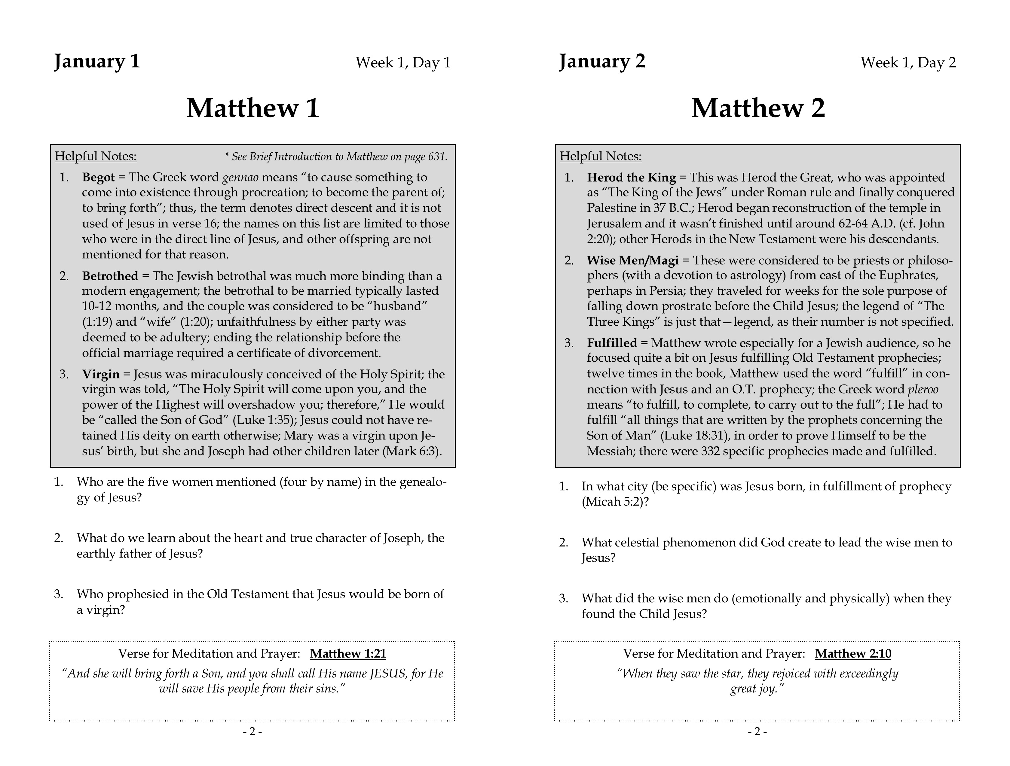

Slide 15
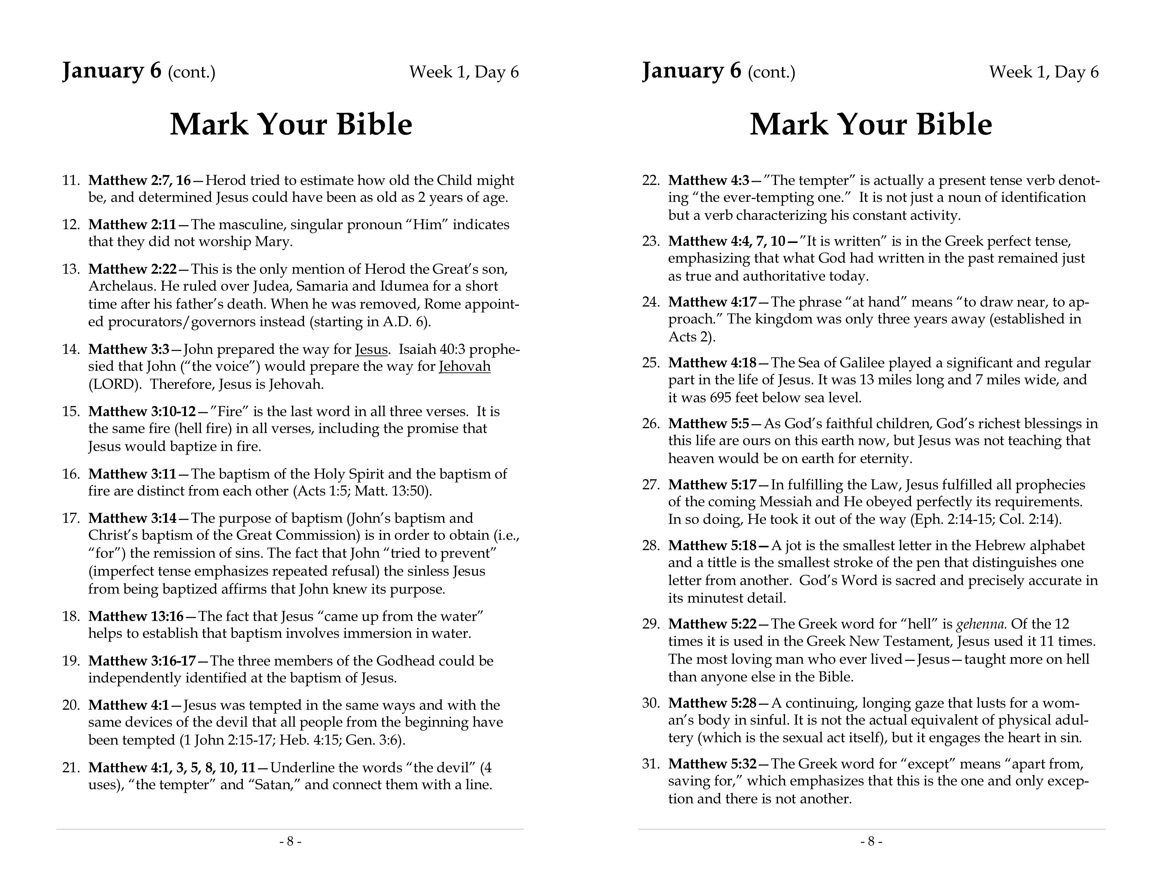

Slide 21
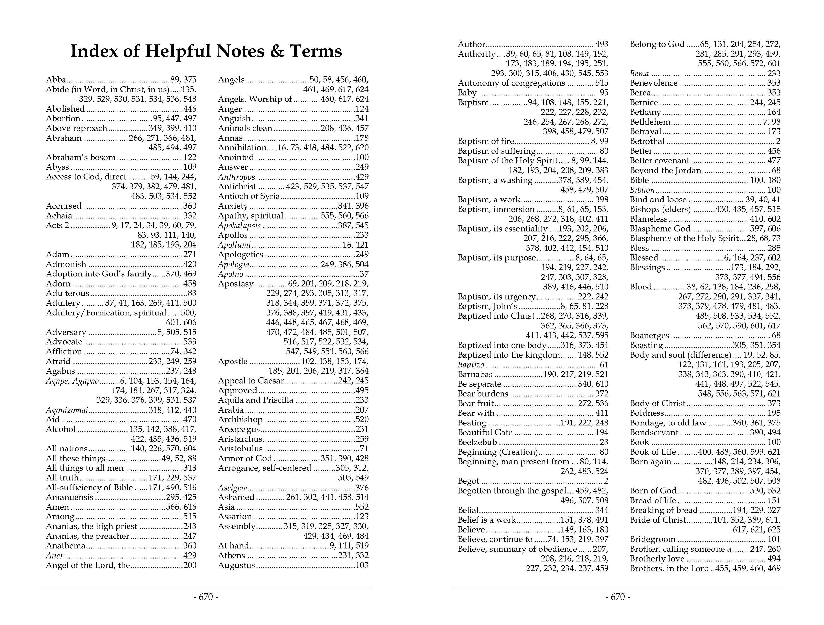

Slide 22
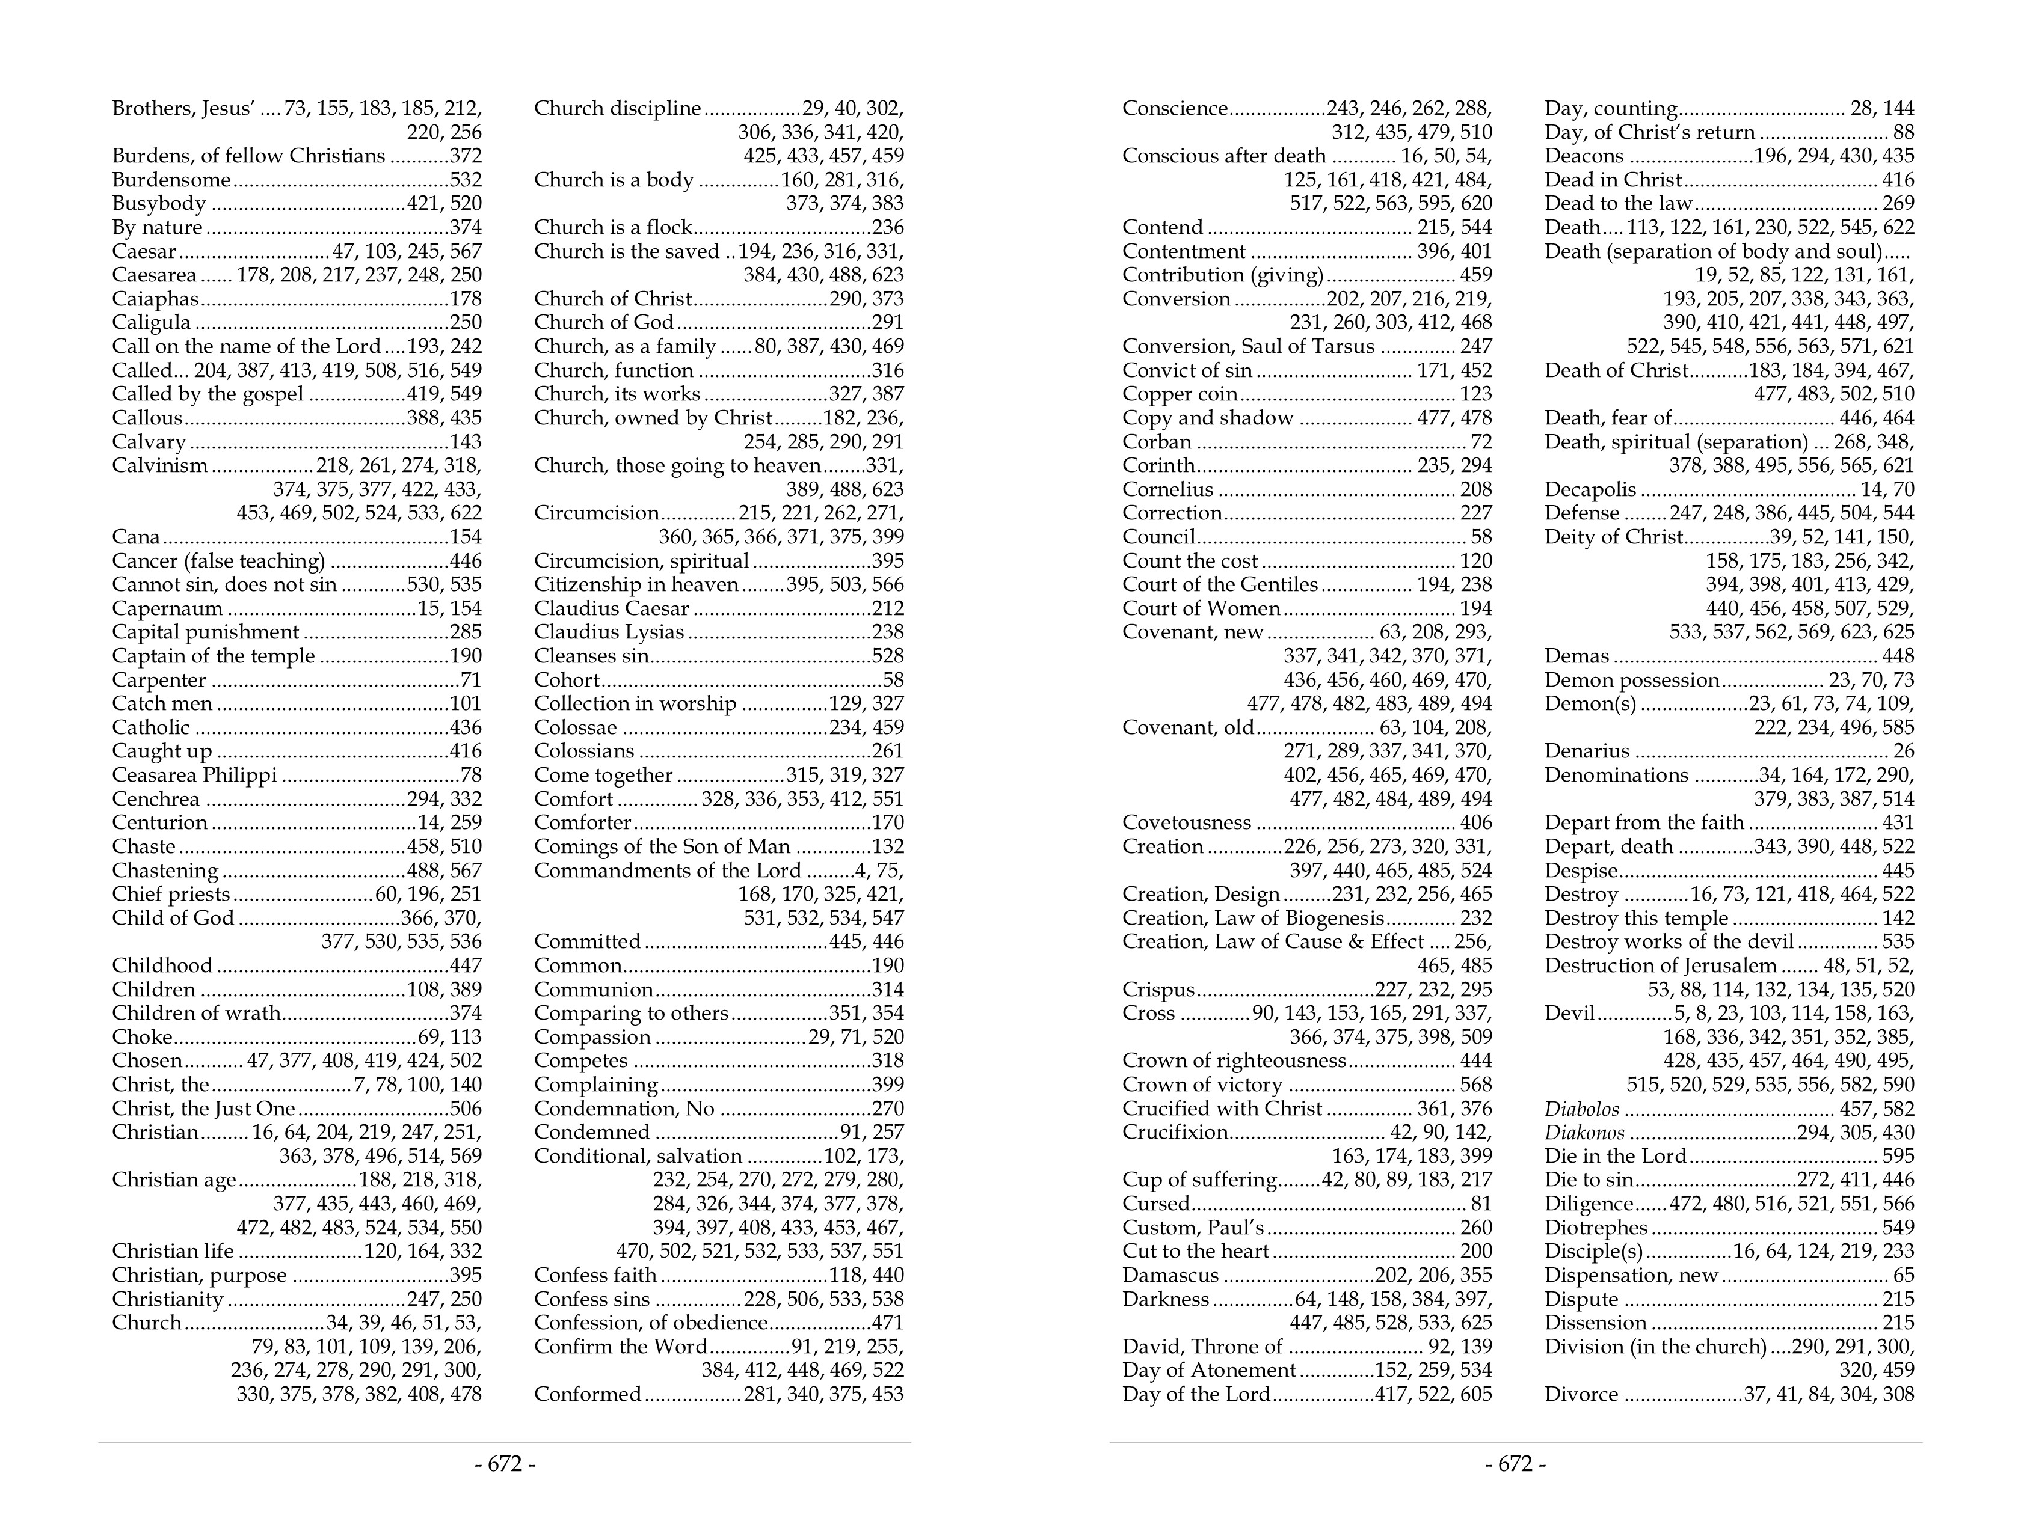

Slide 23
Let’s read together (2 Tim. 2:15)
Let’s grow together (2 Pet. 3:18)
Let’s be transformed together (2 Cor. 3:18)
Let’s strive to do this together (Phil. 1:27)
Let’s create a habit together (Acts 17:11)
Let’s not just make it “part of a day”— let’s make it relevant and central to who we are and what we do

Slide 25
Believe Jesus is God’s Son – John 8:24
Repent of your sins and turn to God – Luke 13:3
Confess your faith in Jesus Christ – Matthew 10:32
Be immersed into Christ to be saved – Galatians 3:27
God will forgive all of your sins – Acts 2:38
God will add you to His church – Acts 2:47
God will register you in heaven – Hebrews 12:23
Live faithfully to the Lord – Revelation 2:10

