Slide 1
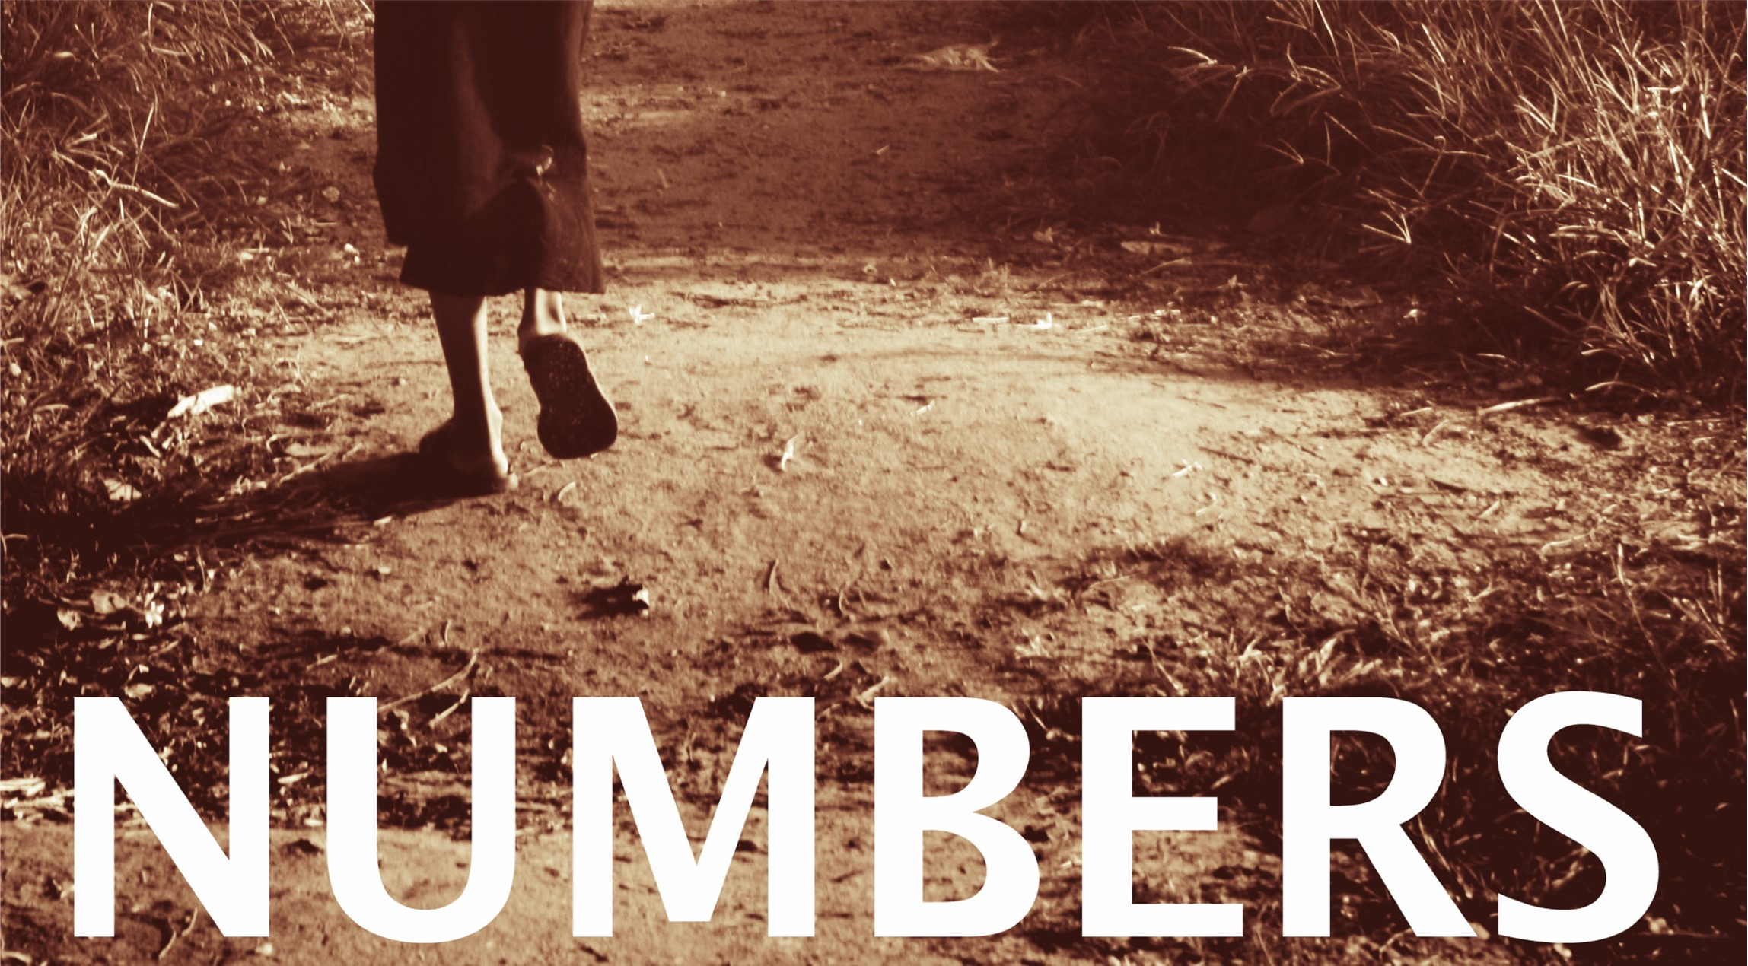

Slide 2
Numbers
  Outline:
  The last chapters of Numbers, from 20-36, the new generation of Israelites again attempt to enter the land to take it as God promised.
    This time they easily destroy two nations that confront them as they are entering.
    Balak uses his prophet Balaam to learn to seduce the Israelites to worship Baal.
    Because of disobedience, about 24,000 people die, including Balaam.
    Before the book of Numbers ends, Moses again conducts a census, and Joshua assumes the leadership of Israel in place of Moses who is banned from the promise land, due to his disobedience.

Slide 3
Chapters 20-36:
Next
Generation
Chapter 31:
1-12: Vengeance on the Midianites
13-24: Correcting the Mistake of the Warriors
25-47: Division of the Plunder
48-54: Offering of Atonement

Slide 4
Chapters 20-36:
Next
Generation
Chapter 32:
1-5: Rueben and Gad Ask for Land
6-27: Moses’ Objection and Their Rebuttal
28-42: Permission Granted

Slide 5
Chapters 20-36:
Next
Generation
Chapter 33:
1-49: The Travels of the Israelites
50-56: A Warning About Possessing the Land

Slide 6
Chapters 20-36:
Next
Generation
Chapter 34:
1-15: The Boarders of Canaan
16-29: The Names of Those to Apportion the Land

Slide 7
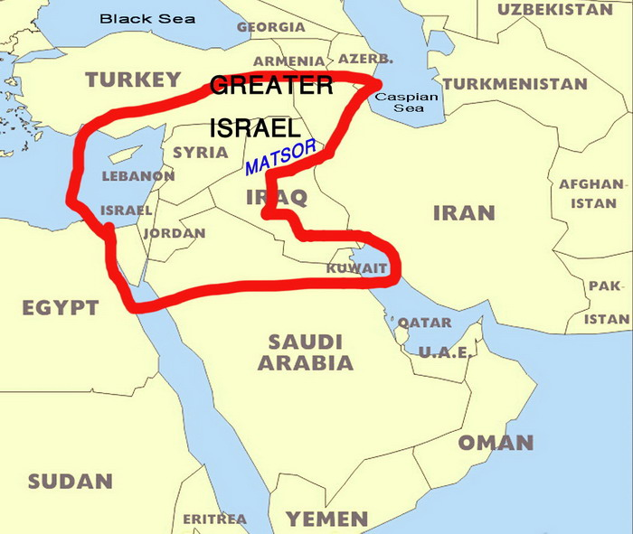

Slide 8
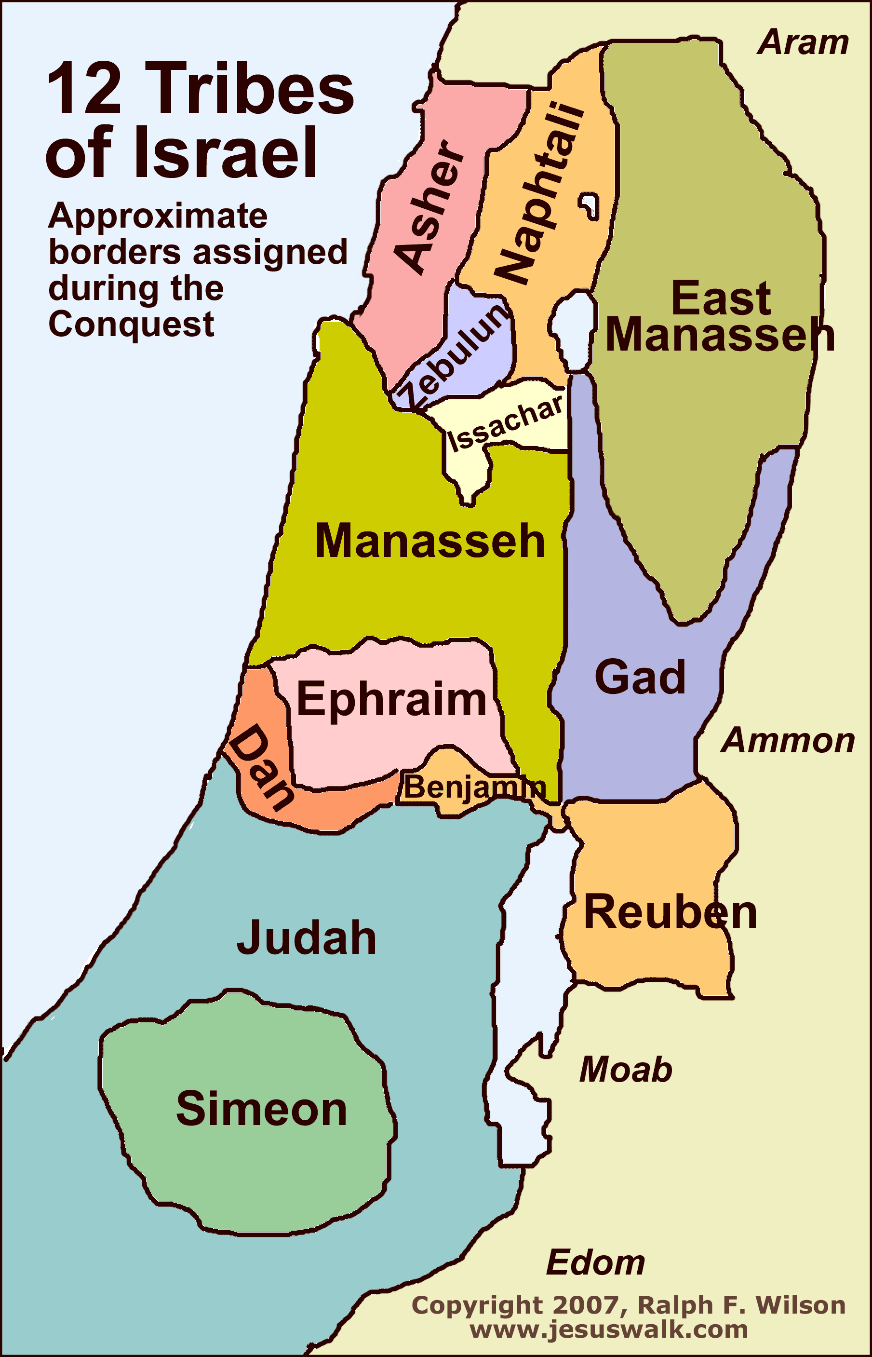

Slide 9
Chapters 20-36:
Next
Generation
Chapter 35:
1-5: Cities of the Levites
6-15: Cities of Refuge
16-34: Laws Concerning Murder and Punishment

Slide 10
Chapters 20-36:
Next
Generation
Chapter 36:
1-4: An Issue Concerning Land Inheritance
5-13: The Solution as a Perpetual Ordinance

