Slide 2
3 Key Questions
Where do I need to put the Bible?
“Your word I have hidden in my heart, That I might not sin against You!” (Psalm 119:11)
What does the Bible do for me?
“Your word is a lamp to my feet And a light to my path.” (Psalm 119:105)
Why do I need to study the Bible?
“Study to shew thyself approved unto God, a workman that needeth not to be ashamed, rightly dividing the word of truth.” (2 Timothy 2:15)

Slide 3
Overview of the Bible
Prophet | Theme of the Bible | Jesus Christ
Priest | Three-Sentence Summary of the Bible | Someone is coming. Someone is here. Someone is coming again.
Introduction to the New Testament
Prophet | Name the Four Accounts of the Gospel | Matthew, Mark, Luke, John
Prophet | "Gospel" Means | Good News
Prophet | The Four Accounts of the Gospel Tell About | The Life of Jesus Christ

Slide 4
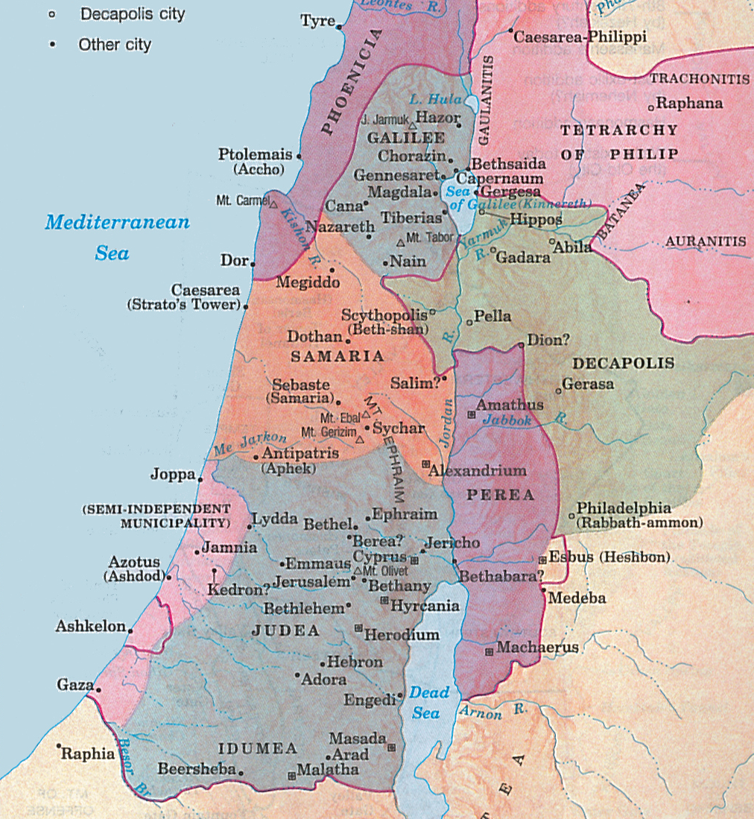

Slide 5
Jesus and the Samaritan Woman
Priest | 3 Geographical Divisions of Palestine | Galilee, Samaria and Judea
Prophet | Person Jesus Spoke to at Jacob's Well | The Woman of Samaria
Priest | Relationship Between Jews & Samaritans | Jews Had No Dealings with Samaritans
Prophet | Jesus' Message to Samaritan Woman | Must Worship God in Spirit & in Truth
Priest | Jesus Saw the Samaritans As | Souls Ready to Be Harvested
Prophet | Baptized More Disciples Than John | Jesus
JESUS TRIED TO SAVE SOULS:
Even when He was physically drained (4:6)
Regardless of racial barriers (4:4, 9)
Regardless of social barriers (4:7, 9, 27)
By turning a simple conversation into a spiritual one (4:10-15)
Regardless of sinful lifestyle (4:16-18)
Regardless of religious differences (4:19-22)
Which involves teaching about true worship of God (4:21-24)
By focusing on one soul at a time (4:7, 28-30, 39)
By looking for and seeing souls (4:34-35)

Slide 6
Memory Verses
Prophet: Memory Verse | John 4:24 "God is Spirit, and those who worship Him must worship in spirit and truth."
King: Memory Verse | John 4:35 "Do you not say, 'There are still four months and then comes the harvest'? Behold, I say to you, lift up your eyes and look at the fields, for they are already white for harvest!"
Key Locations
Prophet | True Worship Must Be Done in Spirit and in Truth | John 4:24

