Slide 2
Paul’s Perilous Voyage from
Caesarea to Italy (27:1-44)
Paul (and company) left Caesarea, headed for Rome, to stand before Caesar (27:1-8).
Paul warned against sailing further in dangerous conditions but was rejected (27:9-12).
Paul and company got caught at sea in a “typhoon” called Euraquilo
(27:13-20).
Paul and company were assured that God would deliver without loss of life (27:21-26).
In a night of horrible fear, Paul encouraged his shipmates to follow God’s plan (27:27-38).
Paul and company shipwrecked on Malta, abandoned ship & all were saved (27:39-44).

Slide 3
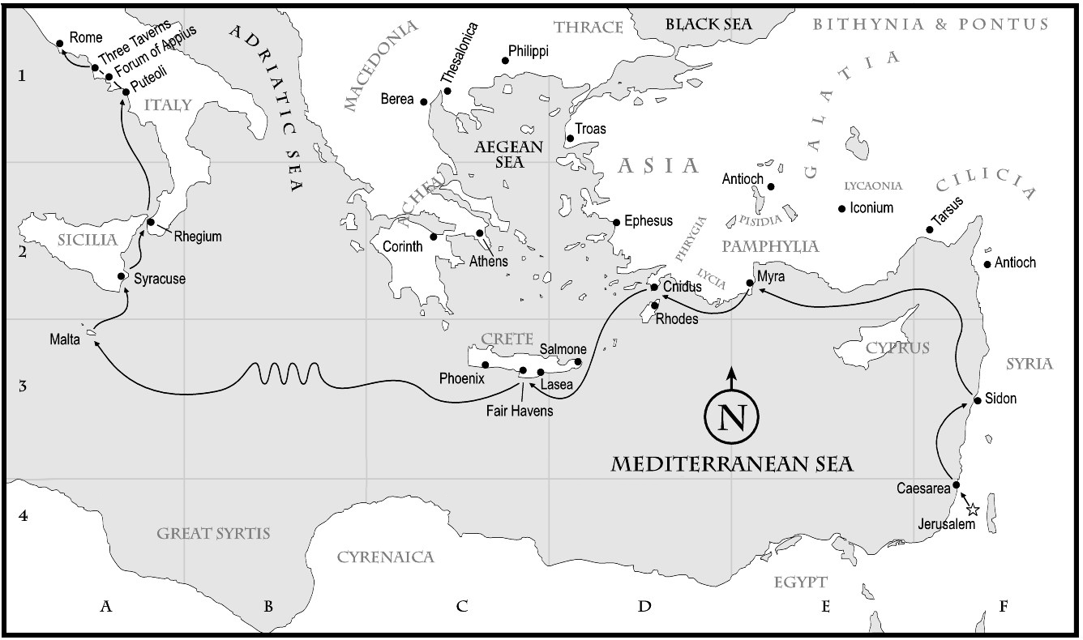

Slide 4
Paul’s Arrival in Rome and Imprisonment for Two Years (28:1-31)
Following the shipwreck, Paul & company safely made it to the island of Malta (28:1-10).
Paul made the final trek of his journey, as a prisoner, to the city of Rome
(28:11-16).
Even in prison, Paul labored for the Lord’s sake and His gospel for two years (28:17-31).
  One of the first things Paul did in Rome was call the Jewish leaders to him (28:17-22).
  Paul preached the gospel of Jesus and His kingdom to the Jewish leaders (28:23).
  The response of the Jewish leaders to the gospel was divided (28:24-29).
  Paul was imprisoned in Rome (in a rented house) for two years (28:30-31).
After the two years, Paul was released from Roman custody for a time.
  From Biblical records, all we know of his Post-Acts life is from 1 & 2 Timothy and Titus.
  From historical records, we know that Paul was imprisoned in Rome one last time.

