Slide 2
Paul’s Defense Before the Sanhedrin & Armed Transfer to Caesarea (22:30-23:35)
Paul was taken before and made his defense to the Jewish Sanhedrin (22:30-23:10).
The Roman commander (at temple), Claudius Lysias, summoned the Sanhedrin (22:30).
Paul began his defense before the Sanhedrin but was harshly struck (23:1-5).
Paul used the sharp divide between Sadducees & Pharisees against them (23:6-9).
Claudius Lysias had Paul forcefully returned to the barracks (23:10).
Over forty Jews conspired to have Paul killed, devoting themselves to the task (23:11-22).
Paul was dispatched to Caesarea, where Felix the governor lived (23:23-35).
Claudius Lysias mobilized 470 of his troops as an armed escort for Paul (23:23-24).
Claudius Lysias wrote a letter to the Roman governor of Judea, Felix (23:25-30).
Paul arrived in Caesarea and awaited trial before Felix (23:31-35).

Slide 3
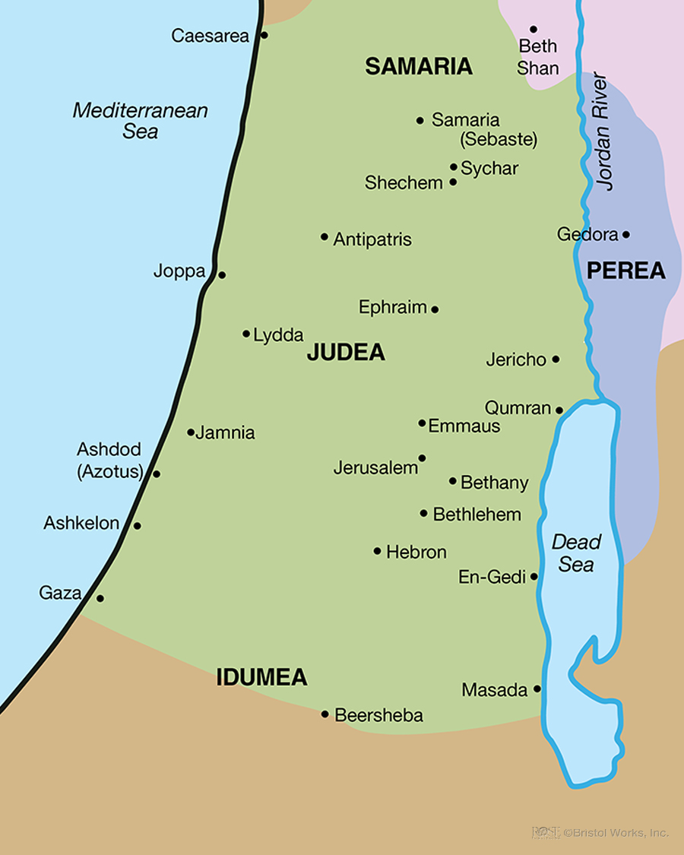

Slide 4
Paul’s Defense Before Felix & Two-Year Imprisonment in Caesarea (24:1-27)
Paul was brought before Felix and accused of insurrection (24:1-9).
Paul made his defense cheerfully before Felix and his accusers (24:10-21).
Paul first argued that none of their accusations against him could be proven (24:11-13).
Paul then testified the truth about himself—his life was focused on God (24:14-16).
Paul summarized the events and the facts worth Felix’s attention (24:17-21).
Felix refused to properly handle (dismiss) Paul’s case but kept him imprisoned (24:22-27).
Paul remained in prison in Caesarea for two years, until Festus succeeded Felix (24:27).

