Slide 1
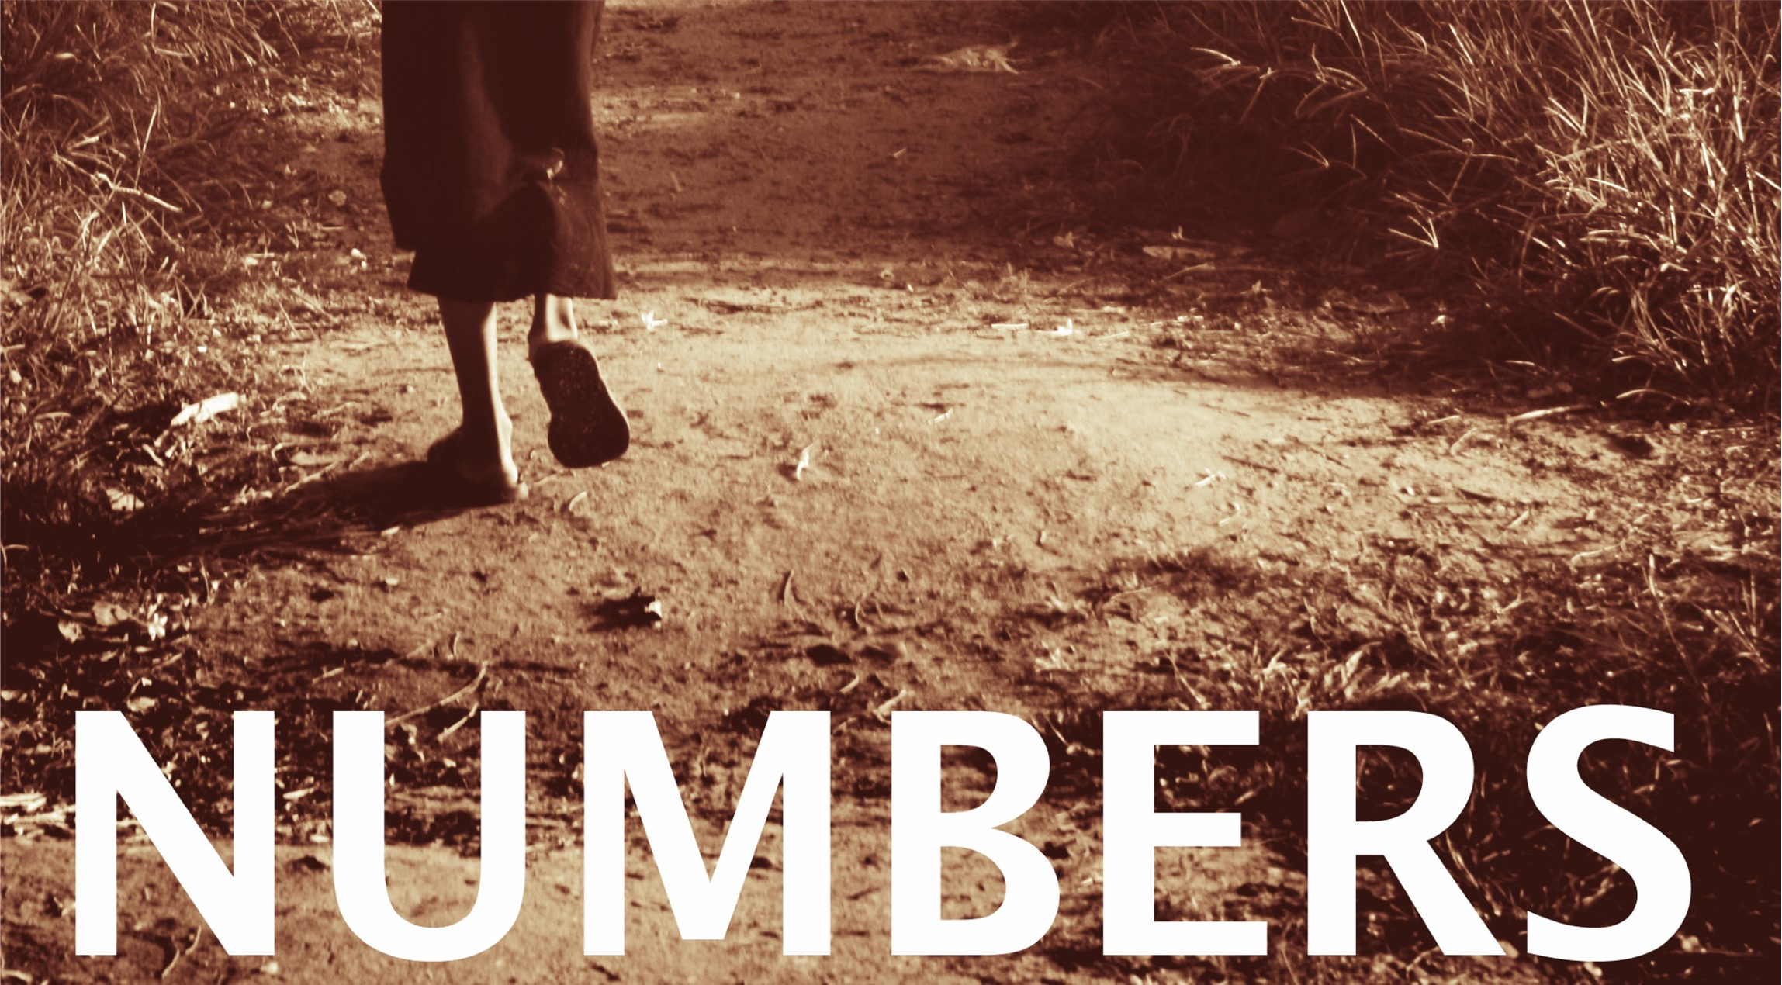

Slide 2
Numbers
  Outline:
  The last chapters of Numbers, from 20-36, the new generation of Israelites again attempt to enter the land to take it as God promised.
    This time they easily destroy two nations that confront them as they are entering.
    Balak uses his prophet Balaam to learn to seduce the Israelites to worship Baal.
    Because of disobedience, about 24,000 people die, including Balaam.
    Before the book of Numbers ends, Moses again conducts a census, and Joshua assumes the leadership of Israel in place of Moses who is banned from the promise land, due to his disobedience.

Slide 3
Chapters 20-36:
Next
Generation
Chapter 25:
1-9: The Daughters of Moab
10-18: The Jealousy of Phinehas

Slide 4
Chapters 20-36:
Next
Generation
Chapter 26:
1-4: The Command for a Census
5-51: The Census
52-56: The Land Divided by Number
57-62: Concerning the Levites
63-65: The New Generation

Slide 5
Chapters 20-36:
Next
Generation
Chapter 27:
1-14: The Law of Inheritance
15-23: Joshua to Succeed Moses

Slide 6
Chapters 20-36:
Next
Generation
Chapter 28:
1-8: The Daily Offering
9-10: The Sabbath Offering
11-15: First of the Month Offering
16-25: The Lord’s Passover & Feast of Unleavened Bread
26-31: Offering of First Fruits

Slide 7
Chapters 20-36:
Next
Generation
Chapter 29: 7th Month Offerings
1-6: Day One
7-11: Day Ten
12-16: Fifteenth Day
17-19: Second Day
20-22: Third Day
23-25: Fourth Day
26-28: Fifth Day
29-31: Sixth Day
32-34: Seventh Day
35-38:Eight Day
39-40: Individual Offerings

Slide 8
Chapters 20-36:
Next
Generation
Chapter 30: Law of Vows
1-2: If a Man Makes a Vow
3-5: If an Unmarried Woman Makes a Vow
6-8: If a Married Woman Makes a Vow
9-12: The Vow of a Widow or Divorced Woman
13-16: More Details on the Annulment of Vows

