Slide 2
3 Key Questions
Where do I need to put the Bible?
  “Your word I have hidden in my heart, That I might not sin against You!”
  (Psalm 119:11)
What does the Bible do for me?
  “Your word is a lamp to my feet And a light to my path.”
  (Psalm 119:105)
Why do I need to study the Bible?
  “Study to shew thyself approved unto God, a workman that needeth not to be ashamed, rightly dividing the word of truth.”
  (2 Timothy 2:15)

Slide 3
Overview of the Bible
Prophet | Theme of the Bible | Jesus Christ
Priest | Three-Sentence Summary of the Bible | Someone is coming. Someone is here. Someone is coming again.
Introduction to the New Testament
Prophet | Name the Four Accounts of the Gospel | Matthew, Mark, Luke, John
Prophet | "Gospel" Means | Good News
Prophet | The Four Accounts of the Gospel Tell About | The Life of Jesus Christ

Slide 4
Key Chapters
Prophet | John 1 | The Eternal Nature of Jesus
King | Luke 1 | Birth of John the Baptist
King | Luke 2 | Birth & Early Years of Jesus
Prophet | Matthew 1 | Genealogy and Birth of Jesus
 | Matthew 2 | Early Childhood of Jesus
Prophet | Matthew 3 | The Baptism of Jesus
Prophet | Matthew 4 | Jesus Tempted By the Devil
Priest | John 2 | Jesus Cleanses the Temple
Priest | John 3 | Jesus Talks to Nicodemus
Priest | John 4 | Jesus & the Woman at the Well

Slide 5
Key Locations
Prophet | Jesus Is Eternal | John 1:1
Prophet | Jesus Created All Things | John 1:3
Prophet | The Eternal Word (God) Became Flesh | John 1:1, 14
Priest | Jesus Was Born of a Virgin | Matthew 1:23
King | Same Word “Babe” Used for Life in the Womb and Out of the Womb | Luke 1:41; 2:12
Priest | Jesus Is Jehovah, for John Prepared the Way for Jehovah | Matthew 3:3
King | Jesus Reigns Now Over His Heavenly Kingdom on David's Throne | Luke 1:32-33
Priest | Purpose of John's Baptism Was for Remission of Sins | Mark 1:4
Priest | Baptism (Being Born Again) Is Essential to Enter the Kingdom of God | John 3:3-5
King | Baptism Is an Immersion Requiring Much Water | John 3:23
King | Biblical Faith Is Equivalent to Obeying Christ | John 3:36

Slide 6
Memory Verses
Priest: Memory Verse | Matthew 4:4 "It is written, 'Man shall not live by bread alone, but by every word that proceeds from the mouth of God.'"
Priest: Memory Verse | Matthew 4:10 "It is written, 'You shall worship the LORD your God, and Him only you shall serve.'"
King: Memory Verse | John 3:5 "Most assuredly, I say to you, unless one is born of water and the Spirit, he cannot enter the kingdom of God."
Prophet: Memory Verse | John 3:16 "For God so loved the world that He gave His only begotten Son, that whoever believes in Him should not perish but have everlasting life."

Slide 7
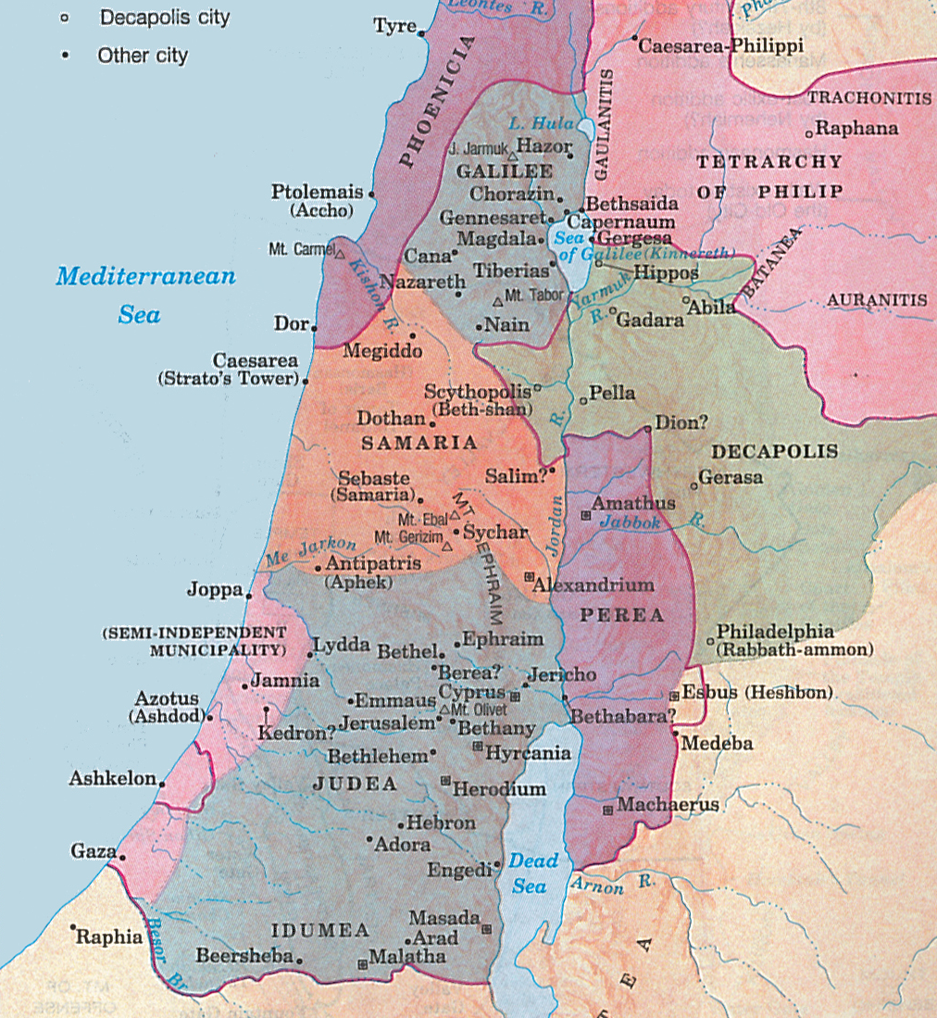

Slide 8
Jesus and the Samaritan Woman
Priest | 3 Geographical Divisions of Palestine | Galilee, Samaria and Judea
Prophet | Person Jesus Spoke to at Jacob's Well | The Woman of Samaria
Priest | Relationship Between Jews & Samaritans | Jews Had No Dealings with Samaritans
Prophet | Jesus' Message to Samaritan Woman | Must Worship God in Spirit & in Truth
Priest | Jesus Saw the Samaritans As | Souls Ready to Be Harvested
Prophet | Baptized More Disciples Than John | Jesus
JESUS TRIED TO SAVE SOULS:
Even when He was physically drained (4:6)
Regardless of racial barriers (4:4, 9)
Regardless of social barriers (4:7, 9, 27)
By turning a simple conversation into a spiritual one (4:10-15)
Regardless of sinful lifestyle (4:16-18)
Regardless of religious differences (4:19-22)
Which involves teaching about true worship of God (4:21-24)
By focusing on one soul at a time (4:7, 28-30, 39)
By looking for and seeing souls (4:34-35)

Slide 9
Memory Verses
Prophet: Memory Verse | John 4:24 "God is Spirit, and those who worship Him must worship in spirit and truth."
King: Memory Verse | John 4:35 "Do you not say, 'There are still four months and then comes the harvest'? Behold, I say to you, lift up your eyes and look at the fields, for they are already white for harvest!"
Key Locations
Prophet | True Worship Must Be Done in Spirit and in Truth | John 4:24

