Slide 2
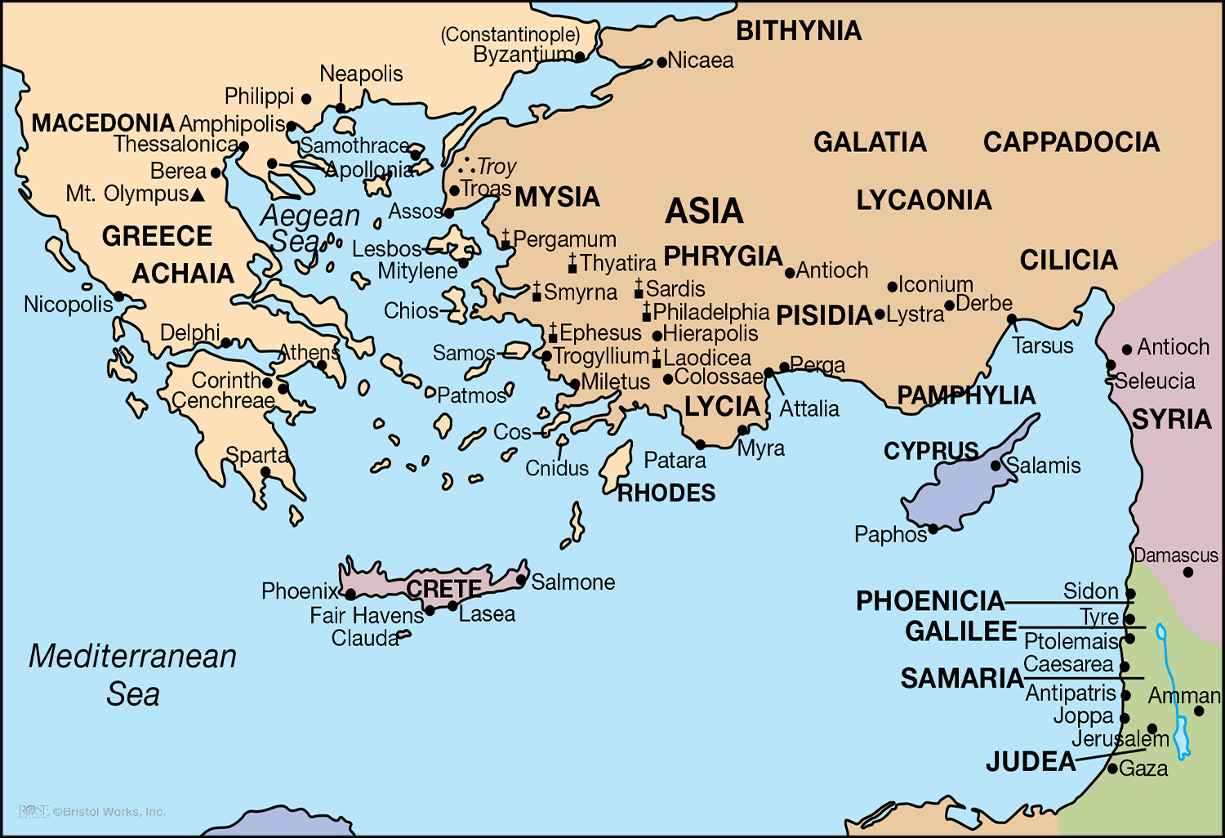

Slide 3
Paul’s Third Missionary Journey (2):
From Ephesus to Troas (20:1-12)
Paul remained in Troas to partake of the Lord’s Supper with the church (20:6b-12).
  Although in a hurry to reach Jerusalem, Paul “stayed seven days” in Troas (20:6b).
  The words “came together” are in the passive voice (not the active voice).
  The infinitive of purpose emphasizes the reason for the gathering—“to break bread.”
    The Lord authorized the first day of the week as His day of worship!
    “To break bread” in Acts 20:7 is specific reference to the Lord’s Supper!
    The Lord designed the Lord’s Supper as the central purpose of the weekly assembly!
  As part of this worship assembly, Paul preached to the brethren (20:7-9a).
  After raising Eutychus, Paul ate & visited (separate from worship assembly) (20:9b-12).
    All verbs in v. 10 are third person singular—“went down…fell…embracing…said.”
    The breaking of break in verse 7 is a synecdoche for the Lord’s Supper.

Slide 5
Paul’s Third Missionary Journey (3):
His Final Trip to Jerusalem (20:13-21:17)
Paul traveled from Troas to Miletus, hurrying to reach Jerusalem (20:13-16).
Paul met with the elders from Ephesus, while he was in Miletus (20:13-38).
  Paul discussed and defended his labor while with the church in Ephesus (20:18-21).
  Paul discussed and shared his plans for the present and near future (20:22-27).
  Paul discussed and delivered strong warnings of the danger of apostasy (20:28-31).
  Paul discussed and exhorted the urgency for continued faithfulness (20:32-37).
Paul traveled from Miletus to the city of Jerusalem, for the last time
(21:1-17).

Slide 7
Paul Arrested and Then Preached to the Mob in Jerusalem (21:18-22:29)
Paul reported all that the Lord had done among the Gentiles (21:18-26).
  Paul met with James & the Jerusalem elders to detail work among the Gentiles (18-19).
  They kept on glorifying the Lord but told Paul of concern among the Jews (21:20-21).
  James & the elders advised a solution to allay confusion & avoid troubles (21:22-26).
Paul was falsely accused, arrested and beaten in Jerusalem (21:27-36).
Paul preached to the riotous crowd after being arrested (21:37-22:21).
  Paul had been carried up the stairs to the barracks to be scourged (21:35-40; 22:24).
  Paul defended his preaching by emphasizing his strong Jewish background (22:3-5).
  Paul defended his preaching by emphasizing his conversion process (22:6-16).
  Paul defended his preaching by emphasizing the Lord’s direct instructions (22:17-21).
Paul exercised his rights as a Roman citizen to prevent further scourging (22:22-29).

