Slide 2
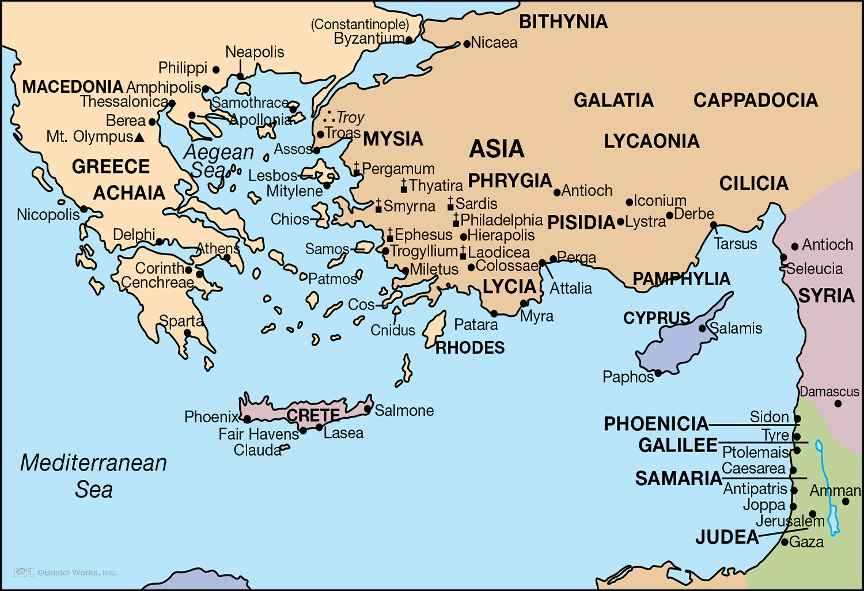

Slide 3
Paul’s Third Missionary Journey (1):
From Antioch to Ephesus (18:23-19:41)
Some important facts about Paul’s Third Missionary Journey:
  From verse 18:23 thru 21:17 Approx. Dates: 53-57 A.D.
  Travel Companions: Paul, Titus, Luke, Timothy, Erastus (and others, 20:4)
Paul departed from Antioch and strengthened the disciples in Galatia & Phrygia (18:23).
Apollos came to minister in Ephesus but needed to be taught more accurately (18:24-28).
  The baptism of John was, at one time, a valid doctrine & practice (cf. Lk. 7:29-30; 20:4).
    One may be sincere in what he believes and practices but be sincerely wrong!
    Baptism is only valid and effective when done properly and for the right purpose!
  Aquila & Priscilla corrected him, teaching “the way of God more accurately” (18:26).
  Apollos went on to “greatly help” believers & “vigorously” debate unbelievers (18:28).

Slide 4
Paul’s Third Missionary Journey (1):
From Antioch to Ephesus (18:23-19:41)
Paul preached the gospel in Ephesus for three years, establishing a strong church (19:1-41).
  Ephesus was the capital of provincial Asia and was the prominent city of Asia Minor.
  God had earlier prevented Paul from preaching in this region (16:6).
  Paul preached to 12 misguided students, helping them be properly converted (19:1-7).
  Paul’s labors in Ephesus are summarized in Acts 19:8-11 (on top of tentmaking, 20:34).
  While Paul preached in Ephesus, the Lord was magnified & many were saved (11-22).
    Paul’s miracles were so effective that some tried to mimic the same acts (19:11-16).
    Their utter failure magnified Paul’s authenticity and kept on magnifying God (19:17-19).
    The impact of God’s Word kept on spreading & kept gaining strength (19:20-22).
  While Paul preached in Ephesus, a riot erupted against Paul & the church (19:23-41).

Slide 7
Paul’s Third Missionary Journey (2):
From Ephesus to Troas (20:1-12)
After preaching there for three years, Paul departed from Ephesus (20:1).
  The Ephesian church had grown strong & would have a key role in early Christianity.
  Paul traveled through Macedonia & Greece, to strengthen and embolden the disciples (20:1-6a).
    On this journey, Paul was also teaching about and collecting benevolent funds.
    Paul traveled from Ephesus to Troas, to meet up with Titus (2 Cor. 2:12).
    Paul traveled to Greece again (probably Corinth) and stayed three months (20:2-3).
    Paul traveled through Macedonia and was joined by several fellow-workers (20:4-6).

Slide 8
Paul’s Third Missionary Journey (2):
From Ephesus to Troas (20:1-12)
Paul remained in Troas to partake of the Lord’s Supper with the church (20:6b-12).
  Although in a hurry to reach Jerusalem, Paul “stayed seven days” in Troas (20:6b).
  The words “came together” are in the passive voice (not the active voice).
  The infinitive of purpose emphasizes the reason for the gathering—“to break bread.”
    The Lord authorized the first day of the week as His day of worship!
    “To break bread” in Acts 20:7 is specific reference to the Lord’s Supper!
    The Lord designed the Lord’s Supper as the central purpose of the weekly assembly!
  As part of this worship assembly, Paul preached to the brethren (20:7-9a).
  After raising Eutychus, Paul ate & visited (separate from worship assembly) (20:9b-12).

