Slide 2
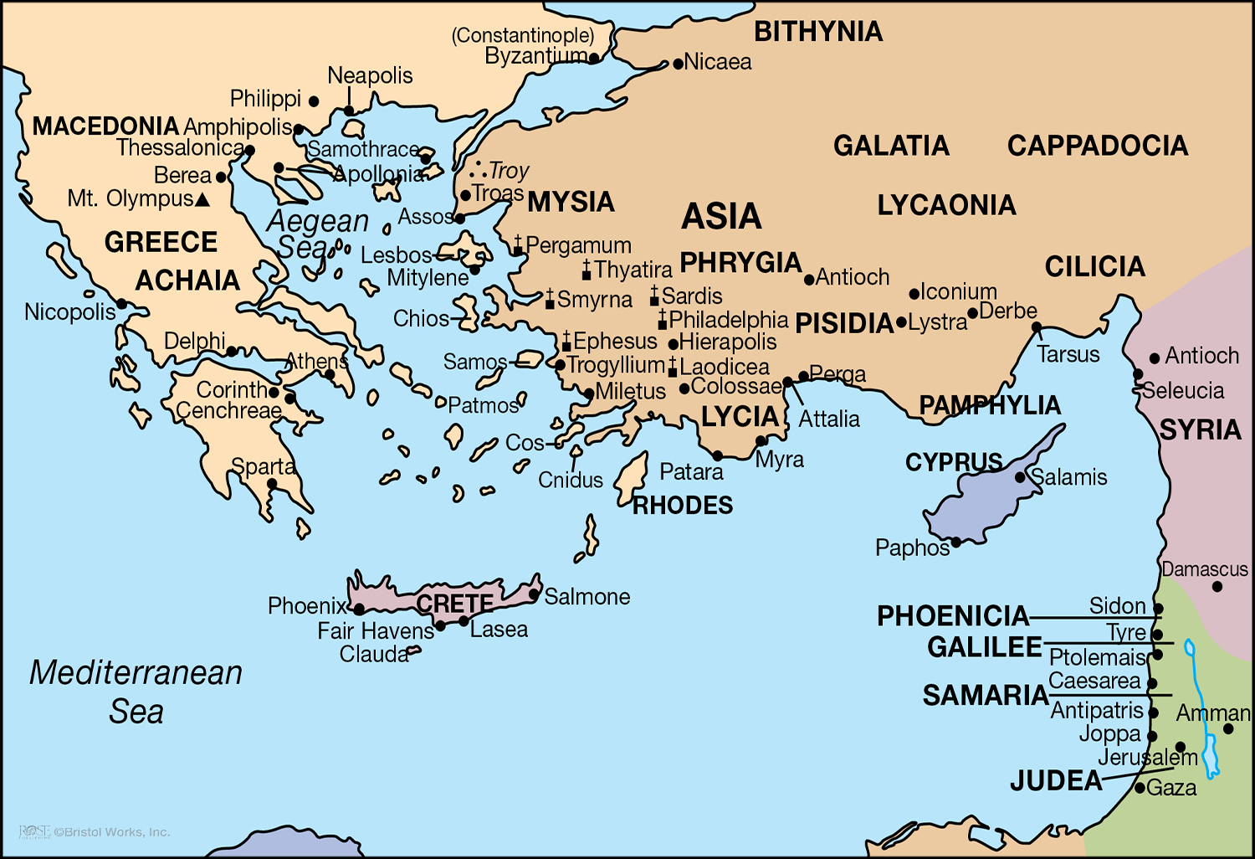

Slide 3
Paul’s Second Missionary Journey: Thessalonica, Berea & Athens (17:1-34)
Paul & Silas preached the gospel in Thessalonica, second largest city of Greece (17:1-9).
Upon arriving in a new city, Paul followed a customary course of action:
He preached first to the Jews, customarily finding them in a synagogue (17:1-2).
He reasoned with his hearers, thoroughly bringing his message together (17:2).
The gospel persuaded many to obey the Lord in Thessalonica (17:4).
However, some Jews who were not persuaded raised up a persecution (17:5-9).
Nevertheless, the church in Thessalonica grew and prospered.
Paul, Silas & Timothy preached the gospel in Berea, to fair-minded hearers (17:10-14).

Slide 5
Paul’s Second Missionary Journey: Thessalonica, Berea & Athens (17:1-34)
Paul preached the gospel in the idolatry-infested city of Athens (17:15-34).
As accustomed, Paul reasoned daily where people were (synagogue & marketplace).
And, as was customary, Paul was met with opposition to gospel message (17:18-21).
To those who did not know God or Jesus, Paul preached God and Jesus (17:22-31).
Paul preached The One True God and that there is only One True God (17:24-29).
Paul preached that The One True God wants a relationship with man (17:27-29).
Paul preached that The One True God offers more and expects more (17:30-31).
The resurrection of Christ was the heart of the message & the response (17:32-34).

Slide 7
Paul’s Second Missionary Journey: From Corinth to Antioch (18:1-22)
Paul preached the gospel in Corinth for 18 months (18:1-17).
In Corinth, Paul met two fellow-tentmakers, Aquila and Priscilla (18:2-3).
In Corinth, Paul reasoned with and testified to the Jews continually (18:4-5).
In Corinth, the response to the gospel was, as usual, varied (18:4, 6-8).
Some of the Jews opposed Paul and blasphemed his sacred message (18:6).
Both Jews and God-fearing Gentiles were steadily being converted (18:4b).
In Corinth, Paul was reassured by the Lord to keep on keeping on (18:9-11).
In Corinth, the Jews sought to silence Paul through legal channels (18:12-17).
Paul made his way back to Antioch by way of Ephesus and Jerusalem (18:18-22).

