Slide 2
Circumcision, the Law, the Gentiles & the Will of God (15:1-35)
Judaizers came to Antioch contending that circumcision was essential for salvation (15:1-5).
It is sinful to bind where God has not bound or to loose where God has not loosed!
Paul and Barnabas boldly and widely contended on behalf of uncircumcised Gentiles.
The apostles & elders gathered to discuss the Gentiles’ relationship to the gospel (15:6-21).
Peter reminded them that God sent him to preach salvation to the Gentiles (15:7-11).
The conditions of salvation are the same for everyone!
Paul and Barnabas told how God had been working among the Gentiles (15:12).
James pointed to the O.T. prophets for God’s eternal plan for the Gentiles (15:13-21).
James called for a letter to be written to their Gentile brethren (15:20-21).

Slide 3
Circumcision, the Law, the Gentiles & the Will of God (15:1-35)
The apostles & elders sent a letter to the Gentiles expressing full acceptance (15:22-29).
Paul, Barnabas, Judas & Silas stayed and worked with the church in Antioch (15:30-35).

Slide 4
Paul’s Second Missionary Journey (1): Antioch to Philippi/Europe (15:36-16:40)
Some important facts about Paul’s Second Missionary Journey:
From verse 15:36 thru 18:22 Approx. Dates: 50-53 A.D.
Travel Companions: Paul, Silas, Timothy, Luke
Sent forth from the church in Antioch; Traveled thru Europe (Macedonia & Achaia)
Paul & Barnabas separated, and Paul selected Silas to be his new teammate (15:36-40).
A sharp contention arose between Paul and Barnabas over John Mark (15:37-41).
But, this dispute did not stop them or the work of the Lord!
Disagreements over matters of judgment must be handled carefully and purposefully!
Paul and Silas traveled by land through Syria and Cilicia to strengthen churches (15:41).

Slide 5
Paul’s Second Missionary Journey (1): Antioch to Philippi/Europe (15:36-16:40)
Paul and Silas returned to Derbe and Lystra, and Timothy joined the team (16:1-5).

Slide 6
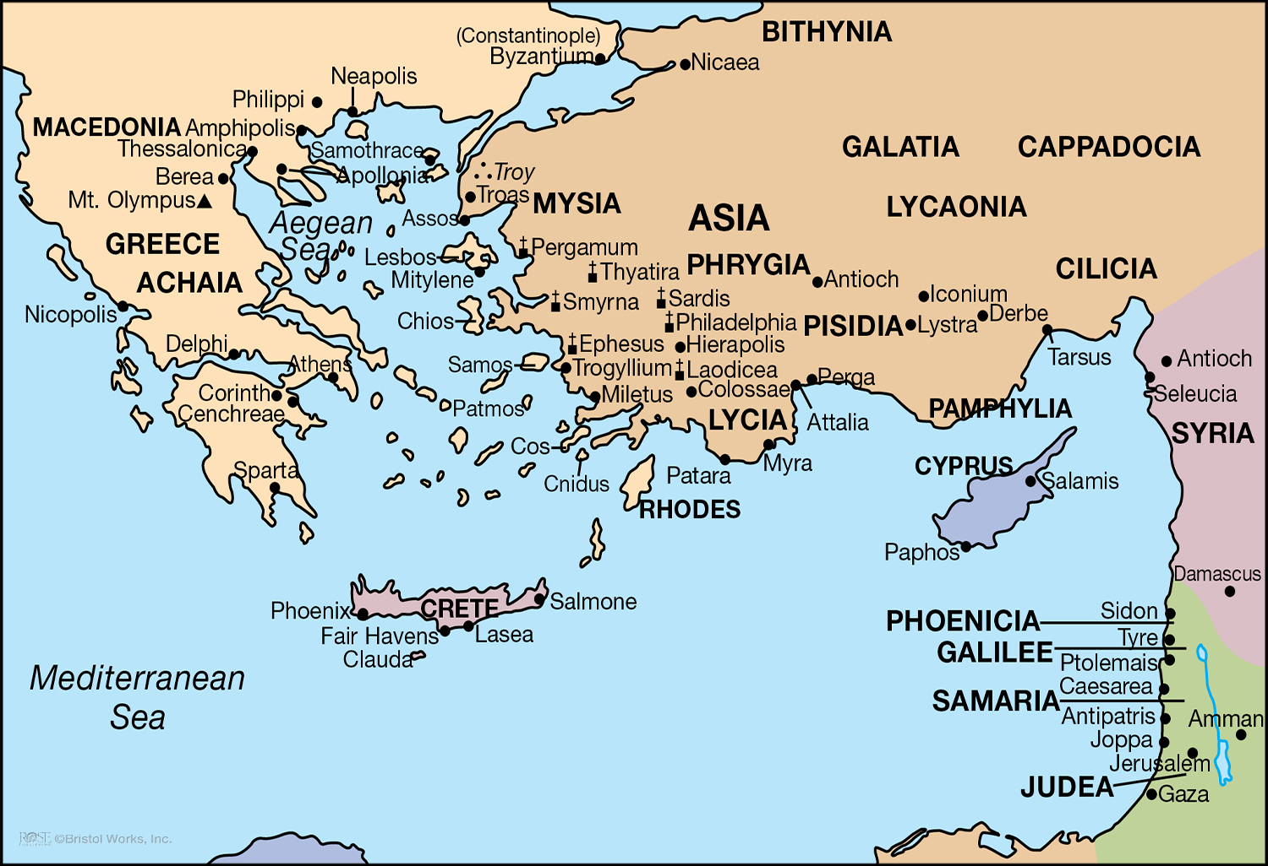

Slide 7
Paul’s Second Missionary Journey (1): Antioch to Philippi/Europe (15:36-16:40)
Paul and Silas returned to Derbe and Lystra, and Timothy joined the team (16:1-5).
Through a vision, God called Paul to preach the gospel in Macedonia (Europe) (16:6-10).
Paul, Silas, Timothy and Luke traveled to Philippi, where Lydia was converted (16:11-15).

Slide 9
Paul’s Second Missionary Journey (1): Antioch to Philippi/Europe (15:36-16:40)
Paul and Silas returned to Derbe and Lystra, and Timothy joined the team (16:1-5).
Through a vision, God called Paul to preach the gospel in Macedonia (Europe) (16:6-10).
Paul, Silas, Timothy and Luke traveled to Philippi, where Lydia was converted (16:11-15).
Paul and Silas were imprisoned after casting a demon from a slave girl (16:16-24).
Paul & Silas were seized, dragged, charged, beaten, imprisoned & fastened (16:19-24).

Slide 10
Paul’s Second Missionary Journey (1): Antioch to Philippi/Europe (15:36-16:40)
Paul and Silas had the providential opportunity to teach and convert a jailer (16:25-34).
The jailer and those in his house were taught the gospel and they obeyed (16:31-34).
After release from prison, Paul, Silas and Timothy departed from Philippi (16:35-40).

