Slide 2
Paul’s First Missionary Journey: From Antioch to Antioch (12:25-13:52)
There is a transition in Luke’s historical record between Acts 12 and Acts 13.
Some important facts about Paul’s First Missionary Journey:
From verse 13:1 thru 14:28 Approx. Dates: 47-49 A.D.
Travel Companions: Paul, Barnabas, John Mark (before returning in 13:13)
Sent forth from the church in Antioch; Traveled thru Cyprus and parts of Asia Minor
The church in Antioch was a thriving hub of activity and leadership (12:25-13:3).
Impartiality in the Lord’s church is possible and required!
The “laying on of hands” in the New Testament had various meanings/purposes.
Paul and his companions traveled through and preached in Cyprus (13:4-12).

Slide 3
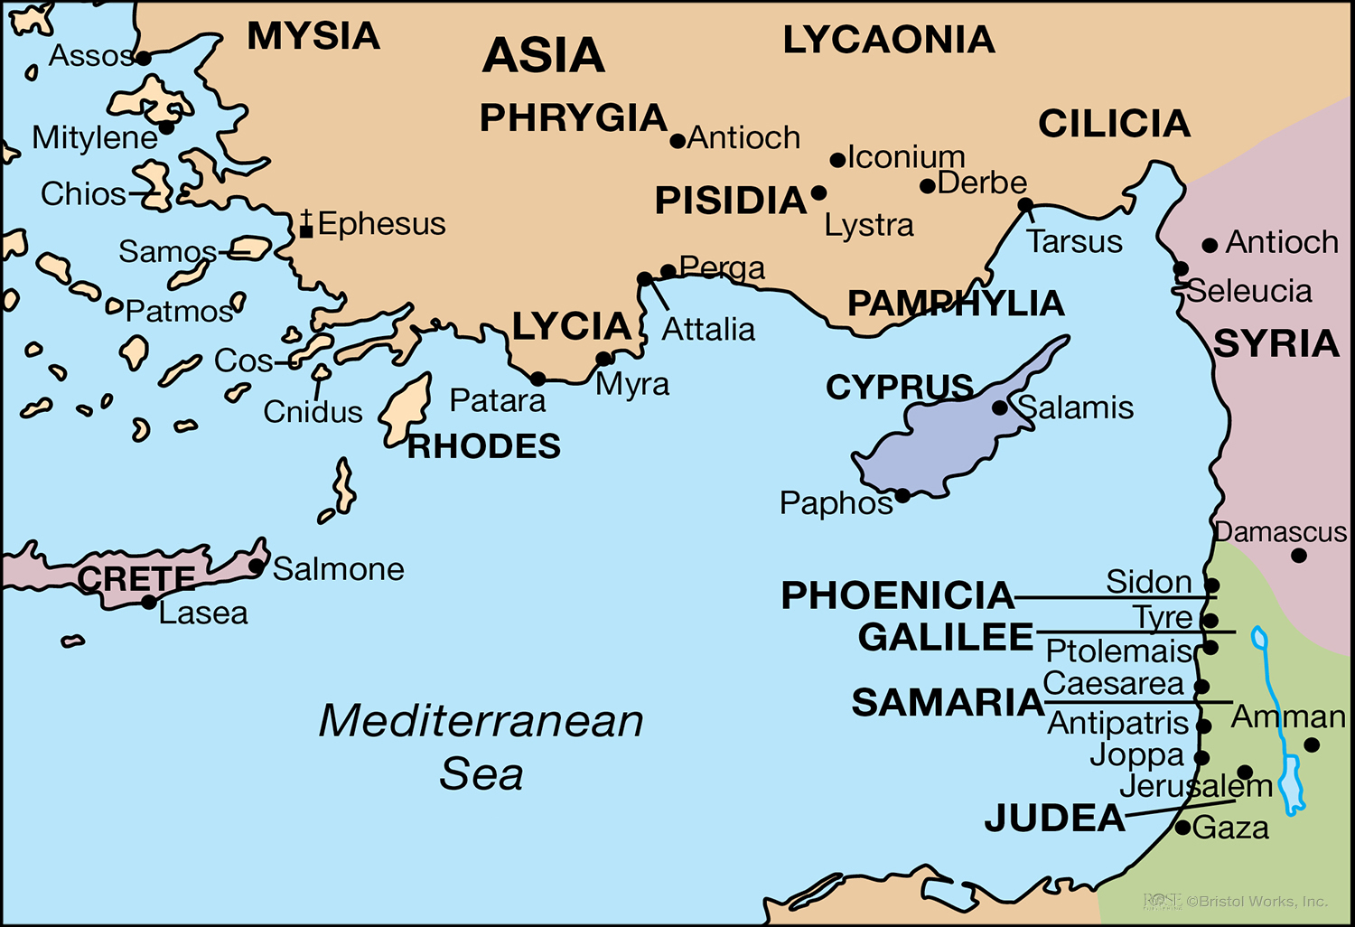

Slide 4
Paul’s First Missionary Journey: From Antioch to Antioch (12:25-13:52)
There is a transition in Luke’s historical record between Acts 12 and Acts 13.
Some important facts about Paul’s First Missionary Journey:
From verse 13:1 thru 14:28 Approx. Dates: 47-49 A.D.
Travel Companions: Paul, Barnabas, John Mark (before returning in 13:13)
Sent forth from the church in Antioch; Traveled thru Cyprus and parts of Asia Minor
The church in Antioch was a thriving hub of activity and leadership (12:25-13:3).
Impartiality in the Lord’s church is possible and required!
The “laying on of hands” in the New Testament had various meanings/purposes.
Paul and his companions traveled through and preached in Cyprus (13:4-12).
They met two very different men in Paphos: Bar-Jesus/Elymas and Sergius Paulus.
These two very different men had two very different effects from the gospel.

Slide 5
Paul’s First Missionary Journey: From Antioch to Antioch (12:25-13:52)
Paul preached a message of hope to Jews & Gentiles in Antioch in Pisidia (13:13-41).

Slide 7
Paul’s First Missionary Journey: From Antioch to Antioch (12:25-13:52)
Paul preached a message of hope to Jews & Gentiles in Antioch in Pisidia (13:13-41).
God made a promise to Israel to give them the land of Canaan (13:16-19).
God made a promise to David to give a Savior from his lineage (13:20-25).
God made a promise to the fathers that the Christ would conquer death (13:26-37).
God made a promise to all of forgiveness & justification for obeying Him (13:38-41).
The gospel brought mixed responses in Antioch in Pisidia (13:42-52).
It is possible for one to “fall from grace” (cf. Gal. 5:4); therefore, it is of critical importance to urge Christians to “continue in the grace of God” (13:43) and not fall.
Being predestined unconditionally to salvation is not taught anywhere in Scripture!

Slide 8
Paul’s First Missionary Journey: From Iconium Back to Antioch (14:1-28)
Paul and Barnabas preached the gospel in the city of Iconium in Galatia (14:1-7).

Slide 10
Paul’s First Missionary Journey: From Iconium Back to Antioch (14:1-28)
Paul and Barnabas preached the gospel in the city of Iconium in Galatia (14:1-7).
The gospel divided the residents of Iconium (14:1-6).
The word “believed” in Acts is synonymous with the word “obeyed”!
Miracles in the Bible had a very specific purpose and did not stray from that purpose!
Violent persecution arose, so Paul and Barnabas fled from Iconium (14:4-7).
Paul and Barnabas preached the gospel in Lystra (14:8-18).

Slide 12
Paul’s First Missionary Journey: From Iconium Back to Antioch (14:1-28)
Paul and Barnabas preached the gospel in the city of Iconium in Galatia (14:1-7).
The gospel divided the residents of Iconium (14:1-6).
The word “believed” in Acts is synonymous with the word “obeyed”!
Miracles in the Bible had a very specific purpose and did not stray from that purpose!
Violent persecution arose, so Paul and Barnabas fled from Iconium (14:4-7).
Paul and Barnabas preached the gospel in Lystra (14:8-18).
Paul healed a cripple who was lame from birth (14:8-10).
The idolatrous Lycaonian residents wanted to worship Paul and Barnabas (14:11-18).

Slide 13
Paul’s First Missionary Journey: From Iconium Back to Antioch (14:1-28)
Paul was stoned and left for dead in Lystra, but then preached in Derbe (14:19-21a).

Slide 15
Paul’s First Missionary Journey: From Iconium Back to Antioch (14:1-28)
Paul was stoned and left for dead in Lystra, but then preached in Derbe (14:19-21a).
Disciples are made the same way today as they were in the New Testament!
Paul and Barnabas encouraged new Christians on their way back to Antioch (14:21b-25).
They returned to the same cities that had violently expelled them.

Slide 17
Paul’s First Missionary Journey: From Iconium Back to Antioch (14:1-28)
Paul was stoned and left for dead in Lystra, but then preached in Derbe (14:19-21a).
Disciples are made the same way today as they were in the New Testament!
Paul and Barnabas encouraged new Christians on their way back to Antioch (14:21b-25).
They returned to the same cities that had violently expelled them.
Paul and Barnabas returned to Antioch to report about the Lord’s work (14:26-28).

