Slide 1
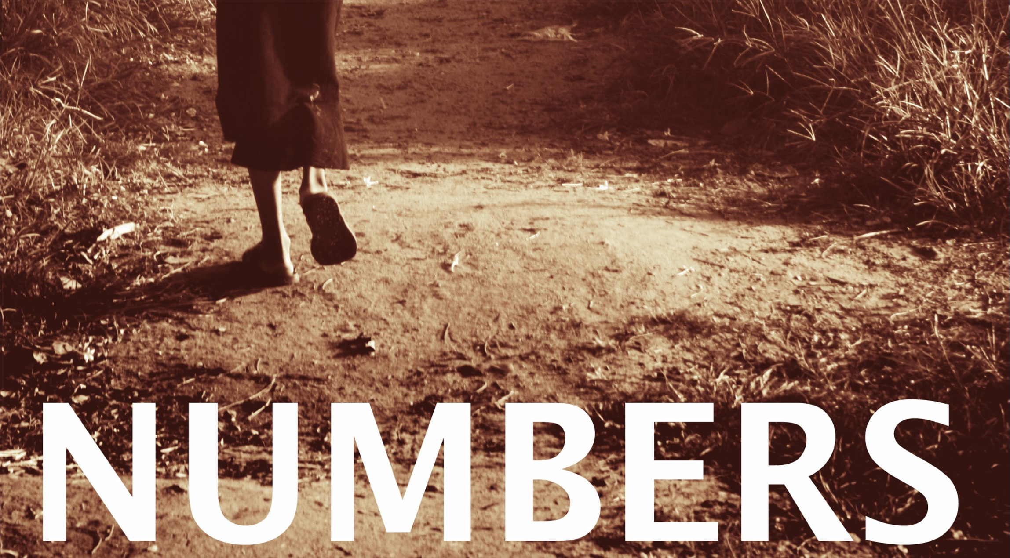

Slide 2
Numbers
  Outline:
  In chapters 10-12, the Israelites travel from the wilderness in Sinai to approach the promise land.
    The people complain about their food, God gives them quail.
    Because of their greed, He also sends them a plague.
    Miriam and Aaron learn a lesson about whom God places in leadership.

Slide 3
Chapters 10-12:
Journey to the
promised land
Chapter 12:
1-3: Miriam and Aaron murmur
4-8: Miriam, Aaron, and Moses before the Lord
9-16: The anger of the Lord

Slide 4
Numbers
  Outline:
  In chapters 13-19, we see severe punishment for disobedience and unfaithfulness to God.
    Moses sends out 12 spies to perform reconnaissance on the promise land.
    The 12 spies return and only two of them bring good news.
    The people fear the occupants and rebel against taking the land.
    For this God punishes them and sends them into the wilderness for forty years to roam.

Slide 5
Chapters 13-19:
Punishment for
disobedience
Chapter 13:
1-24: Spies survey the land
25-29: Spies report
30-33: Caleb tries to offer a rebuttal

Slide 6
Chapters 13-19:
Punishment for
disobedience
Chapter 14:
1-10: The people rebel
11-19: Moses pleads for the people
20-38: God Pardons
39-45: They tried anyway

Slide 7
Chapters 13-19:
Punishment for
disobedience
Chapter 15:
1-31: Various laws
Offering when entering the promised land 1-13
Offering of the sojourner 14-16
Offering of first fruits 17-21
Unintentional sin 22-31
32-41: Sabbath breaking and tassels

Slide 8
Chapters 13-19:
Punishment for
disobedience
Chapter 16:
1-40: Korah’s rebellion
Cause for rebellion 1-3
Moses’ rebuke 4-11
Summons and rebuke 12-19
The Lord speaks 20-24
The punishment 25-35
Plating of the altar 36-40
41-50: Murmuring and a plague

Slide 9
Chapters 13-19:
Punishment for
disobedience
Chapter 17:
1-7: God prescribes a sign
8-13: Aaron’s rod buds

Slide 10
Chapters 13-19:
Punishment for
disobedience
Chapter 18:
1-7: Duties of the Levites
8-32: Portion for the priests
That of holy offerings 8-14
First born offering 15-20
The tithe 21-24
Tithe of the tithe 25-32

