Slide 1
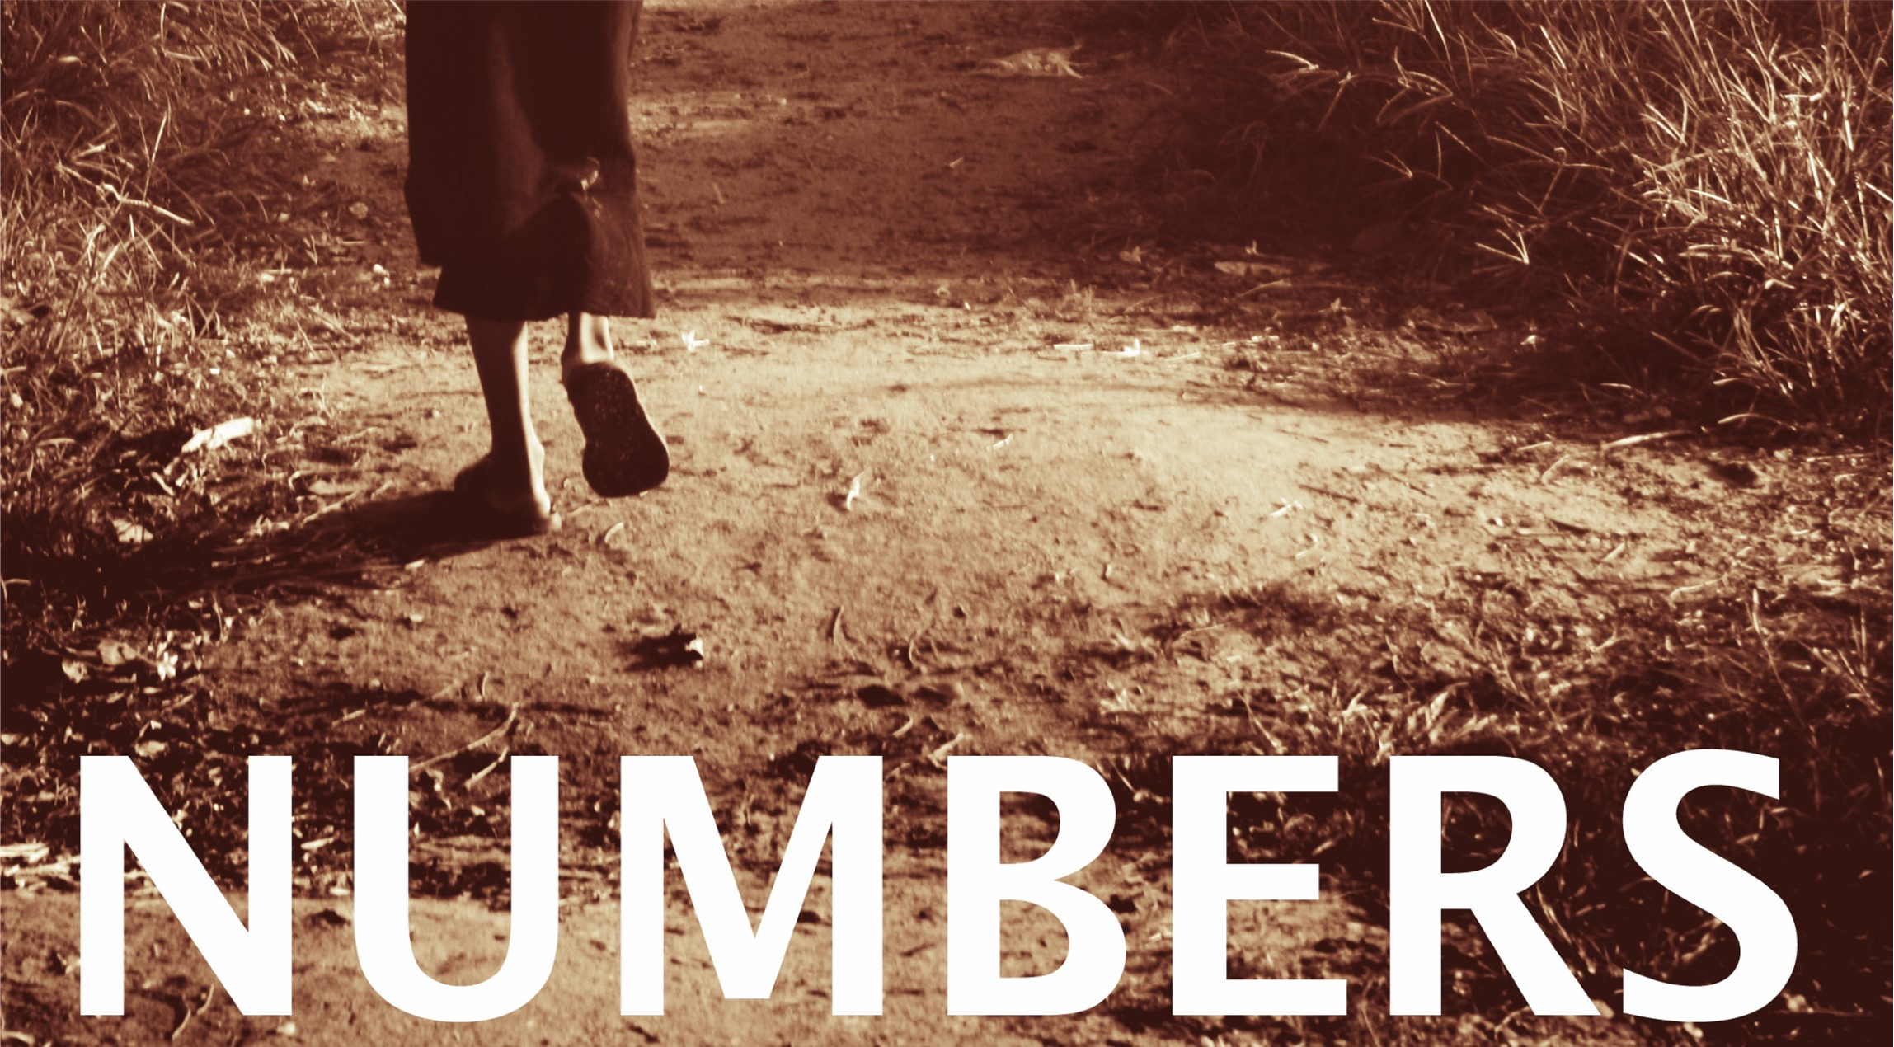

Slide 2
Numbers
The book of numbers is largely narrative of the children of Israel that covers 38 year and nine month span.
It was written by Moses.
Key personalities include Moses, Aaron, Miriam, Joshua, Caleb, Eleazar, Korah, and Balaam.
The purpose of the book of Numbers is to tell about how Israel prepared to enter the promise land.
Tells of their disobedience and punishment.
It describes Moses taking two population censuses, hence the name Numbers.

Slide 3
Numbers
  Outline:
  From chapters 1-9 the Israelites are preparing for their journey and entry into the promise land.
    Moses begins by taking a census of all the tribes, primarily to see how many men are available and in shape for military service.
    Moses dedicates the Levites and instructs the Nazirite vows and laws.
    During this time, the Israelites celebrate the 2nd Passover one year after their exit from bondage.

Slide 4
Chapters 1-9: Preparing to Enter
Chapter 7:
1-9: Consecration of the tabernacle and the carts
10-89: Dedication for the alter
All tribes offered:
1 Silver dish ($951)
1 Silver bowl ($512)
1 Gold pan ($6,444)
1 bull
1 ram
1 yearling male lamb
1 male goat
For peace offering:
2 oxen
5 rams
5 male goats
5 yearling male lambs

Slide 5
Chapters 1-9: Preparing to Enter
Chapter 8:
1-4: Instruction about the lampstand
5-13: Cleansing the Levites
14-22: Levites are separated
23-26: Retirement of service

Slide 6
Chapters 1-9: Preparing to Enter
Chapter 9:
1-14: Observation of the Passover
15-23: Cloud and fire over the tabernacle

Slide 7
Numbers
  Outline:
  In chapters 10-12, the Israelites travel from the wilderness in Sinai to approach the promise land.
    The people complain about their food, God gives them quail.
    Because of their greed, He also sends them a plague.
    Miriam and Aaron learn a lesson about whom God places in leadership.

Slide 8
Chapters 10-12:
Journey to the
promised land
Chapter 10:
1-10: The silver trumpets
11-34: The tribes leave Sinai
35-36: Moses’ words over the ark

Slide 9
Chapters 10-12:
Journey to the
promised land
Chapter 11:
1-9: The people complain
10-15: Moses complains because of the people
16-23: God hears
24-35: God provides

Slide 10
Chapters 10-12:
Journey to the
promised land
Chapter 12:
1-3: Miriam and Aaron murmur
4-8: Miriam, Aaron, and Moses before the Lord
9-16: The anger of the Lord

