Slide 1
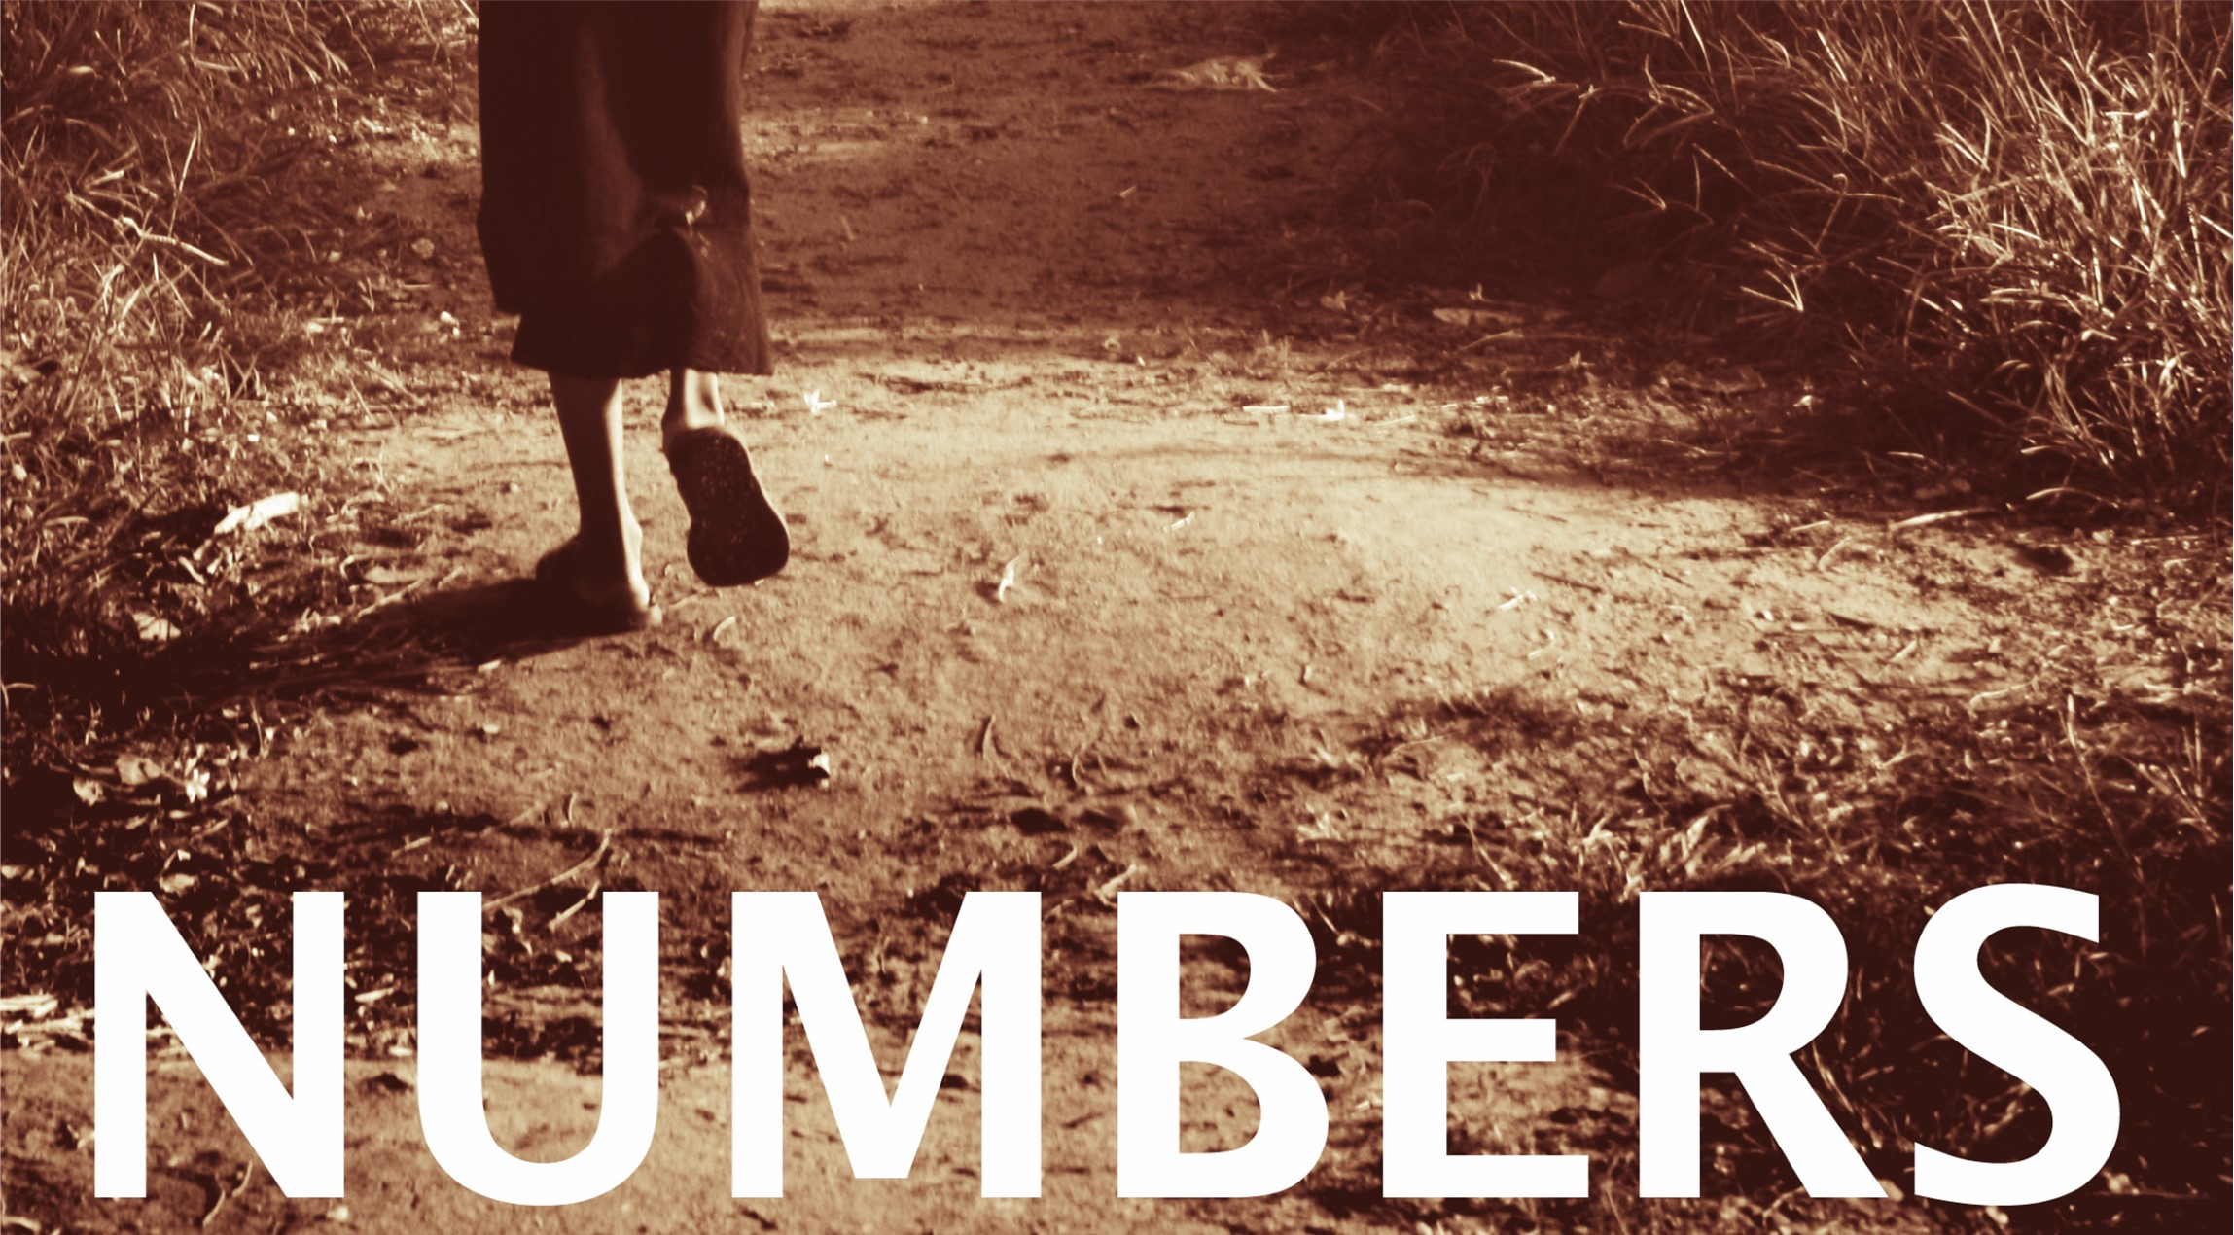

Slide 2
Numbers
The book of numbers is largely narrative of the children of Israel that covers 38 year and nine month span.
It was written by Moses.
Key personalities include Moses, Aaron, Miriam, Joshua, Caleb, Eleazar, Korah, and Balaam.
The purpose of the book of Numbers is to tell about how Israel prepared to enter the promise land.
Tells of their disobedience and punishment.
It describes Moses taking two population censuses, hence the name Numbers.

Slide 3
Numbers
  Outline:
  From chapters 1-9 the Israelites are preparing for their journey and entry into the promise land.
    Moses begins by taking a census of all the tribes, primarily to see how many men are available and in shape for military service.
    Moses dedicates the Levites and instructs the Nazirite vows and laws.
    During this time, the Israelites celebrate the 2nd Passover one year after their exit from bondage.

Slide 4
Numbers
  Outline:
  In chapters 10-12, the Israelites travel from the wilderness in Sinai to approach the promise land.
    The people complain about their food, God gives them quail.
    Because of their greed, He also sends them a plague.
    Miriam and Aaron learn a lesson about whom God places in leadership.

Slide 5
Numbers
  Outline:
  In chapters 13-19, we see severe punishment for disobedience and unfaithfulness to God.
    Moses sends out 12 spies to perform reconnaissance on the promise land.
    The 12 spies return and only two of them bring good news.
    The people fear the occupants and rebel against taking the land.
    For this God punishes them and sends them into the wilderness for forty years to roam.

Slide 6
Numbers
  Outline:
  The last chapters of Numbers, from 20-36, the new generation of Israelites again attempt to enter the land to take it as God promised.
    This time they easily destroy two nations that confront them as they are entering.
    Balak uses his prophet Balaam to learn to seduce the Israelites to worship Baal.
    Because of this disobedience, about 24,000 people die, including Balaam.
    Before the book of Numbers ends, Moses again conducts a census, and Joshua assumes the leadership of Israel in place of Moses who is banned from the promise land, due to his disobedience.

Slide 7
Chapters 1-9: Preparing to Enter
Chapter 1: Warrior Census
1-19: Leaders were chosen by God for every tribe
20-46: Census up all the warriors
47-54: The Levites are exempted

Slide 8
Chapters 1-9: Preparing to Enter
Chapter 2: Camping and Marching
1-9: Those camped on the east
10-17: Those camped on the south
18-24: Those camped on the west
25-34: Those camped on the north

Slide 9
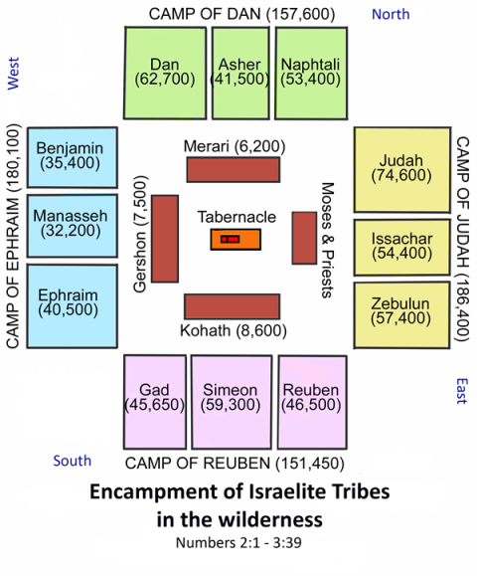

Slide 10
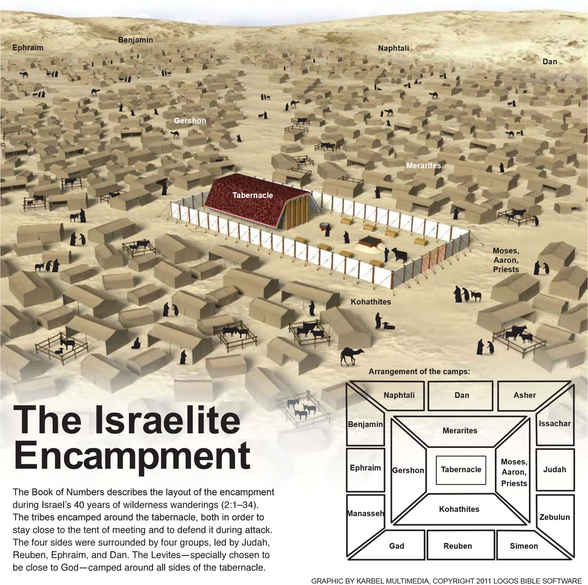

Slide 11
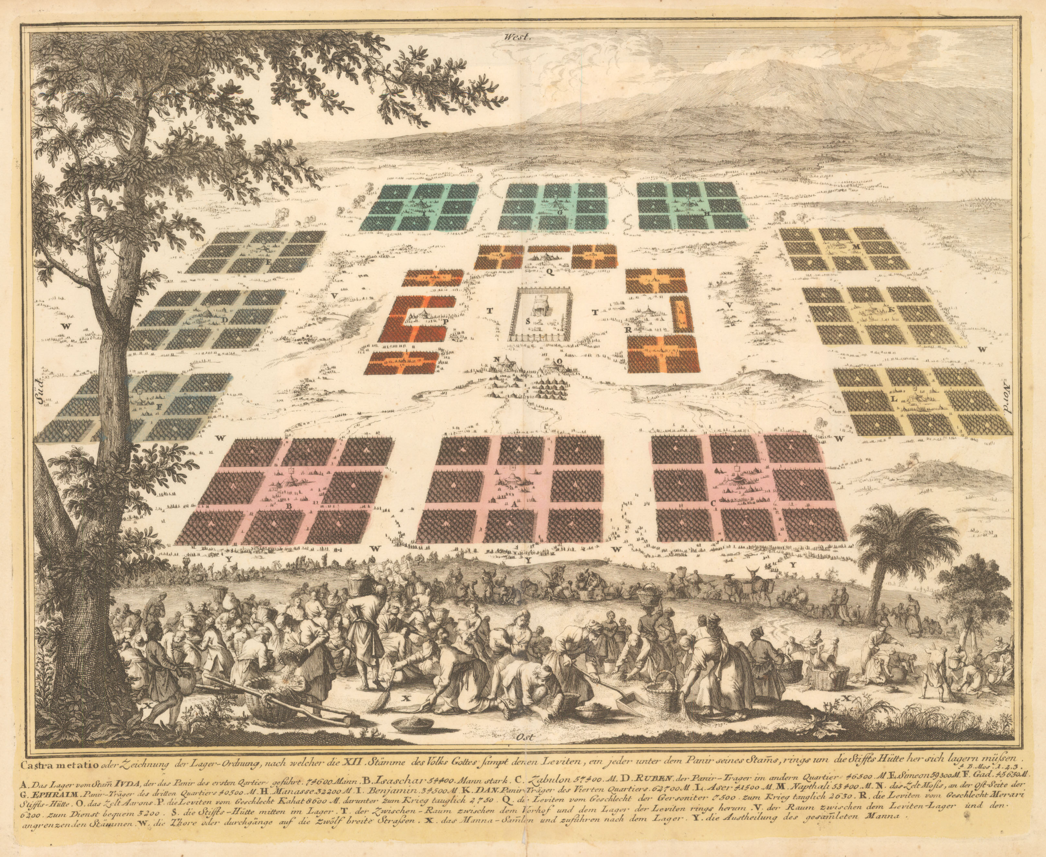

Slide 12
Chapters 1-9: Preparing to Enter
Chapters 3 & 4: Concerning the Levites
3:1-13: The Levites are a priesthood
3:14-39: Numbering and duties of the priests
3:40-51: Redemption of firstborn
4:1-20: Duties of Kohathites
4:21-28: Duties of Gershonites
4:29-49: Duties of Merarites

Slide 13
Chapters 1-9: Preparing to Enter
Chapters 5: Defilement & Adultery
1-10: Defilement
11-31: Law of jealousy

Slide 14
Chapters 1-9: Preparing to Enter
Chapters 6: Nazarites and Aaron’s blessing
1-21: Law of the Nazarite
22-27: Aaron’s blessing

