Slide 2
God chose the church (those “in Christ”) as His people
(1 Pet. 2:9; Acts 10:34-35)
I am “chosen” when I choose to obey Christ and I’m in His church (“in Christ”) (Matt. 22:14+7:14; 1 Cor. 12:13)

Slide 3
God adopted those in the church, according to His good pleasure (1 John 3:1)
When I follow His adoption procedures, I’m His adopted/son
(John 1:12; 3:3-5)

Slide 4
Jesus paid the price for MY sins and bought me out of slavery with His blood (1 Pet. 1:18-19; 1 Cor. 6:19; 2 Cor. 5:21)
When I adhere myself to His plan, I’m His redeemed (Tit. 2:11-14)

Slide 5
Jesus descended into the cesspool of a sin-sick, sin-filled world and shed His blood to save a wretch like me
(Matt. 20:28; 26:28; Rom. 5:8; 1 John 4:9-10)
When I obey Him and walk in His paths, I’m His forgiven
(Mark 16:16; 1 John 1:7)

Slide 6
God has revealed His will for us in the gospel
(2 Cor. 4:4-7; Heb. 6:4-5)
And He has given us the ability to understand it and apply it
(Eph. 3:3-4; 5:17; Jas. 1:22-25)

Slide 7
God is the one who has been wronged, yet He is the one who initiated reconciliation (Rom. 5:10; Col. 1:21-22)
When I respond to His invitation, He takes me in (2 Cor. 5:14-21)

Slide 8
God has made His people His “heritage,” His private possession
(1 Pet. 2:9; Tit. 2:14)
When all is over here, all that God will have left from this earth will be His faithful children, whom He will take home with Him forever (John 14:2-3; 2 Cor. 5:1-8)

Slide 9
Through obedience to His words and promises, God’s people bear His seal/mark of ownership, authentication and security
(2 Cor. 1:20-22)
God’s presence in my life:
  Demonstrates that I belong to God (2 Tim. 2:19; Rom. 8:14-16)
  Is a guarantee of future hope (2 Cor. 5:5)

Slide 10
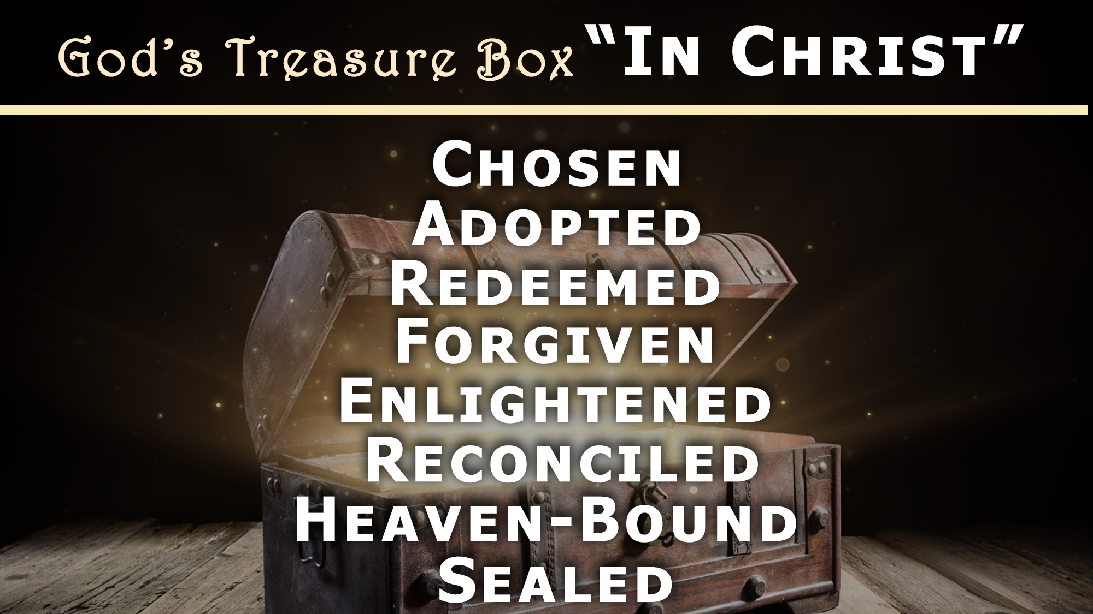

Slide 11
Believe Jesus is God’s Son – John 3:16
Repent of your sins and turn to God – Acts 3:19
Confess your faith in Jesus Christ – Romans 10:9
Be immersed into Christ – Galatians 3:27
  God will forgive all of your sins – Acts 2:38
  God will add you to His church – Acts 2:47
  God will register you in heaven – Hebrews 12:23
Walk faithfully with Him each day – 1 John 1:7

